Slide 1
Recruiting and Salesmanship Boat Shows, VSCs, & Public Education

Slide 2
Topics
Current members
Marketing materials
Making the most of:
Boat Shows
Public educational events
Vessel Safety Checks
Sales and Salesmanship
Vital follow-up after the event

Slide 3
Selling to Existing Members
Necessary for retention; can’t forsake them
Have a process to continuously investigate and monitor each member’s needs
Special care and feeding of newer members
Always promote club to current members as you would a new candidate
Make sure you deliver

Slide 4
Recruiting New Members: Marketing Materials

Slide 5
Use the Two Trifold Brochures
One general & one education-specific
Designed to work together
Add YOUR contact info to brochures

Slide 6
Slide Presentation
Brand Name
Who we are
What we do
Depth of Experience and Educational Expertise

Slide 7
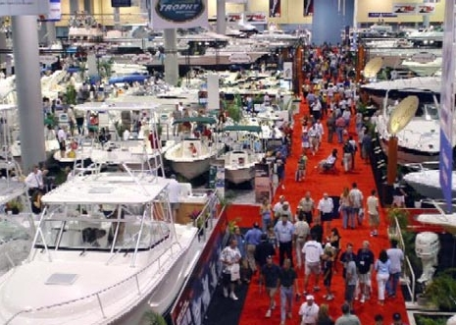
Marketing and Recruiting: Boat Shows & Public Events

Slide 8
Boat Shows: Objectives
Introduce visitor to America’s Boating Club – who we are and what we do
Find out their interests
Identify how we can help them
Get their contact information
Get them to the next step

Slide 9
Booth Layout & Contents
Layout open and inviting
No table between you and your audience
Keep it simple and un-cluttered
Have OUR Tri-fold Brochures prominent!!
Use OUR PowerPoint slides in kiosk mode
Hand out course schedules
Only a few freebies from DNR etc.

Slide 10
Common Sense Rules
No food or alcohol in or around booth
When visitors are nearby, don’t talk to each other; focus on THEM. Cell phones?
Have ONLY 2-4 workers at the booth
Dress in khakis and national/squadron polo
Behave informally but appropriately
S M I L E S M I L E S M I L E

Slide 11
Contact
Collect LEGIBLE email addresses
After show, send SHORT email
Explain ABClub in one paragraph
Mention upcoming courses/events
One sentence on how to join
Keep addresses & invite to all courses/events

Slide 12
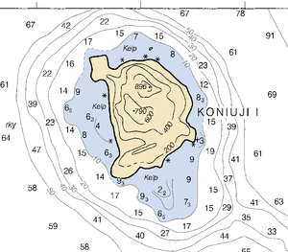
Marketing and Recruiting: Public Education Events

Slide 13
Introduce America’s Boating Club
Start with the slides created for you
Establishes your credentials
Demonstrates your expertise thru affiliation with America’s Boating Club
Explains the organization behind you and created the educational material
Reinforce this with your SEO & instructors

Slide 14
Introduce America’s Boating Club
Create “Take Away” folder
Inexpensive folders
Trifold Brochure
Squadron/club newsletter
Business card with contact information
Student registration form & membership info
SHORT “welcome visit” by Commander
Invite them to more courses, events
Brief instructors on attitude and salesmanship

Slide 15
Making the Most of Vessel Safety Checks

Slide 16
Vessel Safety Checks
Do they know our organization (either name)?
Get their contact info/invite to all events
Give them the brochures and your card
After VSC, explain what we offer, especially if VSC results indicate they need specific help
Does their family/crew need boating license?
Will they join our on-water events?

Slide 17
Sales and Salesmanship

Slide 18
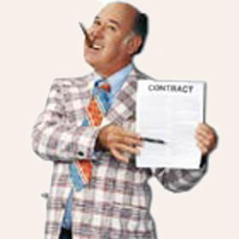
What Is Selling in OUR Context?
Sales is not sleazy or slick
We are all salesmen/saleswomen
for our organization
Just be friendly and engaging
Be welcoming; no exclusive attitude
You’re not pushing anything, just talking
LISTEN, LISTEN, LISTEN before telling them everything you know about us

Slide 19
Effective Salesmanship
Be an expert, but not a know-it-all
Don’t say we are the best; explain what we do so that they conclude that themselves
REMEMBER: Most people are either convinced or not within the first few minutes of the first encounter

Slide 20
What You Always Want to Convey
Excitement/Enthusiasm
Welcoming/Inviting
Joining a fun boating community

Slide 21
Identify Their Interests
Don’t start off with telling them how wonderful we are
Investigate!
What kind of boating do they do? Where?
Why might they want education?
What does a prospective boat owner need?
What about the spouse/significant other?
What else??? Explore.

Slide 22
Respond To Their Needs
Provide explanation, information, and examples of how we can meet their needs
Ask for their general reaction
Ask for their contact information
Invite them to take the next step (seminar or course, come to a dinner meeting, etc.)
Do NOT leave it with “look at our website” or expect them to contact on their own

Slide 23
Sales Skills
Be prepared to answer objections to buying by demonstrating the VALUE ABC offers to fulfill their needs.
Speak to benefits, not features
Use open ended questions, not yes/no answer questions.

Slide 24
Example
Objection: I’ve been boating for years and don’t need courses
Response:
Restate the objection:
So if I am understanding you, you feel you have all the boating education you need already?
Offer Answer to the objection:
You know, there are a lot of new and recent electronics and software that make boating safely a whole lot easier.
Our local ABC club has a course on XXXX coming up Sat, April xx and Sat, June xx that covers all these new programs. Which date works best for you?

Slide 25
Features vs. Benefits
Features (What)are aspects of your product, which could be technical or descriptive.
Benefits (Why) are why that feature matters for your customers. In other words, what can they do with that feature or accomplish with it?

Slide 26
Example of Features Vs Benefits
Feature:
We have this great new seminar on AIS we think you should take.
Benefit:
Our new seminar on AIS will help you navigate crowded waterways easily and safely and show you how the software helps you identify potential dangers so you can quickly make decisions on the water.

Slide 27
Use Open Ended Questions
Use open ended questions, not yes/no answer questions.
Example of closed ended question:
Would you like to take a boating safety class?
Example of open-ended question:
What kinds of boating education are you interested in?

Slide 28
Follow Up

Slide 29
Follow-up
Email each of the contacts
If you have their phone number, call
Try 3-5 times; be patient and persevere
Repeat invitation to meeting, a seminar, or whatever their interest
Use the same salesmanship approach

Slide 30
At Club Event
Any social event, monthly meeting, or seminar
Thank them for coming
Greet them by name
Introduce them around
Prearrange for them to sit with someone
Invite to next event
Ask what they’d like club to offer in future

Slide 31
Remember
Salesmanship is about preparation
No one bats 1000
Be easy-going, friendly and enthusiastic
Listen as well as talk
What needs can we fill?
Get them to the next step, not necessarily all the way to membership
Don’t forget to include the spouse!

Slide 32
Thank You

