Slide 1
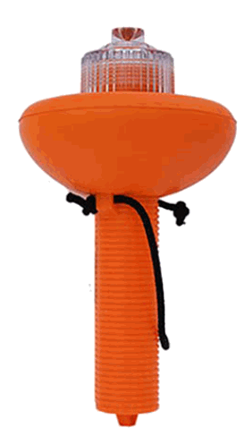
Non-pyrotechnic VDS
Signal mirror – day
Orange distress flag – day
Electric distress light (SOS) - night
>>
Notes:
Paragraph 152 – 158
SOS Electric Distress signal is USCG Approved Alternative to Pyrotechnic Marine Flares and Flare Guns
Weems & Plath SOS Distress Light is an LED SOS Visual Distress Signal Light Powered by a high-performance, programmable microprocessor controlling an SOS signal flashed.
Visible for Over 10 Nautical Miles
(Power – 3 C Batteries)
One Time Purchase
No Expiration Date
No Disposal is Needed

