Slide 1
Meridian Transit
Revised 19 February 2016

Slide 2
Learning Objectives
■ Determine Zone Time of Sun’s meridian transit using Nautical Almanac Mer. Pass. method
■ Determine Zone Time of Sun’s meridian transit using Nautical Almanac Eqn. of Time method
■ Determine Zone Time of Sun’s meridian transit using GHA = Observer’s Meridian method
■ Understand difference between Zone Time (ZT) and Local Mean Time (LMT)
■ Determine latitude from an observation of the
Sun at meridian transit
This method is required for homework & test

Slide 3
Zone Time (ZT) and
Local Mean Time (LMT)
ΔT
Determining
Local Mean Time (LMT)
From
Zone Time (ZT)
Recall that The Sun moves West at a rate of
15 degrees of Longitude per hour of time or 4 minutes of time per degree of Longitude
DLo W ΔT = 4x5° =20
ΔT
DLo E ΔT = 4x7° =28
DLo = 7° E
DLo = 0°
DLo = 5° W
113° W
Zone Meridian
120° W
125° W
LMT = 1158
ZT = 1130
LMT = 1130
ZT = 1130
LMT = 1110
ZT = 1130
LMT = ZT -4 x DLo W
LMT = ZT +4 x DLo E
At the Zone Meridian LMT = ZT

Slide 4
Meridian Transit of Sun
■ GHA – defines position of apparent Sun
■ Meridian Transit – apparent Sun crosses observer’s meridian
■ Local Hour Angle ( LHA ) = 0° 00.0'
GHA = Observer’s Meridian for West Longitudes
GHA = 360° -Observer’s Meridian for East Longitudes
■ Local Apparent Time ( LAT ) = 12-00-00
■ Meridian Transit of Sun is also known as
Local Apparent Noon ( LAN )

Slide 5
Mean Sun & Apparent Sun
■ Mean Sun - an imaginary Sun
invented for keeping Zone Time
■ Apparent Sun - the observable Sun
determines Apparent Time
■ Difference is Equation of Time
■ Meridian Transit occurs at high noon
12 hours Local Apparent Time ( LAT )
A Sun Dial displays Local Apparent Time

Slide 6
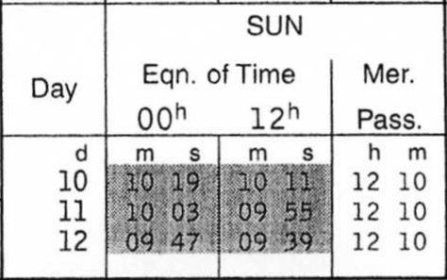
Meridian Passage & Equation of Time
The Equation of Time listed in the Nautical Almanac tabulates the difference between the apparent Sun and mean Sun.
If meridian passage at Greenwich is earlier than 1200 GMT then the apparent Sun is ahead of the mean Sun and the Equation of Time is positive and is shown without a shaded background.
If meridian passage at Greenwich is later than 1200 GMT then the mean Sun is ahead of the apparent Sun and the Equation of Time is negative and is shown within a gray shaded background.
The time of the Sun’s meridian passage listed in the Nautical Almanac is the GMT of the Sun’s passage over the prime meridian at Greenwich rounded to the nearest whole minute.
Notes:
A slight improvement in accuracy can be had by observing the value for the 12h Eqn. of Time. In this example we could use 12h 09m 55sec as the time for meridian passage.

Slide 7
Sun
Day Eqn. of Time Mer.
00h 12h Pass.
d m s m s h m
30 09 55 10 05 11 50
1 10 15 10 25 11 50
2 10 34 10 44 11 49
Rate of change in the value of the Eqn. of Time ≈ 0 seconds/day
Rate of change in the value of the Eqn. of Time ≈ 30 seconds/day
The Nautical Almanac Values Shown In Gray Box
The Nautical Almanac Values Shown In White Box

Slide 8
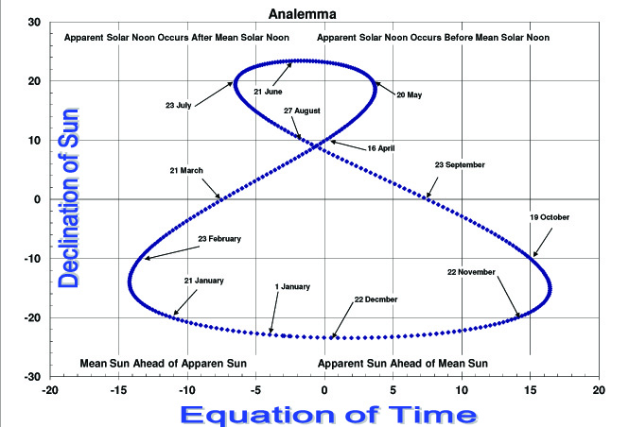

Slide 9
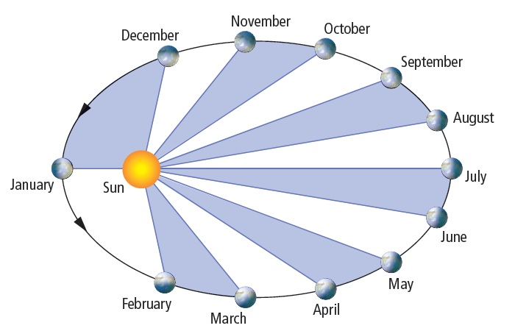
Kepler's Second Law
A line joining the Earth to the Sun sweeps out equal areas in equal times as the Earth moves in it’s elliptical orbit.
≈Eqn. of Time
+AAM
-MAA
+16
+11
+11
0
0
-6
0
-5
-3
0
+2
0
+3
-15
-3
-12

Slide 10
Calculating Apparent Time
If the apparent Sun is ahead of the mean Sun
then: LAT = LMT + Eqn. of Time
LMT = LAT - Eqn. of Time
If the mean Sun is ahead of the apparent Sun
then: LAT = LMT – Eqn. of Time
LMT = LAT + Eqn. of Time

Slide 11
Transit via Nautical Almanac Mer. Pass.
On 22 December 2014 you plan on taking a meridian transit sight of the sun from Ediz Hook, L = 48° 08.5' N; Lo = 123º 26.1' W; (ZD +8)
From the Nautical Almanac you determine that on 22 December 2014 meridian passage at the Greenwich meridian occurs at 1159 GMT.
Assume† meridian passage at your Zone Meridian of 120º W also
occurs at 1159 Zone Time. Your DLo is 3º 26.1' W which equates
to 13 minutes 44 seconds.
Zone Time of Meridian Passage @ 120ºW 11-59-00
DLo West ΔT + 13-44
Zone Time of Meridian Passage @ 123º 26.1'W 12-12-44
You can now calculate meridian passage
at Ediz Hook on 22 December 2014
Maximum error less than 30 seconds
Sun
Day Eqn of Time Mer.
00h 12h Pass.
d m s m s h m
21 02 13 01 58 11 58
22 01 43 01 28 11 59
23 01 13 00 58 11 59
† Accuracy is degraded by rounding time of Mer. Pass. to a
whole minute and the change in the value of the Eqn. of Time
between 1200 GMT & 1200 LAT at observer’s meridian.
Accuracy could be improved by using 11:58:32 as mer. Pass.
time. (See Analemma)

Slide 12
Transit via Nautical Almanac Eqn. of Time
On 22 December 2014 you plan on taking a meridian transit sight of the sun from Ediz Hook, L = 48° 08.5' N; Lo = 123º 26.1' W;(ZD +8)
From the Nautical Almanac you determine that on 22 December 2014 Eqn. of Time at 1200 GMT is 1 minute 28 seconds. Apparent Sun is ahead of the Mean Sun. Meridian passage at your Zone Meridian will be at 1200 LAT. Since your is Zone Meridian is 120ºW your DLo is
3º 26.1'W which equates to 13 minutes 44 seconds.
Using 01 min 28 seconds as the value of the Eqn. of Time, determine meridian passage at Ediz Hook on 22 December 2014
Noon LAT 12-00-00
Eqn. of Time - 01-28
LMT 11-58-32
DLo of 3º 26.1'W ΔT + 13-44
Zone Time 12-12-16
Maximum error† is less than 15 seconds
Accuracy varies through the year from ≈1 to ≈15 seconds, depending on the rate of change in the Eqn. of Time (See Analemma)
Sun
Day Eqn. of Time Mer.
00h 12h Pass.
d m s m s h m
21 02 13 01 58 11 58
22 01 43 01 28 11 59
23 01 13 00 58 11 59
† Accuracy is degraded by the change in the value of the
Eqn. of Time between 1200 GMT & 1200 LAT at observer’s
meridian. (See Analemma)
Notes:
Note: A slight improvement in accuracy can be had by deciding to use Eqn. of Time from the 00h column; but the difference is not significant for determining latitude. If you are west of Greenwich and your longitude is greater than 90 degrees west, you could use the 00h Eqn. of Time for the next day. If you are east of Greenwich and your longitude is greater than 90 degrees east, you could use the 00h Eqn. of Time from the previous day.

Slide 13
Determining UT for GHA = LHA
If you are West of Greenwich, select the latest UT hour from the Nautical Almanac where GHA is less than your meridian.
If you are East of Greenwich, select the latest UT hour from the Nautical Almanac where GHA is less than 360° minus your meridian.
Take difference between your meridian and the above GHA
Go to the Yellow Pages and determine the minutes and seconds that correspond to the above difference.
The Time of Meridian Passage is the above UT hour + the minutes and seconds you determined from the Yellow Pages.
At Meridian Passage the LHA of the Sun = 0° 0.0´
GHA = Observer’s Meridian for West Longitudes
GHA = 360° -Observer’s Meridian for East Longitudes

Slide 14
Transit via GHA = Observer’s Meridian
On 22 December 2014 you plan on taking a meridian transit sight of the sun from Ediz Hook, L = 48° 08.5' N; Lo = 123º 26.1' W;(ZD +8)
From the Nautical Almanac you determine that at UT 2000 the GHA of the Sun will be 120 º 19.4' with a Declination of 23° 25.9'S
Then the Difference between 123º 26.1' and 120 º 19.4' is 03º 06.7'
From the yellow pages we find that 03º 06.7' converted to time is
12 minutes 27 seconds
GHA of the Sun = 120 º 19.4' @ UT 20-00-00
3º 26.1' converted to time + 12-27
GHA of the Sun = 120 º 26.1' @ UT 20-12-27
ZD +8 (rev)
Zone Time of meridian transit 12-12-27
Accuracy ± 1 second

Slide 15
Comparison of Methods
■ The rate of change in the value of the Eqn. of Time is at
it’s maximum value on 22 December (≈30 seconds/day)
■ Nautical Almanac Mer. Pass. method
Zone Time of 12-12-44 Hc = 18° 25.61'
■ Nautical Almanac Eqn. of Time method
Zone Time of 12-12-16 Hc = 18° 25.61'
■ GHA = Observer’s Meridian method
Zone Time of 12-12-27 Hc = 18° 25.61'
■ For Zone Time of 12-10-45 Hc = 18° 25.55'
■ For Zone Time of 12-13-55 Hc = 18° 25.56'
No significant change in Hc over this time period
So ...What difference does it make which method is used!

Slide 16
Time of Transit Example
On 29 February you plan on taking a meridian transit sight of the sun from Ediz Hook, L = 48° 08.5' N; Lo = 123º 26.1' W; (ZD +8).
Use Excerpts from Nautical Almanac supplied with JN Student Manual to determine Zone Time of meridian transit using the three methods shown below:
■ Nautical Almanac Mer. Pass. method
■ Nautical Almanac Eqn. of Time method
■ GHA = Observer’s Meridian method
Also compute Hc for each of the above meridian transit times.

Slide 17
Nautical Almanac Mer. Pass. method
On 29 February you plan on taking a meridian transit sight of the sun from Ediz Hook, L = 48° 08.5' N; Lo 123º 26.1' W; (ZD +8).
Use Excerpts from Nautical Almanac supplied with JN course materials to find Zone Time of Transit.
Zone Time of Meridian Passage @ 120ºW 12-13-00
DLo West ΔT + 13-44
Zone Time of Meridian Passage @ 123º 26.1'W 12-26-44
Your DLo is 3º 26.1'W which equates to 13 minutes 44 seconds.
LHA 0.00000
Lat 48.14167
Dec -7.68367
Zn = 180° Hc = 34° 10.48'
Sun
Day Eqn of Time Mer.
00h 12h Pass.
d m s m s h m
27 02 13 01 58 12 13
28 01 43 01 28 12 13
29 01 13 00 58 12 13
13 01
12 51
12 40
12 56
12 45
12 34

Slide 18
Nautical Almanac Eqn. of Time method
On 29 February you plan on taking a meridian transit sight of the sun from Ediz Hook, L = 48° 08.5' N; Lo 123º 26.1' W; (ZD +8).
Use Excerpts from Nautical Almanac supplied with JN course materials to find Zone Time of Transit.
Eqn. of Time @ 12 hours GMT is 12 min 34 seconds
The mean sun is ahead of the apparent sun
Your DLo is 3º 26.1'W which equates to 13 minutes 44 seconds.
Noon LAT 12-00-00
Eqn. of Time + 12-34
LMT 12-12-34
DLo of 3º 26.1'W ΔT + 13-44
Zone Time 12-26-18
LHA 0.00000
Lat 48.14167
Dec -7.68367
Sun
Day Eqn of Time Mer.
00h 12h Pass.
d m s m s h m
27 02 13 01 58 12 13
28 01 43 01 28 12 13
29 01 13 00 58 12 13
Zn =180° Hc = 34° 10.48'
13 01
12 51
12 40
12 56
12 45
12 34
Notes:
Note: A slight improvement in accuracy can be had by deciding to use Eqn. of Time from the 00h column; but the difference is not significant for determining latitude. If you are west of Greenwich and your longitude is greater than 90 degrees west, you could use the 00h Eqn. of Time for the next day. If you are east of Greenwich and your longitude is greater than 90 degrees east, you could use the 00h Eqn. of Time from the previous day.

Slide 19
GHA = Observer’s Meridian method
On 29 February you plan on taking a meridian transit sight of the sun from Ediz Hook, L = 48° 08.5' N; Lo 123º 26.1' W; (ZD +8).
Use Excerpts from Nautical Almanac supplied with JN course materials to find Zone Time of Transit.
From the Nautical Almanac you determine that at UT 2000 the GHA of the Sun will be 116 º 52.5' with a Declination of 07° 41.4'S
Then the Difference between 123º 26.1' and 116 º 52.5' is 06º 33.6'
From the yellow pages we find that 06º 33.6' converted to time is
26 minutes 14 seconds
UT 20-00-00
06º 33.6' converted to time + 26-14
UT 20-26-14
ZD +8 (rev)
Zone Time 12-26-14
LHA 0.00000
Lat 48.14167
Dec -7.68367
Zn = 180° Hc = 34° 10.48'

Slide 20
Comparison of Results
29 February meridian transit sight of the sun from Ediz Hook,
L 48° 08.5' N Lo123º 26.1' W (ZD +8).
■ Nautical Almanac Mer. Pass. Method Zone Time 12-26-44 Hc = 34° 10.48'
■ Nautical Almanac Eqn. of Time method Zone Time 12-26-18 Hc = 34° 10.48'
■ GHA = Observer’s Meridian method Zone Time 12-26-14 Hc = 34° 10.48'
Observer’s Latitude
Zenith Distance
L = CoAlt -Dec
Declination of Sun 07° 41.0' S = 7.690°
Observer’s Latitude = Zenith Distance ± Declination
L = (90° -34.1747°)N -7.6833°S = 48.137°N = 48° 08.5' N
Equator
Declination
Observer’s Meridian

Slide 21
Computing Latitude
■ Obtain Ho at Time of Transit
■ Subtract Ho from 90° to obtain CoAlt
■ Name of CoAlt is direction from the body to the observer
■ For GMT of the sight, obtain Dec of sun from the Nautical Almanac
■ Combine CoAlt and Dec to obtain your latitude: Lat = CoAlt ±Dec
If CoAlt & Dec have same name add; If opposite names subtract

Slide 22
At Meridian Transit the Navigation Triangle collapses into a segment of a great circle
Elevated Pole
Observer’s Meridian
Observer’s Zenith
Observer’s Latitude
L = (90°-Ho) -Dec
Co-Alt aka
Zenith Distance
Equator
Navigation Triangle
Dec
LHA of Sun = 0° 0.0′
allowing us to determine our latitude
by simple addition or subtraction

Slide 23
North Pole
90° N
At Meridian Transit the Sun is
On the Upper Branch of the
Observer’s Meridian &
Zn = 180° also known as
Local Apparent Noon (LAN)
CoLat
CoDec
Observer’s Zenith
At Meridian Transit Lat = CoAlt -Dec
Observer’s Latitude
Lat
Navigation
Triangle
Equator
Navigation
Triangle
CoAlt = 90 ° - Ho
aka
Zenith Distance
Dec
Observer's Meridian
Zn > 180°
After Meridian Transit
Before Meridian Transit
Zn < 180°
Zn = 180 °
The Arrow of Time
Notes:
The name of CoAlt is determined by the direction from the body to the observer, in this example CoAlt’ name is N.
If the names for CoAlt & Dec. are the same observer’s Latitude = CoAlt +Dec.
If the names for CoAlt & Dec. are contrary observer’s Latitude = CoAlt –Dec.

Slide 24
Example - Computing Latitude
Observer North of Equator and also North of Sun
Ho = 70°
Zn =180 °
CoAlt = 90° - 70° = 20° N
Dec = 10° N
L = CoAlt +Dec
L = 20° N +10° N = 30°N
50°N
Observer
CoAlt
Sun
Equator
NP
50°S

Slide 25
Example - Computing Latitude
Observer North of Equator but South of Sun
Ho = 80°
Zn =360 °
CoAlt = 90° - 80° = 10° S
Dec = 20° N
L = CoAlt - Dec
L = 10° S - 20° N = 10°N
50°N
Sun
CoAlt
Observer
Equator
NP
50°S

Slide 26
Example - Computing Latitude
Observer South of Equator & also South of Sun
Ho = 30°
Zn =360 °
CoAlt = 90° - 30° = 60° S
Dec = 20° N
L = CoAlt - Dec
L = 60° S - 20° N = 40°S
50°N
Sun
Equator
CoAlt
NP
Observer
50°S

Slide 27
LATITUDE BY MERIDIAN TRANSIT

Slide 28
LATITUDE BY MERIDIAN TRANSIT
90° 89° 60.0'
- Ho ___°____'
* CoAlt = 90° - Ho ___°____' N / S
Dec ___°____' N / S
** L =CoAlt ±Dec ___°____' N / S
DR L ___°____' N / S
a ________ nm
* CoAlt name is direction from the Sun to the DR
**If CoAlt & Dec have same name add; If opposite names subtract

Slide 29
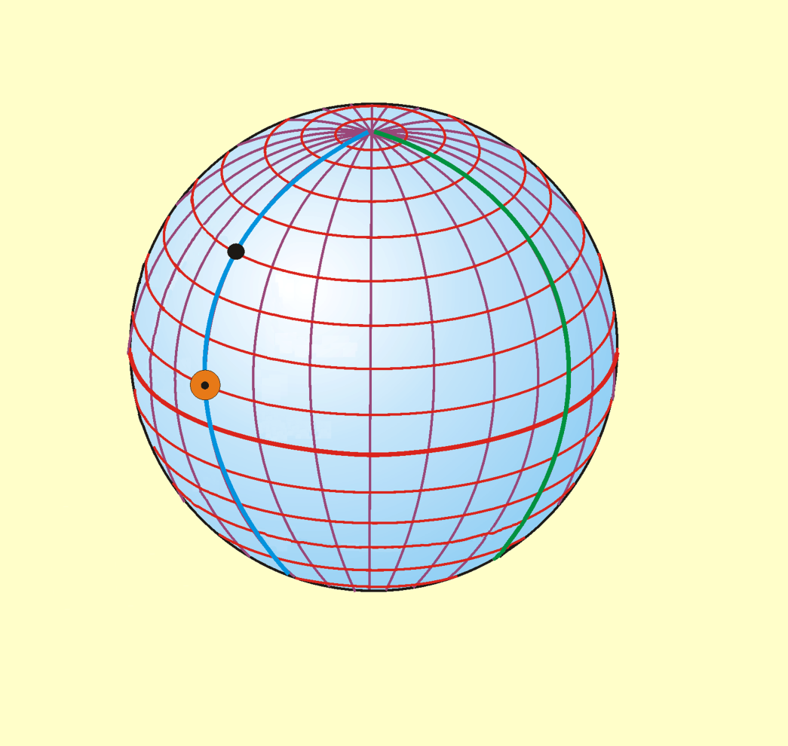
Reviewing -- Meridian Transit
Celestial body is on the upper branch of observer’s meridian
  LHA of Sun = 000° 00.0'
  Sun reaches max. altitude for that date & reference position.
  Azimuth of body is 0° (due north) or (180°) due south of observer’s position.
  Navigation triangle collapses to straight line
    Elevated pole, observer, and GP of body are all on the observer’s meridian.
    Observer’s latitude can be found by simple addition or subtraction
Local Apparent Time = 1200
Elevated Pole
Observer
Greenwich
Meridian
Latitude
Co-Alt … aka
Zenith Distance
GP Sun
Dec
Equator
GHA of Sun Equal to
Observer’s Longitude
In this example:
Observer’s latitude = Zenith Distance + Declination of Sun

Slide 30
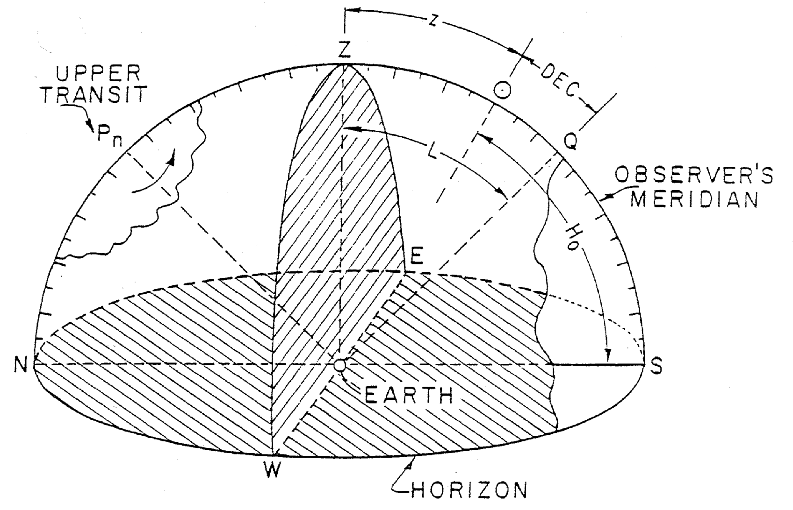
Isometric of Meridian Transit Diagram
CoAlt = 90°-60° = 30° N
Zenith Distance
= 90° - Ho = CoAlt
Elevated Pole
Dec = 15° N
Equator
L = 45° N
Observer’s
Celestial Meridian
Ho = 60°
CoAlt = 30° N
Dec = +15° N
L = 45° N
Celestial Horizon

Slide 31
Altitude of Sun at Transit for Year 2003
Location 48° 8.5' N 123° 26.0' W
Date | Sun's Altitude @ Transit | Sun's Altitude @ Transit ± 60 Seconds
15 January | 21° 46.54' | 21° 46.52'
15 February | 29° 15.43' | 29° 15.42'
15 March | 39° 48.38' | 39° 48.37'
15 April | 51° 41.97' | 51° 41.95'
15 May | 61° 27.25' | 61° 27.20'
15 June | 65° 10.57' | 65° 10.52'
15 July | 63° 20.93' | 63° 20.88'
15 August | 55° 50.60' | 55° 50.55'
15 September | 44° 48.49' | 44° 48.44'
15 October | 33° 16.31' | 33° 16.30'
15 November | 23° 19.64' | 23° 19.60'
15 December | 18° 34.88' | 18° 34.86'

