Slide 1
New USPS Web Site
Background
Current Status
Future Plans

Slide 2
Agenda
Background
First Steps
Current Status
Future Plans
Joomla Basics
Questions
Notes:
These are the items we’re going to cover today. It basically consists of why we’re here, what we’ve done, where we’re going, and what that means to you.

Slide 3
Background
Decision Made To Replace Current Web Site
Development And Maintenance Requires Technical Skills
Difficult To Maintain
Need Marketing-Based Public Site
Notes:
Webmasters need to know html, css, php, javascript
Webmaster turnover – or lack of webmasters
Broken links
Duplicate and obsolete information
Introduce visitors to USPS
Sell Courses and Seminars
Help visitors find Courses and Seminars
Help visitors find squadrons
Get new members

Slide 4
Background
ITCom Was Approached In Arlington To Create Demo For BOD Meeting In November
Produce “Public Face” Of Site
Notes:
It’s been about four months since we started this.
Started with ITCom team
Joe Gibson, Hal Hoadley, Kristi Anderson, Miguel Long, Don Osmond and myself

Slide 5
First Steps
Gathered Material Provided To Developer
Gathered Requirements
Decided To Use Content Management System
Notes:
Had demo from San Antonio
Documents developed by web site design team

Slide 6
First Steps
Selected Joomla And WordPress For Evaluation
Installed Joomla 2.5 And WordPress On Server
Notes:
There’s another tool out there – Drupal, which we decided was too complex.
Joomla 2.5 no longer supported – will need to upgrade later

Slide 7
First Steps
Selected Joomla
Used Artisteer Tool To Generate Template
Notes:
A template is the page framework on which the page is constructed. Haven’t yet determined if we will have to change tools. Needs more study.

Slide 8
First Steps
Augment Team
Marketing Representation
Additional Software Talent
Others For Specific Tasks
Notes:
Paul Mermenstein from Markenting
Dan Bartell and Tom Brincka
Course Chairs for course description review
Will need involvement from the rest of you.

Slide 9
Current Status
Created Functional Public Site
New Site Look / Feel
Will Be Shown On Saturday
Demonstration For You Today
Will Become www.usps.org
Notes:
Keep in mind as we go along that it’s only been four months.

Slide 10
Current Status
Backup Server Operational
Need For Development
Shouldn’t Develop On Live Site
Notes:
Prefer not to have disasters on published site
Move things from development server to production server

Slide 11
Current Status
Working On Templates
Gathering Department And Committee Page Requirements
Want Unified Look
Notes:
Work remains here. We need your participation Look at what we have. Look at what you need. More on this later.

Slide 12
Current Status
Fully Functional
Easy To Maintain
Minimizes Need For Technical Skills
Links To Existing Site Pages (After Logon)
Notes:
Minimal need for html, css, javascript
Must log on to get to member pages

Slide 13
Current Status
Let's Take A Look
About Ready To Go Live With Public Pages
Have Already Worked On CommCom Pages
Has Caused Template Changes

Slide 14
New USPS WEB Site
Future Plans

Slide 15
The Plan
Remaining Pages be Converted to
A Content Management System
(Joomla)
Many Advantages to USPS
A joint Webmaster / Itcom Project

Slide 16
Joomla Basics
Content Management System (CMS)
Open Source & Free
Modern WEB Site Design
Back End Program To Define Web Pages
Front End Program To Manage Web Page Displays

Slide 17
Joomla Back End
Tools to Create Database Content
Provides On-Line Editors to Create Items
Content Stored In Database
Articles - The main topic of a page
Modules - Other Items Displayed
Menus - Items that Define a Page

Slide 18
Joomla Front End
User Requests a Menu Item
Evaluates User Permissions
Obtains Content From Database
Template Controls Placement

Slide 19
Joomla Users & Groups
Front End Users
Public
Registered
Author
Editor
Back End Users
Manager
Administrator
Super Users
Customizable to Organization
Link to Joomla Back End
Link to Joomla Front End

Slide 20
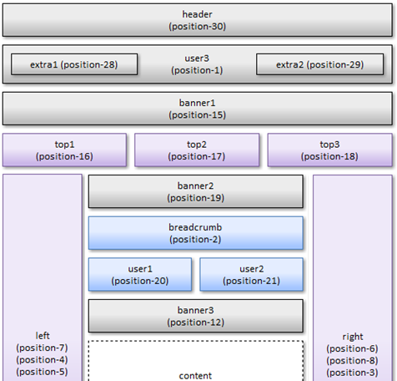
Template – Top Half

Slide 21
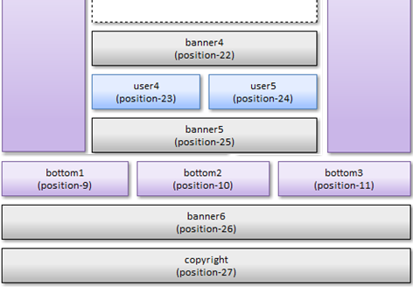
Template – Bottom Half

Slide 22
Member Site on Joomla
Many Advantages:
Quick and easy page management
Consistent brand and navigation
Workflow management
Flexibility for developers
Design is separate from content
Database-driven
Shared resources .
Approval systems
Mobile ready
Archive capabilities
Remote access
Security
Search engine-friendly
Many extensions available
How Do We Use It?

Slide 23
Member Site Path
Keep Remaining Pages “as-is”
Essential for the Immediate Future
Copy, use a current page as a “Model”
Create Site Structure to Meet Needs

Slide 24
Member Page Standard Templates
Department Template
Committee Template
Project Template
Others, as needed

Slide 25
A Joomla Implementation Will:
Reduce Webmaster Challenges
Provide a Structure that can evolve
Provide tools to Centralize Information
Reduce Site Maintenance Needs
Provide Access to External Applications

Slide 26
Project Plan
Finish and Deploy Public Site
Develop Member Site Requirements
Template Decisions
Deploy Development Environment

Slide 27
Immediate Tasks - Committee
Setup on-line meeting schedule
Work to gather Requirements
Refine and publish a Project Plan
Establish Webmaster Development Environment

Slide 28
Webmasters Should
Learn CMS & Joomla Concepts
Practice Joomla
Survey Your Pages
Identify Main Message
Identify Common Items

Slide 29
Summary
We Could Use Some Help
Questions

