Slide 1
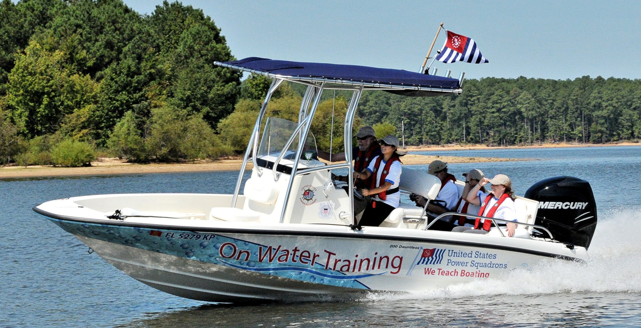
Building Your
On the Water Program

Slide 2

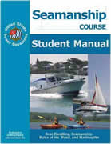
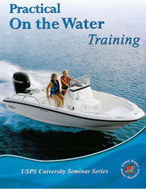

One Program, three offerings
On-the-Water Guides
Practical On-the-Water Training
Boat Operator Certification

Slide 3
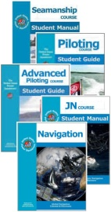
On The Water Guides
Extends existing classroom with relevant exercise on the water
Participation is optional, and not required for course completion
Framework developed by the BOC Committee
Individual guides created by each Education Department Committee
Guides are downloadable from the Committee Pages on the National web site
Guides available for Advance Grade courses, Sailing, and ABC3

Slide 4
Boat Operator Certification
Recognizes education and boating skills of USPS members
Incorporates Courses, Seminars, and Skill Demonstrations
Skill demonstrations are moderated by BOC Certifiers
Four skill levels
  Inland Navigator (basic powerboat handling)
  Coastal Navigator (Piloting)
  Advanced Coastal Navigator (Advanced Piloting)
  Offshore Navigator (under development)

Slide 5
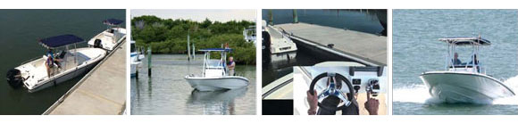
Practical On-the-Water Training
Boat handling skills for new and experienced boaters
1-day, 4 hours in the classroom, 4 hours on the water
Basic Powerboat Handling - Same skill as BOC-IN
On-the-water taught by a BOC-IN or POTW Certifier
Course includes course book and DVD of the skills
Students register and pay through HQ-800

Slide 6
A Brief Comparison
Offering | Boat | Buoys | Instructor | Student | Price
OTW Guides | As Required | No | USPS Instructor Certification | Enrolled members and non-members | $0
Boat Operator Certification (Inland Navigator) | ,23’’ Open Powerboat (BOC-IN) | Yes | BOC Certifier for each level | Members Only | $40 per level
Practical OTW Training | <23’ Open Powerboat | Yes | POTW or BOC-IN Certifier | Members and Non-members | $150-$250

Slide 7
Different Customers, Related Activities
Activities
On the Water Guides
All students
Boat Operator Certification
Experienced Members
Practical On-the-Water Training
Inexperienced Boaters

Slide 8
Benefits
Having fun on the water!
Growth in squadron membership
Increase in squadron revenues
Cross-selling squadron courses and seminars for BOC
Upselling from POTW into squadron courses
Greater squadron involvement in education programs
Create safer, more confident boaters
Improve the quality of your instruction
Improve student knowledge and learning experience
Unique education offerings for the public

Slide 9


1. Start with On the Water Guides
Available for Advance Grades, Sailing, and ABC3
Download the guides online from the USPS website
Add them to your course curriculum
You will need:
Any suitable boat
Water
Qualified
Instructor
Students

Slide 10
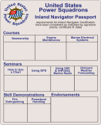

2. Move on to BOC…
All materials for BOC are online
Identify potential students in your squadron
Identify certifiers and get training for new certifiers
Obtain a buoy set
Obtain student passports
You will need:
<23’ Open
Powerboat
Water
BOC
Certifiers
Buoy Set
Passports
Students

Slide 11
3. Add POTW when ready…
Instructor kits are available to order from National
Updated training materials from the BOC Committee
Set up your schedule in HQ800
Advertise your courses
You will need:
<23’ Open
Powerboat
Water
BOC/POTW
Certifiers
Buoy Set
Students

Slide 12
USPS Insurance for Training
$1 Million general liability (on land)
$1 Million marine liability (docks, piers, and wharves)
$1 Million on-the-water liability
  Covers Teaching OTW
  Includes hull damage
  $250 Deductible
  Primary when first student or instructor boards the vessel
  Does not cover getting vessel to location

Slide 13
How do you qualify for insurance?
Plan and document the training prior to the event
  Executive Committee Minutes
  Squadron officer emails
  Newsletter
Follow an approved on-the-water curriculum or guide
  Vessel Safety Check
  Life jackets worn at all times
  Weather check
  Dockside safety briefing

Slide 14

Do I need a Coast Guard License?
If you train the student on their boat, a license is never required.
If you train the student on a Power Squadron Boat:
  A USCG grant is paying for our on the water programs and does not require a license for instructors
  The USCG is solely responsible for enforcing licensing

Slide 15
BOC-OTWTrCom
Boat Operator Certification –On the Water Training Committee
  R/C Chris Windeler (Incoming R/C Scott McDonald)
  Stf/C Ted Shanks
  Stf/C Tim Tate
Regional Directors and Assistant Regional Directors
BOC Certifier Network
BOC Web Page via the Education Department: http://www.usps.org/national/eddept/boc

Slide 16
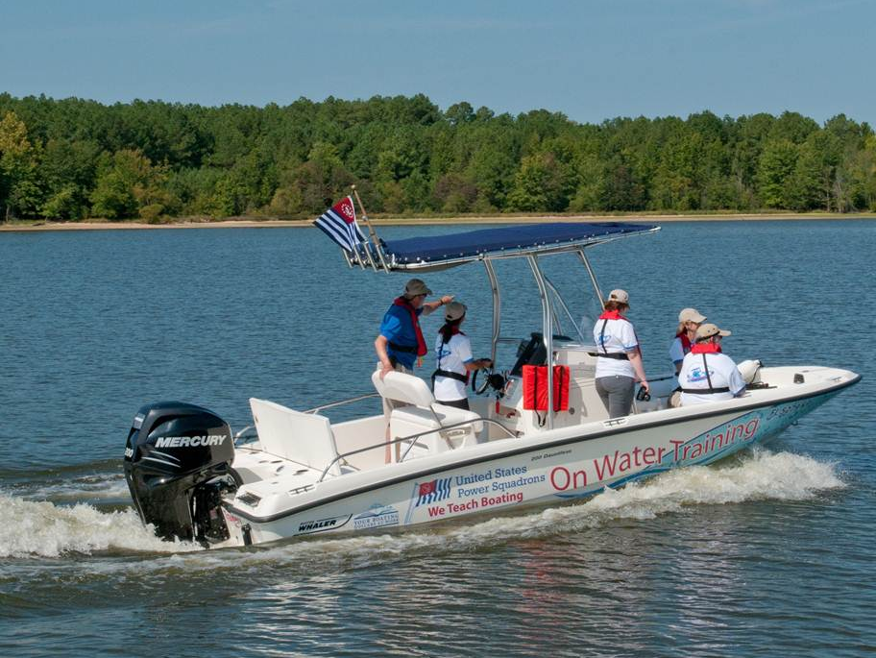
BOC-OTWTr Assistance
All program material is online
Current National training schedule is posted
BOC/POTW Schools
Training for certifiers
Marketing for POTW
Water Trainer

Slide 17
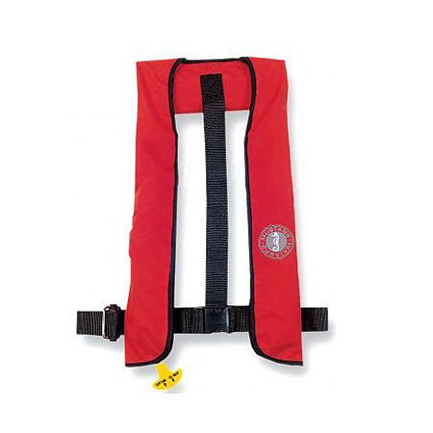
Inflatable Life Jackets
Available for Squadrons to use with OTW training
From the National Safety Committee
Stf/C Lee Chase
Use for Instructors or Students
Contact your District VSC Chair

Slide 18
It’s up to you!
  What are you waiting for?

