Slide 1
Blended Learning
Squadron Education:
Using Technology to
Attract & Engage Students
Notes:
Blended learning is used in many different educational setting today from Elementary Education to Universities. It is rapidly becoming the norm for students to find assignments, information, grades and activities on the internet. Working or interacting online makes the content available to the student when they wish to work with the information. Online activities allow a person to create their own schedule and reduce the need to adjust to someone else’s schedule in the busier world we are living in today. We will provide additional reasons for using blended learning for USPS courses during this presentation.

Slide 2
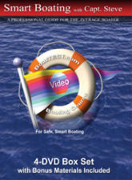
Is This Our Competition?
Notes:
People look for everything online today. If you were a new boater how attractive would this information be to you? If all I want is information then just buy the content online!

Slide 3
Squadron Instruction
Our preferred delivery method
Instruction plan is to deliver information
PPT slides orient the squadron instructor toward talking from the front of the room
PPT slides reinforce the need to cover the course material during face to face class time.
Instructor must consciously choose to go beyond slides to strengthen learner understanding of the content.
Notes:
Power Point slides are a good way to organize content for a presentation. Is presentation the best way to help people learn the skills to be a recreational boater?

Slide 4
The Time Challenge!
People don’t “have time” for an 8-10 week class schedule due to competing obligations.
In addition:
People want to chose the time to do the work.
Many people, young or older, are normally working electronically part of the time.
People can easily find answers individually but want help understanding content or developing a skill.
Notes:
The work world has changed with the expectation that people will have and use online skills and knowledge. It is how we get things done today. I believe that asynchronous learning will be a much more effective structure for online content. Perhaps people need to understand what is behind the why or how something works. Maybe they need to know when to use something or decide on the best way to do something. For example on the water decisions take several pieces of information to make choices. Maybe our work will be more valuable in helping the recreational boater put the knowledge together instead of explaining individual procedures.
People will make quick choices for ROI when it comes to using time.

Slide 5
Confronting the Technology
Notes:
This is a recent ad received in my e mail from my software provider. I have not tried dock-to-dock auto routing. It does work on I Phones and I Pad. But it certainly challenges our paper charting focus. The question for today’s presentation is:
How does the existence of the apps cause us to adjust how we teach the content of our courses and seminars?
(I do not think that automated programs will be as effective as a personal coach in helping people build skills)

Slide 6
Apps Inform – People Train!
Automated programs are not as effective as a personal coach in helping people build skills.
People have too many individual differences for a standard procedure.
Apps do not require complex thinking!
Course Committees and Squadron Instructors create a stronger learning program.
Notes:
A recent article pointed out that programs were not as effective as people in helping improve performance. (NY Times 11-17-15, page D 5 – “For Coaching, Humans Outdo Technology” ). The author points out that Apps meant to improve athletic performance do not take individual differences into account. Squadron instruction can do better than Apps in helping a person improve their boating skills.

Slide 7
Blended Learning Definition
Blended and hybrid learning are the same.
Working Definition:
any learning experience that is structured to be delivered partially online and partially in a traditional classroom setting
Notes:
The working definition for today’s seminar focuses on using online learning to allow students to work out of the classroom to complete assignments. This definition can be found on page three of “Getting Started With Blended Learning” by William Kist. ASCD published the book in 2015. ISBN: 978-1-4166-2119-5. The key word is structured. Blended learning requires a plan to decide what part of the content may be more effective online and what part of the content is more successful in a face to face learning environment. There is less face to face time with blended learning

Slide 8
Many Versions
Blended learning is a broad category
Asynchronous or Synchronous
New terminology and technology change traditional methods. Examples include:
Go To Meeting – synchronous learning
USPS BSVT requires coaching skills
Blended Learning requires a different model for teaching content to students
Notes:
The blend is teaching with technology. Teachers, school districts and higher education can create a structure that works with their program. Organizations can create online content to meet the needs of members and the educational program. USPS can start slowly and make small course adaptations. It is a different way of thinking about teaching. Technology is used to present content in different formats. An familiar example could be our boating simulator. Using the BSVT the person “operates the boat” to try and see what worked. The “coach” may ask some questions or give a brief explanation of how a boat steers and let the person try that to understand how to steer into a slip. As the person begins to understand the correct procedure the “coach” will reinforce the positive actions and help the student understand the corrections needed for success. The instructor becomes the “guide on the side”.
Has anyone in the audience “coached” a person using the virtual trainer? The person using the machine is experiencing the learning and we are assisting them in that learning experience.

Slide 9
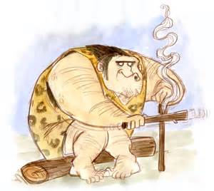
Start Slowly /Build Understanding
Choose the online content or skill to learn
Notes:
Let us be clear! This is not a picture of your typical USPS instructor. Blended learning requires planning for successful online learning. Creating some content for online learning opens more options to build experience with content or learning activities. One step at a time will allow a person to build understanding and confidence in the process and procedures.

Slide 10
A Different Learning Plan
Presentation of some content is online.
With online content the instructor role changes to guiding the learner.
Setting student expectations to work online
Find out what the student understands from working online.
Class room time is used to practice content or build experience.
Notes:
The instructor’s main focus during face to face meetings changes from presenting the power point slides to checking for student understanding. The challenge is to build the skills and strategies needed to work with individuals or small groups of learners.

Slide 11
May be Individually Developed
Blended learning does not need to be an elaborate process.
What part of the content could be structured for effective online learning?
Assignments or activities placed on line could be:
A taped presentation or You Tube Video web site
Web site – Animated Knots By Grog –practice knots
Longer term assignments that do not fit into a typical classroom schedule
Notes:
Teachers can have their own web page. They can also use software such as Google Docs, a blog or wiki-hosting site such as Blogger or PBWorks to post materials and comments. By placing content online the teacher has the flexibility to approach teaching differently. Perhaps the most powerful benefit is to help individual learners understand the content when you are working face to face in the classroom.

Slide 12
OPEN CPN Charting Software
Chart viewer, Chart Plotter, Navigation software
We will show the blended learning approach to teach electronic plotting.
The new boater should build plotting knowledge by using electronic plotting tools.
The ROI (return on investment) time for the learner is much more efficient.
Notes:
Changes have forced educational programs to add technology to the strategies used to teach content. This is a brief look and description of some aspects of blended learning. This presentation will illustrate how blended learning might be gradually introduced through the inclusion of OPEN CPN into the USPS Educational Program.

Slide 13
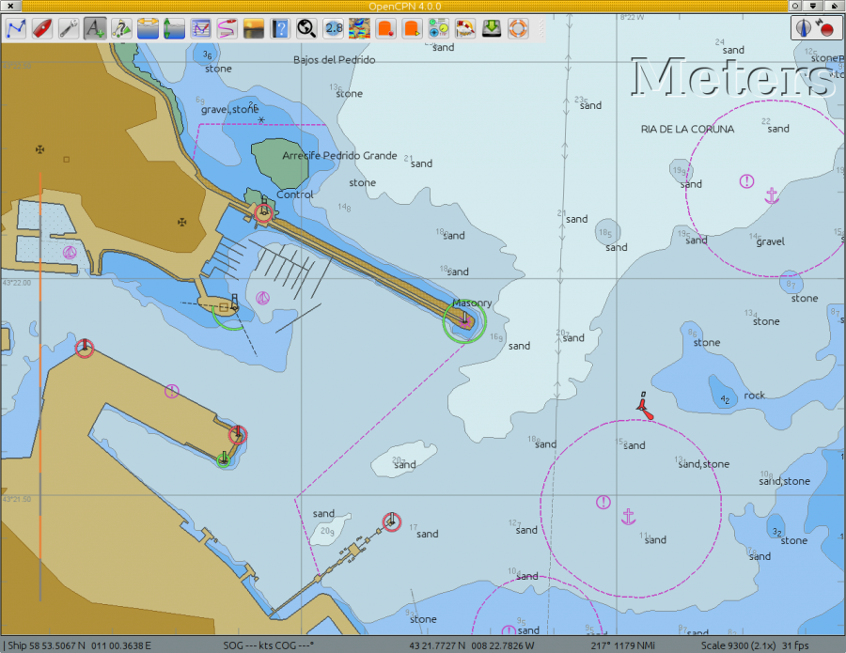
Download OPEN CPN
Notes:
About OpenCPNstart node.tpl.phpgoogle_ad_section_startA Chartplotter and GPS Navigation Software.OpenCPN is a free software (GPLv2) project to create a concise chart plotter and navigation software, for use underway or as a planning tool. OpenCPN is developed by a team of active sailors using real world conditions for program testing and refinement. The most recent stable version, OpenCPN 4.0.0, was published on January the 8th 2015 and can be downloaded from opencpn.org/download.

Slide 14
Increase Comfort Level
Helping the student load OPEN CPN will build confidence to use it for plotting.
Loading the Bowditch Bay Chart demonstrates the process of importing charts.
Teach understanding of how the plotter works.
OPEN CPN can become a common means of discussing individual members chart plotters.
Notes:
The chart plotter is becoming automated and may replace the knowledge or skill for traditional navigation. The USPS point is that if it fails how does the person replace the plotter with individual skills. A more likely need is to understand how a system works and how to use it more effectively. Activities to teach the skills can be placed on the USPS server. Choosing charts for the plotting program will help the student understand the value of different chart choices, for example.

Slide 15
Open CPN Tool Bar
Notes:
Notice the number of options available on the chart plotter menu. How do you help the boater recognize the icon and it’s capabilities? Having the student involved in manipulating the icons is much stronger than “doing it for them.”

Slide 16
Why Place Plotting Skills Online?
The student can view the plotting demonstrations as needed to complete the assignment.
Can you give another reason for plotting online?
Another reason?
Another reason?
Notes:
Student can repeat viewing as needed.
Students may not need to see all the videos to accomplish the assignment.
Student can practice on their own schedule without the pressure of a Face to Face classroom time schedule.
Student is practicing the skills they need to develop in the way they will be using those skills.
The “curse of knowledge” does not come into play when explaining the plotting actions. After teaching something numerous times it is often hard to identify a student’s lack of understanding. When creating an online video one must start at the basic level.

Slide 17
Online Help Videos
Overview to Support Online Learning
Creating a Route – show today.
Editing a Route
Managing Route Properties
NOTE: Do not repeat the content, find out what the person understands or needs to strengthen to learn.
Notes:
We do not have time to show the video support for online learning today. The videos provide information of the plotting tools available in OPEN CPN. Rick Vandermark, SEO of Findley Power Squadron created the overview and other demonstration videos as part of an OPEN CPN presentation for the D29 2015 Fall Conference. The first video is 7 minutes. Second is 3 minutes, 3rd & 4th are 2.5 minutes each.

Slide 18
Creating a Route in OPEN CPN
United States Power Squadrons ®
Back
Notes:
Three Minutes. The video is an example of a learning activity placed online that a student can access on their own schedule and review as needed to build understanding of the program and OPEN CPN plotting skills.

Slide 19
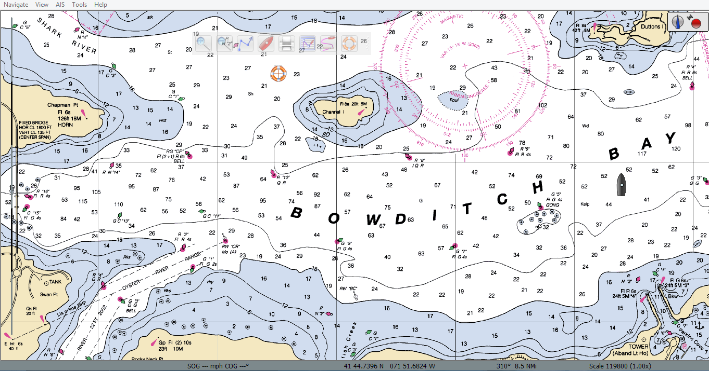
Practice on Their Schedule
Notes:
Helping the student load OPEN CPN on to their personal computer and briefly help them locate the tools will help them begin to understand how to use electronic software. Helping them load the Bowditch Bay Chart will help them understand the chart loading process without choosing charts for them.

Slide 20
Online Assignment
Create a route from R “6” in the Oyster River to RG “D” in the North East of the Bowditch Bay Chart. (Explain route choice in class)
The student would be given a location for the training videos and a completion date for the online assignment.
be placed online for use as needed.
Discuss answers during next face-to-face class time. (Student owns the learning!)
Notes:
Creating an assignment will help the learner use the plotting components of the electronic software. The important discussion will be during the next class or in email exchanges when the student either asks for more help and describes their solution to the assignment. We are in a different learning environment today. Many solutions to problems can be found online at site such as U Tube whether you want to fix a faucet or change a fan belt on an automobile. Thinking that we do not enter that environment is not wise in today’s connected world. Helping people learn to use electronic software should be a stronger focus of our curriculum. If we do not prove valuable for the navigator, technology will move on without our support.

Slide 21
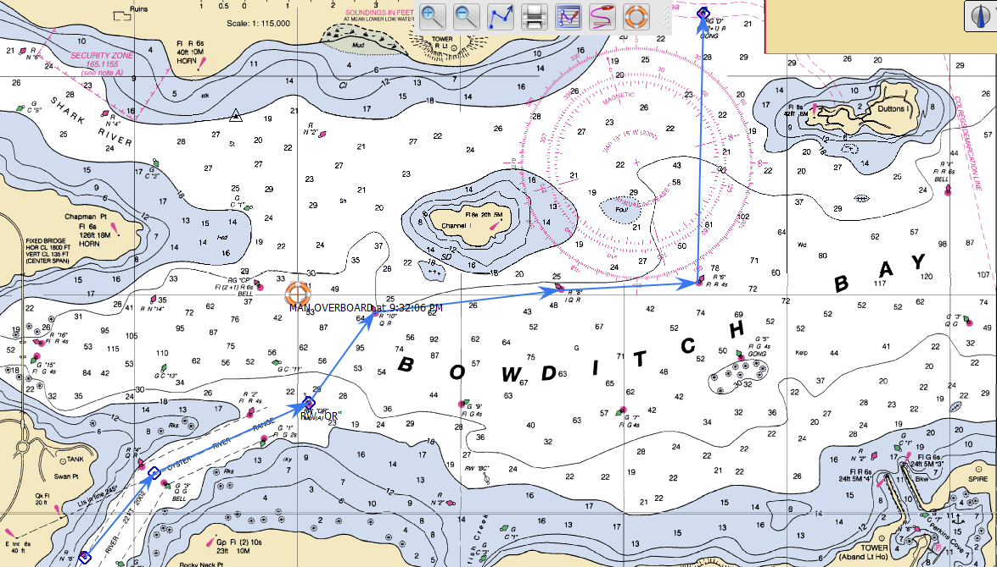
One Solution for the Assignment
Why not teach the procedures the way people will use them?
Notes:
Instructor questions that would help the student think about learning to plot electronically. What makes this a good route choice? Why do you use waypoints instead of a straight route? Why not go to a single waypoint then turn toward RG “D”? The assignment solution does not look very different to someone teaching Piloting. I believe it will look entirely different to a young person doing the plotting. They may not be familiar with paper charts. They will solve the “problems by manipulating a software program. Today’s mariner uses a chart plotter first and paper charts as a backup. Why not teach the procedures the way people will use them? Planning for student interaction with the software is a much stronger learning experience then drawing it in front of them and telling them how to plot.

Slide 22
“Face-to-Face Class Time” Questions for Students
Did the student complete the assignment?
Describe your route choice?
Why did you use waypoints instead of a straight route?
Why not go to a single waypoint then turn toward RG “D”?
Would you use different questions?
Notes:
Good questions help the learner think about what they learned in the activity. By reprocessing the information the student strengthens the connections in the brain and creates a stronger memory pattern. Notice that my questions focus only on the plotting activity. The instructor would also ask questions regarding the use of the software.

Slide 23
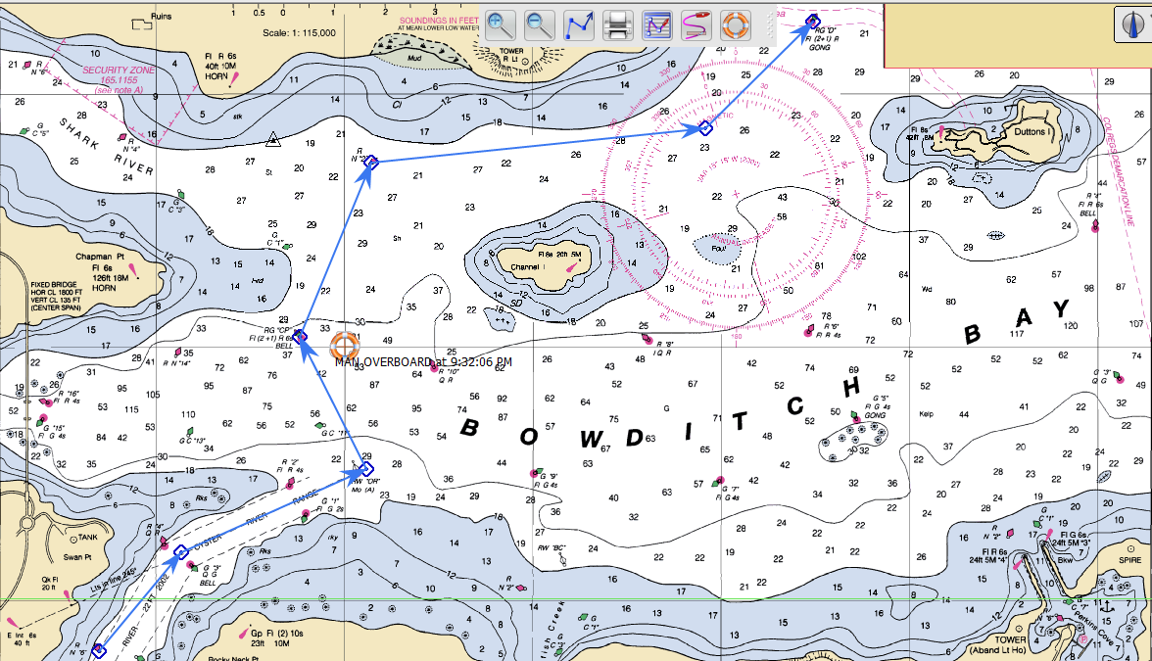
Second Route Choice Questions
Carefully planned questions become much more important
Notes:
Students should have different choices. Why might this a good route choice? What conditions would make this choice a better route to follow? Why have two choices for answers? THIS IS A BRIEF EXAMPLE to illustrate blended learning. The interaction with the student becomes more important with less face time. Carefully planned questions become much more important. Open ended questions or activities create thinking that allow the student to put their own imprint on understanding. Having the student explain the route choice helps the instructor understand student thinking.

Slide 24
Another Example
Checking for student learning is a planned part of instruction
Notes:
Bob Potter uses this site to help students with knots. If the student practices the knots at this site then they can learn other content in class. If it is their skill to learn then you are supporting them. What is their confidence level? An example of how to check might be to ask the following questions: How well do you feel you have learned the knots? They can raise their hand to tell you. One finger, I still need help, 2 fingers I have it but can still practice, 3 fingers I am comfort doing the knot, 4 fingers I can teach someone else how to tie the knot, 5 fingers I can tie the knot with my eyes closed or behind my back,

Slide 25
Spring Lines Video
Notes:
Members can watch the video as many times as they wish to understand the use of the spring line. The instructor could ask the student to apply the use of the spring line to a stern in docking situation, for example, to see if they can transfer understanding to a different spring line use.

Slide 26
What did the student learn?
Set Conditions: Wind off the dock. Boat is attached to the dock with a spring line.
Examples of questions for the student:
Which way do you turn the steering wheel to move the boat back to the dock?
Do you place the throttle in reverse or forward gear to move the boat back to the dock?
What would happen if…?
It is important that the student works with the information!
Notes:
An important component of online learning is helping the student think about that content. Helping the student reprocess the content will strengthen long term memory. It is important that the student works with the information. If the instructor repeats the information in the video little learning has occurred. There is not time or room to put all the potential questions up for viewing or discussion. Other examples: How many lines are attached to the boat when you make the maneuver to move the boat to the dock? Why are the lines attached to that specific cleat on the boat? Are there other ways to use a spring line, steering wheel and throttle to move the boat toward the dock?

Slide 27
Thank You For Your Attention
Should the Education Department place OPEN CPN support videos Online?
Should OPEN CPN training be part of district meetings?
Contact information:
Bob Rayburn, Assistant Chair ID Committee
r.e.rayburn@sbcglobal.net
Notes:
Today’s presentation is a information communication. Time is not available to do any training or lengthy discussions on the topic of blended learning.

