Slide 1
Educational Department DEO/SEO Tools A Primer
Orlando Annual Meeting
February 18, 2016

Slide 2
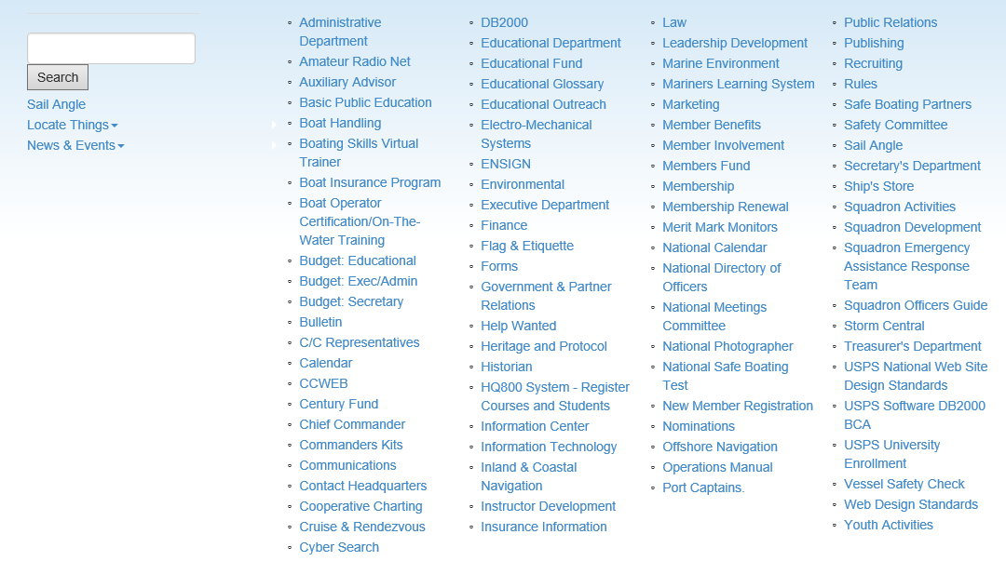
Starting at ED Home Page www.usps.org/eddept
Site Index

Slide 3
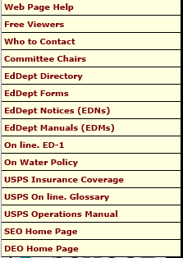
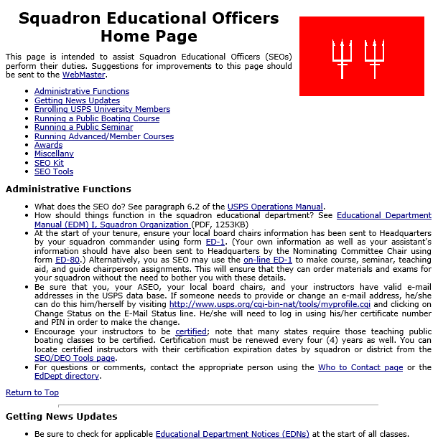
Starting at ED Home Page www.usps.org/eddept
ED Dept Tools

Slide 4
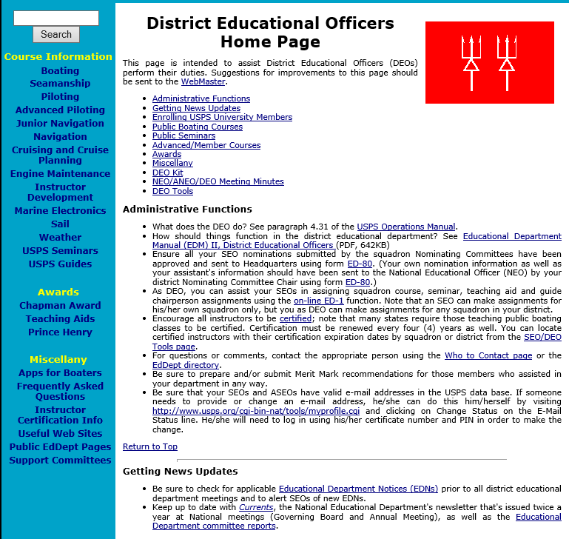
Starting at ED Home Page www.usps.org/eddept
ED Dept Tools

Slide 5
Starting at ED Home Page www.usps.org/eddept

Slide 8
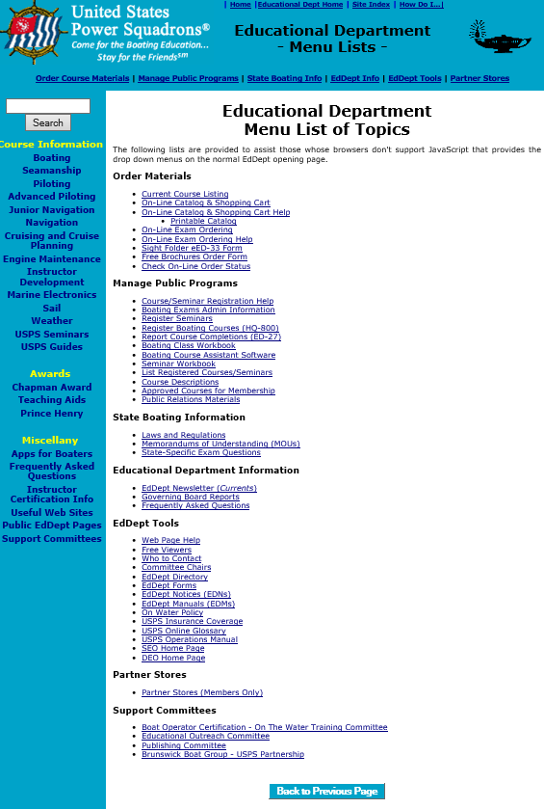
List of Search Topics

Slide 9
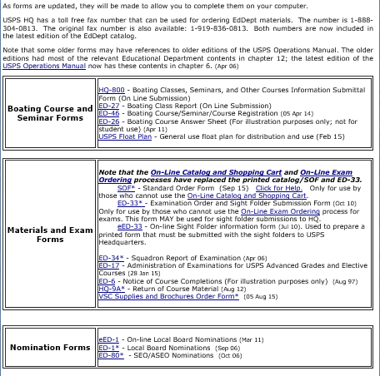
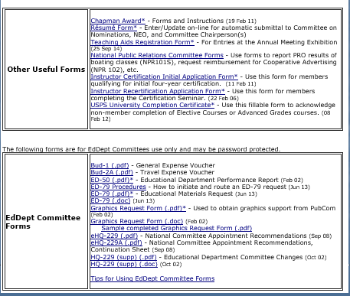
Forms

Slide 10
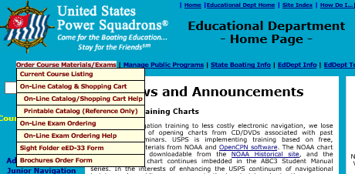
Order Materials & Exams

Slide 11
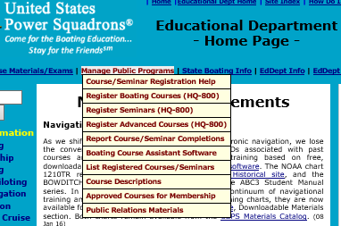
Manage Public Programs

Slide 12
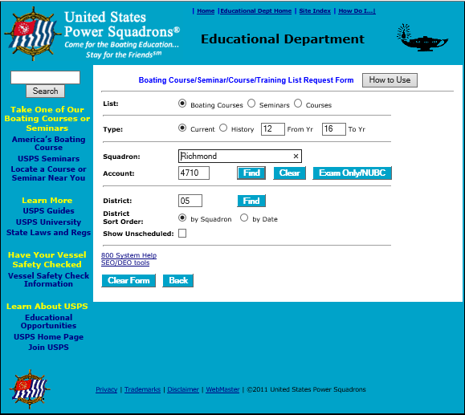
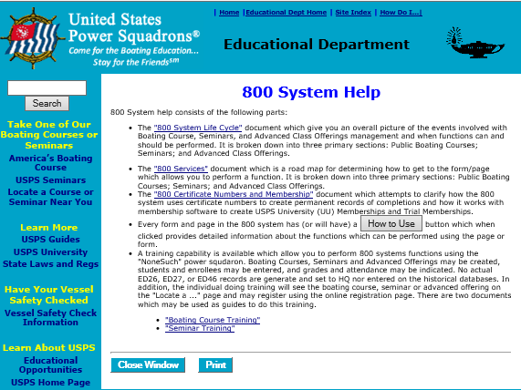
NOTE: This button is on each page of the HQ800. See also the 800 System Help page below for tutorials and special helps

Slide 13
Questions/Comments
??

