Slide 1
Social Media: A Communication Bridge
USPS Governing Board Meeting
11 September 2014
#SocialMedia
@2014GB

Slide 2
What is Social Media?
Communication via the Internet
Also called “social networking”
The best “word of mouth” going
Examples of social media platforms
Facebook, Twitter, Pinterest, Instagram, Youtube
700+ more!
Powerful: Levels the playing field for consumers
USPS can post content
Everyone can see
Everyone can talk about us

Slide 3
74% of Internet
users use social networking sites

Slide 4
That’s a LOT of people!

Slide 5
How Can Social Media Help?
Expands USPS’s reach
Anyone with Internet access can check us out
The more they look, the more they’ll see
Messages live forever
Allows USPS to target its messages
Allows viewers to express their opinions
Feedback for us
Influences their friends and other viewers
Expands our reach
Provides analytical tools
Quantitative & qualitative insights

Slide 6
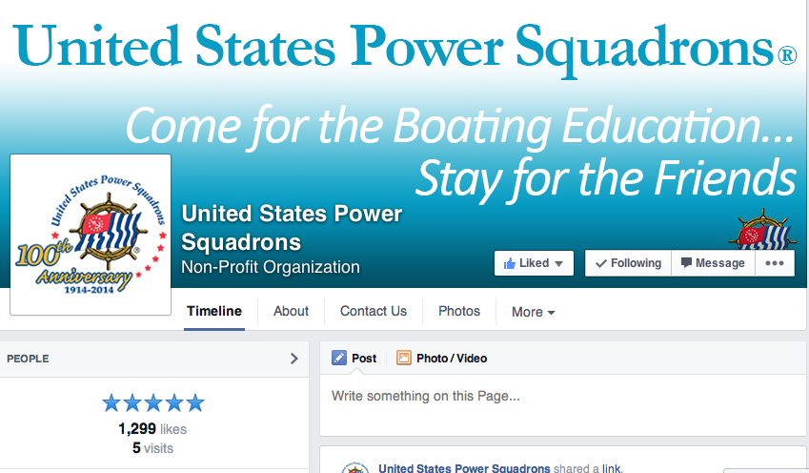
We’re On Facebook
Facebook: www.facebook.com/uspowersquadrons
But we have few friends and almost no original content

Slide 7
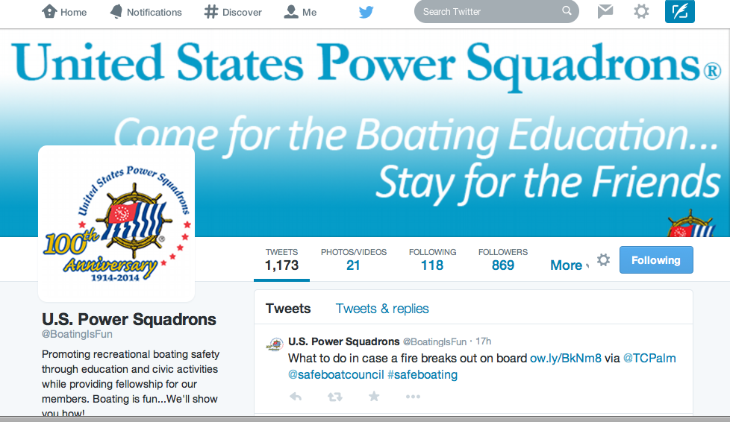
We’re On Twitter
Twitter: www.twitter.com/BoatingIsFun
Twitter could be powerful for us!

Slide 8
How Can USPS Win?
Use original content
Project an authentic USPS personality
Brand
Voice
Images
Have external focus for public messages
Use SM options for internal communications
Build relationships
It’s not about “selling”
Help people want to choose us

Slide 9
How Can USPS Win?
Use social media to
Inform—useful information that helps people
Let prospective buyers sample USPS product
Don’t worry: Info is already in the public domain
We want to be provider of choice
Build trust, confidence in our quality
Then ask for the sale
Make it easy to buy
Promote positive word of mouth
Recommend USPS start with
Facebook, Twitter, YouTube, Pinterest, Instagram

Slide 10
Let’s Get Organized!
USPS HQ (Immediately!)
Dramatically reduce use of non-USPS content
Unless USPS adds comment that shows value
Like/Follow all Districts/Squadrons that use SM
National USPS
Set & communicate branding & style guides for USPS, Districts, Squadrons
Including voice, personality to be projected
Partner with Ed Dept on education content
Ed Dept to take the lead
Broaden administration of SM tools
Manage communications budget to support SM

Slide 11
Let’s Get Organized!
Ed Department to define
Scope/priorities for content development
By tool
Packaging of content
For engagement
Frequency of messaging
Function of time, budget
Mobilize volunteers to
Develop original content, photos, graphics, video
For use by USPS, Districts & Squadrons
Participate in administration of USPS sites
As poster & commenter
Analyze results for feedback loop

Slide 12
Early Content Ideas
Ask users what they want to see
Feedback from members and public
Benchmark vs. “competitors” to offer unique value
Increased use of pictures, graphics
Geared to diverse market
Boating information
Did You Know? Question of week, tips, contests, just for fun, regional information, skills
Special Topics (link to longer original articles)
Course information (beyond USPS web)
Calendars, course content, findacourse links
Classroom, OTW, online

Slide 13
Be a Champion!
Be positive about USPS using social media
Help
Identify volunteers
Generate ideas and suggestions for content
Provide feedback
Thank you!
Contact:
D/1/Lt Jan Wright, AP-IN
912-659-9358 (cell), vjanwright1@comcast.net

