Slide 1
United States Power Squadrons®
We ARE
America’s Boating Club®

Slide 2
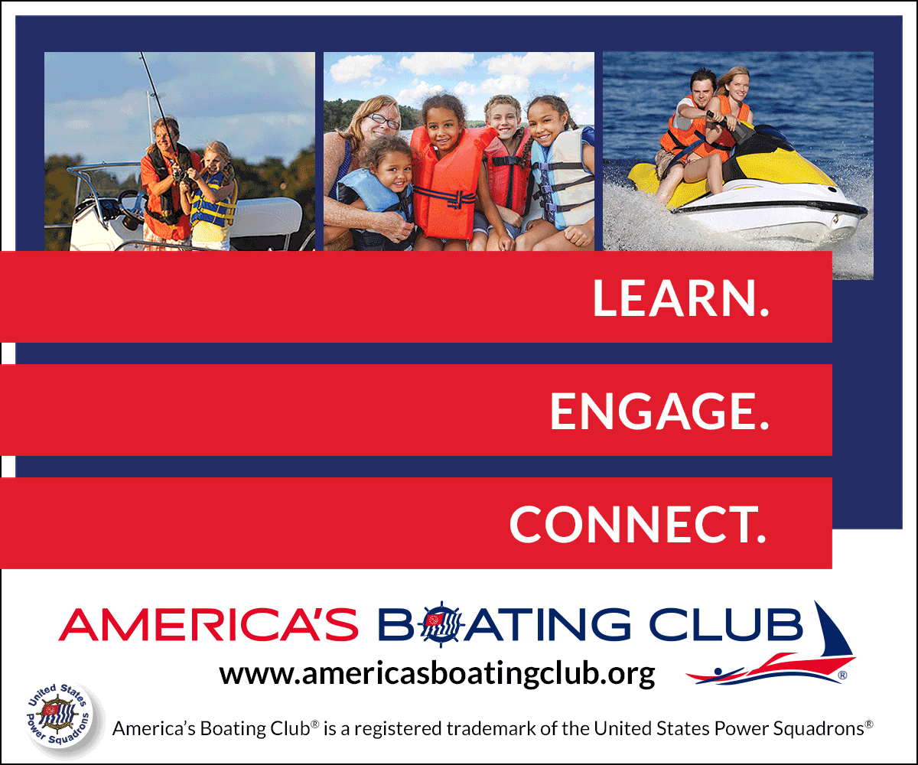
Who Are We?
27,000 volunteer members across the country
346 clubs/squadrons
All recreational boaters
Dedicated to knowledge, skills, and safety
But we also have fun on the water and on land
We help our fellow boaters and the boating community

Slide 3
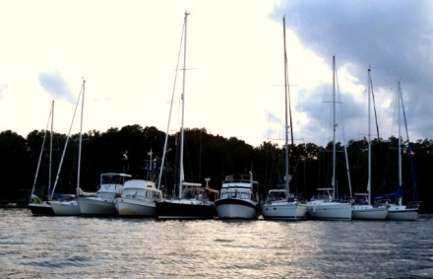
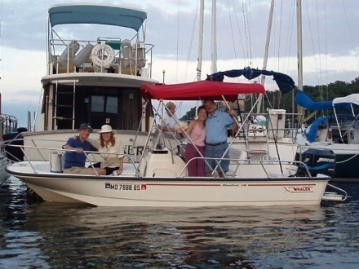
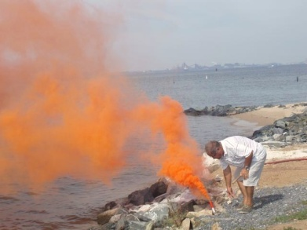
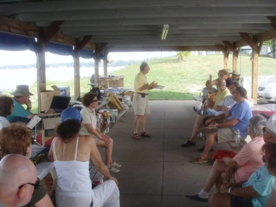
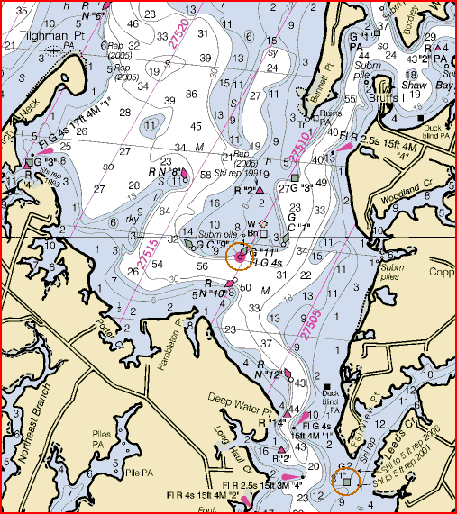
America’s Boating Club Activities
Boating activities and events
Boating courses & seminars
Social gatherings
Public safety demonstrations
Vessel safety checks

Slide 4
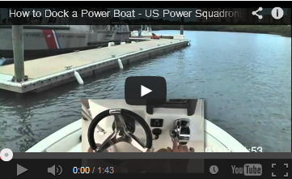
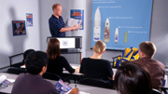
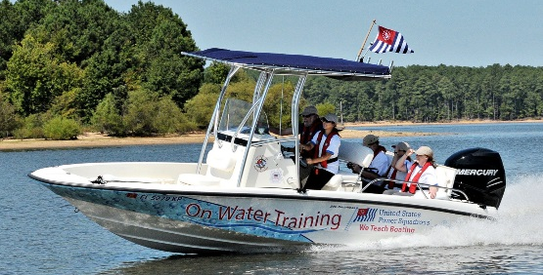
Boating Education
On-line courses
  Convenient
  At your own pace
Classroom
  Certified instructors
  In-depth answers to your questions
  Group learning and interaction
  Realistic simulators
On the Water
  Hands on training
  Skills development

Slide 5
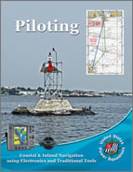
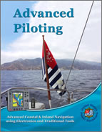
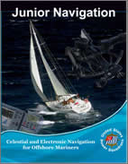

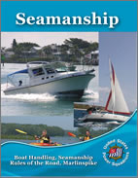
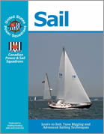
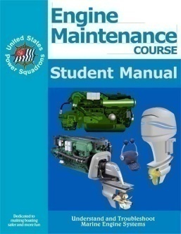
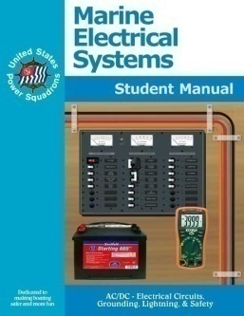
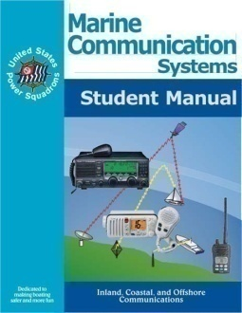
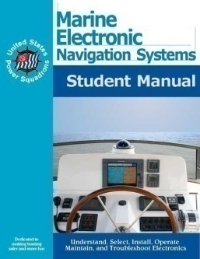
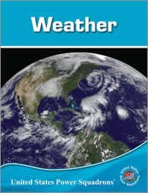
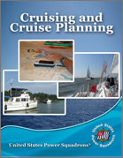
Courses
Navigation
  Inland
  Offshore
  Celestial
Boat Handling
  Power & Sail
Marine Equipment
Weather
Cruise Planning

Slide 6
Two Hour Seminars
Boat Handling
  Rules of the Road
  Docking and Undocking
  Anchoring
  Emergencies on Board
  Knots and Lines
  Boating on Rivers, Locks, & Lakes
  Sail Trim & Rig Tuning
  Paddle Smart™
Navigation
  Using Digital Charts
  Using OpenCPN
Marine Environment
  Onboard Weather Forecasting
  Hurricane Preparation for Boats
  Tides and Currents
Boat Systems
  AIS Electronics for Boaters
  Using GPS, Multi-Function Displays
  Using Marine Radar
  Using VHF/DSC Marine Radio
  Propane Systems on Your Boat
Cruising & Cruise Planning
  Crossing Borders

Slide 7
Americasboatingclub.org

