Slide 1
America’s Boating Club®
A New Marketing Approach for
The United States Power Squadrons

Slide 2
We All Seem to Recognize
Our name does not resonate with boaters
Need to update our public image
Appeal to today’s boater, in new ways
Attract more kinds of boaters
Large powerboats
Small power boats
Sail
Paddlers

Slide 3
Historical Market Segment
Typical of current membership
Typically older (60+)
Declining in numbers
Mid-size to larger boats, cruising
Joined for the education and public service

Slide 4
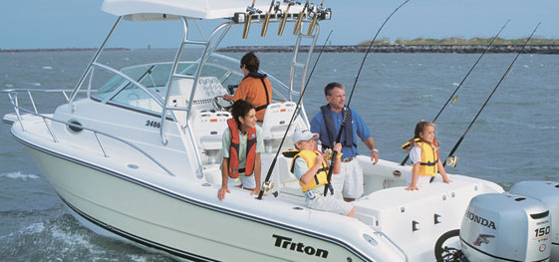
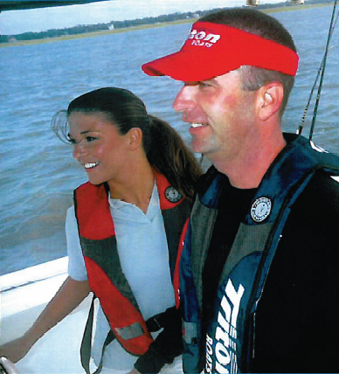
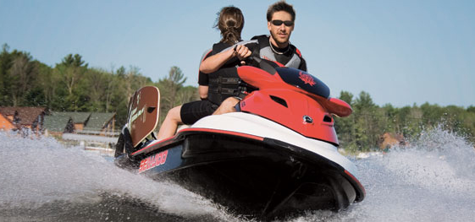
Growth Markets
Investment in their future … and Ours

Slide 5
Growth Market
Includes but not limited to smaller boats
Motivated by activity and fun
Like to contribute to public service
Over 15 million of them
Sufficient disposable income
Tend to be 40-55
Consistent with NMMA targets

Slide 6
Growth Market Descriptors
Outdoor Enthusiast
8.2 million boaters
Outdoor activities
Escape from routine
Mid to upper class
Married, average age is 50
Volunteering: the environment and creating a better world
Education creates confidence on the water
Sociable Adventurers
7.3 million boaters
Adventure-seeking
Activities with family
Above average income
Married, average age is 47
About 40% have children at home
Volunteering: create memories with family
Education for the whole family
Notes:
[Review descriptions. Mention that we have two groups that we want to attract. Note that they are similar demographically, with one group focusing more on family activities, and the other looking at boating as an escape from the routine.]

Slide 7
Stretch Market Segment
Millennials
Primary boating activities are paddling, fishing, and water sports
Do not consider themselves boaters first
Includes some sailors and power boaters but their busy lifestyles do not lend themselves to joining groups as members

Slide 8
Market Segment Focus
Criteria | Historical | Growth | Stretch
Market Size | Medium | Large | Large
Growth | Declining | Stable/Growing | Growing
Fit to USPS now | Good | Good | Poor
Probability of joining USPS | Higher | Medium | Lower
Target emphasis | Medium | High | Low
Historical – Emphasize retention
Growth – Emphasize recruitment
Stretch – Emphasize name recognition for future

Slide 9
A New Public Image Is Required
We are an active and vibrant organization
We are a boating organization
We support our members
We boat together
We learn together
We help each other & the boating community
We are welcoming and inclusive

Slide 10
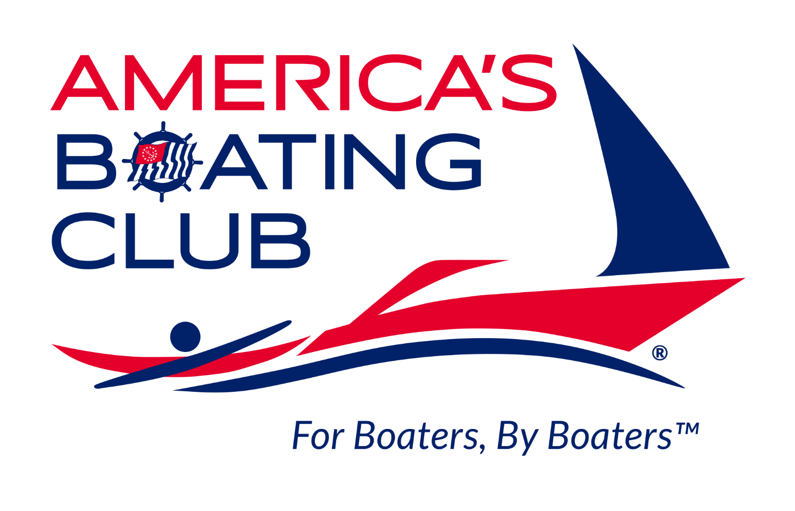
Enthusiastic Support

Slide 11
Marketing Message
LEARN boating skills
ENGAGE with boating friends
CONNECT with the boating community

Slide 12
Example: Recruiting Video
Audience: All boaters
Boaters and boating lifestyle aficionados
Describes how to join
Click

Slide 13
Use of the New Name and Logo
New logo serves as primary public identity
New name is a trade name only
Official name used elsewhere as appropriate

Slide 14
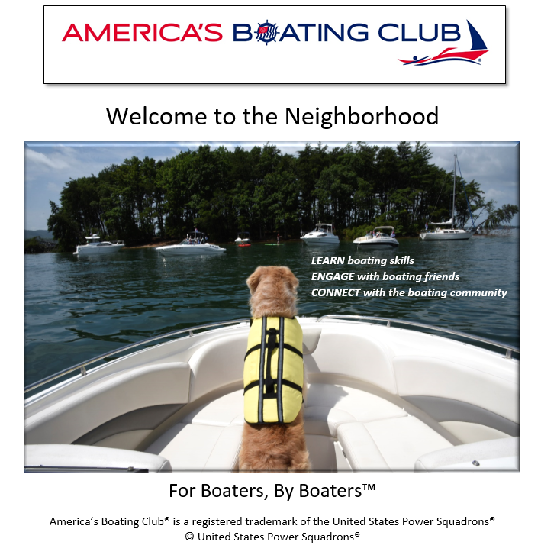
Example: Full Ad Brings It All Together
Marketing Name & Logo
Welcoming
Theme
Learn
Engage Connect
Tagline
Official Name & Trademark

Slide 15
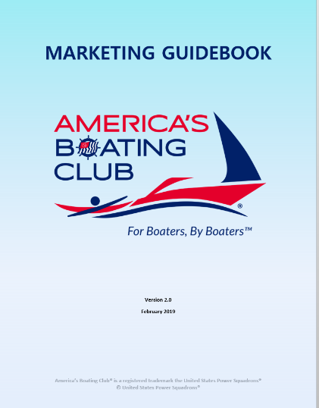
Guidance for Squadrons: Marketing Guidebook
“How to” manual
Organizing & steps
Selling the change
Rebranding approach
New marketing materials
Marketing techniques & ideas
Notes:
Organization: National, Local: PRO, SEO, etc.
Steps: Audit “live the logo”. Decide on local branding. Update materials. Develop strategy.
Why Change?: Makes the case. Changes in demographics. Changes in education. Changes in society.
Rebranding approach: Dual branding @ national level. Choices at local levels.
How to promulgate within the squadron and district.
New materials: Logos, brochures, slide shows, promotional videos
Techniques: Education and training in marketing, promotion, how to run a boat show booth, etc.

Slide 16
Logo Usage
Use only approved logos
Adhere to trademarking standards
Do not modify the logos
Use near squadron burgee if desired
Somewhere on page must include: America’s Boating Club® is a registered trademark of the United States Power Squadrons®

Slide 17
Squadron Trade/Marketing Name
What should you call yourself?
XXXX Boating Club may be confused with other local boating clubs
Link to national name and local identity
Decide if you want to register a Doing Business As (DBA) name with your state

Slide 18
Protect Your Trade Name
DBA = Certificate of Doing Business As
Trade name or alias
Registered in home state where you do business
In some states, may require county instead, or both
Cost = $25 - $30 for most state fees
If required, county costs vary but can be more
Easy to complete online form (in most states)
May require EIN, address, formal name, requested trade names, business description, etc.
First research for no name conflicts

Slide 19
Next Steps
Organize a Marketing task force
Ensure squadron activities “live the logo”
Select a local branding approach
Update marketing materials & website
Craft a marketing strategy including:
Boat shows & public events
Public education
Advertising/Articles
Speaking engagements

Slide 20
When?
Start now. Opportunities await.
Standards compliance flexible right now
Transition period is estimated at 12 months
We recognized people need time
New ideas and feedback welcomed
Many squadrons are excited and starting
See what is doable for your squadron

Slide 21
For More Information:
Marketing Contacts:
R/C Shirley Heald
Chair, Marketing Committee
shirleyheald@verizon.net
Tammy Brown
HQ Director of Marketing
brownt@hq.usps.org

