Slide 1
Report of the Marketing Committee
Fall Governing Board
Sept 14, 2019
Louisville, KY
Prepared by R/C Shirley Heald, AP

Slide 2
Earthrise
Notes:
This picture always haunts me. It was taken by Astronaut William Anders on the Apollo 11 Moon mission.
It conjures up two ideas I think we should always take into consideration,
To always look at things from a different perspective
We are all a part of this universe and are more alike than we are different
This is what the Marketing Committee has tried to do this year with all of the strategies we have implemented.
I encourage you to think “outside this world” as we consider the path our organization will take over the next few years.
Here is the 5 point strategy MarCom has used this year to attract new members from a National Level.

Slide 3
New Tagline Trademark Status

Slide 4
Driving Membership
5-POINT NATIONAL MARKETING STRATEGY
ATTRACT
Phase 2 Ad Campaign
INTEREST
New Website / Call to Action
ENGAGE
Collateral / POP / Face to Face
CONNECT
Social Media
LOCAL CLUBS
Demonstrate VALUE by
Providing Activities
If you are not able to demonstrate value, they will walk away
Mentoring
Inclusion

Slide 5
Phase II National Ad Campaign
“Call to Action”
Beyond the class theme
100% Digital
Will emphasize more social media and enewsletter platforms than print
Will show diversity, having fun, and being safe doing it

Slide 6
Phase II Ad Campaign

Slide 7
Phase II Ad Campaign

Slide 8
Animated Digital Ad Sample

Slide 9
America’s Boating Club New Website
Builds on Phase I ads with Learn, Engage, Connect theme.
Phase II ads will now land on a new website designed to have the same look, feel, and message as the ads.
Features Nationally Recognized Educational Classes.
Features an inclusive, “beyond the class” recreational boating experience at the local club level.

Slide 10
Considers the Following in all Pictures
Target audience of social adventurers and outdoor enthusiasts
All types of boaters, power, sail, fishing, human power
45-60 Age range
Diversity in all photos
Folks having fun
Wearing life jackets
High resolution pictures
Minimizing alcohol consumption

Slide 11
Website Update – Home

Slide 12
Website Update – Learn

Slide 13
Website Update – Engage

Slide 14
Website Update – Connect

Slide 15
Website Update – Join

Slide 16
Spanish Language Ad Campaign
Targets individuals with browsers set to Spanish
Digital marketing campaign in select markets
Reached over 15M viewers
Created a lot of dialogue in this demographic
Still need to keep knocking on the door

Slide 17
Spanish Ad Campaign – Carmen

Slide 18
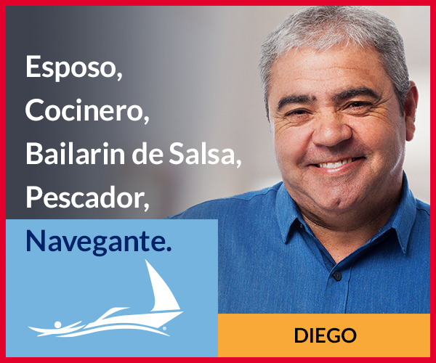
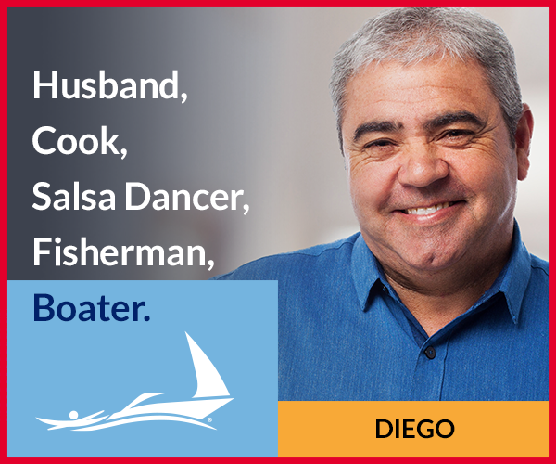
Spanish Ad Campaign – Diego

Slide 19
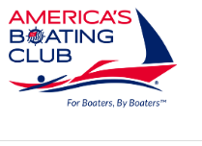
What’s Next? America’s Boating Club Mobile App!
Notes:
MarCom has just received a grant from the Educational Fund to construct a new Americas Boating Club® mobile application
A task force is being formed to begin work right after this Governing Board
We need input for content
Goal to have it available by Saltgrass AM.

