Slide 1
2017 D2 Fall Conference
Proven Marketing
Susan Ryan, JN
Past District 2 Commander
GreenwichSquadron@gmail.com
Notes:
Paul Mermelstein has shown what National is doing for the overall look of USPS, let’s review what can be done at the squadron level
Karl is helping you hold classes

Slide 2
Proven Marketing
Your ABC3 classes are vital
They bring new boaters to the squadron
This can lead to new members
Class promotion highlights the squadron
Some D2 squadrons have not had a class this year
Two D2 squadrons consistently draw 50 - 60 students to all their ABC classes
Here’s how . . .
2
Notes:
Paul Mermelstein has shown what National is doing for the overall look of USPS, let’s review what can be done at the squadron level
Karl is helping you hold classes

Slide 3
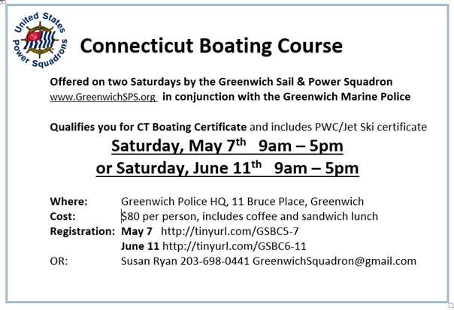
Start Early
Marketing starts 3 months in advance
Each year, the same simple flyer
3
Notes:
We establish the dates, create the class schedule and post on HQ800, then create this flyer. Each week we spend an hour reviewing what needs to be done. Our flyers are distributed one month ahead of class.

Slide 4
Simple and Punchy
Simple; no extraneous text
Registration link goes to HQ800
Plus simple contact information - an easily remembered email address for the squadron
We print 300 neon flyers and think
WHERE ARE THE BOATERS?
4
Notes:
Use the same flyer for everything. Ask the audience ‘Where are the Boaters’ and they will mention marinas, yacht clubs, docks. So say ‘Boaters are first regular people, doing regular things . . . ‘

Slide 5
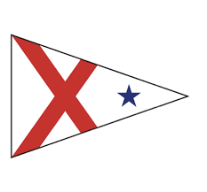
300 Neon Flyers
5
Notes:
Boaters are commuters so post at train stations. They drink coffee; coffee shops have bulletin boards. Our vessel safety check examiners always have a pile of flyers with them. And the usual marinas, dive shops, yacht clubs etc.

Slide 6
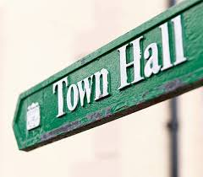
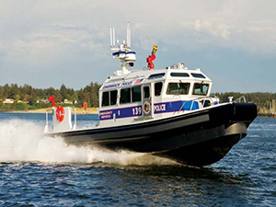
300 Neon Flyers
6
Notes:
Boaters go with their families to the library. Yes, boaters have their hair cut. The Town Hall boating department may have a counter for the flyers. Does your town dump have a place? We have five town docks, and the marine police always take a bunch of flyers to post for us or hand out.

Slide 7
E Flyers
Exponential Marketing
Our members have identified a key person in 8 organizations who post these in their newsletters, on their websites etc.
7
Notes:
Think exponentially. For each key person in an organization flyers can go to over 2,000 people
Our Rex Marine’s newsletter goes to over 6,000 boaters once a week for two months prior to our classes.The town’s Parks & Rec newsletter posts for us. We get on the police website and newsletter and Facebook page.

Slide 8
E Flyers
Posted on Facebook
Squadron page
D2 page
Individual members’ pages
On digital newspapers (Patch, Voice)
On neighborhood sites such as NextDoor
8
Notes:
Social media is definitely exponential marketing. Get your members to like/re-post/share. NextDoor.com is throughout the U.S. and a friendly, neighborhood site.

Slide 9
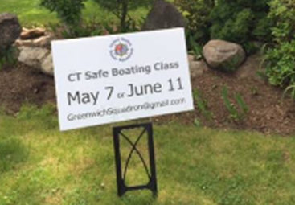
Street Signs
Our signs are even simpler
We buy 4 roadside signs @$17 from Staples; put outside a yacht club, and on 3 places on way to Harbor
9
Notes:
We don’t bother with details and certainly don’t call it the ABC3 Class which is unknown to the public. At least 15 students per class see the one outside this member’s house

Slide 10
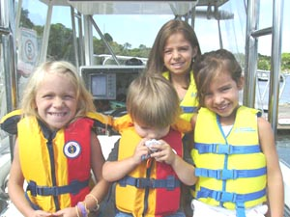
Traditional Press
Each year we write up a boating story from National’s website, with a graphic, and send to those who report on boating in our local papers
This year we used ‘Educate your Crew’ with accident statistics from the US Coast Guard
Also published in the brochure Greenwich Boat Show
brochure
10
Notes:
It just doesn’t take long to get a story to send out

Slide 11
Key Points
For maximum impact
Keep all flyers simple – and punchy
To reduce labor
Use same material over and over
Use same material in different formats
Relationships
Build key contacts in boating community
Know your local press
Use your members’ outreach
Keep track of Non Members who boat
Contact me about Constant Contact
11
Notes:
It’s vital to add non members to your distribution lists. Over two years we have captured emails of over 2,000 non members from cybermembers, friends of members, enquiries, even boat club websites and put on different lists that receive appropriate eblasts. Some get invitations to our events, some to our parties, and all to our ABC3 class.

Slide 12
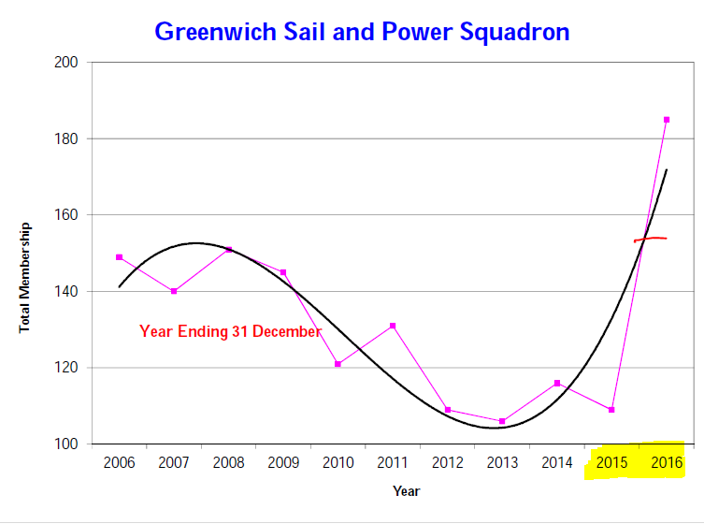
RESULTS
NOW
152
12
Notes:
This marketing plan was implemented in 2015. We had a false spike in membership numbers by using the free trial members, but didn’t repeat that in 2016. Our numbers as of Oct 2017 are now a realistic 152. Two other squadrons within ten miles of us, so with the same demographics, have not attracted the students that we have. They have not copied our marketing.
Membership had a false spike with trial members
BUT is now at 152 thanks to our membership involvement

Slide 13
Once all those students come to your classes, hold weekly sails, dynamic speaker meetings and have fun with them, because WE ARE NOW
13
Notes:
Thank you

