Slide 1
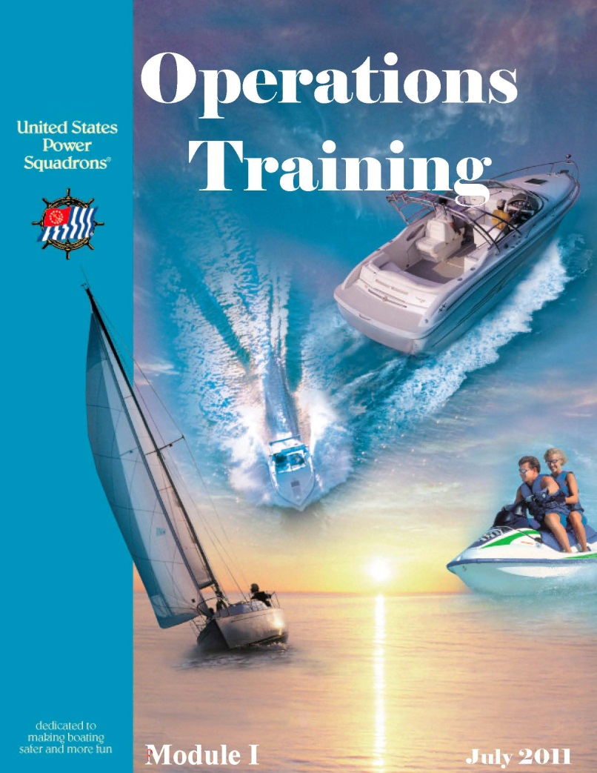
‘OT in 3’
Introduction
Lesson 1
The
3 hr Seminar version
Presented by
D/Lt E J ‘Betty’ Dysart, JN
Notes:
Welcome to the new 3 hour Operation Training Seminar
I’m D/Lt Elizabeth Dysart, JN (everyone calls me ‘Betty’).
For those of you not familiar with all the various alphabet soup connected to squadron members names, no worries. It will all become clear to you thru the process of this seminar.
A thumbnail – that which is before name – relates to the position held
that which is after name – relates to educational achievement
This is the new abbreviated version of Operations Training. For those of you who think you are going to get off easy – not so much. In the longer version, members actually had time to review and study the material and assimilate some of it before moving on. Not so with this class. Its pretty much rapid fire
You get to pay attention, listen fast, grab a hold of as much as you can, and home study ‘like crazy’. Up to you how much you learn.
In 3 hours you cannot learn everything you need to know to run a successful squadron, but you can learn how and where to find it OR Who to ask.
This class is NOT about leading your squadron; we have the Leadership Seminars and Programs for that. This class is about managing local squadron organizations, and operating them successfully.
What does that mean - What is success? That’s up to you and your members to decide, it is not the same for all squadrons.
2 mins

Slide 2

Purpose of OT
Introduction
Lesson 1
Personal
Acquaint new members of USPS to:
Advantages of membership
Opportunities for self through civic service, self-education & fellowship
Update seasoned members to the changes
Organizational
Develop new members by encouraging involvement in USPS activities
Identify potential leaders
>>
Notes:
The purpose of OT (Operations Training) is 2-fold
First. For the Personal advancement of our members - We hope to encourage each of our members to become as involved as they can, so they can take advantage of all the opportunities & benefits of membership.
OT (Operations Training) is for new members and not-new members alike. Participating in the program every 4-5 years keeps our members up-to-date and current with the changes that take place, in the intervening years.
Second. Organizationally, of course we also expect our squadrons will benefits from having the skills and talents of our members brought to bear for the benefit of the squadron, and we have programs, seminars and trainings to develop and hone their skills, for this purpose.

Slide 3
Time Commitment & Expectations
Introduction
Lesson 1
Seminar attendance - takes 3 hours
Tailored for presentation at:
  GB meetings
  District Conferences
Time to actually learn material ?
  Way longer
  Up to YOU
>>
Notes:
Originally OT Program was a 12 hours presentation, in 2012 we took it down to 8 hours. This 3 hour version was created to allow this material to be presented at your District Conferences.
Of course, by shortening the presentation, it means you will need to do a bunch of home study, if you want to become well versed, in all things USPS.

Slide 4


Time Commitment & Expectations
Introduction
Lesson 1
Reading assignments for homework
Materials provided - on-line & downloadable
  OTP Manual
  Operations Manual
  Job Descriptions
  Bylaws
  Handouts
>>
Notes:
There will be reading assignments for your home study
There is a wealth of materials available, much of it on the USPS website and downloadable.
Including the handouts in your packet.
About 1 hr into this seminar – we will have a short break then later,
about 2 hrs in – there will be a longer break

Slide 5
What You Will Learn
Introduction
Lesson 1
Structure of organization
  The objectives & how it operates
  Relationship among levels
Educational courses/seminars available
Squadron/district Management
  Committees & Delegating
  Scheduling & Teambuilding
  Problem solving
4 required squadron actions
>>
Notes:
You will be introduced to the structure of USPS, it’s squadrons, and districts
You will see how the levels relate to each other.
All about the various educational courses, seminars, programs and hands-on training available to you.
We will discuss some things to sharpen & hone your skills in scheduling, delegating, committee management, problem solving techniques.
AND -- you will learn the 4 required actions that all squadrons must take. That’s right- there are only 4.

Slide 6
Some USPS History
Introduction
Lesson 1
Four U.S. presidents commended USPS, for service to the nation & the American people.
1913: A “Power Squadron” organized within Boston Yacht Club in January 1913
1914: United States Power Squadrons founded February 1914
1945: USPS headquarters established - NJ & District organization developed
1982: Women admitted as members for first time
>>
Notes:
USPS has a rich history of service to our country and to its members
It all started back in 1913 with a bunch of those new-fangled boats that didn’t use sails. They called them ‘powerboats’
In 1914 USPS was officially founded as a separate organization
A milestone after WWII, headquarters were set up in New Jersey, and district level was developed to serve as liaison to the squadrons.
Another milestone --- In November of 1982, after years of discussion, the all-male organization voted to admit women members for the 1st time.
(Long before the folks at Augusta – where they hold the Masters - started admitting woman in 2012)
6.5 mins

Slide 7

Introduction
Lesson 1
What about Your Squadron’s History?
When was Your squadron founded?
What’s the story
behind Your Squadron’s
burgee ?
Diablo 1958
? _________________ ?
To what district has it been assigned?
District 25
?_____________?
>>
Notes:
?? Do you know when was your Squadron founded ??
. (Diablo in 1958.)
?? Assigned to what district - do you know ??
. (District 25)
(Note to instructor – this slide a place holder template – change it to fit your squadron/district.
My squadron, Diablo is now the oldest squadron in our Northern California geography.
The others in D25 are: Peralta 1960, Carquinez 1961, Sacramento 1962, Santa Clara 1963, San Joaquin Delta 1970, Redwood 1984, Monterey Bay 2004. These dates can be found in your D25 roster.)
?? So what’s the Story behind the design of your squadron’s burgee?? Do you know it’s heraldry ??

Slide 8
USPS Mission Statement
Introduction
Facing outward - - -
To promote recreational boating skills and boating safety through education, hands-on training and civic activities
Facing inward - - -
while providing fellowship for USPS members
>>
Notes:
Our Mission faces us outwardly and inwardly.
Externally toward the public & internally toward the members
The mission of United States Power Squadrons® is to promote recreational boating skills and boating safety through education, hands-on training and civic activities - - - while providing fellowship for members.
Our Websites & SailAngle come to mind.
Our Websites facing outward - open to the public – designed to show who we are, and why they should join us.
While SailAngle is strictly internal - for the use of members.
8 mins

Slide 9

The USPS Triangle
Introduction
The graphic representation of USPS Mission
>>
Notes:
Please Notice in this graphic representation – the USPS triangle has 3 equal sides.
People join for different reasons – We need to keep that in mind.
Encouraging our members to follow their bliss (to borrow a phrase from Joseph Campbell)
Goals are needed, as sign posts, to measure our progress
USPS has set a 1% growth goal per year - and we should all strive to achieve that for our squadron.
Keeping our current members involved in all 3 sides of the triangle (Self Education, Fraternity and Civic Service) will help your squadron get there.
Experience teaches us – Satisfied members bring in more members. Your new members will be as happy and proud to promote USPS, as you are .

Slide 10
Achievement
Introduction
Members Achieve The USPS Mission
Through voluntary contributions - time & energy
Teams of people with common goals
Engaged in worthwhile activities for the common good
>>
Notes:
We are a volunteer organization
It is the energy of our members that fuels our mission.
Teams work best when the members have a common goal & when we take advantage of our differences, by celebrating those strengths and tapping into them. The more diverse the membership, the stronger the squadron
We are happy to promote USPS when we realize how valuable our classes are and how the knowledge gained keeps members and the public alike, out of harm’s way.

Slide 11

Be
Be
>>
Notes:
What we do is important.
We’ve been at it since 1914, and we’re VERY GOOD at it.
9.5 mins

Slide 12






The Mission Triangle
Self Education
Introduction
Learning from experienced instructors
Material continually updated to keep members informed of latest developments
Self-study “Learning Guides” are available on a variety of subjects related to boating
>>
Notes:
Our instructors are experienced and our material is continually updated.
To stay current, and learn about new courses and seminars, visit the USPS website often.
Order and home study the (Learning ) Guides from Ship’s Store
Be sure to log in – take advantage of smaller prices for members

Slide 13

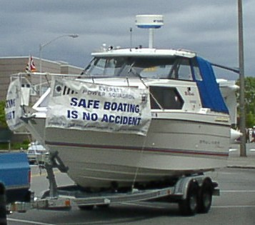
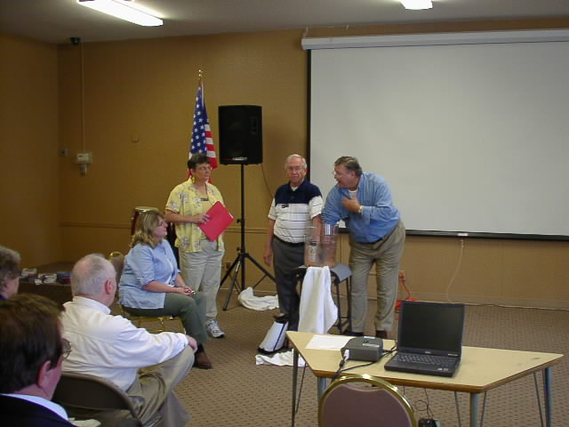


The Mission Triangle
Civic Service
Introduction
Learning Lamp
>>
Notes:
One of the biggest Civic Services we perform is to teach the Boating Course.
Another is giving Vessel Safety checks.
Notice how both of these civic services also relate to the educational side of the triangle
When we do these things in teams, we also relate to the 3rd side of the triangle - - fraternal boating club. It is way more fun when we work with a squadron buddy or team

Slide 14
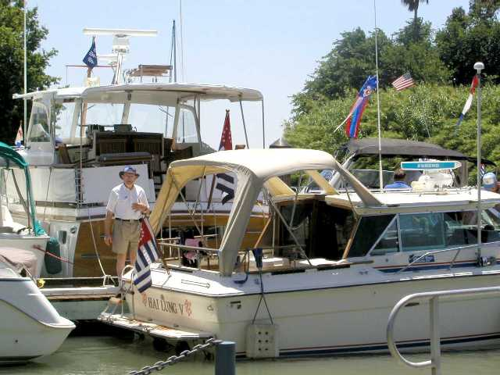
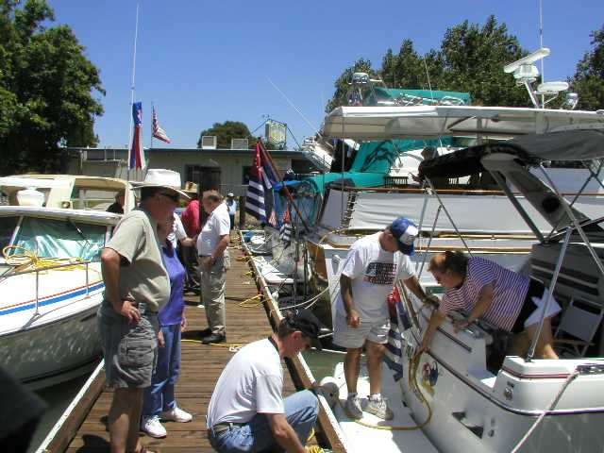


The Mission Triangle Fraternal Boating Club
Introduction
A District 25 Cruise & Rendezvous
>>
Notes:
(Slide animated – automatic)
Of course some of the ‘fraternal’ is un-related to duties – some is just plain FUN
11.5 mins

Slide 15
Membership Is a Privilege
Introduction
Types of Membership & Requirements
Active
  Willing and able to contribute time, energy & skills to USPS
  Accepted by Squadron ExCom
  All applicable entrance fees & dues paid
  Granted voting rights - If at least 18 years of age
Sea Scout/Apprentice (Age 12 – 24)
Honorary – good for one year, ExCom bestowed
Corporate – limited, approved by BOD only
>>
Notes:
Membership is a privilege – we are a private organization
We have several different ‘Types ‘of Membership
Active Member
Willing and able to contribute, accepted, and dues paid
~ Takes courses ~ Attends meetings ~ Holds office, elected or appointed
~ Earns merit marks
Authorized to vote
~ Active members less than voting age may not hold an elected position
Apprentice / Sea Scout – for the younger set
Extends from age 12 to 24 (end of the dues year of 23rd birthday)
~ Takes courses ~ Attends meetings ~ cannot vote ~ cannot hold office, elective or appointed.
~ Can serve on committees - where they learn the ropes. This is where all members should learn the ropes – on the committees
Honorary – for doing something noteworthy
Corporate very limited – National BOD approved – no participation rights at local level

Slide 16
Categories - Service & Dues
Introduction
Service Categories
Senior Member – earned 5 merit marks
Life Member – earned 25 merit marks
GB Member Emeritus – earned 50 merit marks
Dues Categories
25-Year Member – member for 25 years
Sustaining Member – paid a lump sum equal to 20 times the then-current national dues
>>
Notes:
There are various other terms describing members within the Types.
These deal with Service and Dues categories
Senior, Life and GB Emeritus all relate to # of MMs earned.
25 Year & Sustaining relate to # of years member has paid dues.
14.5 mins

Slide 17
Membership’s Many Benefits
Introduction
Intangible benefits: (the most important?)
  Knowledge & skills of seamanship, piloting & navigation,
  Life-long friendships,
  Self esteem,
  Developing individual potential
  …On and …On
>>
Notes:
Membership carries many benefits. Some consider the intangibles to be the most important
The knowledge gained - - - A sense of confidence, self-worth,
having added value, having given back - - -

Slide 18
Membership’s Many Benefits
Introduction
Tangible benefits:
  On-the-water activities,
  Leadership opportunities & experience,
  Honing your management skill set,
  Discounts,
  ………..this list is really long
>>
Notes:
Tangible benefits are also to be had
On the water training and activities
Leadership roles to fill -- skills to practice
Management experience to gain using that skill set,
For those of you who have gotten a promotion & raise from your employer, having honed your skills in USPS - you know what I’m talking about. AND
the Member Benefits Committee has been very busy - - -

Slide 19
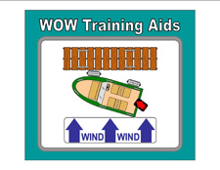











Some Tangible Benefits
Introduction
These & more on USPS website
>>
Notes:
Many Tangible benefits are listed on the USPS website:
Here are just a few.
Go to Member Benefits page – on USPS website
17 mins

Slide 20
The Officers
Introduction
National, district and squadron
Elected or appointed
Bridge (only 6)
  Commander (Cdr)
  Executive Officer (XO)
  Educational Officer (SEO)
  Administrative Officer (AO)
  Secretary (Secy)
  Treasurer (Treas)
*
*
*
*
*
The assistants are elected as well
Note
OM Chapter 14 has list of common USPS abbreviations
>>
Notes:
For some members, being tapped to serve as an Officer is a member benefit. Others prefer to work behind-the-scenes, as worker bees.
Some officers are elected by the members, while others are appointed by the ExCom, and still others by the Cdr.
The 6 Bridge Officers are elected. Notice the official abbreviation for each of these Officers (in parens) - Learn to recognize them as soon as you can
See OM – End of Chapter 14 for list of common USPS abbreviations. Please use these rather than making up your own.
The assistants to the bridge are also elected
Assistants to those positions are:
Educational
Administrative
Secretary
Treasurer

Slide 21
& Committees
Introduction
General, Standing & Departmental
Elected or appointed
Chairs & Assistant chairs
Committee Chairs are also officers
Some committees in Ed Dept are known as Local Boards
Rank is also an indicator of level at which the committee is serving:
  Squadron = Lt
  District = D/Lt
  National = R/C and Stf/C
>>
Notes:
We have 3 types of Committees (General, Standing, Departmental)
4 Committees are elected (The 3 Generals - Audit, Nominating & Rules & ExCom)
Others are appointed, (Budget & Finance, Membership, LBB, VSC, Roster, Supply)
Committees & LBs are headed by Chairs and Assistant chairs
The Chair of every committee & LB is an officer. Their rank indicating at which level they serve
Squadron - Lt
District - D/Lt
National - R/C and Stf/C
These are the very people who will submit your name for a paycheck when you work for the organization.
?? What is that paycheck called ?? (Merit Mark)
20 mins

Slide 22
Merit Marks
Introduction
For significant service related to achieving the USPS mission
Only 1 MM possible in any given year
Rewards of service are limitless, however, a MM is the only “paycheck” received
It’s vital to submit merit mark hours on a timely basis!
HANDOUT # 1 MM Criteria Guidelines
>>
Notes:
We earn a MM by putting our oar in the water and working to move the organization forward. Whenever we work on behalf of the organization, we hope to be recognized for the effort. If it’s deemed ‘significant’, we might earn a MM.
Only 1 is possible for the year
Same for new members and old, alike. Same for Potato peelers and Officers (sometimes the same person)
Each of us is responsible for submitting MM report for those who serve on our committee, or team, or project, or department It’s important - It’s our paycheck !
A Tip – write up who did what, at end of every event, project, so you don’t forget anyone. Turning in Quarterly reports will ease the pain of the MM Chairman at the end of the MM Year in November.
The C/C awards MMs, after reviewing the reports submitted by the squadron Cdr
?? So how much work is needed to earn a Merit Mark?? The Chiefs won’t say! (Minimum total 10-12-15-20 hrs on multiple events, days)
HANDOUT # 1 MM Criteria are Guidelines - created some years ago by the Area Monitors, who review the MM submissions before they go to the Chief.
While they don’t cover every situation, they do offer some great tips to help ensure your recommendations ‘pass muster’, so to speak.
This in addition to the tips in Chapter 16 of the OM

Slide 23
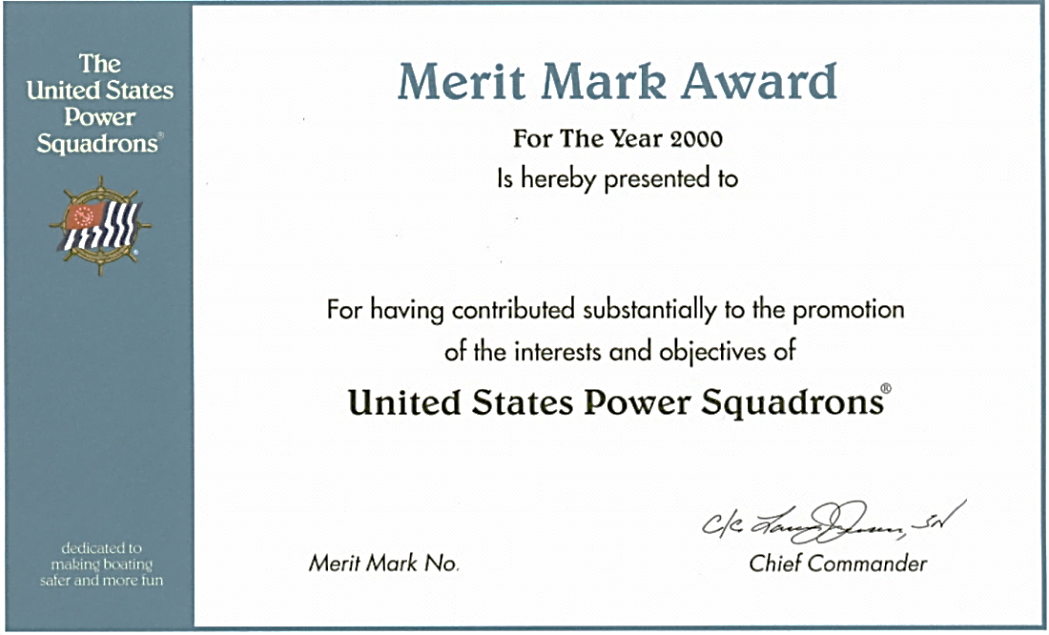



Merit Marks
Introduction
Senior Member 5 merit marks
?_________________?
Life Member 25 merit marks
?_________________?
>>
Notes:
When we earn a Merit Mark, we are sent a Certificate, nowadays by email. For those with uniforms, a single gold bar can be added to our uniform, although most apply the gold bars in multiples of 5. (Uniform company sells them that way.)
?? How many MMs to earn Senior member status? 5
?? How many MMs to earn Life member status? 25
When I joined back in 1983, my mentor explained MM to me. He said, “It’s no big deal to earn one, that’s expected – we are a volunteer organization. Not earning one is the big deal. The Cdr publishes a list of all who earned one, in the newsletter and I expect your name on that MM earned list, every year!!”

Slide 24

Recap – USPS Mission
Introduction
Self Education
?_________________________?
What are the 3 sides of the Mission triangle?
Civic Service
?_________________________?
Fraternal Boating Club
?_________________________?
>>
Notes:
?? What are the 3 sides of the Mission Triangle ??
( Self Education)
( Civic Service)
(Fraternal Boating club)
?? Which side is the most important ?? (3 equal sides)
26 mins

Slide 25

United States Power Squadrons The Organization
Organization
>>
Notes:
Let’s dive into how USPS is organized

Slide 26
Organizationally
USPS Has 3 Levels
Organization
Active Members may serve as elected or appointed officers, at all three levels of the USPS organization, simultaneously:
  Squadron
  District
  National
>>
Notes:
Of the 3 levels, Squadron is where it’s at. They are the local engines that drive USPS forward. They are the local ambassadors, that grow USPS. Every member serving district or national is a local squadron member– first. Many hold positions at the various levels simultaneously. BTW – You need not be an officer to serve simultaneously.
The District level serves to guide, advise, assist squadrons & be a communication conduit to and from other levels & among the squadrons within.
The National level is where it all started, where the continuity is spelled out, where the mission and vision are defined, where the courses are developed and published, and where we approve and adopt that which unites the squadrons while allowing for their individuality.
Squadrons are fiercely independent, carving out their niche in their local communities, while relying on the other levels to supply them with tools to be successful. (Course & Program materials, database for member records, national website, SailAngle, etc. etc.)
28 mins

Slide 27
Officers Reviewing the Ranks
Organization
Squadron District National
Commander Cdr D/C C/C
Department Lt/C D/Lt/C V/C
Assistant 1st/Lt D/1st/Lt R/C
Chairman Lt D/Lt R/C
Asst Chairman ----- ------- Stf/C
Except for P/C/C
Using highest active rank is always correct
HANDOUT # 2 Reviewing the Ranks
>>
Notes:
To a new member this might seem a bit like alphabet soup. Rank is used to identify what position an officer actively holds, and it goes before their name. In other words, Rank indicates position held this year.
At any level of USPS, -- the highest current (active) rank is always correct. This applies to all but P/C/Cs. (As the saying goes – “Once a Chief, always a Chief”)
Keep in mind, except for P/C/C, past ranks have no standing in the hierarchy of ranks.
Having said that, due deference is of course, given to those who have served in the past, and the appropriate past rank may be used when member holds no officer’s position.
OM – Chap 13 Uniforms & Insignia has a full list of Past ranks recognized.
In a nutshell – Lt/C and higher can achieve Past rank, when the required # of years of service is met. (Lt/C = 3, Cdr = 1).
So – your Rank deals with what are you doing in the here and now, and Past rank is about your history, and indicates you are not an officer.
HANDOUT # 2 Reviewing the Ranks - On top is a duplicate of this slide – bottom of page is the hierarchy of ranks
Notice – Squadron Cdrs (#6) outranks D/Lt/C (#9).
Being Squadron Cdr makes you one of the Top Dogs
35 mins
Note to instructor - In 2010, the OM was updated in an attempt to clarify one of the paragraphs dealing with rank. A typo was made (the word ‘’chief’ was left out), and confusion has reigned. In 2015, the typo was corrected and the OM now again matches USPS policy relative to past ranks.
As does this OT in 3 material.

Slide 28
Ruling Body
Squadron Membership
Organization
Squadron
Members Responsibilities
We the members:
Decide the dues & fees to be assessed on ourselves
Adopt rules & bylaws to govern ourselves
Adopt budget & charge officers to live within
Elect our officers & some committees
Most work is done through committees: elected and appointed
>>
Notes:
As members, we have some responsibilities – it does not all fall on those Officers with ranks,.
We decide the dues and fees we will pay
We adopt and amend the rules and bylaws
We adopt the budget within which our squadron is to operate
We elect our leaders, officers and some committees
Most of the actual work accomplished – is done by the committees.
The Executive Committee (ExCom) is to whom we have delegated the day-to-day operation of the squadron
Let’s look at the Squadron structure.

Slide 29
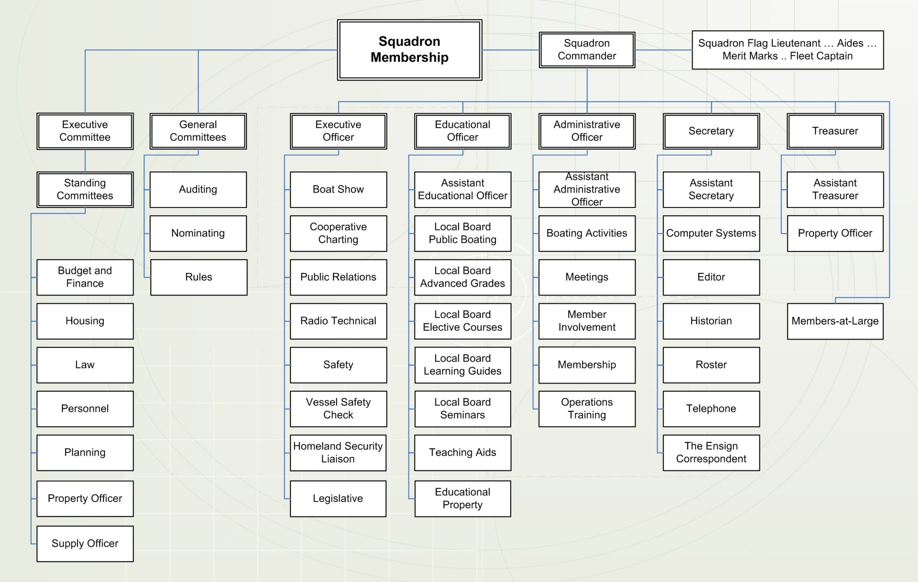

(Typical)
Squadron Organization
Organization
Squadron
District Executive Officer
Past
Commander
HANDOUT # 3 Squadron Chart
>>
Notes:
Here - from the OM – we see a typical squadron chart
The Members are the Ruling body and they elect 4 Committees:
The 3 General Committees -- which are :
– Auditing, Nominating, Rules
The Executive Committee – to take care of day to day business
These 4 committees report to the Membership (3 Generals & ExCom)
ExCom is comprised of Cdr,
5 Department Heads,
members at large (defined in your squadron bylaws),
P/C
?? How many members at large do you have ? 3 is minimum.
?? Any squadron have more than 22 ?
Standing Committees report to the ExCom
Departmental Committees report to the various department heads.
Department heads report to the Cdr, who reports directly to the Membership.
Cdr also reports functionally, to the District Executive Officer
Command runs thru the Exec Dept. Cdr reports to DXO, and D/C reports to NXO
HANDOUT # 3 Typical Squadron Chart
For you detail & accuracy fans – the Learning Guides committee is not a Local Board, however Seminars Committee has now been designated as a Local Board (per USPS bylaws – see 7.11.6) – more about this later.

Slide 30

Executive Committee Elected by Membership
Organization
Squadron
Policy – Management – Finances
ExCom
  Process applications for membership,
  Approves budget to be submitted to membership for adoption
  Approves Educational schedule - times & places for courses, seminars, programs on advice of SEO
>>
Notes:
Elected by the membership - The Executive Committee has charge of the policy, management and finances of the squadron, between meetings of the membership.
It processes new member applications and approves the budget which will ultimately be submitted to the membership for adoption or revision.
It also approves the Educational Schedule of times and places, submitted by SEO. This schedule also needs to include a yearly Boating Course, which is required by USPS bylaws. It is the Squadron which is held accountable for offering the Boating Course every year.

Slide 31

Executive Committee Reports to Membership
Organization
Squadron
ExCom
Designates depositories for squadron funds
  on advice of Treasurer
  Makes appointments to Standing Committees
    advises Cdr on other appointments
Hears reports of Committees
Enforces the authority given it by the bylaws
Institutes disciplinary proceedings
>>
Notes:
Also, --- The Treasurer submits a report to ExCom relative to where to ‘stash the cash’, and ExCom has final approval over where that is to be.
‘ExCom’ as it is called, also makes appointments to Standing Committees, and advises the Cdr on other appointments.
An ExCom meeting is often where the Committee Chairs report what they are doing & planning. If you want to know what is going on in the squadron, these are the meetings to attend.
In some squadrons, the meetings are referred to as ‘Bridge Meetings’, however they are in fact to be full ExCom meetings (‘Board Meetings’ if incorporated), with not only the associated bridge officers, but also the members at large , and (bylaw optionally) the most recent P/C. This body (ExCom) has the authority to conduct squadron business. Remember - As a group, the 6 member ‘Bridge’ has no such authority.
Meetings of the ExCom are where the lively discussions are heard, plans are made and ironed out. Where new ideas are brought up, past experiences are tapped into, and where unresolved issues are dealt with and resolved.
These are working meetings and all members are welcome to attend, listen, learn. Only actual elected members of ExCom can vote, but others are often granted privilege of floor, at these meetings.
45 mins

Slide 32
Only 4 Actions - HAVE to Do
Extracted from 2012 quote from then C/C John Alter, SN
HANDOUT # 3a 4 Required Actions
>>
Notes:
Earlier I mentioned there were 4 required squadron actions.
This grid was created from a report offered by then C/C John Alter, SN back in 2012
(Read verbatim)
He said, "I often hear Squadron Commanders complain they can't keep up with all the administrative chores expected of them and items beings promoted in the Monthly Blasts and other sources - the never ending 'to do' list. Remember, there are only four things you HAVE to do; everything else is optional based on your member's interests and desires.“
(Review GRID ) -- HANDOUT #3a OT Required Squadron Actions
Please keep these in mind, as you review the various Committees and officer duties. Squadrons range greatly in size and while we each should do all we can, as our members interests dictate, we need to prioritize & focus on what our members can do - well. In other words - Allow your members to succeed
Sometimes we get so caught up in trying to do it all -- we forget this.
What we need to do is -- prioritize. Focus on what has to be done, adding in what we can do WELL -- and do that!.
48.5 mins

Slide 33

General Committees Report to Membership
Organization
Squadron
General committees - Elected
  Auditing
  Nominating
  Rules
Find these committees in Model bylaws, OM, Job Descriptions
Find Nominating Committee Seminar on LDCom website
>>
Notes:
Moving on to other committees
We the members vote these folks into office, and they report directly to the membership.
Remember - the Cdr is not a member of the General Committees – a Separation of Power concept.
Auditing – if you’re an accountant and numbers person, being on this committee may be nirvana for you. Reviews the Treasurer’s records, makes recommendations for any needed follow up.
Nominating – if you are a people person, adept at building successful teams, this may be the spot for you. Past Cdrs are often tapped to serve here, due to their knowledge of who has successfully done what in past, or shown leadership potential. A year-round job, members of NomCom should attend every meeting, observing and evaluating potential nominees.
Rules – if you are a detail person, gifted with a great memory, this committee might benefit. They are the guardians of adherence to the bylaws (USPS, District & Squadron), and USPS policies. They keep squadron bylaws current and consistent with the Model, and ensure ExCom & Officers are not inadvertently outside the bylaws.
Each squadron has their own bylaws, and a fair degree of individuality is afforded, as long as they are not in conflict with district & USPS bylaws.
Descriptions for these 3 committees are in Model Bylaws, OM & JDs.
You can also find a terrific seminar on the HOW-TOs of working on the Nominating Committee – LDCom webpage
51.5 mins

Slide 34
Standing Committees Report to ExCom
Organization
Squadron
Standing committees - Appointed
  Budget & Finance
  Housing
  Law officer
  Planning
  Personnel
  Property
  Supply officer
In some Squadrons these 2 committees are departmental within the Treasurer’s Department
Find in Bylaws, OM, Job Descriptions
>>
Notes:
As we go through the next several slides dealing with Committees, look for a way to bring your talents and skills to the table. What interests you.
Find more information – when you read all about them, in your reading assignments (includes your sqd bylaws – Sqd Chapter OM – Job descriptions)
* Budget & Finance –prepares the annual budget for adoption by the Membership – Treasurer often on this committee
Housing –finds rooms and facilities for meetings and classes and activities
Law – licensed attorney concerned with any legal matters of squadron
* Planning – With an eye toward the horizon, helps bring ideas into reality.
Personnel – maintains an inventory of member skills, for use by the Cdr and Nominating when filling positions or populating projects
Property – creates/maintains an inventory list of squadron equipment, where its stored, and who has physical possession of it at any given time
Supply Officer / Ships’ Store– buys and sells USPS paraphernalia (burgees, ensigns, officer and educational insignia, squadron shirts, etc.)
These 2 committees often defined as departmental in Treas. Dept.

Slide 35


Bridge Officers
Organization
Squadron
The Commander (Cdr):
Ranking officer of squadron
Responsible for its growth & vitality
A voting member of all committees
  except Auditing, Nominating & Rules
Appoints chairs to appointive committees
Submits Merit Mark recommendations
  1 of the 4 required ‘HAVE to do’ actions
Top Dog
>>
Notes:
Cdr is top ranking Officer
The growth & vitality of the squadron is his/her responsibility – (Top Dog).
As such – Cdr is a voting member of all committees (except Audit, Nominating & Rules).
A smart & savvy Cdr will enlist Department Heads in the process of making appointments to departmental committees, working with them to develop their skills in making appointment. More about that later.
Some Commanders delegate the decision to the Depart head, and simply approve their choice, thereby continuing to own the accountability.
Remember the 4 actions required – 1 of them is to submit Merit Mark recommendations.

Slide 36
Bridge Officers
Organization
Squadron
The Commander (Cdr):
Delegates tasks & authorities as appropriate
  Trains / develops future officers
Presides at all squadron meetings
  General membership & ExCom
Voting Member:
  National meetings (GB & AM) &
  District meetings (Council & Conference)
Appoints voting delegates to Conferences & GBs
>>
Notes:
Training future officers is part of the job of every officer, from committee chair and up! Being willing and able to delegate authority is essential for any Cdr. Running a successful squadron takes a team effort. Cdr cannot do it alone. If you don’t know how to delegate – learn! For some, giving up control can be very difficult – Do it anyway!
Cdr presides (that is Chairs) at all meetings of the full membership & ExCom meetings.
Cdr is also a voting member of the District Council, Conference, District Executive Dept and the National Annual meeting and GB meeting. As such, the Cdr is expected to attend these meetings, if at all possible.
Some squadrons, if flush with cash, have a line item in the budget to help fund trips to National Meetings by the Cdr and offset some of the expense
Cdr also appoints voting delegates - prior to Conferences and GB meetings who will represent the Squadron. This is an opportunity to encourage a willing member to attend & participate, and is often a point for discussion amongst the ExCom members.
60 mins

Slide 37

Let’s take a Stretch Break
Please be seated when you hear the bell
END OF BREAK
>>
Notes:
(60 minutes gone.)
Time for a very short break.
Everybody stand up & Stretch.
Introduce yourself to those around you. Fore & Aft -- Port & Starboard
1 hr 5 min

Slide 38

Executive Department
Organization
Squadron
Headed by - Executive Officer (XO)
Committees
  Boat shows
  Cooperative Charting
  Legislative
  Liaison
  Public Relations
  Radio-Technical
  Safety
  Vessel Safety Check
These committees described in OM & Job Descriptions
>>
Notes:
Remember - Keep an eye out for a committee in which you might lend a hand.
Could it be on one of the Executive Departmental Committees ?
Boat Shows – Do you like taking to people? Workers often get in free when ‘working-the-booth’, telling the public all about USPS & what we have to offer.
CoOp Charting – Go out on boat, locate needed chart corrections, use electronics to report same via software tool. Many a skipper finds this to be a ‘fun’ activity, especially in a group. Speaking of fun – Bench Mark recovery is back! A Land based activity. Searching for Geodetic markers is sort of like going on a ‘scavenger hunt’. Can be done individually; great fun as a group activity.
Public Relations - Use communications to manage public perception of your squadron. The new ‘Branding Standards Manual’ can be found on USPS PR/Com webpage
These committees are all described in your homework reading assignment. SO - - We will not take the time to describe all of them here.
BTW - The chairs of these sqd committees are members of the district committee of the same name, AND as you see -- they are all about that which is external to the squadron

Slide 39
Executive Department
Organization
Squadron
Executive Officer (XO)
External functions of the squadron
Member of all committees in XO dept.
If Cdr absent, perform Cdr duties & functions
Delegate tasks & authorities to train & develop future officers
>>
Notes:
The head of each of the departments is a member of all committees within, described in OM as ex officio member.
Ex officio simply means – by virtue of position.
If the Cdr is absent, the XO temporarily steps in.
XO’s attendance at District Conference is expected and encouraged at Council. XO is the Cdr in training.
Training future officers is part of the job of every officer! Knowledgeable committee chairs makes XO job as head of department – way easier
1 hr 8 mins

Slide 40
Educational Department
Organization
Squadron
Headed by - Educational Officer (SEO)
Local Boards
  Boating (LBB)
  Advanced Grades (LBAG)
  Elective Courses (LBEC)
  Seminars (LBS)
Class Chairs
  Instructors & Proctors
Committees
Teaching Aids
Property & Supplies
These committees described in OM -- some in USPS bylaws
>>
Notes:
The Squadron Educational Dept. is led by the SEO & Local Boards. The entire department is all about education, and making it available to members and the public, alike.
In larger squadrons, the 4 Local Boards, are populated by chairs, instructors, proctors and a host of others. Smaller squadrons do well to have an SEO and 4 LB Chairs.
In a recent change, LB for Seminars was added and all 4 LBs are now described as optional (This was a USPS bylaw change Section 7.11)
We should all be somewhat acquainted with a goodly portion of USPS bylaws Article 7 – Squadron Organization. Local squadron bylaws augment, but often do not repeat that which is contained in USPS bylaws. Check both
Chapter 6 of the Operations Manual will give you an appreciation of the rigors involved to maintain the integrity of the courses and the associated grades.

Slide 41
Educational Department
Organization
Squadron
Educational Officer (SEO)
Manages the Educational Department,
  Schedules courses, seminars
  Trains & certifies instructors
  Offer Boating Course on behalf of Squadron - Report via HQ800
    1 of the 4 required ‘HAVE to do’ actions
Delegates tasks & authorities, to train & develop future officers
>>
Notes:
It has often been said, the SEO’s job is second only to that of Squadron Cdr, relative to size & complexity.
In smaller squadrons, instructors are often in short supply. Some doing double duty in other jobs, making scheduling a challenge.
Remember - the HQ800 report is 1 of the 4 Required squadron actions to record when & where your Boating Course is been offered.
Training future officers is part of the job of every officer! Knowledgeable LB & committee chairs make SEO job as head of department – way easier
This applies to you instructors as well. Are you in the process of training your replacement when you move on or retire?
1 hr 11 mins

Slide 42
Administrative Department
Organization
Squadron
Headed by - Administrative Officer (AO)
Committees
  Boating Activities (Cruise & Rendezvous)
  Meetings & Programs
  Membership
  Membership Involvement
  Operations Training (Leadership Development)
These committees described in OM & Job Descriptions
>>
Notes:
Here are several more committees for you to consider joining.
Boating Activities – aka ‘Cruise & Rendezvous’ . Consider being an OIC for a single cruise. Publicity thru district channels can bring members from other squadrons.
Meetings & Programs– Consider taking charge of a single meeting OR a single task for every meetings.
Membership – every squadron member should consider themselves a member of this committee
Operations Training – Become a Trainer. Help members increase their understanding of the USPS organization, to hone their management & leadership skills, to keep up-to-date with the ever changing USPS organization.
All of these squadron committee Chairs are members of corresponding District Committees, except Meetings.

Slide 43
Administrative Department
Organization
Squadron
Administrative Officer (AO)
Internal functions of squadron
Member of all committees in AO dept.
If Cdr & XO absent, AO performs Cdr duties & functions
Delegates tasks & authorities to train & develop future officers
>>
Notes:
The AO, and the entire Administrative Department, including all its committees, is concerned with that which is ‘internal’ to the squadron.
If the Cdr & XO are absent, the AO temporarily steps in.
BTW - Command positions are: Cdr, XO, AO. Staff positions are: SEO, Secy, Treas
Training future officers is part of the job of every officer! A knowledgeable assistant & committee chairs make AO job as head of department – way easier
If you have strong committees within, it is easier to fill the AO position. People are more willing when they know they have strong support.
1 hr 14.5 mins

Slide 44
Secretary’s Department
Organization
Squadron
Headed by - Secretary (Secy)
Committees
  Computer Systems
  Editor (Newsletter)
  Historian
  Roster
  Telephone (Calling)
  The ENSIGN correspondent
These committees described in OM & Job Descriptions
>>
Notes:
Still looking for a place to apply your skills & talents? These Committees are also ‘internal’ to the squadron.
Computer Systems – Are you a PowerPoint wiz OR Website wiz? For websites, there are new requirements for Websites dealing with the new Branding Standards. (Find requirements on USPS website – Communications Committee page in Secretary Dept.)
Editor (newsletter) - Are you a reporter at heart? OR a shutterbug.
ENSIGN correspondent – Are you a writer who wants to be published or a reporter who wants a national byline? This could be the spot for you.

Slide 45
Secretary’s Department
Organization
Squadron
Secretary (Secy)
Responsible for all the non-financial records
Minutes, meeting notices, correspondence
Official squadron member data (DB2000)
Complete OD-2 (Officer Directory report)
  1 of the 4 required ‘HAVE to do’ actions
Delegate tasks & authorities, to train & develop future officers
Want to know more? Attend the new Secretary’s Seminar
>>
Notes:
The Secretary’s Department is a record-keeping department, responsible for the non-financial records of the squadron.
Keeping minutes, sending meetings notices, maintaining member data (DB2000), submitting the OD-2 report --- 1 of the 4 required actions
Training future officers is part of the job of every officer! A knowledgeable assistant & committee chairs make Secretary job as head of department – way easier
To learn more on this, be sure to attend the new Secretary’s Seminar --- being rolled out later in 2016. Stay tuned to USPS Monthly News Blasts (or visit LDCom webpages).
?? Show of hands -- How many of you receive the monthly News Blast??
To receive the Monthly Broadcast – go to Members Home page, then Resources on task bar, then Monthly Broadcasts on drop-down menu, fill in your contact info.
1 hr 17 mins

Slide 46
Treasurer’s Department
Organization
Squadron
Headed by - Treasurer (Treas)
Committees
  Property Officer
  Ship’s Store / Supply Officer
These committees described in OM & Job Descriptions
See OM Appendix H – for list of How-to-Manuals - many committees - all 5 departments
>>
Notes:
Committees:
We talked about these 2 committees earlier when we were looking at the Standing Committees.
In some squadrons, they report to the Treasurer.
Both Treas & Secy have How-to Manuals, as Chapters in the OM.
Many of the departmental Committees also have How-to Manuals. All available for download, for various locations on the USPS website. A list of many of them is in the OM (Appendix H)

Slide 47
Treasurer’s Department
Organization
Squadron
Treasurer (Treas)
Collect & disburse squadron funds
Keep financial records
Properly account for squadron funds & keep in proper depositories
Work closely with Budget & Finance, and Auditing Committees
File tax forms & returns - IRS 990, TR-1
  1 of the 4 required ‘HAVE to do’ actions
Delegate tasks & authorities, to train & develop future officers
>>
Notes:
The Treasurer’s Department is another record-keeping department, but this department responsible for keeping the financial records, including the budget once adopted by the membership.
Files the IRS 990 form and reports it on TR-1 - 1 of the 4 required actions
Training future officers is part of the job of every officer! A knowledgeable assistant & committee chairs make Treasurer job as head of department – way easier
1 hr 19.5 mins

Slide 48
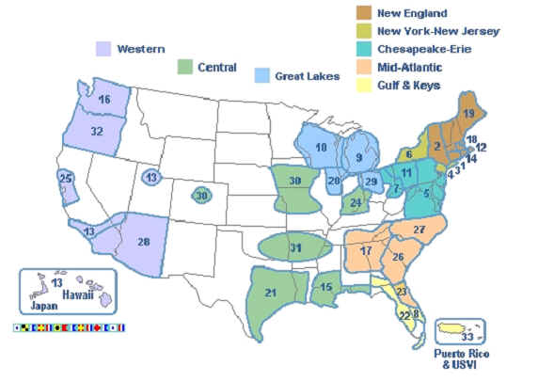
USPS Districts
Organization
District
>>
Notes:
Let’s turn our attention now, to the district organization.
USPS currently has 31 districts spread over a considerable area. (D18 & D31 recently dissolved)
Notice D13 - centered in Southern California, with squadrons in Hawaii and Japan. Off the east coast, we have D33 – made up of squadrons in Puerto Rico and the U.S. Virgin Islands.

Slide 49
USPS Districts
Organization
District
Organized geographically
Purpose
  Inform & assist squadrons in area
  Communications link among squadrons & with Governing Board
Each district has its own bylaws
Members are the squadrons within their geography
>>
Notes:
Districts were & are created by National to geographically associate squadrons in that area or region.
Their purpose – to inform and assist the local squadrons in the area, to stay abreast of new policies, using new technologies & tools. To facilitate the sharing of knowledge/experience among district’s squadrons
In the past, geographical proximity was more critical than it is in today’s world of electronic tools. However it still impacts travel distances for meetings, events, activities, and the face time needed to conduct some essential business.
1 hr 20.5 mins

Slide 50
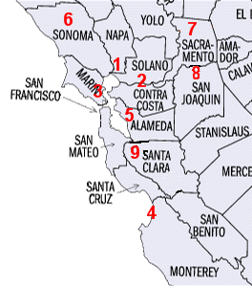







District 25
Organization
District
5
6
Carquinez
Diablo
Monterey Bay
Peralta
Redwood
Sacramento
San Joaquin Delta
Santa Clara
7
4
8
3
Create a HANDOUT of squadrons in your district
>>
Notes:
And here are the squadrons in D25!
(Note to instructor – this slide is a place holder – please change it to fit your district. Consider creating a list of squadron burgees in your district., and the year each squadron was founded.
Squadrons as a rule do not actively recruit in areas outside their geography, but we have no problem accepting applications from outside our geography, if the person can meet the membership requirements.
The point is - It is way more convenient for members to gather, for meetings and classes, when they are in geographic proximity.
We are still just scratching the surface with ‘distance learning’ tools - Webinar, Go-to-meetings, U-Tube, Skype
The better we get using those tools, the better we can serve members far removed from where our squadrons are centered.
HANDOUT # 4 YOUR District Squadrons - shows all the Squadron Burgees, so when you are out on the water – and see one - you’ll know to which squadron the skipper belongs
1 hr 23 mins

Slide 51
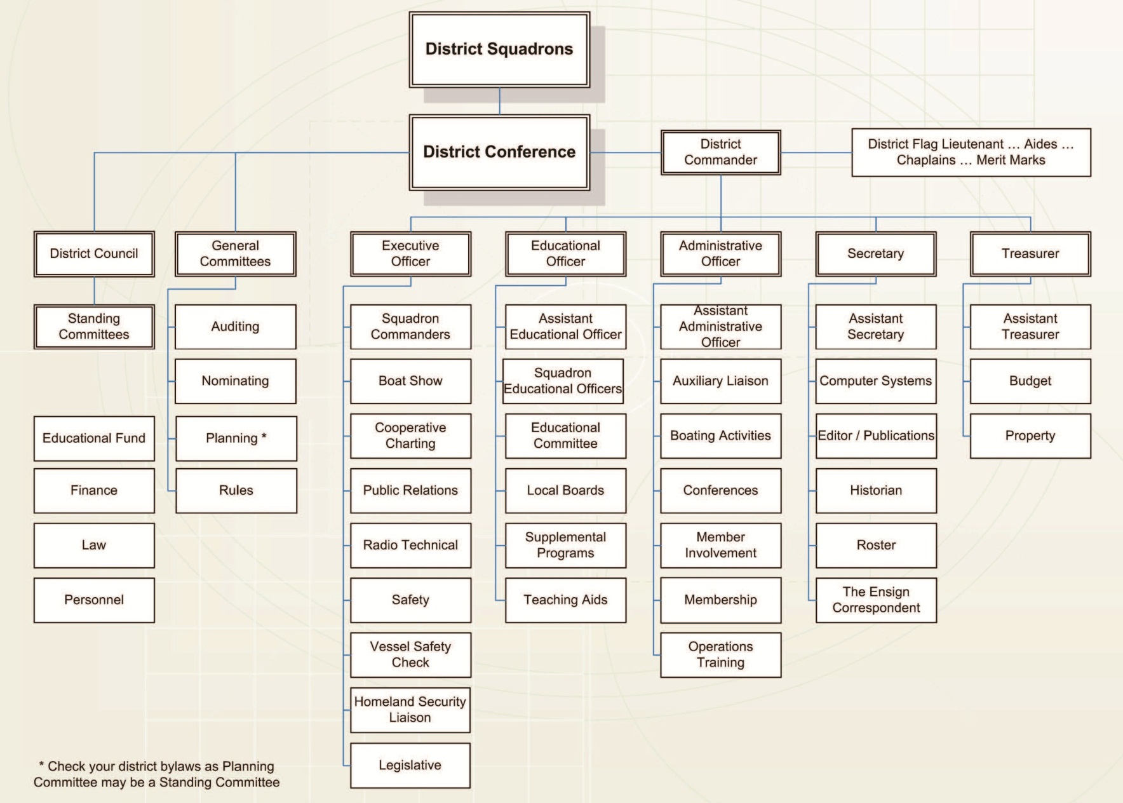
District Chart
Organization
District
District Chart very similar to Squadron Chart
Planning
Supply
Budget & Finance
Past District
Commander
Squadron
Commanders
See page 1-3-2 of OTP Manual for District organization chart
>>
Notes:
District is organized much the same as squadrons. Learn the structure of one, you’ll know both
The Conference is a group representing the membership at district and is therefore the ruling body.
General Committees are the same 3 as in the squadron
(Auditing, Nominating, Rules).
Planning moved from a General Committee to
a Standing Committee to match the Squadron. (District Model bylaws)
The Council relates to the squadron ExCom – the body responsible for the Policy, Management & Finances. At district, the council members are the 6 bridge officers
(D/C and
5 dept heads),
the Past D/C, and
the squadron Cdrs
There is a difference between the squadron ExCom and District Council. At district, the 3 chairs of the General Committees, are also voting members of the council.
The district Conference voting members are these same Council members, plus all the past D/Cs, and all the delegates from all the squadrons.

Slide 52
District Officers & Committees
Organization
District
Bridge Officers
  Commander (D/C)
  Executive (DXO)
  Educational (DEO)
  Administrative (DAO)
  Secretary (DSecy)
  Treasurer (DTreas)
Standing Committees
  Budget & Finance
  Planning
  Educational Fund
  Law
  Personnel
General Committees
  Auditing
  Nominating
  Rules
District committees described in OM & Job Descriptions
>>
Notes:
Take note of the job title abbreviations – a D is added to squadron abbreviations when referring to district bridge officers
If we were to look at the abbreviations for the national job titles, we would see an N swapped in where the D is.
So – leading N = national bridge officer
Leading D= district bridge officer
The committee tasks are similar to those for squadron committees.
All are described in detail in the District Job Descriptions
1 hr 27.5 mins

Slide 53
2 Types of District Meetings
Organization
District
1
Council Meetings
  Board of directors
    relates to Squadron ExCom
  Conducts business between Conferences
>>
Notes:
There are 2 types of District Meetings.
Remember - A Council meeting at district relates to a ExCom meeting at squadron. Due to geography and distances to travel, some districts hold only 2 per year. In D25 we hold a minimum of 4. (Note to instructor – Check your district bylaws)
These are working business meetings– with a wide range of viewpoints. Some discussions are very interesting, as those in attendance are exposed to different ways of seeing things – by people from other squadrons.
As in -- Why didn’t we think of that?

Slide 54
2 Types of District Meetings
Organization
District
2
District Conference
  Membership meeting of the district
  Voting members
    Council members
    Squadron delegates
    all Past D/Cs
  Two per year
    Spring - elections & Change of Watch
    Fall - budget & educational
>>
Notes:
Conferences relate to full membership meetings
Delegates from each of the squadrons add to the number of voting members. Delegates are appointed by the squadron Cdrs , who submit their name to the District Secretary as an authorized voting delegate.
(Note to instructor - - check your district bylaws for the rate/number of delegates from the squadrons in your district)
For District 25:
?? At the rate of 1 per every 25 active squadron members, how many delegates should your squadron have at every Conference?? (each squadron gets minimum of 2)
The Spring Conference is when D25 holds elections and conduct the COW. (Note to instructor - Check bylaws - some districts do this at Fall Conference)
Fall Conference is when D25 adopts the budget (Note to instructor - Check bylaws - some districts do this at Spring Conference)
Due to the heavy emphasis on educational matters and seminars, it is often called the “educational conference”.
1 hr 30 mins

Slide 55

District Meetings
Organization
District
Building Bridges
Sharing ideas
Attending Seminars
>>
Notes:
And speaking of District Meetings, here’s a personal opinion, shared by thousands of others.
District conferences can be a happening place to be.
The social events give us a chance to meet & greet members of other squadrons who may have a different (better?) approach.
The Training seminars are great for Bridge members & Committee Chairs, and often the officer reports are informative .
Attention – all you squadron bridge officers, including all 5 department Heads, and committee chairs -- you should participate as much as possible. Meet & greet members from other squadrons – share your good ideas – learn theirs.
Maybe they have a better approach, maybe you have. The more we stand together – the stronger we are.

Slide 56

Our District Flag
Organization
District
Designed by D/Lt E J Dysart, JN
With input from district council
>>
Notes:
Here’s the District flag for D25
(note to instructor – you’ll want to swap this out for a picture of your district flag & tell your members about its design / heraldry)
For D25 Flag: The arc over the 25 represents all but the most southern points of a compass circle and is formed from Cardinal & inter-Cardinal points of a compass, to indicate D25’s northern California geography. The Golden Gate Bridge is iconic for the area.
Now on to our National Organization - - - Who are those people??
1 hr 32.5 mins

Slide 57
Who’s on the Governing Board?
Organization
National
Squadron members one and all !!
Chief Commander, Vice Commanders, Rear Commanders, members of national general committees (C/C V/C R/C)
District Commanders, District Educational Officers
Squadron Commanders (D/C DEO Cdr)
Past Chief Commanders, Past Vice Commanders, Governing Board Members Emeritus (P/C/C P/V/C)
Elected General Members (1 for each 600 members)
Squadron delegates (1 for each 100 members)
>>
Notes:
Who’s on it ? Squadron members one and all !!
The National Bridge members and all the members of the 2 Generals
District Commanders & DEOs & Squadron Cdrs (so your District & Squadron is represented)
P/C/C & P/V/C and also any member who has earned 50 merit marks
And finally, there are the elected General members (1 for each 600 members of USPS) and the Squadron delegates (1 per each of that squadrons 100 members) -- -- ?? Do you know who the General Member(s) for your district geography is/are?? Often listed in District roster
If any of your squadron members attend the GB meetings and are not voting members already, they should apply to be appointed as a delegate. The Cdr can certify that person as a voting delegate. If the Cdr cannot attend, an alternate can also be designated, and that too, needs a signed authorization form from the Cdr.

Slide 58
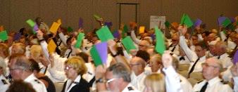
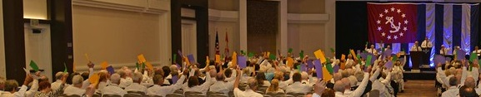
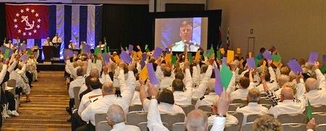
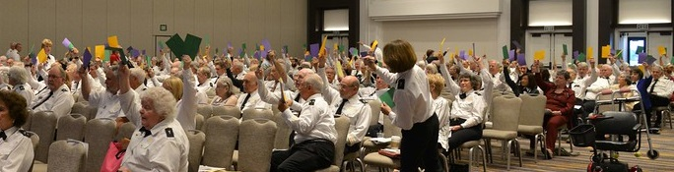
Voting at National Meeting photos taken by National photographer Steve D. Erickson, JN
>>
Notes:
These photos are from 2015 GB in San Diego. All of these folks are squadron members, many not only attending the meeting, but serving at the national level as well.
The different colored voting cards represent the various voting groups. For example, here the purple cards were for squadron Cdrs or their alternate. Squadron delegates got a different color, District Cdrs yet another.
It’s important that your squadron get full voice at these meetings, and the National Secretary made a request at this very meeting. “Cdrs – please appoint delegates and report their name (s) to N/Secy, so we can give them voting cards.” He said, “The # of delegates is a factor in determining a quorum.”
(If you are curious – quorum calculation is spelled out in USPS Bylaws.)
Remember - N/Secy supplies a form to every Cdr – fill it out send it back. Form is not only for an alternate for yourself, if you are unable to attend, but also for your squadron delegates. Forms are also in the Cdr’s KITS – find on LDCom website
(photos taken by National photographer Steve D. Erickson, JN )
1 hr 36 mins

Slide 59
Review
Opportunities for Participation
>>
Notes:
As we have seen so far - - there are many different opportunities - - -

Slide 60
Committee Review
Review
Educational Department has organizational units. Committees & ? _ _ _ _ _ _ _ _ _ ?
What officer rank are committee chairs & local board chairs ? _ _ _ _ _ _ _ _ ?
Who appoints them ? _ _ _ _ _ _ _ _ ?
In the future, will your squadron - - - -
  a. Fill all committees?
  b. Fill those needed?
Local Boards
Lieutenant
Commander
X
>>
Notes:
Let’s see who has been paying attention
ED Dept has organizational units. Committees & _________?
(Local Boards)
What rank are Committee & local board Chairs ___________?
(Lieutenant)
Who appoints them ________________?
(Commander)
Hopefully in concert with SEO recommendations AND
NomCom input
What about this – does your squadron try to fill all committees?
Consider this – going forward
( fill those your squadron needs- - X )
Allow your members to succeed

Slide 61
Lending a Hand
Review
Did you find any activities that interest you or in which you could use your knowledge and skills to lend a hand?
>>
Notes:
What are you interests? See anything that suits your talents and skills?
Where will you lend a hand?

Slide 62
Review
Develop your plan
Plan should include a schedule for taking the advanced grades & electives courses
Which seminars will you take?
Interested in Boat Operator Certification?
HANDOUT # 5 ED Courses, Seminars & Guides .
>>
Notes:
Part of what this Training is about, is getting you started on, or back on, a path - - to take advantage of all the educational opportunities.
Draw up a list of the courses and seminars you want to take or teach.
Then - - List some of the skills you could bring to the table OR
the ones you want to learn.
For you new members, we will try not to ask you to do any heavy lifting for a while, but we would like to help you find a little something to do - to give you a sense of purpose - of being a part of the squadron effort.
Jumping into the educational or training classes is BTW - - a really great start.
This HANDOUT #5 is a List of Educational Courses & Seminars, available -- as of Dec 2015. Use it to draw up your Plan.
(BTW - Most current list can be downloaded from Ed Dept webpages at anytime)
1 hr mins

Slide 63

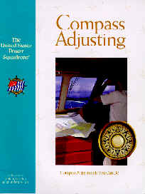


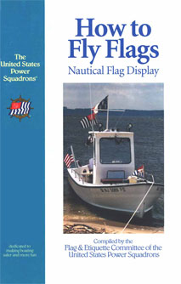



Educational Opportunities
Education
The Boating Course (ABC3)
Advanced Grade Courses
Elective Courses
Guides
Seminars
Boat Operator Certification
On-the-water Training
Learning Lamp
& Webinars
>>
Notes:
By definition our educational courses are that which are completed by passing an exam. You can complete a Course without attending instructor led classes, if you can pass the exam. Having said that, for some , the classroom setting is often, a more beneficial environment for learning, having both an instructor and fellow students, to enhance the learning dynamic. In USPS we have it all.
Boating - is our most basic Course. It lays down a foundation on which other courses can build.
Advanced Grades are awarded in sequence, each building on knowledge gained in the prior. There are 5 AG Courses. The Courses can be taken out of sequence, but Grade will not be awarded until all the requisite courses are passed. More about this later.
Elective Courses focus on a specific general topic, and can be taken in any order. Currently there are 8 ECs
Guides are self study booklets (name shortened from ‘Learning guides’). As of Dec 2015, there were 14 – they are listed on your handout- Here are some of them.
Seminars, are completed by attendance & participation. Most can be completed in 2 hrs, although there are a couple that run longer. In the past few years, there has been an explosion of topics, As of Dec 2015, there are 24 seminars available
These in addition to the BOC Seminars & OTW Trainings
& we now have Webinars. Distance learning, on-line courses, Webinars, U-Tube videos, etc. are all avenues of educational opportunities, in addition to classroom settings, self study Guides & OTW.
( Note to instructor --- Online Course – Cruising and Cruise Planning consists of 3 online seminars and an online exam. First 2 seminars ‘Weather for Boaters’ and ‘Planning Your Cruise’ are the 1st 2 seminars - now available via BoatUS as of Dec 2015. )

Slide 64
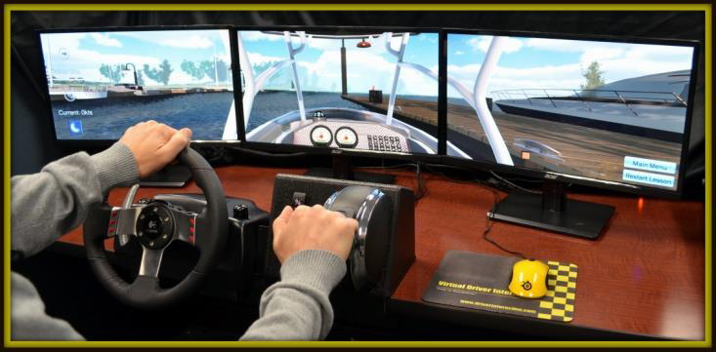
Educational Opportunities
Education
We even have: Virtual Trainers for learning boating skills
At trade shows, boat shows, AND classrooms
In USPS, we have it all!
>>
Notes:
Add to that - We now have 18 Virtual Trainer units, for use in the classrooms as well as at trade shows and boat shows. (as of end of 2015 year – equipped with Drunk Goggles )
In USPS , we have it all!
1 hr 43.5 mins

Slide 65




Advanced Grades
Education
Seamanship (S)
Piloting (P)
Advanced Piloting (AP)
Junior Navigation (JN)
Navigation (N)
Senior Navigator (SN) All AGs & 6 ECs
>>
Notes:
This is the logical progression in which to take these 5 Advanced Grade Courses. They were designed with this sequence in mind.
Take either S or P to start the progression.
To be awarded the grade of AP, you must have completed not only the AP Course but the courses listed above it . This applies to the grades of JN and N as well.
The SN (Senior Navigator) grade applies to a person having taken all Advanced Grades and any 6 of the 8 Elective Courses.
These are the only 6 Grades approved by the GB, to be used after a member’s name.
Let’s look at the ECs - - - -

Slide 66
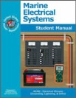
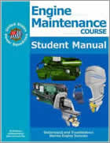


Electives
Education
Cruise Planning (CP)
Engine Maintenance (EM)
Instructor Development (ID)
Marine Electrical Systems (MES)
Marine Communications Systems (MCS)
Marine Navigation Systems (MNS)
Sail (SA)
Weather (WX)
>>
Notes:
Elective Course classes are offered on a rotating basis, depending upon student interest and instructor availability.
In squadrons with hundreds of students, many try to offer all of them within a single years’ time. Smaller squadrons, offer Courses on demand.
There is no prescribed sequence to these Electives – take them as your interests dictate. Completion of any 3 Electives, along with the first 3 AG (S, P, AP) will gain you the Educational Proficiency Award. As a minimum, the recommendation is to take EM, MES, & W.
The abbreviations for ECs (CP, EM for example) are not added after a member’s name, nor are any of the BOC completions added (IN, CN, ACN for example)
Only Advanced Grades are to be added, after a member’s name.
The correct format for both written and spoken is: RANK – NAME – GRADE
To clarify - USPS website shows BOC completions after official AG, but that is for IT folks convenience only – They are not GB approved GRADE designations, any more than EC completions are.

Slide 67





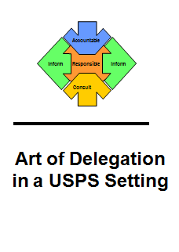
Additional Training
Training
Operations Training (OTP)
Leadership Development (LDP)
Leadership Training Trilogy
  LD101 – LD102 – LD103
Many self-education publications
  Squadron/district job descriptions
  Parliamentary procedures
  Parliamentary Skit
  Presenter’s guides
See OM Appendix H – list of How-to-Manuals
>>
Notes:
Additional Training Programs & Seminars - brought to you by other Departments & Committees. For example:
As its name implies, this is a training seminar – it is part of the series offered by the LDCom in the ADMIN Dept. It deals with squadron management issues, --- whereas, - -
The Leadership Development Program (LDP) deals with Leadership. It also takes about 3 hours, and is the next in sequence to Operations Training. Want to know more about delegating in a volunteer organization? LDP offers some guidelines to help you learn how.
The 3 Trainings in the Trilogy are offered at national meetings, and there is a select group of instructors who travel to various areas across the country and present the Trilogy classes to the local folk in those regions.
Most District Conferences offer some kind of training seminar, and there are many publications and manuals available on the USPS website,. These shown here all brought to you by the LDCom
For a list of available Manuals, Publications and How-to Guides check out the OM – Appendix H.
The OM - part of your Homework Reading Assignment - is a wealth of information. When in doubt – look in the OM. Many years ago, a Past Chief Commander (Pou Bailey) lamented that the OM was the “little read book” - Not talking color !
Next up – some management issues
1 hr 50 mins

Slide 68
Membership Participation
Staffing
Educational Activities - Internal & external
External Activities - Involves working with agencies outside USPS - some relate to civic services
Internal Activities - Directly benefit members of USPS
SEO
XO
AO, Secy, Treas
Not everyone says yes
>>
Notes:
We want our members to participate in as many activities as they can, and have interest.
Educational External Internal
Spearheaded by the SEO, XO and the AO / Secy / Treas
For a bridge officer, one of the most important issues is to have their departmental committees - populated by willing and interested members.
As many of us have learned - – not everyone will say yes.
Let’s look at why that might be the case.

Slide 69


Why Members Decline Committee Positions
Staffing
Lack of knowledge
Lack of time
Individual’s feeling of inadequacy
Monetary reasons
>>
Notes:
Some members question whether they have the experience or knowledge to take on a Committee position. The good news is – there is no need to be an Einstein !
Some question whether they can make a contribution – citing a lack of time and how busy they are. (work – family)
We know everyone can contribute – it may be simply a matter of degree OR perhaps the need for a bit of training/learning.
In USPS we learn & do, then turn and offer a hand to those who follow. Just as those who came before us turned to offer a hand to us. That’s how USPS works!
If you don’t have a Money Tree in your Squadron, you need to be mindful of that. To do some jobs, requires some travel and expense, outside the comfort level of some members.
With a bit of imagination – work-a-rounds can often be found.
And we should always remember that it’s okay to say NO!
Let’s look at why they say YES.
1 hr 53 mins

Slide 70
Why Members Volunteer
Staffing
Interesting work
Self Fulfillment: authority (power, influence, control), personal growth (knowledge, skills, attitude)
Commitment: to USPS mission
Loyalty: to friends and/or organization (‘peer pressure’ to be involved)
Recognition: gaining attention, acceptance
Part of organization
Part of organization
Being useful / valued
>>
Notes:
What drives us is often dependent on the generation from which we come.
‘Self Fulfillment’ to one generation is called ‘Interesting Work’ by another.
Loyalty and Commitment come from feeling a ‘Part of the Organization’.
‘Recognition’ for one generation is called ‘being valued’ by another
The 3 top motivators - keep coming up, in study after study. decade after decade.
Recognition
Money
Feeling a part of the organization

Slide 71







Why Members Volunteer
Staffing
3 Fundamentals of Motivation
Recognition
Money
Feeling a part of organization
>>
Notes:
Let me say that again !!
Recognition
Money
Feeling a part of the organization
Since we don’t pay our members, recognition and feeling a part of the organization are key for us
Merit Marks are part of recognition - - but they are not the whole of it. Don’t wait for the end of the year – verbalize ‘attaboys’ and ‘attagirls’ on the spot.
Catch them doing something right – and tell them about it. Let them know how much you value their contribution – immediately!
Job descriptions can help our members through their decision process. What do they want to volunteer to do. The squadron & district job descriptions are part of your Homework Reading Assignment. . . (published in Sept 2009)
1 hr 55 mins

Slide 72
Staffing
Staffing
Staffing is a key responsibility - - - shared by all officers (Cdr + Lt/C + Lt)
  Nominating Committee - critical to ensuring nomination of qualified ‘Bridge’
  No activity should be undertaken without a solid understanding of position
>>
Notes:
There are 6 people in this boat – doing a variety of jobs – working differently to get to the same place – together. They all understand their job and its importance to the team effort.
When the Nominating Committee does not fully describe what is involved in different squadron jobs, the result often spells trouble for the squadron.
When you staff your committee – Keep this in mind
(point to last bullet on slide)
There is an excellent NomCom Seminar now available for download from USPS website - LDCom webpages. Highly recommended, not only for your NomCom members, but for anyone looking to add staff.
1 hr 56 mins

Slide 73
Staffing 101
Staffing
Integrity
Dependable
Conduct
Work habits
Accustomed to hard work
Follow through on tasks
Exhibit the desire for personal growth
Adaptability
Works well with others
Tolerant of opinions of others
Invent & reinvent
Gracefully accept constructive criticism
Enthusiasm
Positive attitude toward the procedures and policies of USPS
Toward committee mission and goals
>>
Notes:
This list is Staffing 101
When looking for members to work in our committees - -
We look for members who are Dependable. members who are Adaptable and Work well with others - - Who will invent and then re-invent in order to progress & stay current
Giving criticism is part of the job. It should be constructive and polite. It’s hard to give and often difficult to receive. Check out the expanded sandwich technique discussed in the Instructor Recertification Seminar - - for some great guidelines.
We also look for members whose Work Habits & preferences match the job requirements.
For example, I’m not good with cameras, so my being Squadron photographer - NOT a good idea! That said, I do know my way around a computer, so I am often tapped to use those skills.
Remember the motivators -- recognition and feeling a part of the process
Are they Enthusiastic about their role ?
Their participation should be positive and fun. Having a bunch of Grumpy characters around is not fun for anyone.
1 hr 58 mins

Slide 74

Job Descriptions
Staffing
Know & Understand
A publication of the USPS Leadership Development Committee
Staffing begins with accepting a job description Parties involved need agreement
Officers should be able to outline the ‘Job’ their committee members take
>>
Notes:
?? How many of you have a copy of yours ?
?? Do you have a copy of all of them, so you can see where your job fits into the bigger picture, and how what you do and don’t do impacts other members trying to do their jobs?
The sins of omission are often greater than the sins of commission.
Staffing begins with accepting a job description
Make sure you know what you are asking your team members to do.
Squadron members, working at the national level, created one for every squadron/district job they could think of.
This does not mean every squadron needs to fill all these jobs. Fill the ones you need
The bylaws specify the tasks & responsibilities of some jobs. Check there 1st.
The people who created these job descriptions worked to make them generic enough so as not to get in the way of the individual squadrons, each being fiercely independent.
The trick was - - to make them specific enough to give the squadron member a clue as to what the job actually entailed.
Read the description, then update it to fit your squadron’s needs for the job. In some cases, this will be as you learn them. A bit of On-the-Job training is not unheard of.
If you are in the lead position, give your team members a complete copy.
By the way - -Every member of the Nominating Committee should have a complete copy, and they should make sure every nominee has a full set.
2 hrs 2 mins

Slide 75
How Many is Enough?
Staffing
How large of a committee is needed to get job done?
How would you know - what can you do?
Discuss with departmental bridge officer
Interview potential committee members
  inactive members & especially your friends
>>
Notes:
How big of a committee is needed - - How would you know?
Department Head might be able to add some insight.
Often the size of the committee is directly related to the size of the squadron. The more members a squadron has the greater the pool to draw from to share the work.
A committee of 1 is almost always not enough. Remember – this is supposed to be fun – take a buddy with you when you join a committee..

Slide 76
Appointments
Staffing
Appointing people to the “Right Job” Not always an easy task
Requires knowledge of their interests & skills
Find a job that fits the member
Your job is way easier if you’ve appointed well
>>
Notes:
Appointments often require careful thought – Not easy.
With a bit of effort, and genuine interest odds improve. It’s possible to get so wrapped up in filling a job slot, the time is not taken to discover the member’s interests & talents.
The focus needs to be reversed.
Rather than finding a member to fill a job - - - find a job that fits the member.
Fill a position only when there is someone with requisite interests & skills. Remember – you don’t have to fill them all

Slide 77

Officers Develop
Future Officers
Staffing
Get to know & listen to members
  Learn common values
  Their reasons for joining USPS
  Their expectations
  Level of satisfaction
Results-oriented planning is key
>>
Notes:
Each squadron officer, bridge officer & committee chair alike, should attempt to meet all new members
Each new member should attempt to meet as many officers as well - - this is a 2-way street.
Officers should be actively matching a new member’s interests to an appropriate position or task.
This should be the same for all members – new and not new.
Start with a vision of the desired result. Everything done from that point on, should be with the intent of getting you closer to the desired result. If it doesn’t – it has no place in your plan.

Slide 78
Management vs Leadership
What’s the Difference?
Staffing
From leader skill set – set the goals
Manager skill set – achieve the goals
Manage Things -- Lead People
>>
Notes:
We often hear these terms used as if they are interchangeable. They are not.
What’s the difference - Management deals with achieving goals.
Leadership deals with setting goals.
We use our Leadership skills to define the goals (the desired result)
We use our Management skill set to then achieve those defined goals (that result).
Remember -- Manage things – Lead People. People can tell when someone is ‘managing them’ They don’t like it any more than you do.
2 hrs 5 mins

Slide 79
Let’s take a 10 min Break
Please return when you hear the bell
END OF BREAK
>>
Notes:
(125 mins or 2 hrs 5 mins in total minutes gone)
Time for a break
Synchronize your watch – Please be back in your seat in 10 mins
2 hrs 15 mins
45 mins to finish

Slide 80
Two Concepts of USPS Policy
Goals
Participative Decision Making
  Developing leaders by sharing decision-making process
Accountability for Achieving Goals
  Shared responsibility for decision-making leads to better goal achievement
Bridge officers are expected to learn duties & responsibilities of district & national officers
>>
Notes:
There are 2 fundamental concepts of USPS policy
participative decision making and
accountability for developing & achieving goals.
While it is true – as Leaders we are responsible for developing and achieving goals,
we also know, we can develop more realistic goals, if we share this thought process with our team members. This is also one of the ways we develop future officers
Many a good idea has come from a single squadron, who has taken it up the line, until the whole of USPS is on board.
Knowing who is who - - and who does what in District and National organizations very useful in this regard.
Let’s turn our attention to Goal-Setting - - - Setting a goal is the 1st step to achieving it

Slide 81
USPS Interactive Process for Creating Committee Goals
Goals
USPS
DISTRICT
SQUADRON
COMMITTEES
INDIVIDUAL COMMITTEE MEMBERS
>>
Notes:
How this process is supposed to work:
When the National Annual meeting is completed and members return home, they bring with them the news about the Organizational goals for the year.
At each level then, goals are set to do what they can toward meeting the USPS goal.
Sometimes the D/C sets an additional goal for the district which may or may not be complimentary (meaning it lends itself to accomplishing the USPS goal). Sometimes the D/C’s goal is unrelated.
Sometimes the Squadron Commander sets an additional goal for the squadron, which may or may not be related to either the USPS or District goal.
Sometimes an additional goal is set by the Committee
Notice – the arrows point in both directions.
Goal setting originates at all levels, and when achievement is successful, it’s shared up and down the line.
2 hrs 17.5 mins

Slide 82
Planning for Goal Achievement
Goals
Planning begins by finding answer to 3 questions, for each of the specific tasks
Result you want to achieve? (what outcome, action, actors)
How will you gauge success of your efforts? (criteria, measurement)
When will result be realized? (time, date)
HANDOUT # 7 What’s the Plan
>>
Notes:
When we set about to achieve our Goals, we need to answer 3 questions for each of the specific tasks required.
This applies to existing Job description tasks as well as any new tasks necessitated by any additional goals.
What results are we expecting, and by whom ?
What will be the yardstick to measure the degree of success ?
When will it be done ?
HANDOUT # 7 What’s the Plan
2 hrs 19 mins

Slide 83
5 Prelim Steps
Goals
5 Preliminary Steps to reach Goal
1
2
3
4
5
Analyze
Present
Situation
Determine
Obstacles
List
Essential
Inputs
Utilize
Available
Information
Build a
Support
Team
>>
Notes:
AND there are some. preliminary steps to take which are also listed on the handout. Here’s a framework for what that might look like.
Don’t get lost in the semantics used here – different words and phrases have been used to describe these steps over the years, but the actual steps remain pretty much the same.
Don’t forget, you don’t have to learn every lesson the ‘hard way.’ It’s good to be able to learn from others OR get a refresher of something you already know

Slide 84
Build a Support Team
Goals
Whose support you will seek in achieving goal ?
  Identify people, in & out of squadron
List what assistance you will seek & for which task
The RACI chart in your OT manual is a great tool
Find it on LDCom webpages
>>
Notes:
Now this is Teamwork! These 2 puppies definitely have a common Goal, and are using each of their particular strengths to good end.
When you build your support team -- Identify the WHO. Determine the WHAT.
List the tasks and assign a person to take care of each.
These are the people to whom you will delegate authority to actually do the work. For however skillful you are, you cannot do it all, nor should you even try. Share the workload, lest you burn yourself out. Remember – only 4 required actions.
In the Operations Training manual, there is an example of a grid used to match people to tasks, called the RACI tool. Very useful for keeping track of all the tasks and people assigned to do them.
Find it in Module II – Chapter 3 - under the heading “A Helpful Planning Tool”

Slide 85

Goal Reality
Goals
Establish goals in participatory plan
Do a reality check with team
Set a range of outcomes for routine tasks
Think in terms of results desired
If you can’t measure it, you can’t manage it.
>>
Notes:
Remember:
Get your team involved in the goal setting process &
Keep it real.
Set a range of outcomes, to measure degree of success &
Think in terms of the desired results.
You need a way to check your progress - how far have you come, how close to your goal.
You can’t manage it , if you can’t measure it.

Slide 86
Drafting Personal Goals
Goals
What do YOU want to accomplish?
Any hurdles to overcome?
Need a refresher or more knowledge/skill?
Which of your goals can be met by doing committee work?
Which by learning from other members?
Which by study?
Personal goals - - - Administrative, Community Service or Education based. What are YOUR goals?
>>
Notes:
Drafting your own personal goals is as important as any of the others.
Apply the same set of 3 questions and 5 preliminary planning steps as you work to achieve your personal goals, as well.
?? What results do you want to achieve ?
?? How will you measure it ?
?? When will it be done ?
Asking yourself -- What do you want to do ?
2 hrs 23 mins

Slide 87
Planning
Planning
‘If you don’t know where you’re going; any road will get you there’
‘I came to a fork in the road and took it’
Financial Plan
>>
Notes:
Quotes from Lewis Carroll and Yogi Berra! Two great minds, both talking about roads to travel
Planning & Program Evaluation are 2 points on the same road.
The budget is the expression of the squadron plan in financial terms. Comparing ’budgeted’ to ‘actual’ is part of the program evaluation process.
The Budget/Finance Committee reports to the ExCom for a reason. The product produced (the budget) should be a reflection of the ExCom’s plan for the coming year.
Back In 2011, the squadron model bylaws reflected this change in appointing authority - - (ExCom now appoints members to Budget/Finance, rather than being appointed by Cdr)

Slide 88

Planning A Critical Skill
Planning
Plans can be very broad
  Building bridges
  Cruises offered during the year
  5 yr Course Calendar
Plans can be very specific
  Seamanship lesson plans
  Boating Course faculty
  Designing a meetings flyer
>>
Notes:
People expect those in the lead positions to do the planning. They want to know ‘Where are you taking me?’
Plans can be very broad in scope and complexities OR
Very specific – like a single lesson plan OR
The design for a flyer - - An effective flyer takes some careful thought & planning.
2 hrs 25 mins

Slide 89

Planning
Innovation
Do you have an idea for doing something new & different to achieve a goal or task?
Can you make it work within the limits of presently available resources, including members willing to work on your idea.
>>
Notes:
Let’s talk “Innovation Planning”
The simplest form of innovation deals with achieving an existing goal, by doing something new & different. Perhaps with a better result.
The challenge is to find a way to bring the new idea into play, while limiting disruptions to others. They are volunteers like you. Can your idea be implemented without adverse effect? Will they buy in?

Slide 90
Planning
Innovative Planning
Produce change in the way things are done Something New
Planning Worksheet
Innovative Concept – Not the goal, but new idea for achieving a goal
Results Desired – Goal to be achieved
Procedure Steps
Cost in Resources
>>
Notes:
Just so we are clear - -
Innovation planning is not about a new goal. This type of planning deals with achieving an existing goal in NEW way. Is there a better way?
Could be a big idea, that might be adopted nation-wide, or something tailored for just your squadron.
In any case, don’t overlook Step 4.

Slide 91
Cost-Benefit Analysis
Planning
Whenever innovative plan is under consideration, a COST-BENEFIT analysis is in order.
For every step in planning procedure, cost of planned event is assigned
Every cost in squadron resources is considered—people, time, facilities, money
Does the squadron have the resources?
>>
Notes:
Will you need a Cost –Benefit Analysis? Probably. When Squadron resources will be used, it’s not a bad idea.
This doesn’t always have to be a complicated process – if in doubt- take it up the ladder – to your Committee chair or Department Head (if you are the chair).
Remember to include the people power needed. Often overlooked. Don’t forget yourself !
Got the resources OR will you need more ?
2 hrs 27 mins

Slide 92
Scheduling the Work
Scheduling
The squadron calendar - a vital tool for organization & scheduling
For an entire ‘watch’ year
Published & available to all members
>>
Notes:
Another management skill is Scheduling -- done by use of the Squadron Calendar
A vital tool for scheduling
Often a collaborative effort of the Squadron leadership, pulled together at a meeting well before the start of the Watch year.
The Calendar of Events is then published by various mediums, to make it available to every member.
Not everything on schedule need be on Calendar of Events. Officer reminders, for example, are included on schedule, but need not be on your Events Calendar.
If the Cdr is savvy, the members will have been asked for their input prior to the creation process.

Slide 93

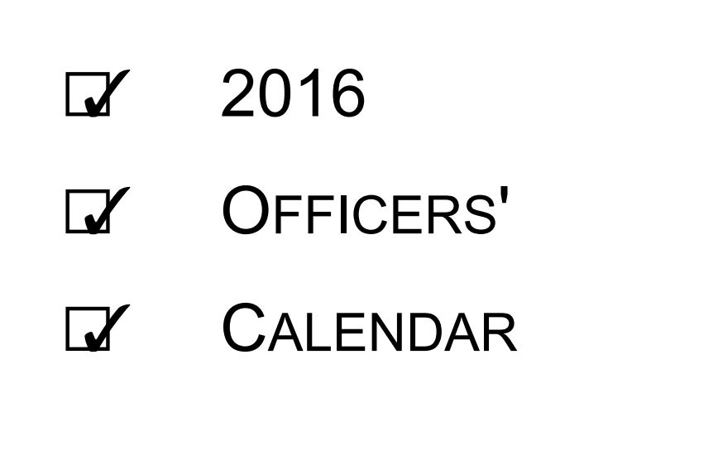
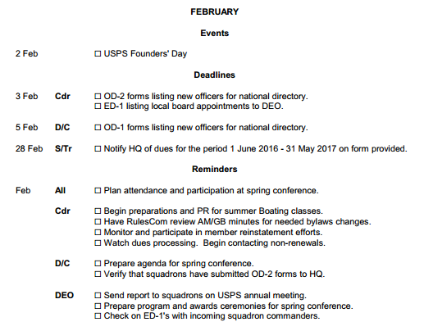
Building Squadron Annual Calendar
Scheduling
Refer to yearly Officer’s Calendar in Cdr’s Kit
Find in Cdr’s Kit on LDCom webpages
>>
Notes:
Many of the officer reminders are listed on the annual Officer’s Calendar included in the Cdr’s Kits each year .
find that on LDCom webpages - the when and by whom for many yearly tasks are included
Deadlines & Reminders are shown by month – the dates are shown and for whom they are intended.
Use this tool - when you build your squadron calendar, to help your officers remember

Slide 94


Building Squadron Annual Calendar
Scheduling
Meetings - required by bylaws: National, District, Squadron
Officer & Committee duties & tasks
Deadlines: Roster, Newsletter, Merit Marks, USPS Educational Fund, Chapman Award, etc.
All 4 of the Required ‘HAVE to do” actions
Courses, Seminars
Training Programs
Squadron Special Events (cruises parties, etc.)
District & National Special events (trainings)
>>
Notes:
There are as many ways to build the Squadron calendar, as there are squadron’s. Some tips:
Start with that which is spelled out in the bylaws – Meetings are always a good place to start.
Fill in National dates, then District dates. National meetings dates are known years ahead of time.
Officer duties & tasks – When committees are to do bylaw described tasks ( for example – the Audit, NomCom, the Budget, etc. )
Deadline dates should include when inputs/data/articles are due, as well as when they are to be published.
For Merit Marks - Milestone dates at a minimum of once a quarter should be included.
The prep work needed for submitting a Chapman Award Candidate takes some time
Pick a Squadron date well in advance of the District deadline, to complete the process on time.
Add All 4 Required Squadron Actions – the ‘HAVE to do’ items – when and by whom
Courses – Seminars
Training Programs
Special Events
2 hrs 32.5 mins

Slide 95

Awareness of Change
Finding Solutions
The struggle to identify & adapt to change is on-going
Squadrons not immune from penalties for ignoring signs
When something no longer works - - - -
It’s time to identify what has changed & adapt
>>
Notes:
Dealing with Change and Problem Solving go hand-in-hand.
Change is inevitable. . . how we deal with it - is the critical issue
USPS is a mature organization (in 2014 we celebrated our 100th Anniversary). We can’t ignore that the majority of our members are ‘mature’ as well.
We need to keep looking forward & moving forward while honoring the traditions of the past
While we profit and learn from the ‘tribal knowledge’ of our more ‘mature’ members, we must keep adapting to the times & needs of the younger generations & the new technologies.

Slide 96
Adapting to Change
Finding Solutions
MURPHY’S LAW
“Whatever can go wrong will go wrong; at worst possible time”
Problem solving skills are required to meet goals in an ever changing world
>>
Notes:
In addition to adapting to the external changes outside our squadrons
Stuff happens - - - inside our squadrons
Officers deal with these issues – hopefully in a rational way
Three approaches – Rational, Emotional, Political – you may be familiar with the formula - 40/40/20. These 3 approaches all have their place.
Knowing the difference and when each is appropriate takes skill

Slide 97


Finding Solutions When Results are Below Accepted Norm
Finding Solutions
Identify the problem area
Determine unsatisfactory performance level
Define a reasonable, desired level
Isolate difference between current & desired
>>
Notes:
When results don’t match what you want/need - - - take corrective steps.
What follows is a straight-forward 9 step problem solving process, but a good model, none-the-less. Finding solutions doesn’t have to be complicated.
1-2) Start by identifying the real problem area – not always easy.
A key point - - separate symptoms from causes
(when we have the sniffles - is it allergies - a cold - a sad movie?)
3) What is acceptable – What is not - - - Is there an acceptable range?
4) What’s the difference between where you are and where you want to be?

Slide 98
Finding Solutions When Results are Below Accepted Norm
Finding Solutions
Brainstorm possible causes of problem
Decide which causes are most critical
Identify alternative solutions
Evaluate proposed solutions:
  Estimate contribution to goal achievement, cost & feasibility
Make commitment to a plan
HANDOUT # 9 Problem Solving – 9 Step Process
>>
Notes:
5-6) Brainstorm all the possible causes, then decide & focus on those that are the most critical.
7) Come up with possible solutions. Don’t judge them at this stage . Put everything out there for later evaluation. Encourage open minds – encourage innovation.
8) Then evaluate each relative to its problem solving value & cost, and do a reality check.
9) Finally- get a commitment to the plan from all parties.
Not all 9 steps are needed to solve every issue, some are small and quick to resolve. Use these 9 steps when you are looking to solve the larger gnarly variety
An important officer skill - Turning this 9 Step Process into an automatic reaction to problem solving
HANDOUT # 9 Problem Solving – 9 Step Process
2 hrs 36.5 mins

Slide 99
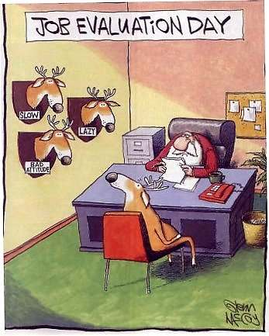
Team Performance Evaluation
Finding Solutions
Ask yourself
How well is my team performing?
Are we meeting the goals of plan?
If goals are not met, what problems need to be solved?
It’s like an audit
>>
Notes:
Once a plan is put into motion – we need to monitor the results and make adjustments as needed
Corrective measures need not necessarily be drastic (GRIN)
Be you a member of the team or the team leader – it’s an evaluation you conduct yourself. These are the questions you’ll want to ask yourself.
How well are we doing?
Are we progressing toward the goals according to plan?
If not – why not - what are the causes
We need to look at our action plan with as candid an eye as possible
What worked – What didn’t
Acknowledge both the Good news & areas with room for improvement

Slide 100
Finding Solutions
Evaluation Model
7. Audit
1. List Goals
7. Re-audit
6. Implement Action Plan
2. Examine Results
5. Develop Solutions
3. Evaluate Progress
c. Personnel failure?
4. Identify Weaknesses
b. Resources inadequate?
a. Are goals unrealistic?
>>
Notes:
Here’s a standard evaluation model – for monitoring progress/results. This is also sometimes used as a goal re-setting loop.
List the goal, do the work, evaluate progress made (with pre-set measurement criteria), to identify any problem areas or weaknesses.
You can’t fix it, if you don’t chart it.
You can’t manage it, if you can’t measure it.
working around the loop,
to develop solutions & an Action plan
then around again.
It’s a repeating process until the goals are realized.
2 hrs 40 mins

Slide 101

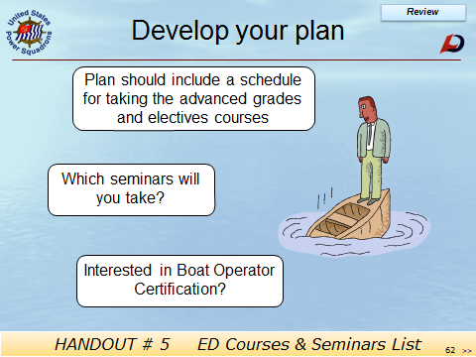

Finding Solutions
Self Performance Evaluation
Think about what you want to do
What you’ve done so far
What you need to do for personal growth
Add your answers to the plan you were asked to develop earlier
Whether you aim high and make it, or
settle for whatever comes your way
It’s up to you
>>
Notes:
We’ve talked about team performance evaluation – We also need to look at self-performance evaluation
Think about what you want to do with your life
What you’ve done so far to become the person you want to be
What you need to do to make progress in your personal growth
Click thru – let slide speak for itself

Slide 102



Communication
Communication
Next topic communication
Form & function
Body language
Class exercise
>>
Notes:
Another officer skill and our next topic -- Communications
We will look at some form & function as well as some of the mediums, Including - - - How we convey a great deal about our thoughts and attitudes through body language
Such as the thumbs up signal. Then a class exercise

Slide 103






Electronic Media Websites, SailAngle, E-mail & Social
Communication
Guidelines
Be explicit: state the matter clearly
Be tactful
Make criticism constructive, specific
Be pleasant
Use USPS customs for correspondence
Courtesy is always in order
Be prompt in answering communications
>>
Notes:
These guidelines have always applied to our written and oral communication, but it doesn’t hurt to remind folks to follow them when using the electronic mediums as well.
Try to remember to pause – breath – reread – before you send.
An acknowledgement – simple ‘got it, thanks’ is always in order. Be prompt in response.
Stuff happens “lost in cyber-space” is still an issue, although this happens way less now than in the early internet days.
You all know about NOT using all CAPS, bold or red - Right? – taken as shouting - Of course use them to emphasize a single word or phrase.

Slide 104

Organizational Decorum
Communication
“Prestige, honor and respect” - sound familiar?
I do solemnly pledge to:
Abide by the bylaws of the United States Power Squadrons
Promote high standards of navigation and seamanship
Maintain my boat and operate it legally
Render assistance whenever possible
Conduct myself in a manner that will add prestige, honor and respect to the United States Power Squadrons.
>>
Notes:
“Prestige, honor, and respect” – sound familiar?
It is part of the Pledge we, as members of the United States Power Squadrons make, when we or anyone else joins the organization. Let’s review that. (click thru bullets one by one – let them read)
It is imperative that we remember that USPS is comprised of men and women, young and old, encompassing many faiths and social disciplines. We must always remember to exercise care and appropriate decorum when presiding over or attending any organizational function. We must always reflect positively upon our organization and its members.
Our actions are also a form of communication, to everyone around us.
When we treat everyone with dignity and respect, we add prestige and honor to our whole organization. To do otherwise – does not.

Slide 105


Body Language
Communication
>>
Notes:
And speaking of our actions, we understand more body language than some of us think we do.
Be aware -- If your words don’t match what your body is saying – your listener will see/hear and believe your body language.
I’m rather fond of this fellow – this comes to mind regularly!
And we can only imagine what brought this on between these 2 disparate expressions. What we can see - these 2 are definitely not on same page!
2 hrs 43 mins

Slide 106
Class Exercise
Communication
Active Listening is a 2 Stage Process
Hearing
Understanding
Try paraphrasing
Do you mean. .?
Are you saying.. .?
>>
Notes:
Active Listening is hard work.
Hearing is just the first part. Understanding is often the hard part
EXERCISE – You’ll need a piece of paper for this - I’ll read something and then ask 6 questions. Number your paper 1-6. Please try to answer as many as you can – True or False.
A businessman had just turned off the lights in a store when another man appeared and demanded money. The owner opened the cash drawer. The contents of the cash drawer were scooped up, and the man sped away.
A man appeared after the owner had turned off the lights. ( Businessman turned off lights - maybe owner – maybe not )
The robber was a man. (Could it have been a woman? )
The man who open cash draw was owner. ( Was owner a man? )
The store owner scooped up the contents of the drawer and ran away. ( Don’t know who did scooping nor who sped away )
The robber demanded money of the owner. ( Was there a robbery? )
The man who appeared did not demand money. ( Yes he did. )
Let’s review the answers – questions by question
(Note to instructor – answers are in italics & parens after each question)
Research tell us, we tend to make assumptions and ‘fill-in-the-blanks’ for that which we don’t recall. One method to increase recall is to paraphrase what you think you heard.
2 hrs 48 mins

Slide 107
Alternate Approaches Learning & Recall
Communication
1
A
More than one way
2
Alternate routes to understanding
B
3
C
4
D
5
6
E
7
F
>>
Notes:
There are many ways to learn and recall.
Like an ARROW shot from a bow, some people can make the logical jump and go directly from point A to point F
Others may need to take it step by step A, B ,C, D, E then F.
Still others may require different route with more steps (1-7) to reach the same understanding.
And of course - like Billy in the Sunday comics, some take a more circuitous route
When you are showing someone how to do something, include alternate approaches for those individuals.

Slide 108
How we Remember
Communication
We remember approximately
20% of what we Hear
30% of what we See
50% of what we See & Hear
70% of what we Say (after learning)
90% of what we Say & Do
>>
Notes:
Here are some statistics on how we remember
To get the whole story, we need to add 2 new stats.
Saying what we’ve learned, improves retention to 70 % - another reason to paraphrase back your understanding.
90% can be achieved when we say it and do it.
OTW Training is effective for this reason. The Virtual Trainer is as well. Students get to apply what they’ve learned. They - - -
SAY & DO
If you want to retain the knowledge you’ve gained by talking a USPS course, seminar or training - - you can hit that 90% retention figure by teaching it to others.
That’s how USPS works. We learn from the guy ahead of us, then we turn and teach the guy behind us. Learn it and pass it on.
This applies to being a Officer as well - in management circles this is part of succession planning -- learn it and pass it on
2 hrs 51.5 mins

Slide 109
Communication – 4 stage process
Introduce, Present, Summarize, Verify
The Rule of 4
Communication
  Tell them what you are going to say,
  Say it,
  Tell them what you just said,
  Get them to tell you what they heard.
>>
Notes:
Some of you may have heard the following expression:
I know you THINK you understand,
what you THOUGHT I said,
But I’m not sure, what you HEARD,
Is what I MEANT !
Effective communication has 4 stages.
Every USPS course follows this simple “Rule of 4”, and that last stage “get them to tell you” is seen:
when the instructor asks the student a question in class,
when the students work the homework questions and
when the students take the EXAM.
It’s a very effective model, and easily applied when working with your team (Committee – Department)
When you do this 4th stage – you will in some cases be absolutely amazed – perhaps thinking to yourself – “How in heavens name did they get that, from what I just said?
Taking this last step is very important.

Slide 110


Homework
Develop your Personal Plan
Courses & seminars you want to take / teach
Skills you have to offer & want to learn
Actions needed / Self Performance Evaluation
Reading assignment
Materials on USPS website
‘OT in 3’ Handouts
Exploring assignment – all on the internet
USPS website
SailAngle
HANDOUT #10 Homework Assignments
>>
Notes:
And now for your Homework assignments – there are 3 parts
HANDOUT #10 – Homework Assignments
For your Planning Assignment - Start developing your personal plan. What do you want to learn – What do you want to teach
For your Reading Assignment – you will find everything on the USPS website. Refer to your handouts from this training
For your Exploring Assignment – get to know how to find things on the new USPS website, and learn to navigate the new SailAngle site and using its new features.
?? Any questions ??
2 hrs 55 mins

Slide 111
Evaluation
Your candid evaluation of this program is appreciated
Please complete the form provided and turn it in
>>
Notes:
I’ve enjoyed this class and hope you did, too
Please take a few minutes and fill out the evaluation form
Your opinion is greatly appreciated .
Be sure to fill in your NAME and CERTIFICATE # at bottom of form. I need it to update your database record and give you credit for attending today.
HANDOUT Evaluation FORM is last page in your packet.
When you are finished, turn in your form before you leave.
Thanks for participating and being so attentive!
And YES this seminar will be available for download on LDCom webpage.

