Slide 1

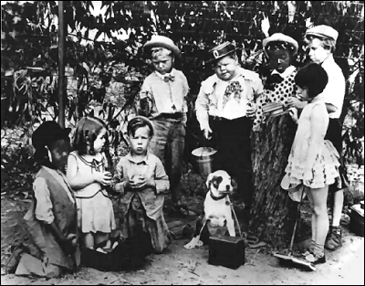
Clubhouse Rules or You Can’t Come Into My Clubhouse
9 April 2016
D/8 Spring Conference
Officer’s Meeting
Rear Commander Anita F. Walker, JN
Notes:
We’re going to spend a little time, together, before we leave for home. So I intend to keep this Leadership talk lighthearted. I hope we take away a few new thoughts that might be helpful after we return to our squadrons
So – instead of screen beans and the Seven Dwarfs, we’re going to look at some old photos and movie shots that focus on the clubhouse. We’re going to talk about how we lead and manage an organization. These photos are meant to be examples of some of the great things we do and some that we wish we hadn’t done. . . After all, if we don’t make mistakes, we can’t develop. . . So here we go
For those who like this program, it is posted on our website. . . It’s fully scripted so enjoy

Slide 2
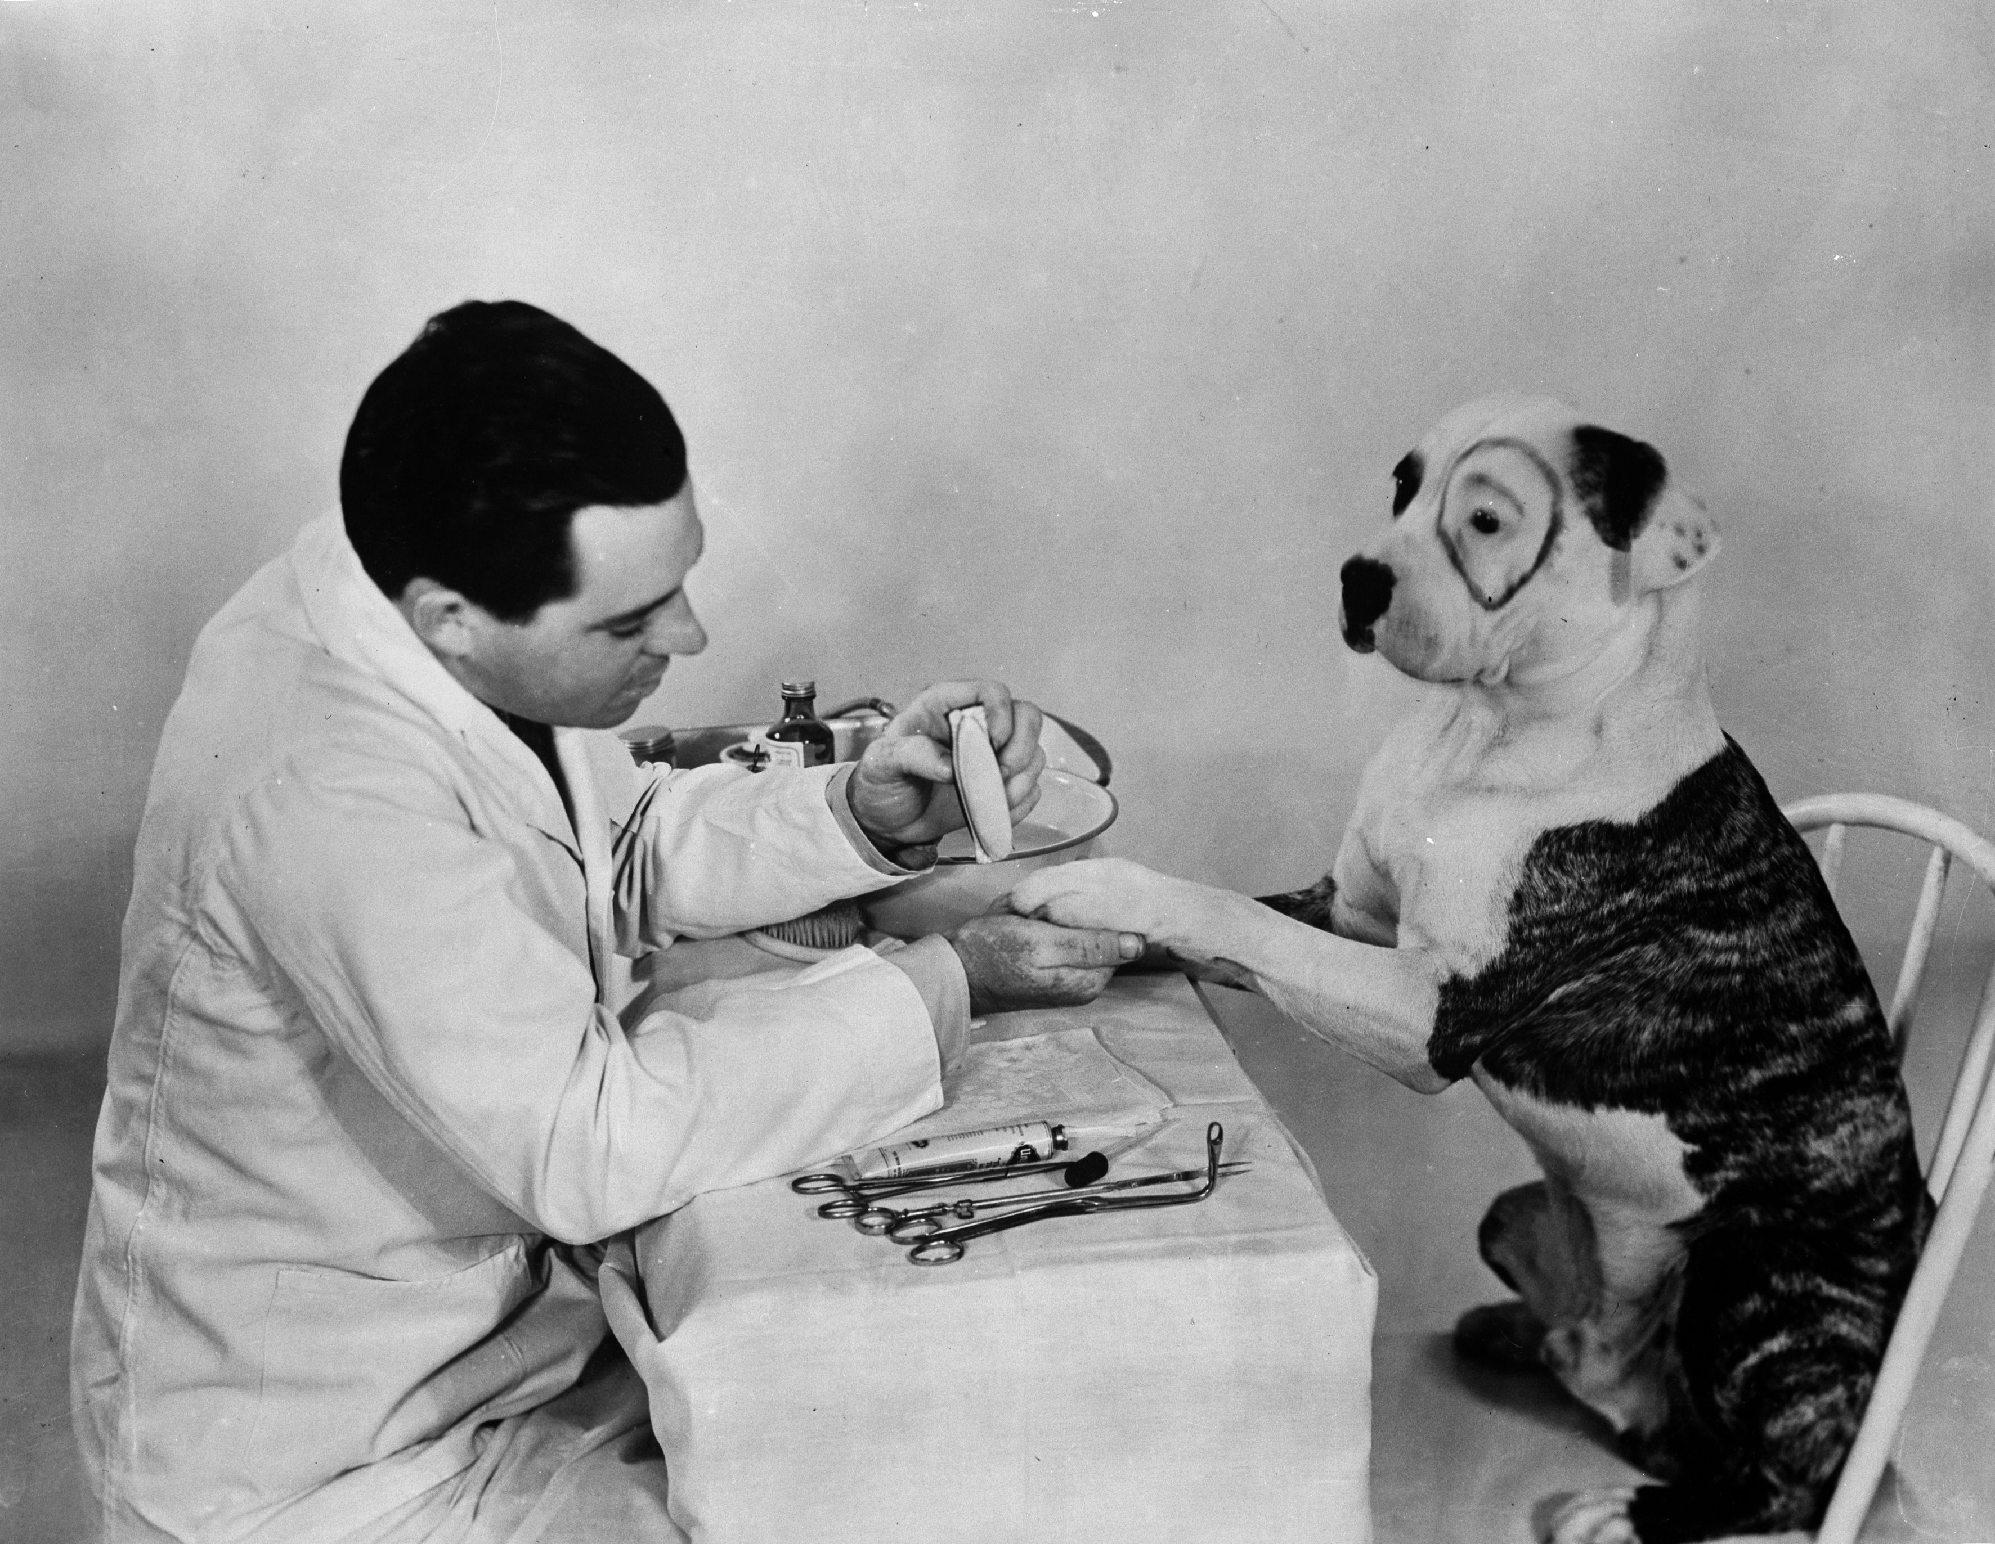
Today’s Topics
What challenges do we face?
Do we limit membership?
What’s our attitude?
Are we effective leaders?
Do we build teams well?
What are the rewards?
Figure out the problem. Work on the solutions
Notes:
I believe the solutions are simple, but not easy
Get them, train them and place them
That said let’s go a little deeper

Slide 3
While We’re Talking About Meetings. . .
Let’s talk for a minute about matching our audience to our words
What topics are In and what topics are Out?

Slide 4
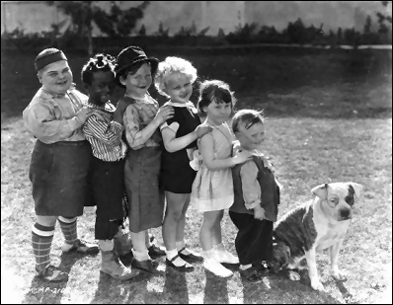
What Challenges Are We Facing?
Declining net membership
  More non-renewals
  Fewer new members
Difficulty filling the Bridge
Less people participating
  Classes
  Events
Notes:
What does good look like?
Net growth: which means solid involvement
A full Bridge: which means succession planning
More participation: people join for different reasons and we need to appeal to those
Motivation –
Three principles: Can you name them?
Recognition
Money (merit marks)
Feeling a part of the organization
Shameless advertisement for LD classes. LD 103, OT in 3

Slide 5

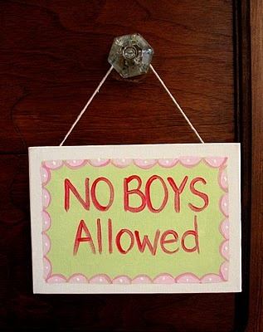
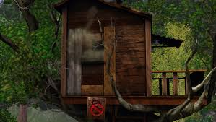
Do Our Squadrons “Limit New Members” or Are We Welcoming?
Notes:
Are we unintentionally keeping folks out because of age (young or old,) experience, grade
This is where I remind us about unintentional discrimination: race, gender, orientation

Slide 6
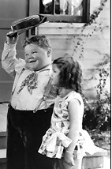
What’s Our General Attitude?
How do we greet new or potential members?
Who do we include at our tables?
Do we ask for opinions?
Do we ask for help?
Leadership Development 2016
Notes:
My opinion – If you’re on the bridge, you might sit with new members (or 1st Timers) most of the time
This role models behavior, sets the tone with new members and will help retention/involvement
How do you feel when you’re asked for your opinion?
How do you, normally, answer when you’re asked to help out?
Why would you assume others would feel or respond differently?

Slide 7
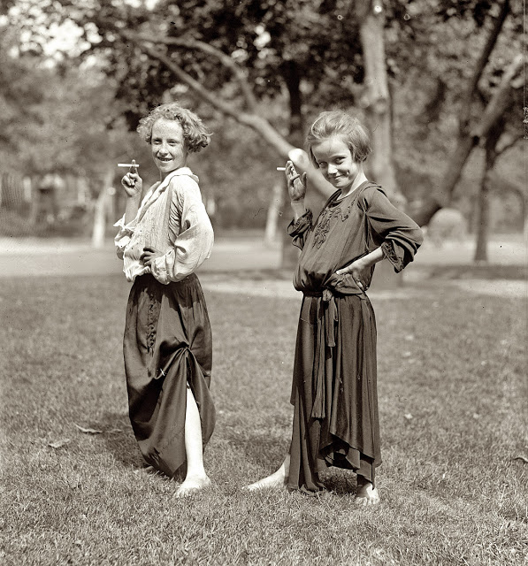
How Are Our Communication Skills? Do We Use A Variety Of Avenues?
Social Media has a long shelf life
Notes:
What we share in writing or pictures lives a very long time
Most of you have heard me say, don’t write anything that you don’t want in the NY Times or would embarrass my grandmother
That includes all of our behavior at all meetings and at all of our functions
That said, we should laugh easily, dance like no one is watching and sing like no one can hear us
We should take our organization very seriously, but not ourselves

Slide 8
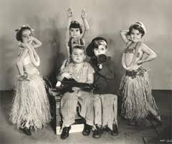
Do We Dress The Part?
Class A to Uniform T
Notes:
I loved Uniform T on the last Friday of our Annual Meeting. . . It’s the first time I didn’t dress in business casual to teach and it was fun.
What is your view regarding uniforms?
Remember, most of our meetings state a uniform or appropriate attire and the Commander sets the dress code

Slide 9
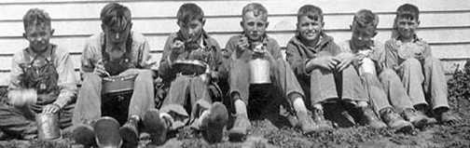
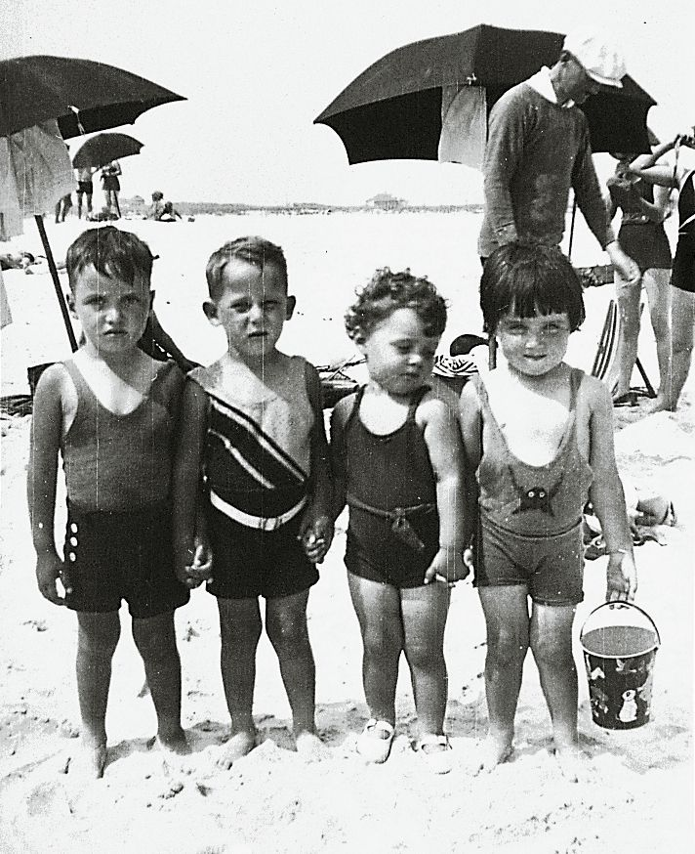
How Do We Select Our Leaders?
Do our officers understand how General Committees work?
Can each officer run a meeting?
Do all of our officers understand their job descriptions? Responsibilities?
Do we share our knowledge?
The Nominating Committee
The Rules Committee
Leadership Development 2016
Notes:
If you want to make me sick to my stomach, use the phrase ‘Nobody told me that was my job!’ UGH. . .
Let’s put it this way – You walk into a restaurant for the first time. You’re going to eat a certain cuisine for the 1st time – although you’re an adventurous eater. How many of you would say to the server, ‘bring me anything you want.’ When the server replies, ‘do you have any questions?’ You say, ‘Nope.’
If you haven’t looked at the Nominating Committee Seminar on our website, attended one of the sessions nor taken LD 103, please consider one or all for homework after this meeting
If we don’t understand our jobs and pass that knowledge on, who will take our places

Slide 10
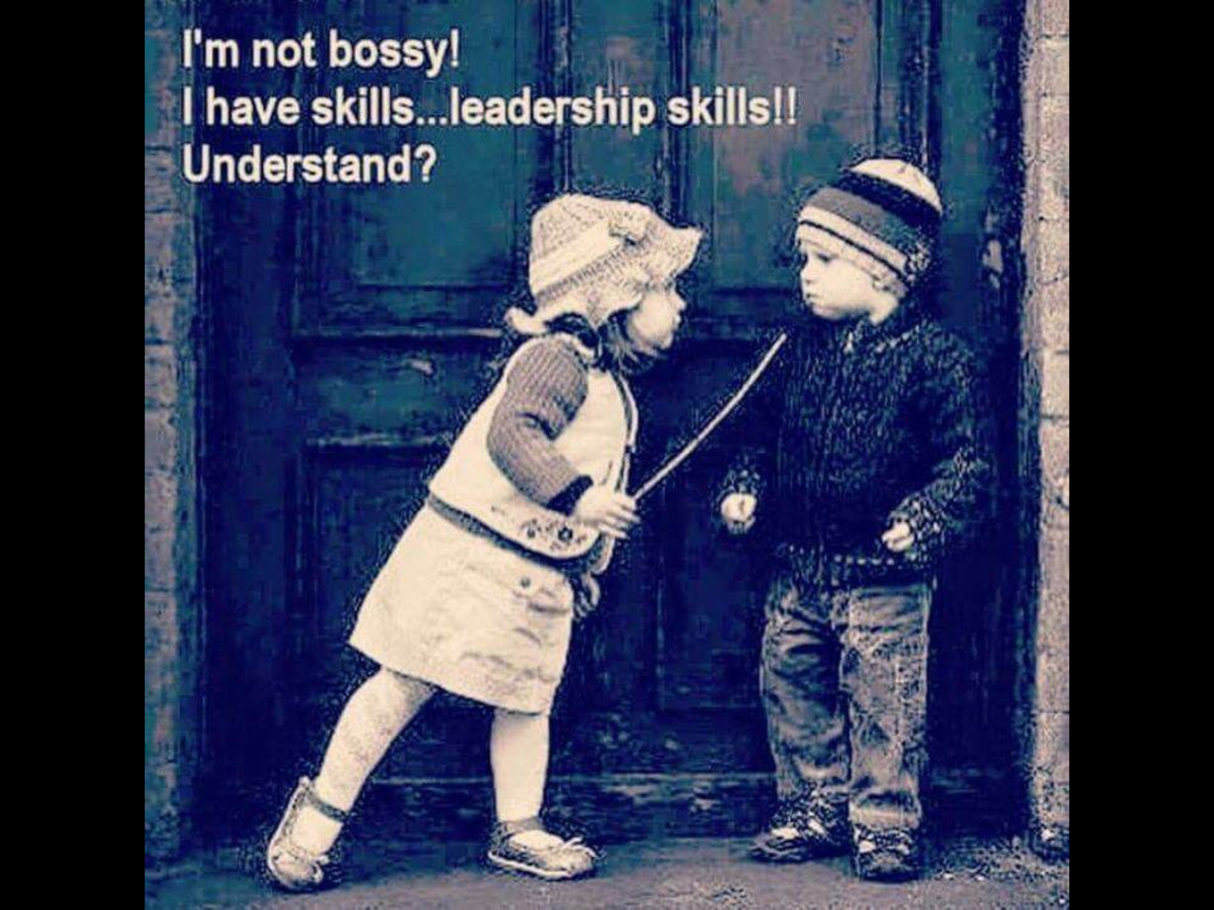
How Do We Train Our Leaders? Do They Have The Knowledge They Need To Lead?
Do we offer Operations Training at our squadrons or districts?
Do we supplement our Officers’ budgets to attend District and National meetings?
Do we invite others to join us as we take classes?
Leadership Development 2016
Notes:
This choir doesn’t need leadership lessons, or you would be on your way home or still at breakfast
But let’s think about how we can take the leaders coming up behind us to the next level
Let’s be more inclusive and help others to be, too. There’s always room for one more at the table
Let’s make sure our members know where to look and what’s there
I always need to remember the fine line between bossy and setting the bar high

Slide 11
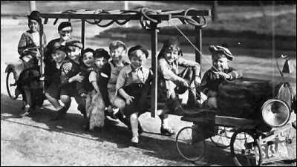
Do We Take Advantage Of District And National Meetings? Who should Attend?
Topical Classes and Seminars
Departmental Meetings
Tours and Outings
Meet and Greet
Voting and Elections
Participative Decision Making
Latest Information
Carpooling to Orlando
Leadership Development 2016
Notes:
Many of this group has been to a National meetings understands the value
Why do you think we have so much difficulty getting better participation at our District and National events?
What could we do to improve this?

Slide 12
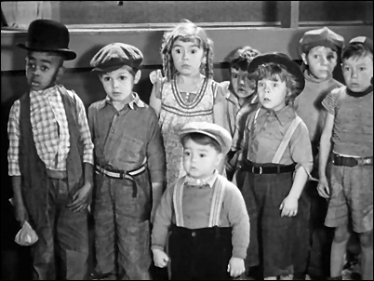
Wow! Can Each of Us Learn Something New And Make A Contribution?
Participation is not just about our learning, but our ability and willingness to contribute
That may mean going to a meeting, teaching or helping in some other way
Leadership Development 2016
Notes:
If someone asks for advice with a class, an event or a situation, each of us would help willingly
But, how many times do we really think about how we can contribute in a more public setting. Sometimes we have information that we share, but do we ever think that some situations are for teaching
For example, in my home squadron, we have several instructors who have taken AP, JN and N several times. They gain new knowledge and contribute/support the instructor
Scott Aiken suggested a concept from Philippians when we were doing LD 103 in Charlotte, last year, and it stuck with me. . . All volunteers should have a ‘servant's heart’ We should serve because of the contribution we make not the public rewards we might receive

Slide 13
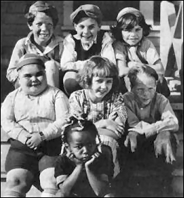
Do We And Can We Get Along?
We won’t agree with everyone
Don’t take disagreement personally
Don’t become over-invested in a given point of view
Not every hill is one to die on
Someone will be happy and someone might be unhappy!
Notes:
In our beloved organization, there are disagreements
These range from philosophical to demonstrative. Shouting, taking sides and other forms of behavior
Robert Baldridge, at the Leadership Academy, said not to take disagreement personally
Colin Powell, in his autobiography warned about losing a war over becoming too invested in an opposing point of view
Doris Kearns Goodwin, the noted historian, wrote that leadership can be improved by working with a Team of Rivals
All three recognized that emotions can run very hot, but that working through various points of view may make the outcomes stronger
One of my favorite expressions is to pick the hill to die on – Looking back I wish I’d following that advice a bit better
Your thoughts?

Slide 14
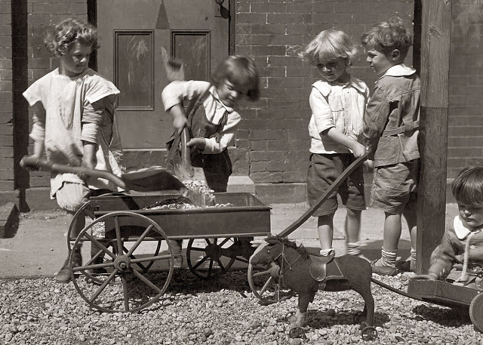
Do We Understand The Value Of Teamwork?
Balance between delegation and doing a job alone
Leadership Development 2016
Notes:
We need balance!
No one wants to be on the Bridge with someone who delegates everything without follow-up
No one wants to be on the Bridge with someone who takes lots of assignments, but doesn’t deliver
Remember bacon and eggs – the chicken is involved, but the pig is committed
What does this say about us?

Slide 15
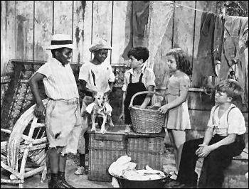
Delegation and Participation: Sometimes There’s Work to Do – Do we ask for help?
Don’t be afraid (or too good) to do some work
Know when to delegate and when to pitch in
Make the tasks fun
Leadership Development 2016
Notes:
What do you think of the Tom Sawyer perspective on delegation?
People want to help
People will do a good job
People want to be part of the process

Slide 16
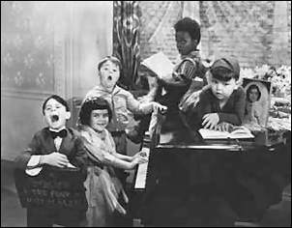
What’s The Value Of Becoming A Team?
Singing the same song
Notes:
What’s your opinion?
We can provide more instruction to more people and make the waterways safer
We can have and provide a more satisfying experience
We can have more fun!

Slide 17
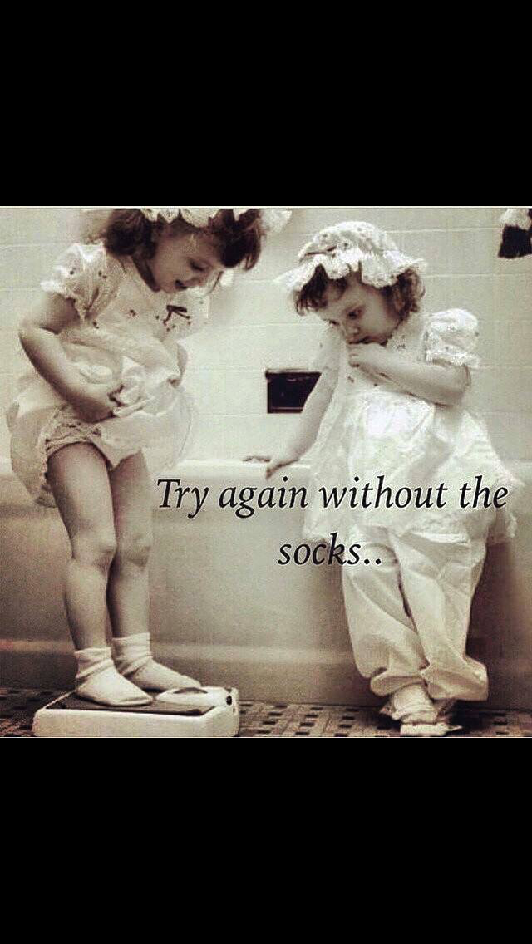
You May Make A Friend Or Friends Along The Way
Notes:
How many of you see people you met at USPS outside of the organization? (I rest my case)

Slide 18
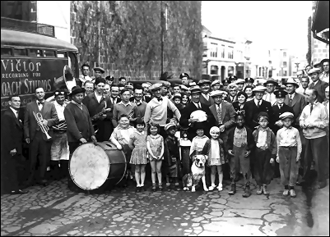
No This Is Not West Palm Beach, But It’s Time To Go!
One final thought
Notes:
Any final thoughts?
Our time, together, is about at an end. . . Thanks for contributing your time and thoughts
I’m glad we did this – have fun and be safe!

Slide 19
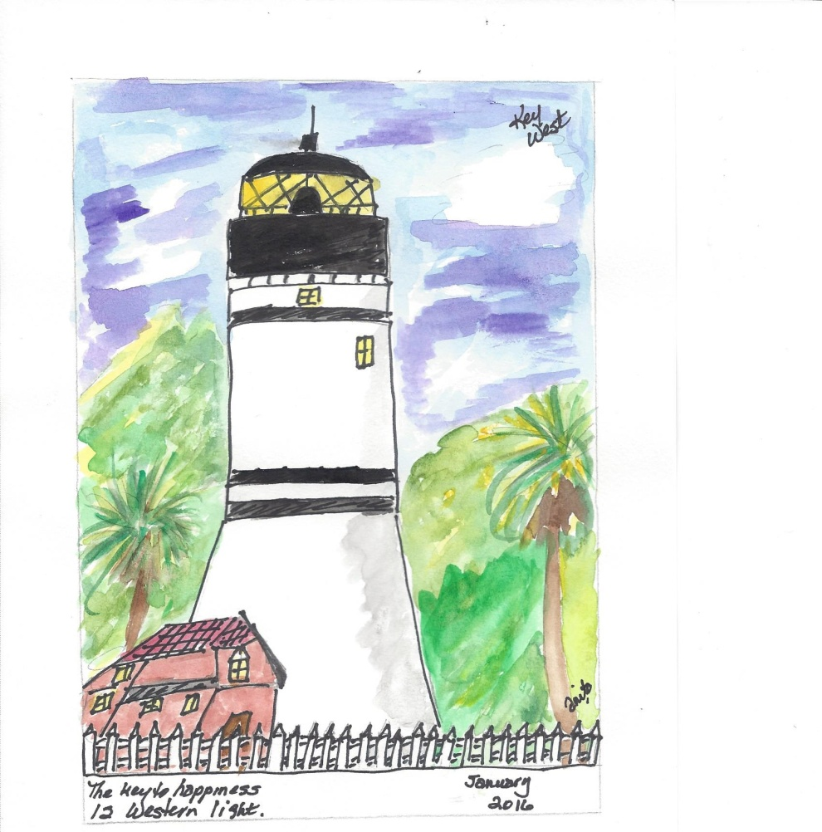
You Should be Able to See the Key West Lighthouse From the Ship. . . .

