Slide 1


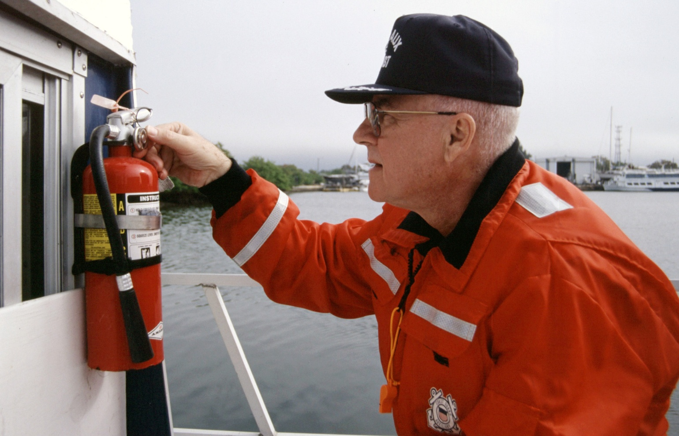
VSC DATA COLLECTION
William S. Griswold

Slide 2

Presentation Agenda
1
USCG Strategic Plan
2
NASBLA Work Group
3
Project purpose
4
Results to date
5
Q&A

Slide 3
STRATEGIC PLAN of the
National Recreational Boating Safety Program
2012-2016
Objective 8: Operator Compliance – USCG Required Safety Equipment
Increase compliance levels for specific required safety equipment on recreational boats.
Strategy 8.1 – Evaluate Incidents of Non-Compliance with specific USCG Required Safety Equipment

Slide 4

NASBLA - ERAC
Engineering, Reporting & Analysis Comm.
Charge C-3: Continue to review the data from USBI (and affiliated organizations’) efforts to capture the reasons why vessels fail a Vessel Safety Check (VSC), and the VSC program analyses conducted to date by the USBI project partners. Assess the significance of the data and analyses and determine whether there are any potential applications of – and implications for – the data findings beyond the original intent.
[National RBS Plan Performance Goal for reducing casualties; RBS Obj. 8, Operator Compliance-Required Safety Equipment; NASBLA’s strategic goal of conducting research for evaluating RBS program efforts and informing decision makers.]

Slide 5
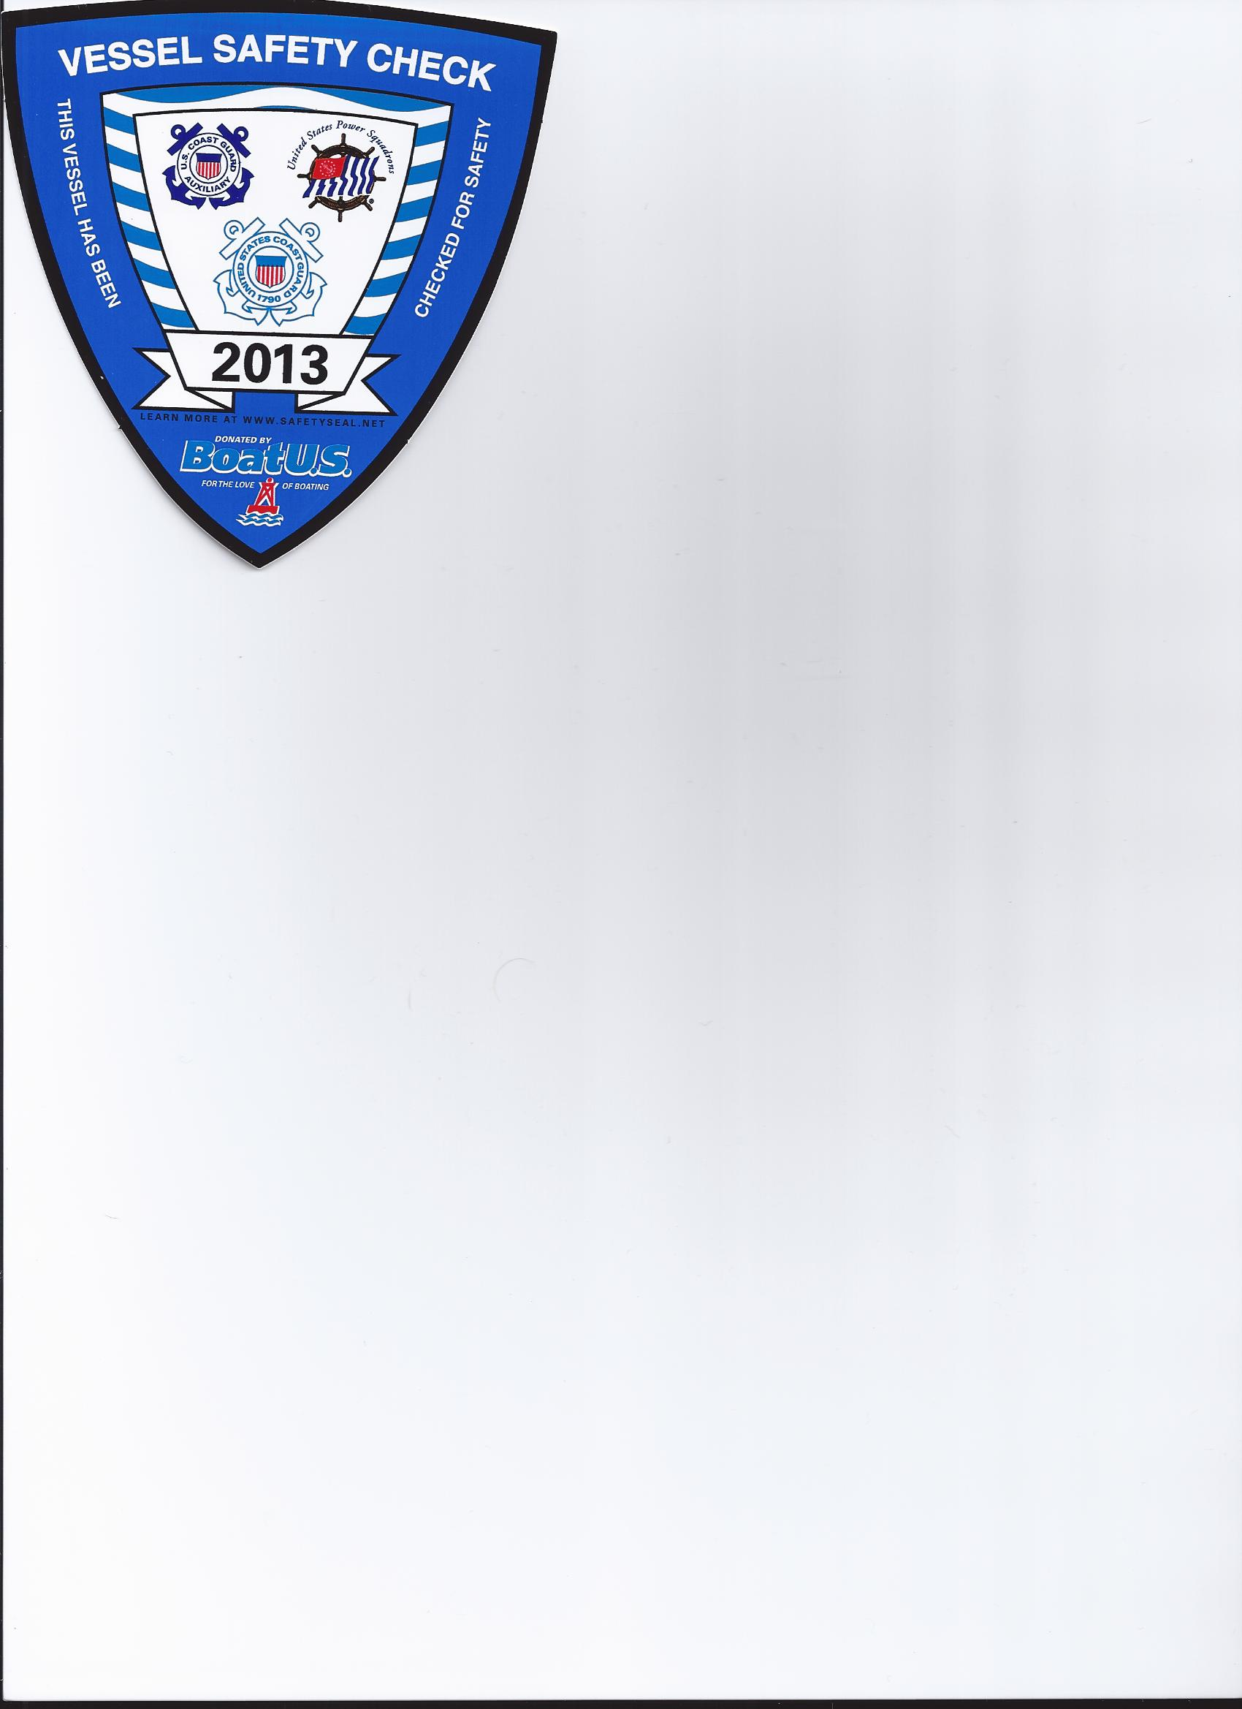
Purpose of the VSC Data Collection Project
Make better use of data from the VSC Process

Slide 6
USBI – United Safe Boating Institute
Undertook project, funded by CG grant & Involving two parent organizations:
  USCG Auxiliary
  United States Power Squadrons (USPS)

Slide 7
  Determine Why Vessels Fail VSCs
  CG Aux - July 12-Dec. 13 159,118 vessel exams
  119,267 passed
  39,851 FAILED (25%)
  Compare with Accident Data
  Correlations ? Trends? Regional Differences?
  Archive for Other Future Uses
  Incorporate in future data collection systems

Slide 8
  AUXDATA is on life support
    No funds to change VSC collection
    Trial run 11 years ago – not possible
  Why USBI?
    Represents both CGAux & USPS
    Has an existing web site for collection

Slide 9
Gather only important information
Only need info from exams that FAILED
No personal information, but some other info that’s already captured on form 7012

Slide 10
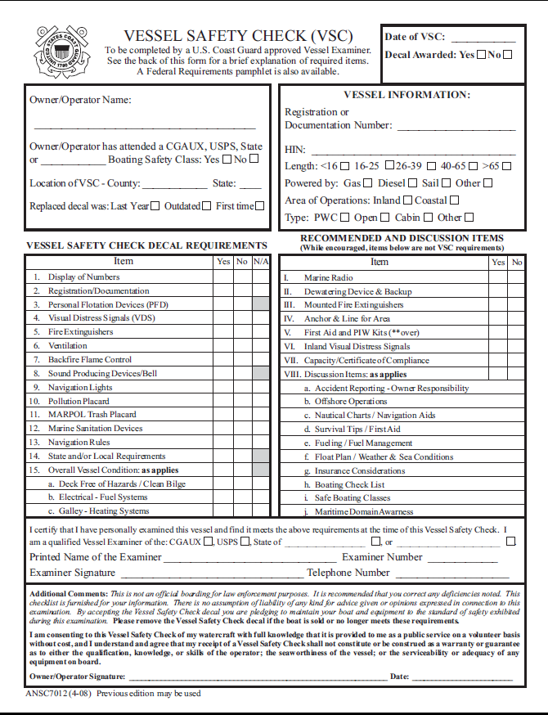
Form 7012
Used by both
USPS & CGAux

Slide 11
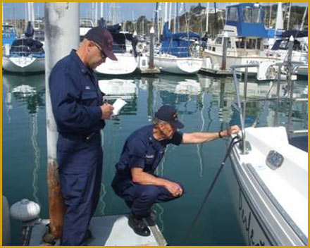
Auxiliary Examiners
Will be asked to complete their VSCs as always
For those vessels that fail, the examiner will go to the web page at
http://www.usbi.org/vsc.php
and enter the reasons the vessel failed

Slide 12
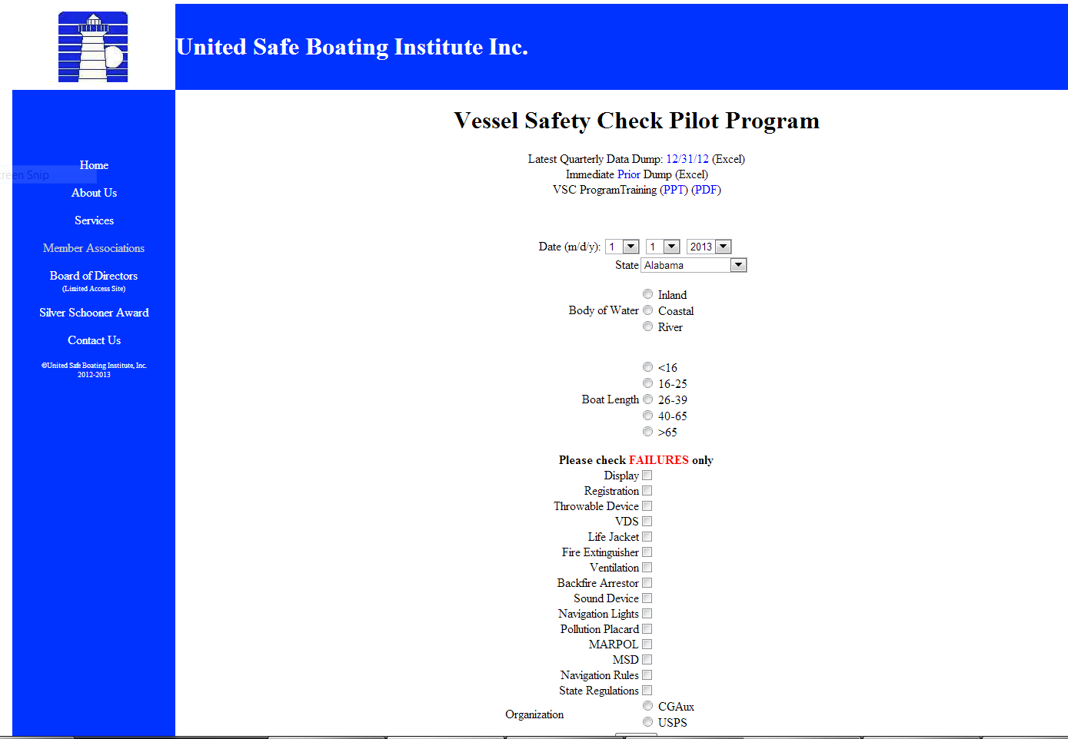

Slide 13
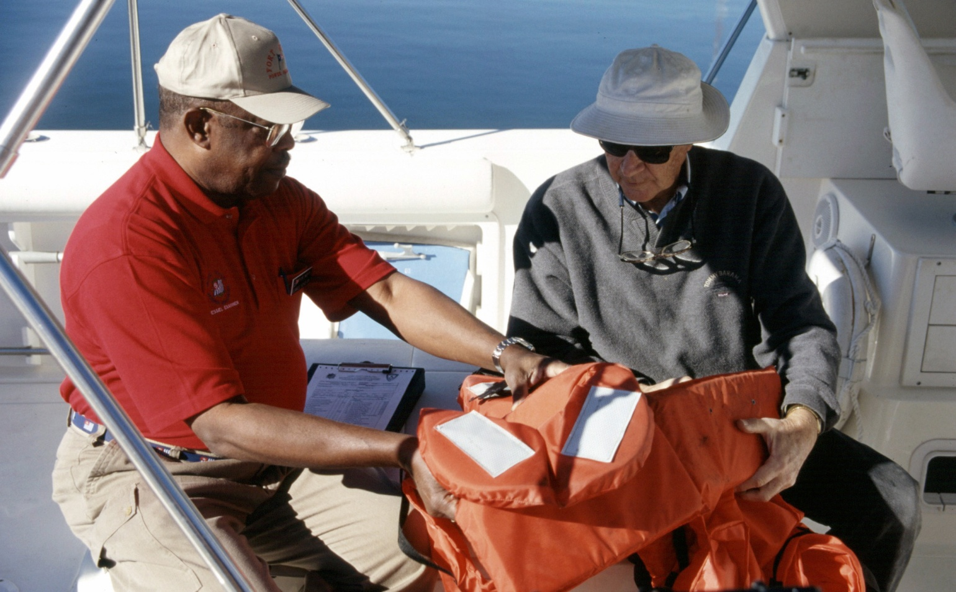
USPS EXAMINER AT WORK

Slide 14
USPS Vessel Examiners
Asked to complete their VSCs with the additional data asked for
The Squadron VSC Chairs entered the VSC data on a newly designed USPS input page rather than the old page
Data passed to the USBI database, merged with the Auxiliary data, quarterly

Slide 15
MEASUREMENT
To see if this pilot program is capturing significant data, we can compare number of VSC failures in each state between AUXDATA and the Pilot Program
This measurement might help future changes

Slide 16
Example of Measurement
CGAux VSC’s July 1, 2012 – Dec. 31, 2013
Data taken from AUXINFO
Exams 159,118
Exams passed 119,267
Failed – 39,851 (25%)
CGAux failures reported to USBI
1,553 – 3.8% of total above

Slide 17
ANALYSIS – so far
Data collected is up to end of 2013
Hurricane Sandy flooded CGAux host equipment Oct. 29, 2012 shutting down web site for 2 months
USPS data intact – National input from most states
CGAux data incomplete – Extra step for examiners preventing significant numbers.
TOTAL FAILED EXAMS – 9,163 (83% of total from USPS)

Slide 18
Focusing on 5 reasons which could cause an accident, reports show % of total failures:
Navigation Lights 14%
Visual Distress Signals 13%
Fire Extinguishers 11%
Life Jackets 5%
Sound Device 4%
Notes: An examination may result in a failure for more than one reason
These differences are statistically significant

Slide 19
TOP TEN STATES REPORTING
State % of Failures % of Registered Vsls
FL 13% 0.12%
OH 10% 0.18%
MI 9.6% 0.10%
NC 6.5% 0.14%
NY 5.7% 0.09%
MD 5.3% 0.22%
CA (TIE) 4.1% 0.04%
VA (TIE) 4.1% 0.14%
TX 3.4% 0.05%
WI 3.0% 0.04%

Slide 20
Summary table of failures
5 out of a possible 15 failure categories
Reason for Failure | CGAux Failures | CGAux % of Fail. | USPS Failures | USPS % of Fail. | Total Failures | % of Total Failures
PFD | 149 | 6 % | 782 | 5 % | 931 | 5%
VDS | 514 | 19 % | 1,771 | 12 % | 2,285 | 13%
Fire Ext. | 235 | 9 % | 1,677 | 11 % | 1,912 | 11 %
Sound | 141 | 5 % | 600 | 4 % | 741 | 4%
Nav Lts. | 547 | 20 % | 1,860 | 12% | 2,407 | 14 %
TOTAL TOTAL OF ALL 15 | 1,586 2,715 |  | 6,690 14,965 |  | 8,276 17,680

Slide 21

Possible reasons for differences in failure patterns
  Lack of consistency in criteria used by each organization and reporting to USBI
  Differences in boat populations being examined by the two organizations (locations, size of boats, other)
  There is some consistency between both organizations looking at types of failures

Slide 22
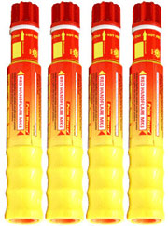
VISUAL DISTRESS SIGNALS (VDS)
CGAux reported 514 VDS failures – 26% were on Inland Waters
USPS reported 1,771 VDS failures – 51% were on Inland Waters
Some concern about Federal requirements, State requirements on Inland Waters and Vessel Examiners getting it right
46% of VDS failures reported on Inland or River waters.

Slide 23
Other Interesting Facts
52% of USPS “Pollution Placard” failures were on vessels <26 feet – not a Fed. Requirement
Florida had the highest # failures – 13%,
Ohio and Michigan had 10% each
These three states had 32.6% of the reported failures , 18% of registered boats, and 19.95% of reported boating accidents in 2012

Slide 24
MORE STUFF
9,163 failed VSC indicated 17,680 reasons for failure – averaging 2 failures per failed exam
46% Auxiliary failures had multiple reasons
58% USPS failures had multiple reasons
2012 Accident statistics – 74% accidents & 81% fatalities occurred on Inland bodies of water
As above – 75% of vessels & 83% involving death were on vessels less than 26 feet
54% of VSC failures were on vessels less than 26’

Slide 25
Location
Area | CGAux | USPS | TOTAL | % of TOTAL
Coastal | 779 | 3,002 | 3,781 | 41%
Inland | 704 | 4,339 | 5,043 | 55%
River | 70 | 269 | 339 | 4%
TOTAL | 1,553 | 7,610 | 9,163

Slide 26
SIZE OF VESSEL
Length | CGAux | USPS | TOTAL | % OF TOTAL
Unknown | 0 | 6 | 6 | 0
<16 Feet | 247 | 1,085 | 1,332 | 15
26 Feet | 1,002 | 3,342 | 4,344 | 46
39 Feet | 75 | 2,441 | 2,516 | 27
65 Feet | 324 | 716 | 1,040 | 12
>65 Feet | 5 | 20 | 25 | 0
TOTAL | 1,553 | 7,610 | 9,163

Slide 27
And in Conclusion
This project is a long term wish to use VSC’s as a vehicle to determine why boats fail, where they are and what they don’t have on board
Perhaps, we can correlate carriage deficiencies with boating accidents
Other data bases have not been able to tell us why; maybe our method will help direct our educational efforts, and public awareness initiatives

Slide 28
More Conclusions
VSC’s reach less than 1% of the total registered boats
Many of the VSC failures revealed discrepancies with:
Overall Condition Display of Numbers
Registration Pollution Placard
Not associated with CAUSES of accidents
Numbers and Trends did not vary much from the report given in early 2013 compared to 2014

Slide 29
VSC – BOTTOM LINE
Reinforce education messages on:
Navigation Lights
VDS (let’s train examiners what’s ok)
Fire Extinguisher
It appears we’re OK with life jackets and sound devices
Is there a correlation with accidents ?

Slide 30
Check Us Out http://www.usbi.org/
We are glad to be partners with
NASBLA
NSBC
NWSC
If you have any questions, please contact us
wsgriz@aol.com

Slide 31

?
Q & A time

