Slide 1
MarCom Open Meeting
Welcome!
Annual Meeting
Ponte Vedra, FL
13 FEB 20

Slide 2
Marketing Committee Team
R/C Shirley Heald, Chair
Stf/C Glen Sherman, Assistant Chair
R/C Jeff Lagrew
R/C Jan Wright
Stf/C Ron C. Jones
P/R/C John Malatak
P/D/C Susan Ryan
P/R/C Paul Mermelstein
HQ Marketing Tammy Brown

Slide 3
Branding and Trademarks
Considerations from
MarCom and LawCom

Slide 4



Branding and Trademarks
Use the newest versions off all logos.

Slide 5
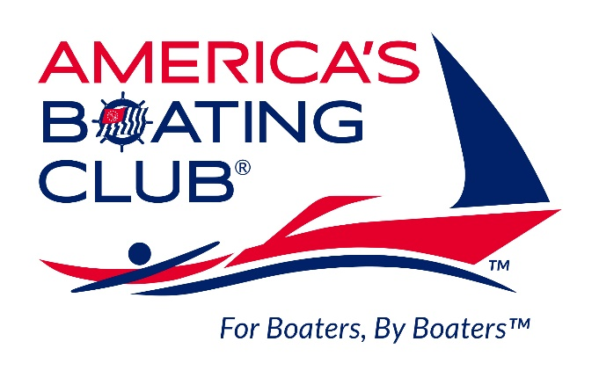


Branding and Trademarks
Use the newest versions off all logos.

Slide 6
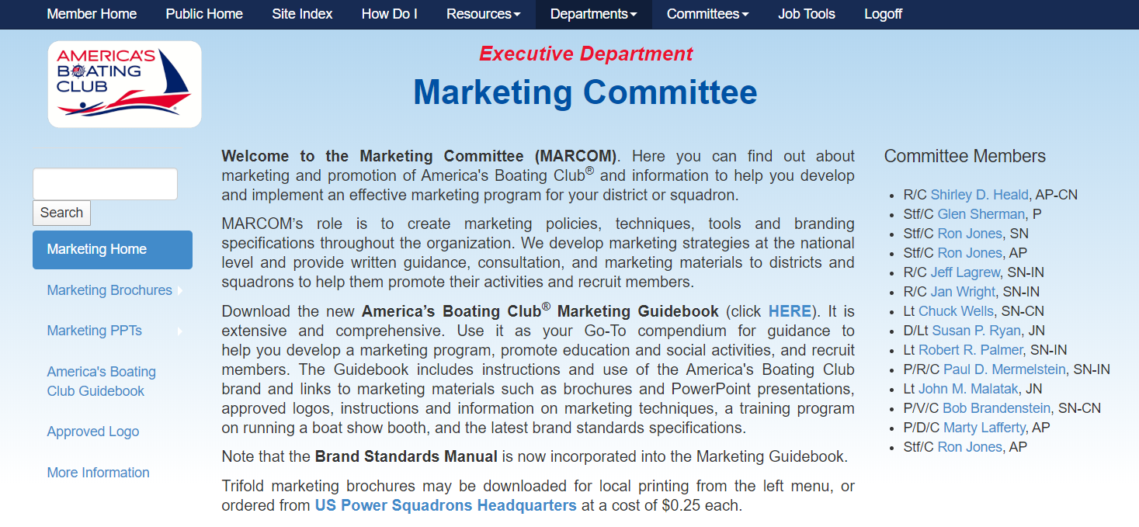
Branding and Trademarks
Where do you find current logos?

Slide 7
Branding and Trademarks
Do you need more info and templates?

Slide 8
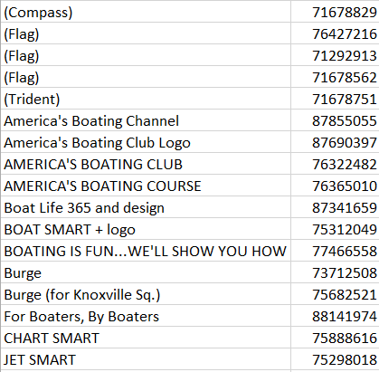
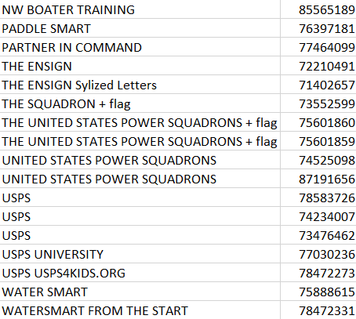
Branding and Trademarks
What is registered

Slide 9
Branding and Trademarks
Renewal requires
3 Ps
Payment
Paperwork
Proof of Use
Use it or Lose it

Slide 10
Branding and Trademarks
We have many registered marks
Problem?
Adding more can dilute the brand.
Solution?
Associate with existing marks or brands.

Slide 11
Branding and Trademarks
We have many registered marks
Example:
Instead of registering Jump Start®
Use something like:
Jump Start,
a proprietary program of
America’s Boating Club®
Ponte Vedra arCom 2020

Slide 12
Branding and Trademarks
We have many registered marks
Why join instead of 2 trademarks?
Lower cost
Less paperwork
Plus greater usage and improved
recognition of the primary trademark,
America’s Boating Club®

Slide 13
Branding and Trademarks
and NEVER forget
America’s Boating Club®
is a registered trademark of
the United States Power Squadrons®

Slide 14
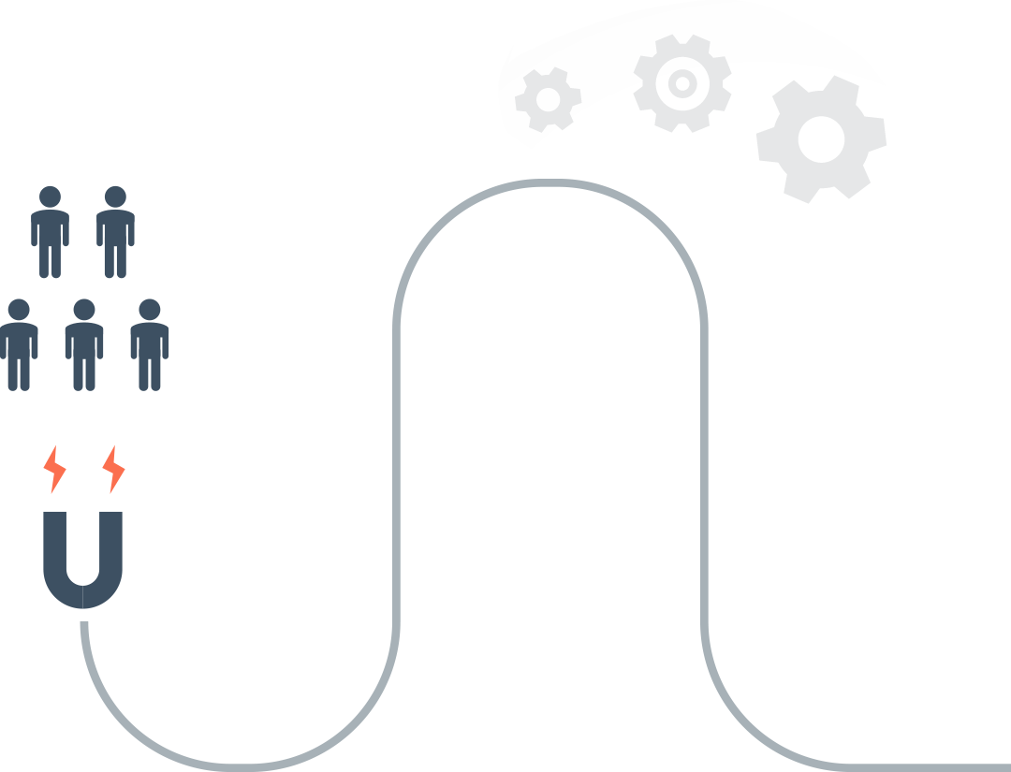







Driving Membership
5-POINT NATIONAL MARKETING STRATEGY
ATTRACT
Phase 2 Ad Campaign
INTEREST
New Website / Call to Action
ENGAGE
Collateral / POP / Face to Face
CONNECT
Social Media
LOCAL CLUBS
Demonstrate VALUE by
Providing Activities
If you are not able
to demonstrate value,
they will walk away
Mentoring
Inclusion

Slide 15
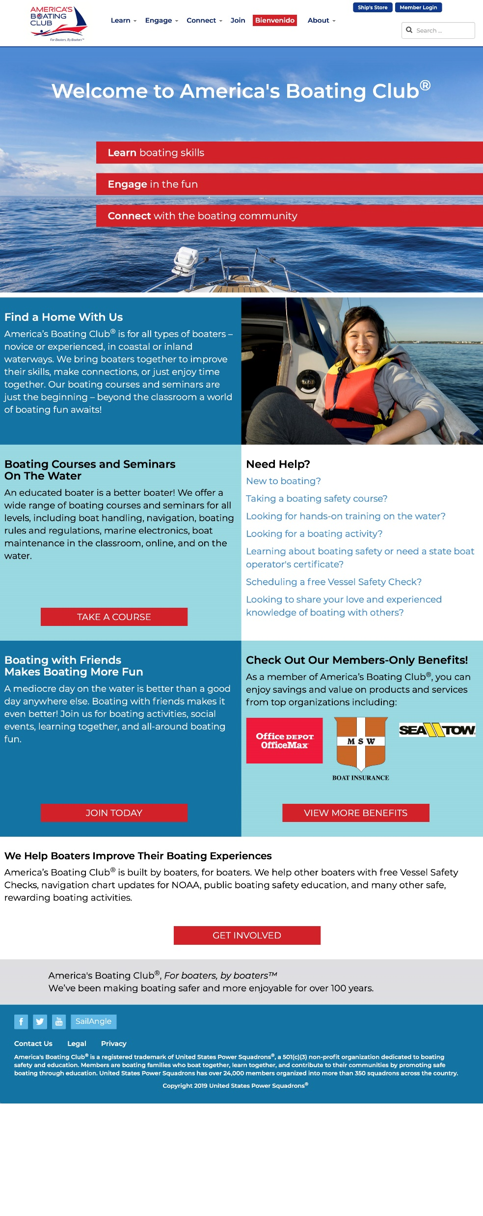

Website Update – Home
Notes:
Builds on Phase I ads with Learn, Engage, Connect theme.
Phase II ads will now land on a new website designed to have the same look, feel, and message as the ads.
Features Nationally Recognized Educational Classes.
Features an inclusive, “beyond the class” recreational boating experience at the local club level.
Considers the following in all photos
Target audience of social adventurers and outdoor enthusiasts
All types of boaters, power, sail, fishing, human power
45-60 Age range
Diversity in all photos
Folks having fun
Wearing life jackets
High resolution pictures
Minimizing alcohol consumption

Slide 16
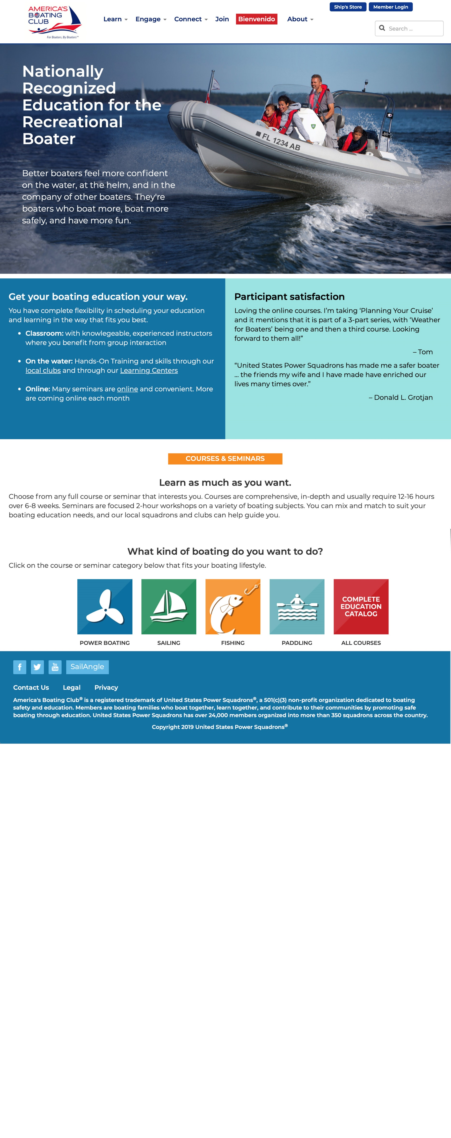
Website Update – Learn

Slide 17
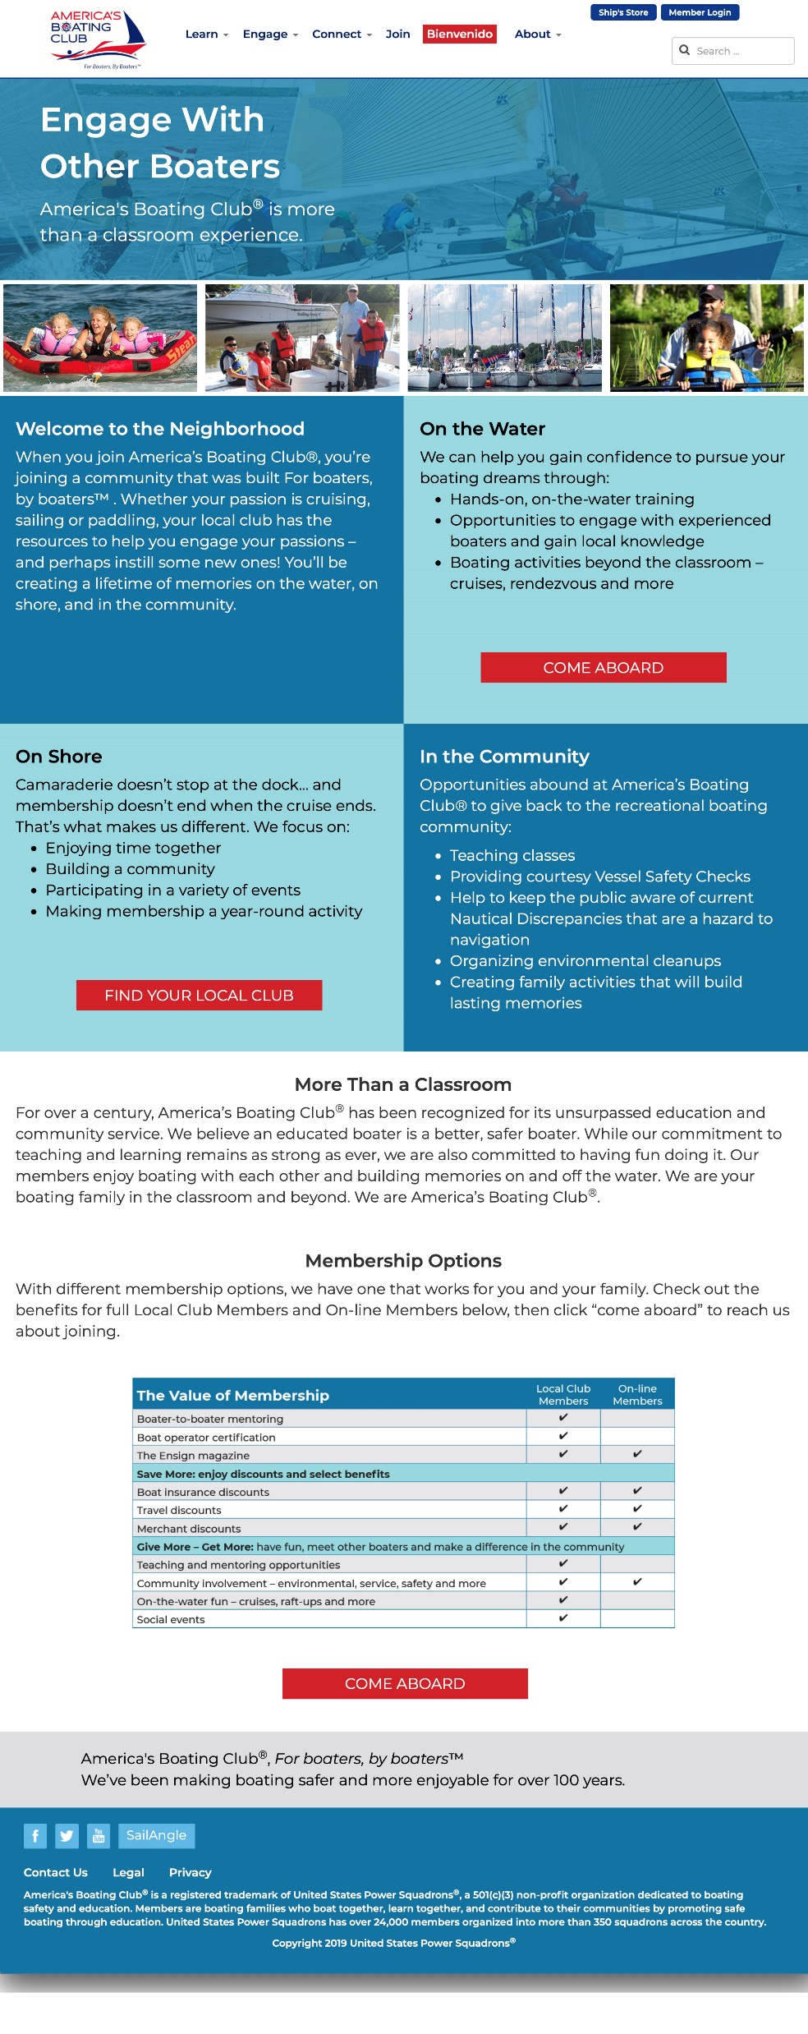
Website Update – Engage

Slide 18
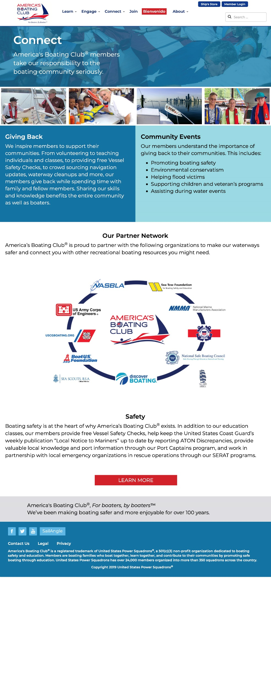
Website Update – Connect

Slide 19
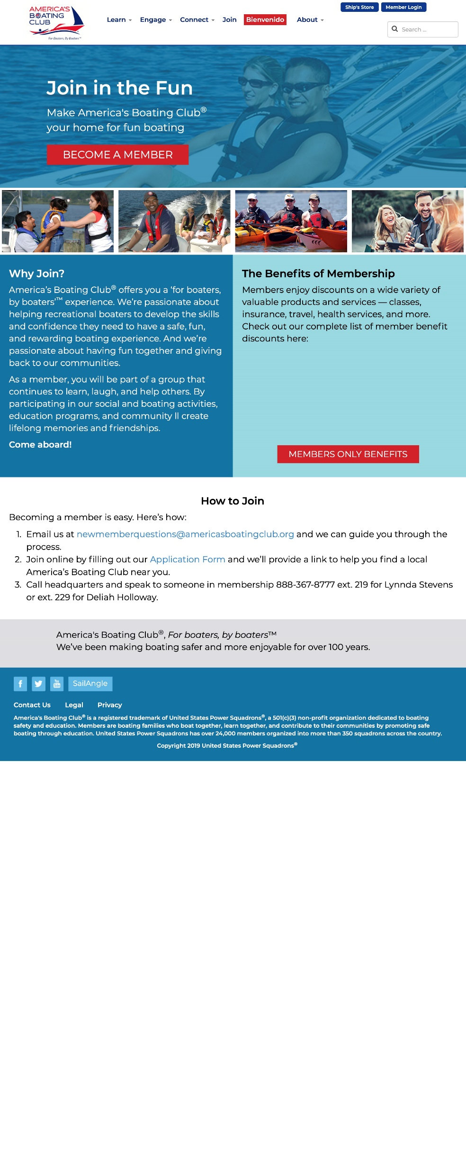
Website Update – Join

Slide 20
Phase II National Ad Campaign
“Call to Action”
Beyond the class theme
100% Digital
Emphasizes more social media and enewsletter platforms than print
Shows diversity, having fun, and being safe doing it

Slide 21


Phase II Ad Campaign
Notes:
Advertising Message
Our creative drives our Learn, Engage, Connect message and is designed to drive people to the front door of our site to learn more about what we do and how to become a member.
The ads use the same colors and imagery as our website for consistency, and higher retention and engagement

Slide 22
Phase II Ad Campaign Website Impact
Oct-Dec 2019
 |  | Users | Sessions | Avg Time (Min)
Organic |  | 7,255 | 9,538 | 2.96
Social |  | 121 | 157 | 2.16
Phase II Campaign |  | 10,054 | 10,971 | 1.82
Total Phase II |  | 20,482 | 26,014
2018 Total |  | 6,293 | 8,915
YOY Growth Same period 2018 |  | 325.5% | 291.8%
Phase II Campaign %age |  | 49.1% | 42.2%

Slide 23
IMPACT OF PHASE I, PHASE II, AND SPANISH CAMPAIGNS
YOY Delta 2018-2019
Nov 2018 Data
Users | Sessions | Pages | Time (min)
835 | 1105 | 2.13 | 0:02:08
Nov 2019 data
Users | Sessions | Pages | Time (min)
7,811 | 10,003 | 2.39 | 0:02:03
YOY delta
Users | Sessions | Pages | Time (min)
935.4% | 905.2% | 112.2% | 96.1%
Notes:
In Nov 2018, our new brand launch just started & resulted in 23 clicks to the site. YOY, our traffic to the site is nearly logarithmically (10x) higher with a slight growth in page views and approximately the same amount of time on the site.

Slide 24
Website Pages Visited From Ad Campaign
  5,751 visits to education and learning pages
  1,688 visits to Find Your Squadron
  1,106 visits to the Join page
  402 visits to the Benefits page
  442 visits to the Engage page
  330 visits to the Connect page
  73 visits to the Contact us page
  783 visits to the /bienvenido page, highlighting cross campaign efficiencies

Slide 25
Performance by Media Outlets

Slide 26
People Who Engaged With Us in Phase II Campaign

Slide 27
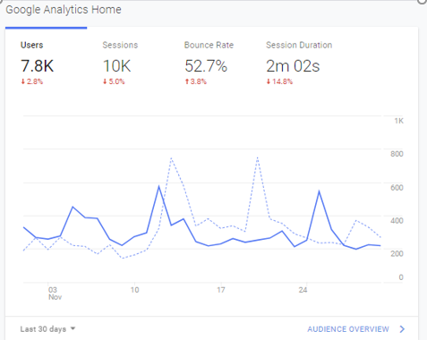

Graphic Picture of Spikes in November Website Traffic Related to Phase II Advertising Events

Slide 28
Campaign Spend Effect on CYM
Total New Cym Memberships since campaign began , 113
Total Single Memberships, 71
Total Family Memberships, 42
Total New Members, 158
Simultaneous Hispanic and Phase II Ad Campaigns going on.
Direct correlation of spike in Cyber Memberships on days on or around Phase II advertising pushes
Notes:
10/5 Boating enewsleter (went out early) 11/5-7 Boats.com social media post
10-9 New ABC website goes live 11/12-14 Sport Fishing social post/Saltwater Sportsman
10/15 Phase II Ad Campaign starts enewsletter
10/16 Power and Motor Yacht enewsletter 11/25-26 Boattest.com enewsletter
10/31 Cruising World enewsletter

Slide 29
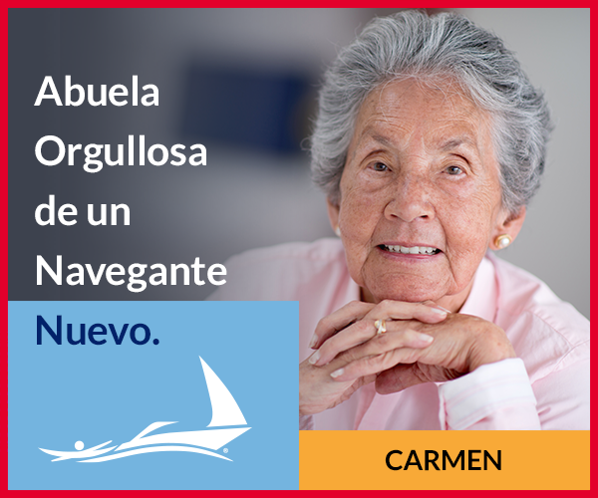

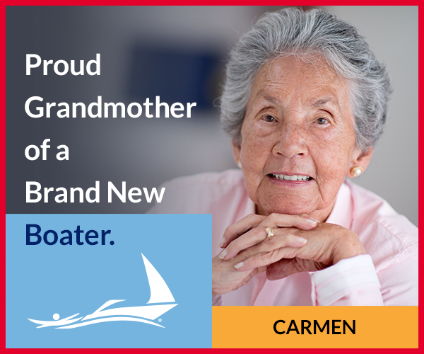

Spanish Ad Campaign – Carmen
Notes:
Targets individuals with browsers set to Spanish
Digital marketing campaign in select markets
Reached over 15M viewers
Created a lot of dialogue in this demographic
Still need to keep knocking on the door
New Grant to continue marketing submitted to USCG

Slide 30
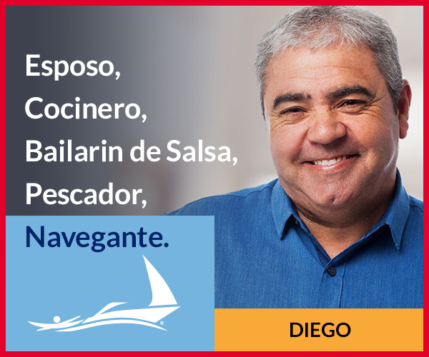
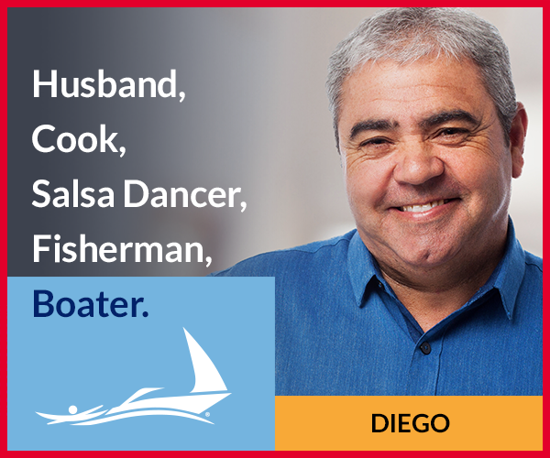
Spanish Ad Campaign – Diego

Slide 31
Spanish Campaign Target Audience
The campaign targeted individuals:
With browsers set to Spanish
Who have browsers set to English but have been identified as Hispanic
Who exhibit similar browsing behaviors to people who visited the targeted URL /bienvenido
High Hispanic Demographic States, Fl, TX,
CA, GA, NY Tri-State area, Chicago

Slide 32
Spanish Campaign Results
The campaign
  generated 17,256 sessions to the /bienvenido page since Feb
Campaign Traffic to /bienvenido
  99.9% of the traffic to the Spanish page was generated by the ad campaign
  Only 16 people came in organically (via Search engines).
The campaign has generated:
  270 visited Spanish online ABC3 course.
  108 visited the Spanish contact page with 15 of those visits coming after viewing 3 or more pages
  25 looked for local squadrons near them
  215 visited America’s Boating Club home page as their first click from landing on /bienvenido from the ad

Slide 33
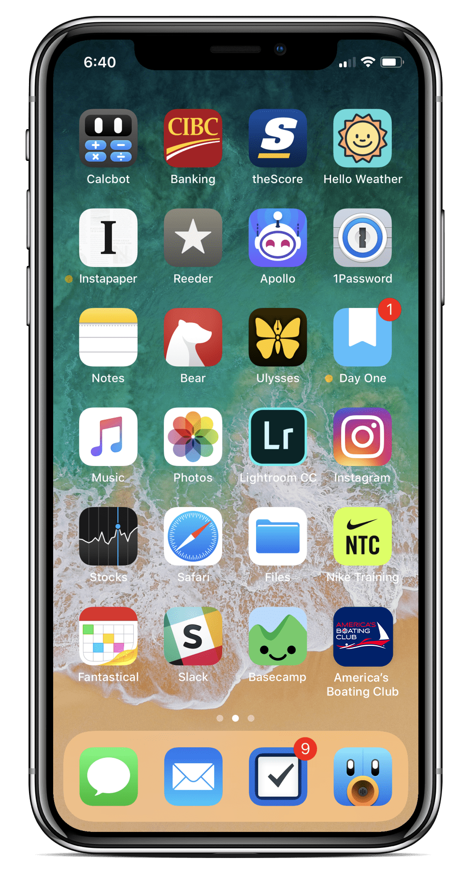
America’s
Boating Club
Mobile App!
Notes:
MarCom has just received a grant from the Educational Fund to construct a new Americas Boating Club® mobile application
A task force is being formed to begin work right after this Governing Board
We need input for content
Goal to have it available by Saltgrass AM.

Slide 34

America’s
Boating Club
Mobile App!
Notes:
MarCom has just received a grant from the Educational Fund to construct a new Americas Boating Club® mobile application
A task force is being formed to begin work right after this Governing Board
We need input for content
Goal to have it available by Saltgrass AM.

Slide 35
America’s
Boating Club
Mobile App!
Notes:
MarCom has just received a grant from the Educational Fund to construct a new Americas Boating Club® mobile application
A task force is being formed to begin work right after this Governing Board
We need input for content
Goal to have it available by Saltgrass AM.

Slide 36

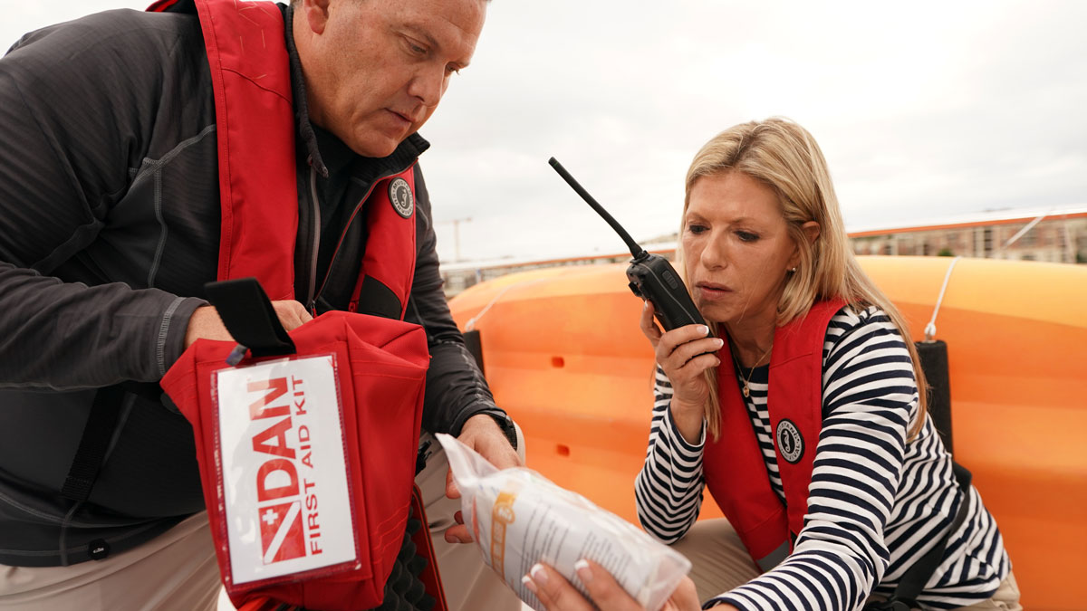
DAN BOATER

Slide 37
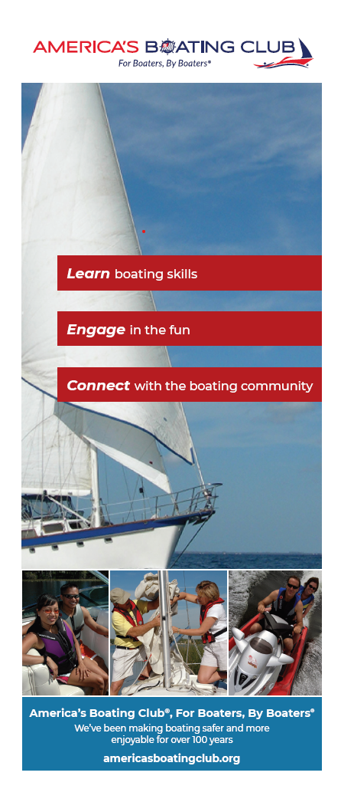
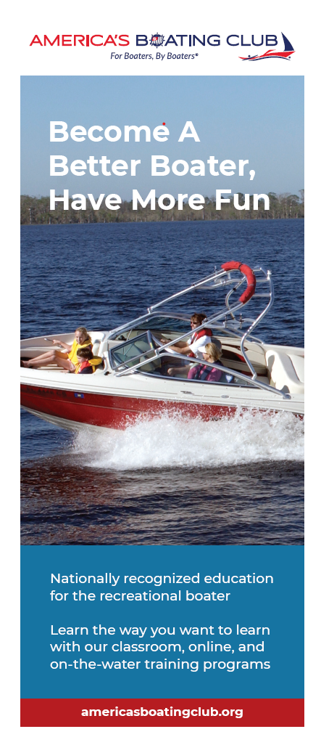
Use the Two Trifold Brochures
One general & one education-specific
New and improved
Consistent message
Designed to work together
  Who we are
  What we do
  Educational offerings
Avery 5160 labels for local branding

Slide 38

Partnerships
Corporate Sponsors
Organizational Partnerships
< 25,000 members
25,000 – 100,000 members
> 100,000 members
MOUs
DAN BOATER

Slide 39

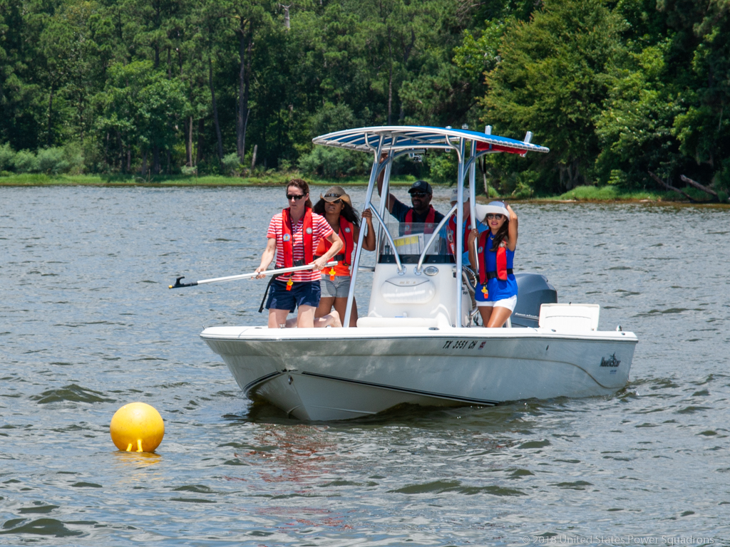
Our Hands-on Training: Basic Powerboat program helps you develop boat handling skills. You will learn basic and advanced techniques that will last a lifetime.

Slide 40
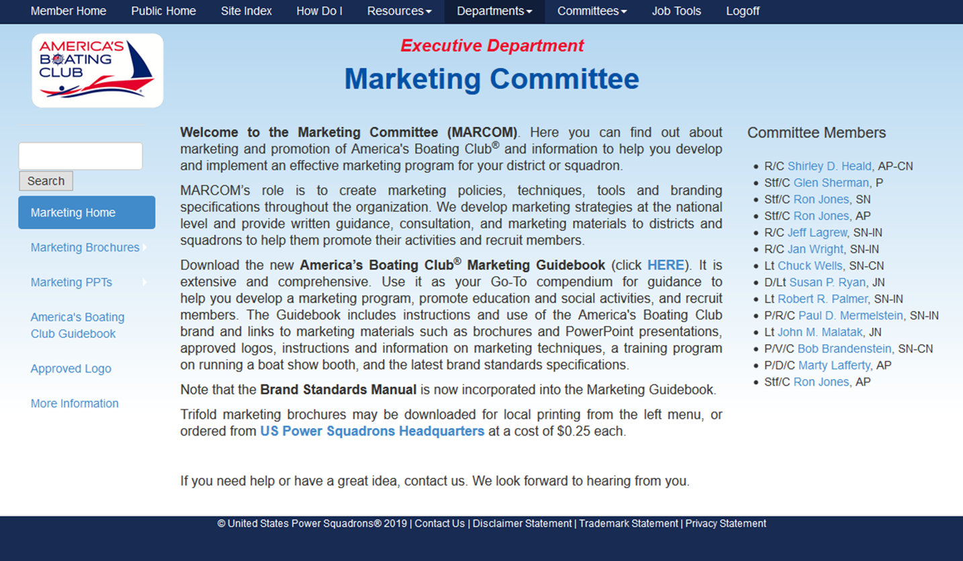
Updates to Marketing Committee web site

Slide 41
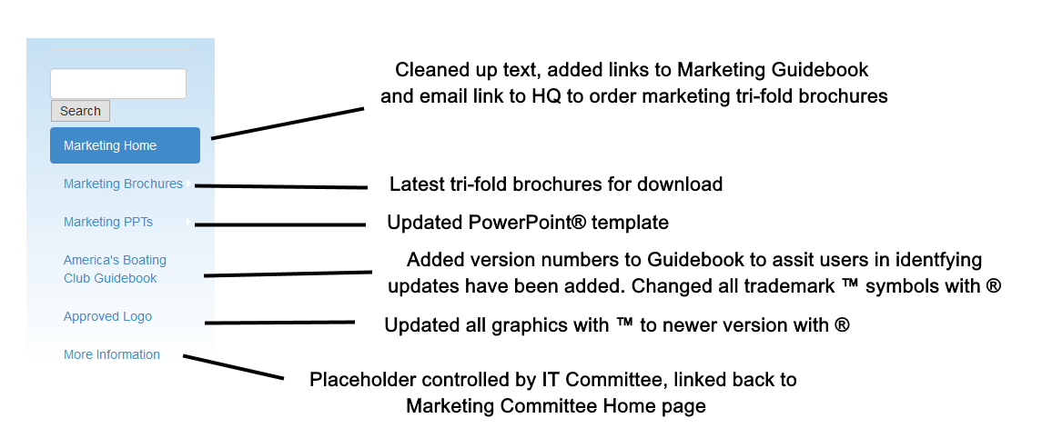
Left navigation

Slide 42
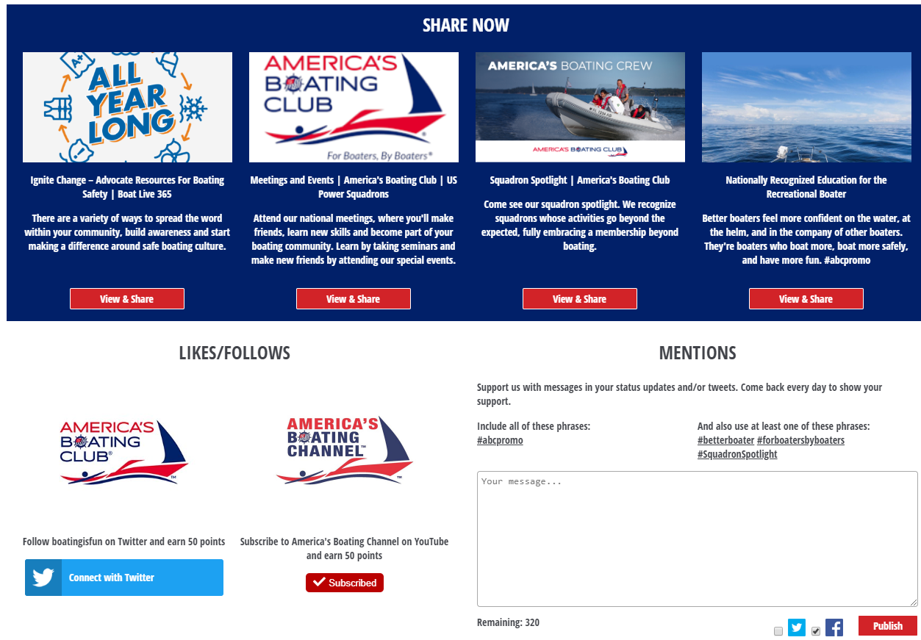
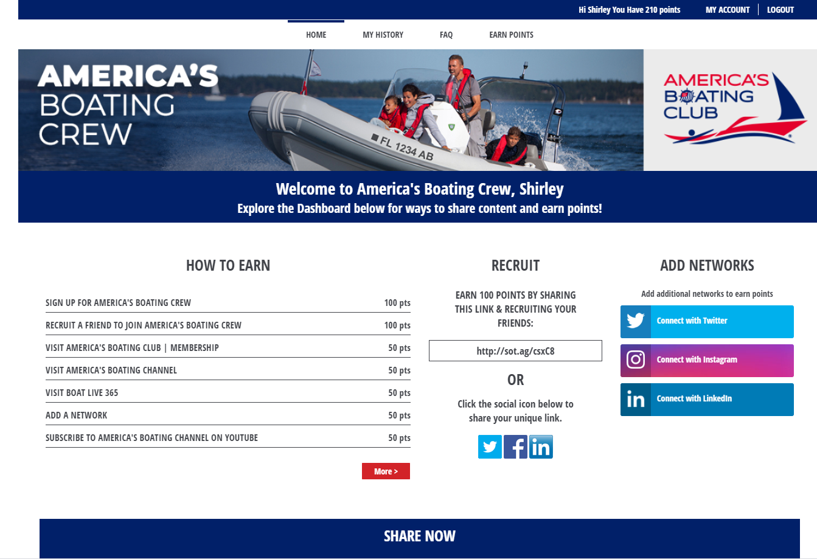
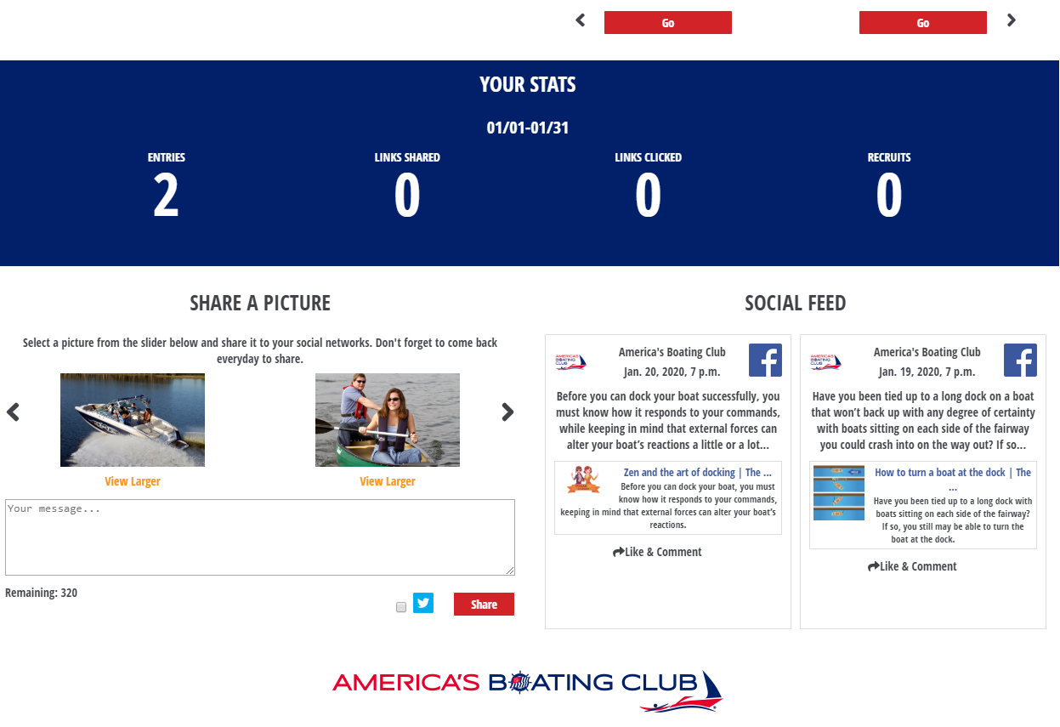
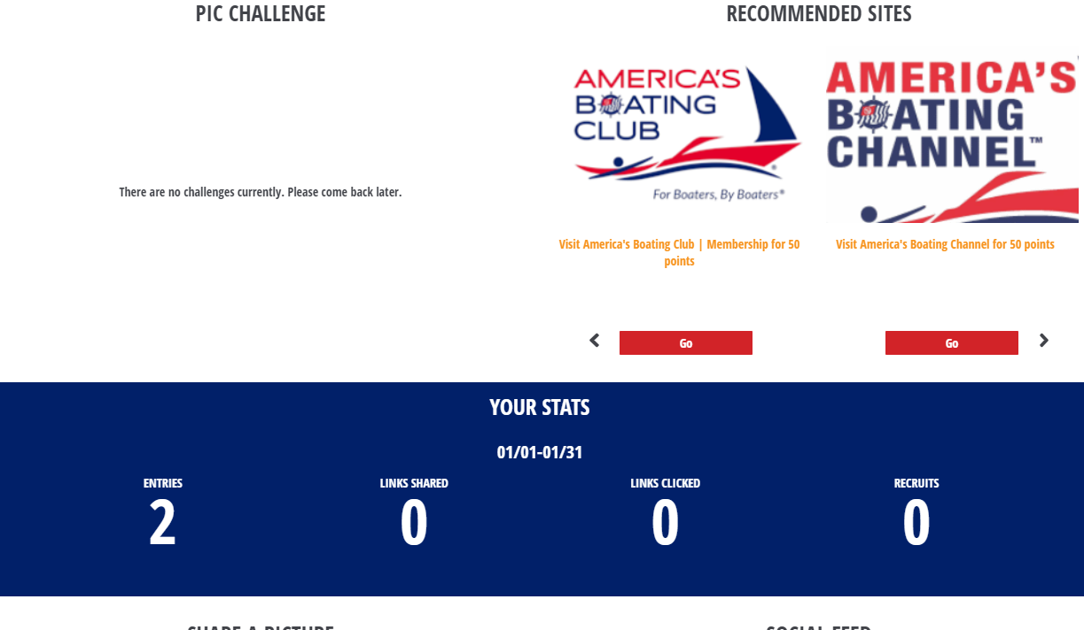
Social Toaster

Slide 43
New Educational Products
Reflecting Our Brand,
Appealing to Our Target Market
R/C Jan Wright, SN-IN
Chair, Publishing Committee

Slide 44
Our New Book Covers
Brand recognition is exactly what it sounds like: the ability of a consumer to recognize one brand over other brands.
In other words, it's the ability of consumers to identify your product by its attributes and design elements.
  Design elements include such things as:
  shape, color, illustrations, and graphics.
Notes:
Our Boat Handling curriculum comprises one six-part course and six seminars. The six parts of the course are identical to the individual seminars.
We sought to brand this new curriculum in a way that promotes America’s Boating Club, while honoring our design traditions, embracing our legal name, and appealing to our target market. We consulted closely with MarCom volunteers with our strategy.

Slide 45
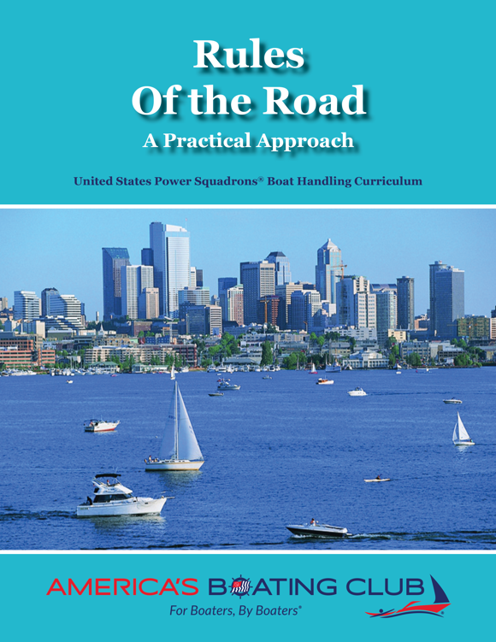
New Boat Handling Curriculum
Branding Elements
  Teal stripe
  Prominent ABClub logo
  USPS affiliation
Market Appeal
  Focus on skill competence
  Inclusive representation
Notes:
Our new Boat Handling curriculum debuts rebranded book covers. Front covers reprise the teal stripe that has long been part of our trade dress.
America’s Boating Club’s horizontal logo is featured prominently. The course name’s subtitle anchors the seminar as part of the United States Power Squadron’s Boat Handling Curriculum.
Images for all of the Boat Handling seminar series are inclusive of a diverse group of boaters. Rules of the Road features sail, power, and paddle boaters in an urban setting.
The market appeal focuses on skill competence and what students want and need to know. “A practical approach” to understanding the Rules of the Road, makes the content more accessible.

Slide 46
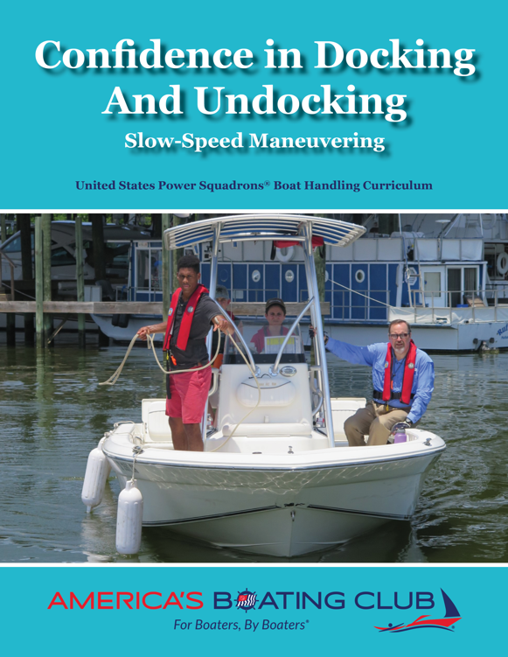
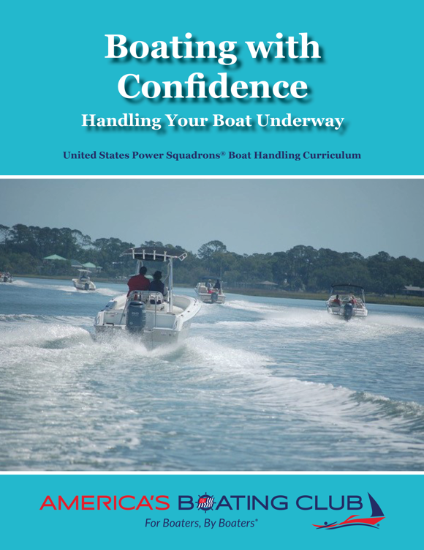
Docking, Boating
Notes:
Our Confidence in Docking and Undocking cover reprises the same design and branding elements. The photo is of a training session just before our America’s Boating Centers LLC was launched. It features young boaters, teen-age men and women, as well as racial inclusion.
The Boating with Confidence cover shows the fun our members have when they boat together. The image photo is on the Intracoastal Waterway in Savannah, GA.

Slide 47
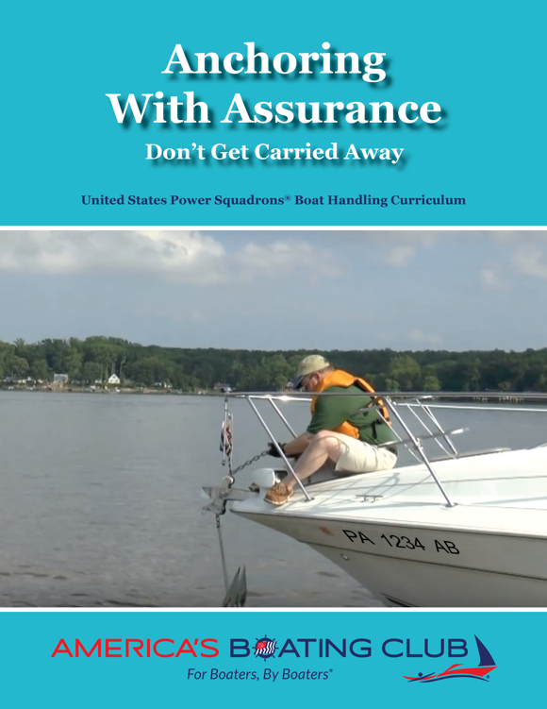
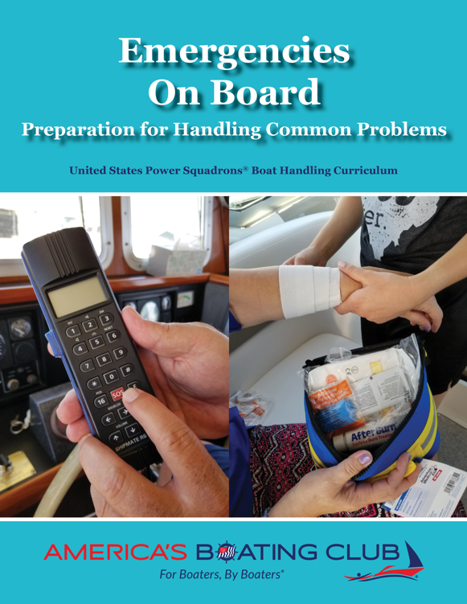
Anchoring, Emergencies
Notes:
Anchoring with Assurance also shows skill competence and appropriate safety (life jackets and gloves).
Emergencies on Board images focus on communications in an emergency and how to handle a medical emergency. The hands convey competence and inclusion by gender, age, and race.

Slide 48
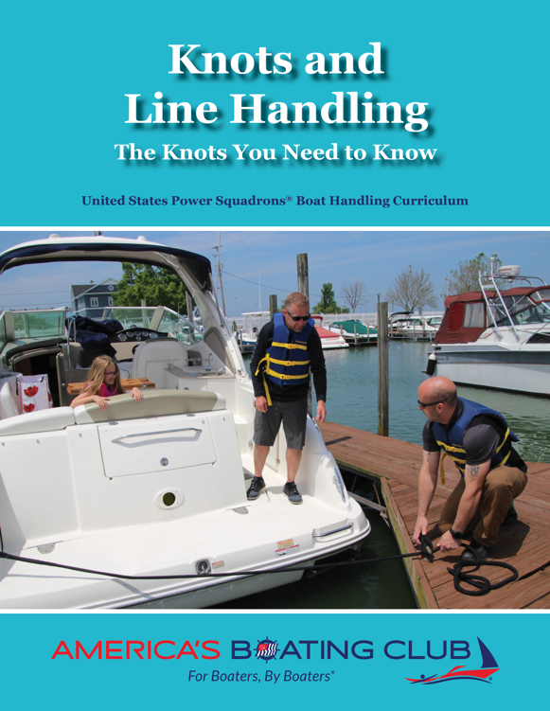
Knots and Line Handling
Notes:
Knots and Line Handling demonstrates collaboration between boat operators and dockhands, the fun that fathers and daughters can have boating together, safe practices (life jackets aboard and on the dock), and competent use of stern lines.

Slide 49
Seminar Back Covers
Branding Elements
  Our logo
Market Appeal
  “You may also be interested in”
  Contact info focuses on Membership and Boater Education
Notes:
We have decided that our back covers must connect on the membership front, not just education.
For Boat Handling seminars, we share other boat handling seminars, as well as other useful seminars.
The white box is where the ISBN bar code is placed.

Slide 50
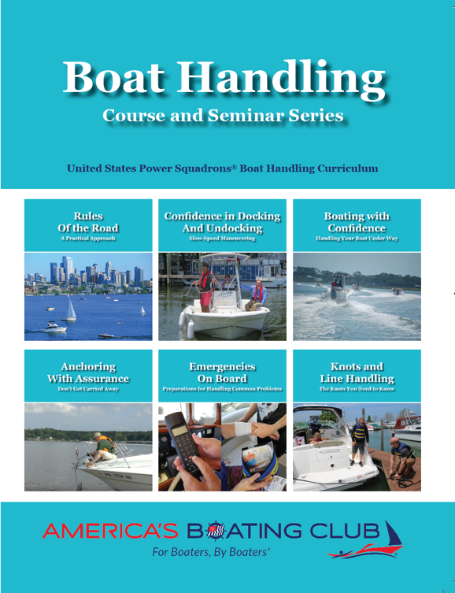
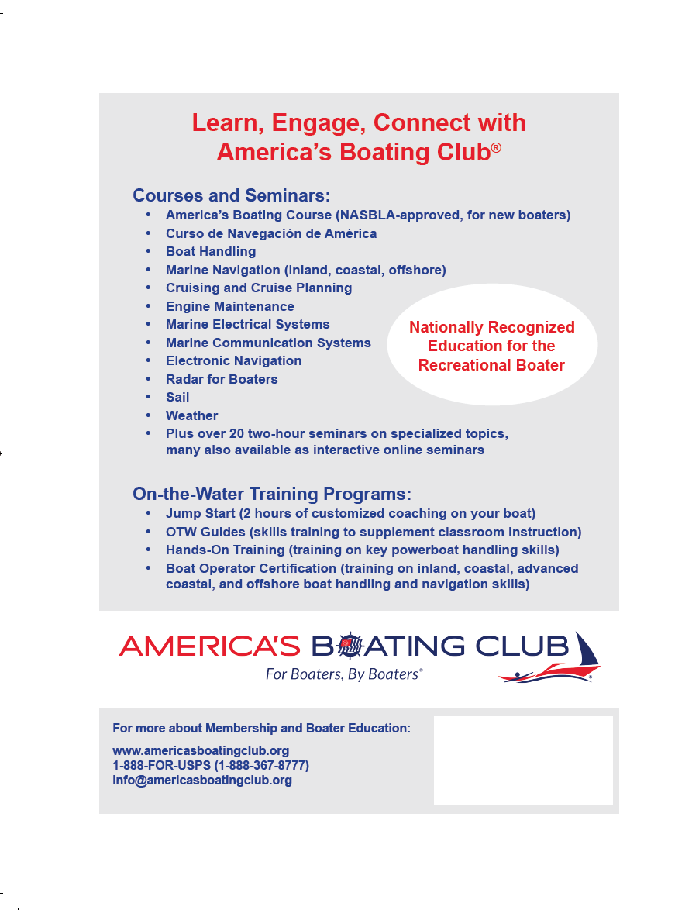
Boat Handling Course
Notes:
The Boat Handling course front cover reprises all six seminars, so there is no confusion that the Boat Handling course and seminar series are part of a single curriculum.
The back cover reprises our public website’s “Nationally Recognized Education for the Recreational Boater” theme and provides information about our courses and on-the-water training programs.
Again, it showcases our America’s Boating Club identity and invites students to contact us for more information about membership and education.

Slide 51

MarCom
Questions?

