Slide 1
Marketing for USPS
Business Concepts Applied to Our Not-For-Profit Organization

Slide 2
Objectives
Clear up the mystery about Marketing
Differentiate between PR and Marketing
Apply proven business concepts to USPS
Provide a structure for
Brainstorming
Planning
Executing an effective marketing strategy

Slide 3
Change Is Necessary
The world is changing before our eyes
Boating vs. other recreational activities
Traditional outreach vs. social media
Education in general is in transition
Our internal organizational inertia inhibits rapid response and evolution
In past we had separate, uncoordinated marketing groups and committees

Slide 4
We Confuse Ourselves
Do not understand Marketing and PR
We create products and services without understanding the customer
There is no real strategic plan or associated marketing plan
Muddy guidance throughout
Marketing vs. PR:
What is the
difference?
Notes:
Pause for the question and solicit answers from audience.

Slide 5
We Often Send The Wrong Message
Traditional USPS Marketing
Who is this? Why?
A message includes not only what you say, but how you say it and how it appears to others.
We MUST understand our audience.
What is the Message?
What are we selling?
Who is the Customer?
Children? Pirates?
Where is our primary customer?

Slide 6
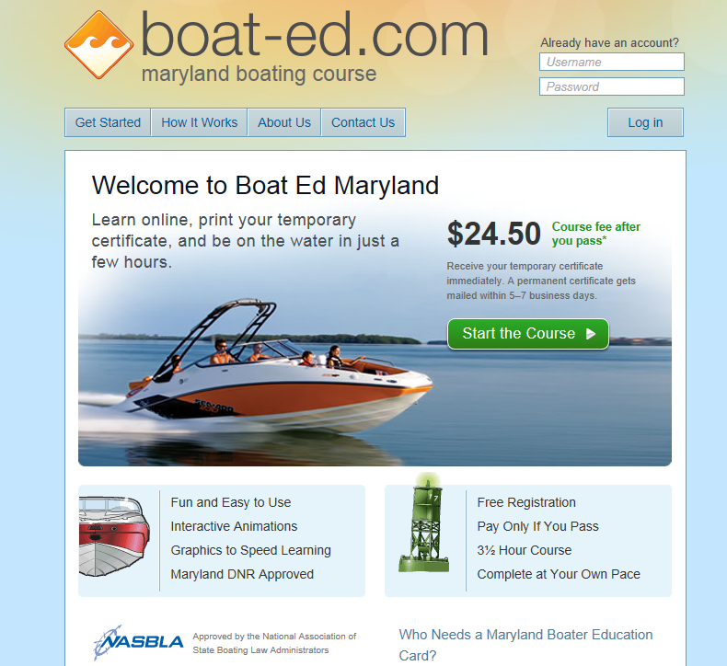
Competition Is Tough
This Texas outfit is a for-profit company.
They make this same offer in 45 states. You pay $24.50 when you pass the test.
We Are Better!!

Slide 7
We Do Not Have Consensus
What do we actually sell?
How can we use our superior courses to a competitive advantage?
Who is our target audience?
What do our customers really want?
How do we attract them to us?

Slide 8
We Need to Kill Our Own Myths
Our mission compels people to join
If we hand out mission-related materials (e.g. safety) , people will:
Know who we are & what we do
Come to us for education
Join a squadron
“Build it and they will come”

Slide 9
We Need to Kill Our Own Myths
We believe our uniforms attract people from the public
Pictures of our member demographic are good tools for marketing
People like the fact that we have 100 years of existence
If they are interested in joining, they will easily find out how to do so

Slide 10
We Must Understand Our Customers
Just because we think they need it does not mean that they want it
Foster an external focus on them, not internally on ourselves
Purchase decisions are based upon emotion, wrapped in a rational shell
People want to feel a connection
Recognize that we are just a commodity and that we have competition

Slide 11
Public Relations
Promotes a USPS-specific image to the general public
Raises awareness and name recognition
Who we are and what we do
Mission messages ok, but is not PR unless connection to USPS is clear and obvious
Does not advertise specific products
Not directly aimed at customer purchases or new members

Slide 12
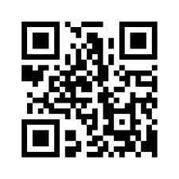
Public Relations
Employs media as primary channels
Traditional press releases etc. (passé)
Freebies, buttons, pins, etc. with OUR logo
Social Media (a must!)
Go Mobile.

Slide 13
Marketing
It is not just advertising or selling
Marketing is a strategic function that helps determine:
Market segments and target audiences
What to sell, what features, etc.
Pricing strategies
How to promote offerings
How to sell
How to deliver

Slide 14
Four P’s or C’s of Marketing
Product | Commodity | What people want to buy
Price | Cost | What consumers are willing to pay Competition’s price
Place | Convenience or Channel | Make it easy to buy and to access/use
Promotion | Communication | Message & medium Ongoing/repetition

Slide 15
How Does This Apply To Us?
Determine and define our target markets
Primary member demographics
Education products market segments
Offer them products and services designed for their specific needs (one size does NOT fit all)

Slide 16
How Does This Apply To Us?
Determine the right price
In collaboration with others
Cost-based or market-based
Loss leaders
Determine and design promotional strategies, branding, and media
To create demand
To differentiate our products
To convince customers to buy

Slide 17
How Does This Apply To Us?
Promotion is a call to action
Promotes education and membership directly to individuals
Not public service announcements
Not generalized statements about safety
Not education
Not materials from other organizations

Slide 18
Marketing and PR Committees

Slide 19
Committee Structure
Marketing Committee | Headquarters Marketing | Public Relations Committee
Marketing Chairman | Headquarters Director | Chairman
Assistant Chairman |  | Assistant Chairman
Education |  | Headquarters Director
Membership |  | General Members
Member Benefits
Public Relations
Communications
Headquarters Marketing
8 At-large Members

Slide 20
Committee Responsibilities

Slide 21
Marketing Committee Goals
Coordinated National Marketing Plan
District and Squadron Plans
National branding manual
Social Media implementation & training
Customer based Market Research
How to Sell training

Slide 22
USPS Marketing Committee
Questions?

