Slide 1
Basic Navigation United States Power Squadrons® Website
Prepared by:
Squadron Development/Leadership Committee
December 2018
© United States Power Squadrons®
December 2018
All Rights Reserved
1
Notes:
Greet your audience. Introduce yourself [Rank, Name, Grade]
There is a great deal of information on our website, useful to all members, especially to officers.
Many of our members do not use the website very often for various reasons; one reason in particular is not understanding how to find the information desired.
This seminar is intended to help our members find their way around the website and to find desired information. We are using a series of screenshots from the website as examples.
This seminar is intended for use in district and squadron events and meetings. We assume that most members working in national positions are reasonably familiar with the website. We have tried to also make the website useful to newer members and to help them learn more about our organization by using our website.
This presentation starts with basic information about logging into the home page of the website and logging into the members page, then explores the basics of finding information useful to our members.
We urge you to spend some time exploring the website on your own, and looking through the information that is available for your use.

Slide 2
GETTING STARTED
Website Internet Address:
https//americasboatingclub.org/
Entering this, you will get to the homepage shown on the next slide
2
Notes:
Let’s get started.. To get to the USPS website, use the address shown above. This will take you to the USPS home page, shown on the next slide.

Slide 3
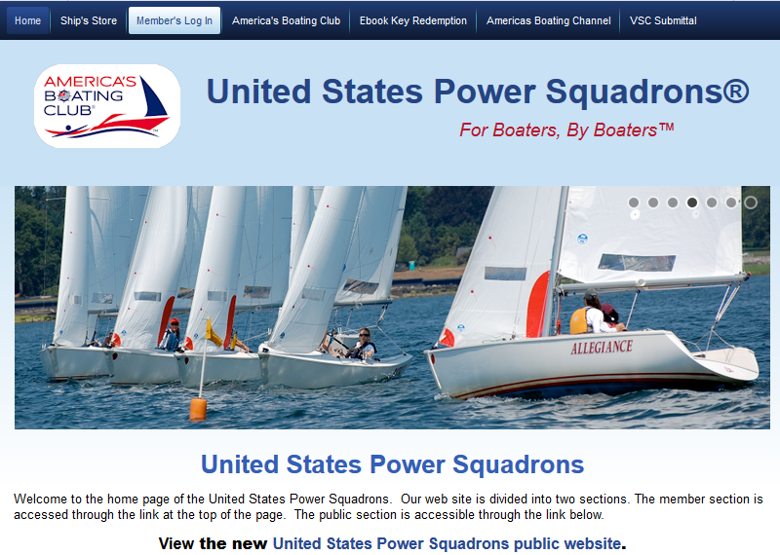
3
Notes:
There are two links on the home page. One link will lead to the public site, the other to the member site. The public site discuses general information about who we are and some of the things we do as an organization, information about joining USPS, and the many benefits of being a member of USPS.
There is also information about finding a local squadron, the importance of boating education to the recreational boater, and boating safety.
We will be discussing the Member’s Site in the remainder of this seminar.
To get to the member site, click on “Member’s Log In” on the tool bar at the top of the page.

Slide 4
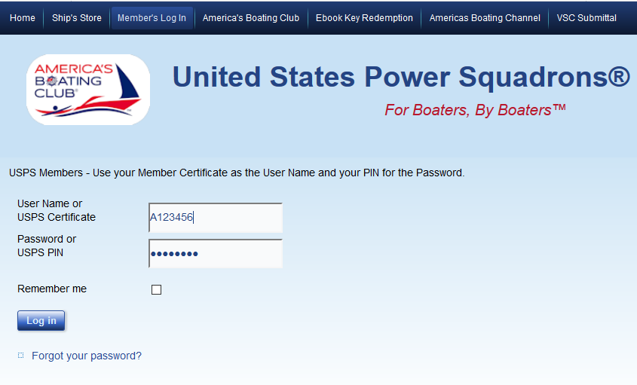
4
Notes:
Clicking on the “Member’s Log In” on the home page leads to the log in sheet. Enter your Certificate Number and your USPS PIN. Your PIN will be on the dues bill that you receive from USPS. If you have trouble remembering your PIN, you can change it as will be discussed later in this presentation.
Logging in will lead to the “Member Site”, shown on the next slide.

Slide 5
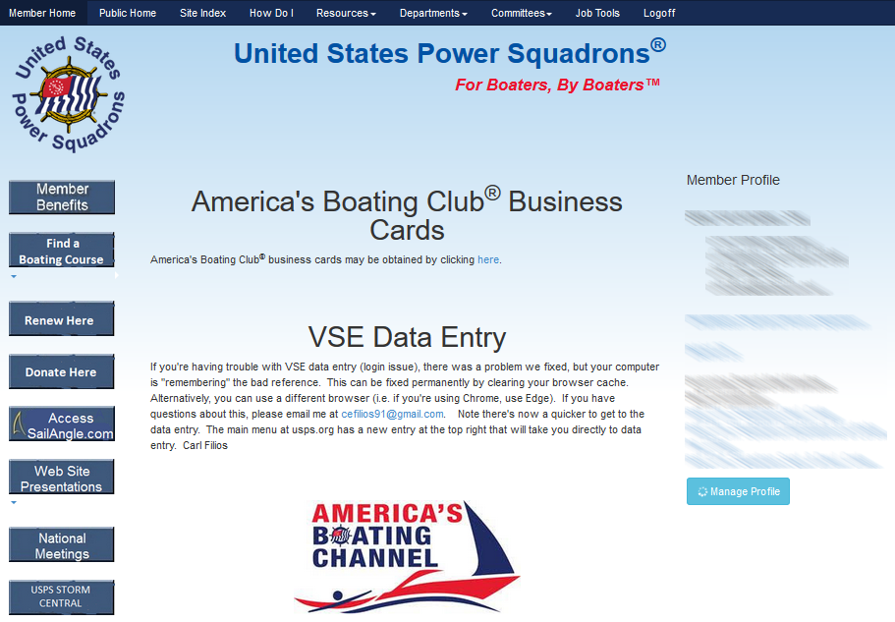
5
Notes:
On the Member Site page, you will find your member profile and a link to manage your data through the “Information Center”, which will be discussed later.
Scrolling down the page, you can find “News Publications” with links to:
Monthly Blast
Compass
Ensign
Clicking on “National Meetings” will take you to the meetings page shown on the next slide.
Please note that the personal information under the “Member Profile” has been purposefully blurred for this presentation.

Slide 6
6
Notes:
If you are interested in attending a national meeting, information on this page gives dates and locations of meetings as well as links for hotel reservation, event reservation, an agenda for the events during the meeting week, etc.

Slide 7
7
Notes:
Let’s go back to the Member Site page, and explore some of the information that can be accessed from the tool bar at the top of the page. These links will be used to access material covered in the majority of the remaining slides in this presentation.
If you click on “Site Index”, you will find links to many of the features in the USPS website, as shown on the next slide.

Slide 8
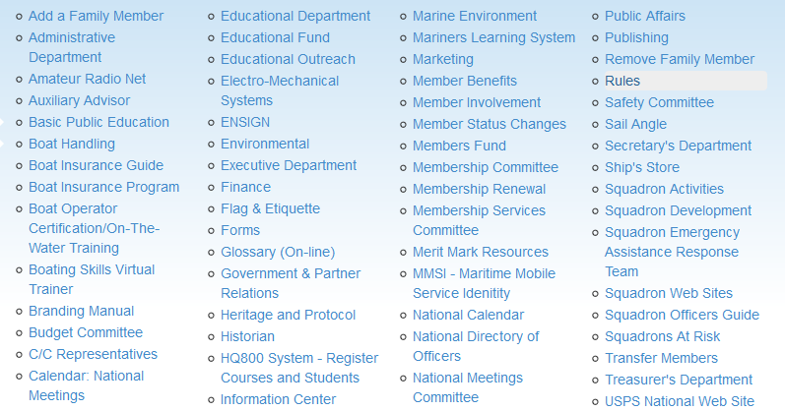
PARTIAL LIST
8
Notes:
A partial list of the links on the Site Index is shown. The actual list of topics is considerably longer. Let’s look at two useful items from this list, “Forms” and “Information Center” on the next two slides.

Slide 9
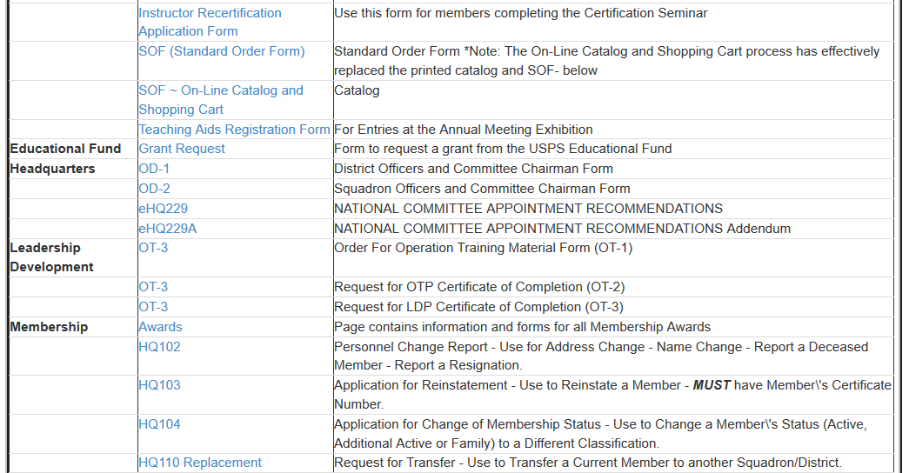
PARTIAL LIST
9
Notes:
A list of the forms used for various purposes in USPS (only a partial list is shown on this slide) is given from the “Forms” link. The list includes the form designation and a description of each form’s use. This is helpful for district and squadron officers, and some committee chairs to find the proper form for reporting to USPS headquarters, and to national departments and committees.

Slide 10
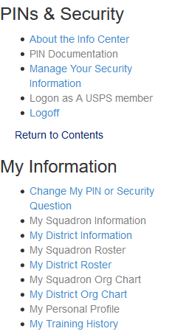
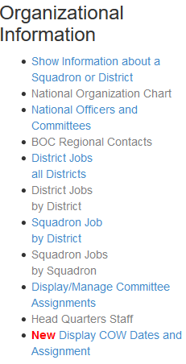
10
Notes:
Clicking on “Information Center” provides information about the national, district, and squadron organization including officers and committee chairs at the three levels of USPS with contact information.
It also contains information (My Information) about the member logging in to the “Member’s Site”. This information is only available to a small group, primarily certain officers as well as information available to the member logging in. Included In this list is the ability to correct or update information such as an address change, new email address, telephone number change, and to change your USPS PIN.

Slide 11
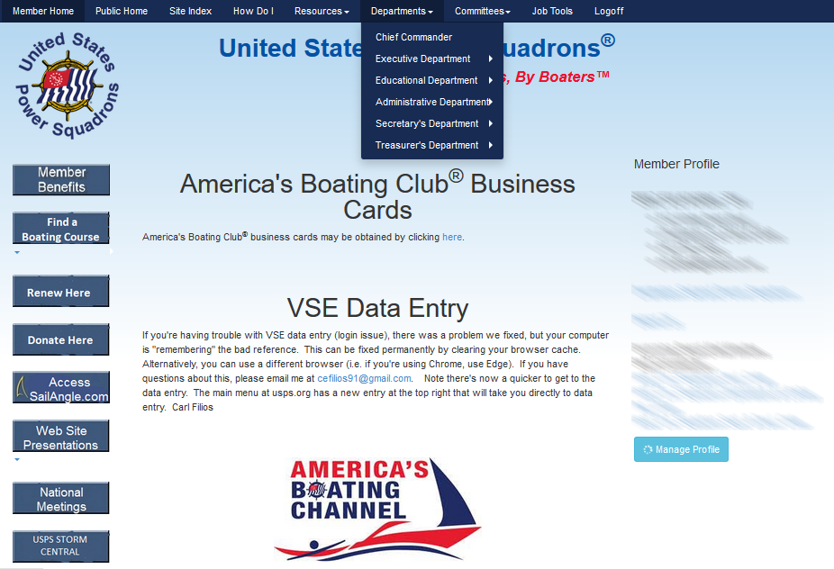
11
Notes:
If we go to the Member Site page and point on Departments, a drop down menu listing the six departments will pop up. The six departments are:
Chief Commander
Executive Department
Educational Department
Administrative Department
Secretary’s Department
Treasurer’s Department

Slide 12
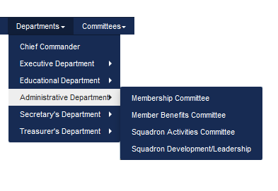
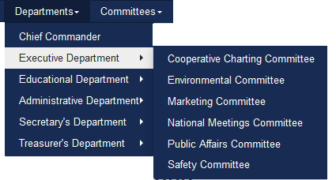
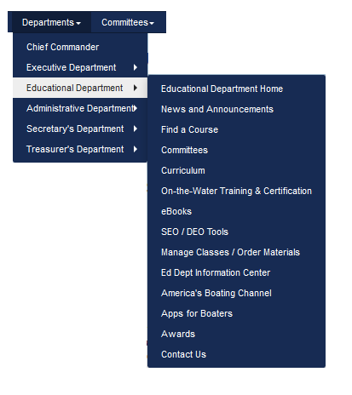
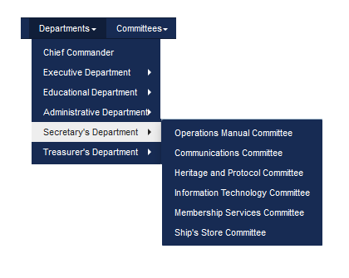
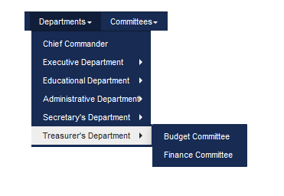
12
Notes:
This slide shows the departmental committees for each department. In actuality, there are only two committees in the Administrative Department; Membership and Squadron Development/Leadership. Member Benefits and Squadron Activities are sub-committees of the Membership Committee.
Clicking on the department name (as an example, the Executive Department) will bring up information about the current department head. There is also a brief description of pertinent information about the work of the department.
Clicking on a committee name will bring up information about a specific committee. We will talk about committee information later in this presentation.

Slide 13
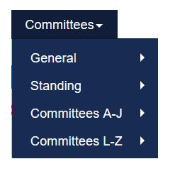
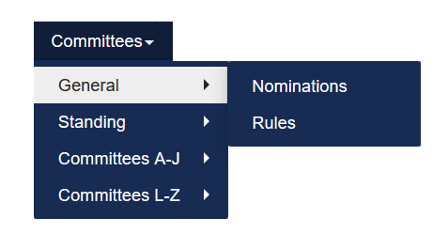
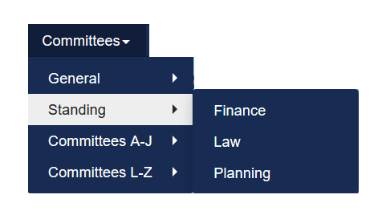
13
Notes:
Pointing on “Committees” will show a dropdown menu shown on the left, with General and Standing Committees and an alphabetized list of departmental committees. Pointing to “General” will bring up a menu of the two General Committees, and pointing to “Standing” will bring up a menu of the three Standing Committees. Click on the specific General or Standing Committee you are interested in and you will get to the committee webpage.
If you know the name of a departmental committee, point to the range of the first letter of the committee name which will bring up a list of committees beginning with the first letter in the range. Click on the specific committee you are interested in, and you will get to the committee webpage.
We will next discuss the General and Standing Committees, the Departments and Departmental Committees.

Slide 14
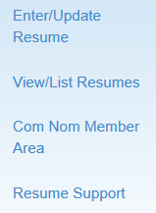
14
Notes:
The Committee on Nominations:
Provides list of nominees
Maintains a list of member resumes, and has provisions for members to enter on-line resumes or make changes to previously submitted resumes
Provides data for committee chairs in selecting candidates for committee members

Slide 15
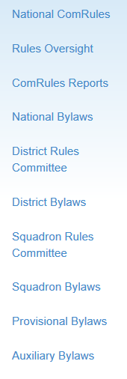
15
Notes:
The Committee on Rules is one of two General Committees of USPS (the other is the Committee on Nominations.) As such it reports to the membership in its entirety.
Its responsibilities include administration of the bylaws of all parts of USPS -- From national to district and squadron plus provisional squadrons and (on request) auxiliaries. That administration extends to writing the national bylaws and all amendments to them and the approval of all bylaws of all subordinate levels. It is further responsible for interpreting the national bylaws and passing on credentials of voters at Governing Board meetings.
In addition it is charged with the responsibilty of chartering new squadrons during periods between governing Boards. Its chairman or his appointee is the parliamentarian at all national meetings and his counterparts serve the same role at district and squadron levels.

Slide 16
STANDING COMMITTEES
16
Notes:
The Finance Committee reports to the Board of Directors and reviews the proposed budget for the ensuing fiscal year as prepared by the budget director to determine that the necessary funds can be made available to finance the budget as presented.
The Law Committee (LawCom) is a standing committee of, and reports directly to, the Governing Board. LawCom provides legal advice and services to the Governing Board, Operating Committee, National Departments and National Committees.
The Planning Committee is a 'think tank' for where United States Power Squadrons/America's Boating Club is headed. The Planning Committee makes recommendations in response to queries referred to it by the Governing Board, by the Board of Directors and, on its own initiative, makes recommendations of proposed changes for the improved functioning of USPS.

Slide 17
17
Notes:
The Operations Manual Committee, in the Secretary’s Department, has a very important role to play in USPS. The “Operations Manual” can be downloaded from the committee webpage. This committee keeps the manual updated based on changes in USPS Bylaws and actions of the Governing Board. The manual discusses the operating principles of the national, district, and squadron levels of USPS. This manual provides organizational information that should be of interest to all members, and in particular to all district and squadron officers. These officers should be well versed in the contents of the manual.
There is a seminar, that is helpful to all members, and that should be attended by all district and squadron officers called Operations Training. The current seminar is titled “OT in 3”, and was developed by the Squadron Development/Leadership Committee. As mentioned on this slide, this seminar synoptic summary of the “Operations Manual”.
Now let’s take a little time to explore the Departments and Departmental Committees, starting with the Chief Commander’s Department. Click on the department of interest on the tool bar at the top of the Member Site page.

Slide 18
Department Leaders
Chief Commander
Flag Lieutenant
Chaplain
Parliamentarian
National Medical Officer
National Photographer
Aides to the Chief Commander
Contact the Chief Commander
C/C Reps’ Guide
C/C Reps’ Bio &
Conference Schedule
National Photographer
18
Notes:
On the left side of the Chief’s home page are links to topics and information for the C/C Department.
In the center of the page is a short biography of the current Chief Commander.
On the right side are a list of members serving as Department Leaders.
Note that the other department home pages have a short discussion about each department head and also about the goals and programs the department is emphasizing.

Slide 19
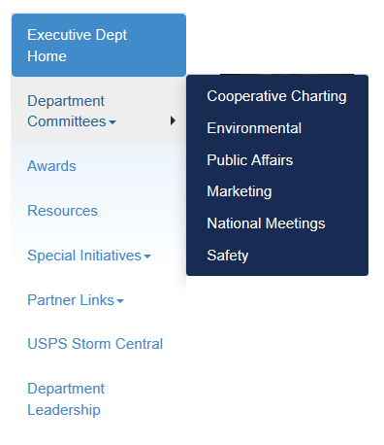
19
Notes:
On the Executive Department home page, there is a list of links to various aspects of the department on the left side of the page.
Committees include:
Environmental – to educate members in environmental stewardship including proper disposal of wastes.
Public Affairs – partner relations and public relations.
Marketing – marketing USPS at national level and help squadrons with marketing programs.
National Meetings – Set up Governing Board and Annual Meetings including hotels, costs, food, transportation, etc. Also discussed on Slide 6.
Other programs include:
Special Initiatives - primarily homeland security issues.
Partner Links – especially USCG Boating Safety Center.
The next two slides concentrate on the Cooperative Charting and Safety Committees.

Slide 20
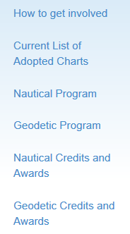
20
Notes:
The Cooperative Charting Program of the United States Power Squadrons is conducted in close cooperation with United States Army Corps of Engineers, the United States Coast Guard and NOAA's National Geodetic Survey Division (NGSD). The Program continues to be a major public service of USPS. As in the past, members supply important information to the above agencies so updates can be made to nautical charts and the National Survey Marker databases.
Clicking on “How to get involved” provides links for reporting nautical and geodetic information.
There is also information on credits and awards.

Slide 21
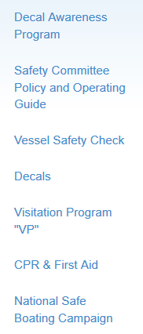
21
Notes:
The Safety Committee covers several programs. One very important community service program is performing vessel safety checks, including reporting of inspections and issuance of decals.
CPR and first aid programs are coordinated with the American Heart Association and the American Red Cross. Information on how to contact these organizations to provide districts and squadrons with training in these areas is given.
Information on the safe boating campaign in conjunction with the National Safe Boating Council, including National Safe Boating Week activities is included.
There is also information about a new program, Boat Live 365, included on the committee home page.

Slide 22
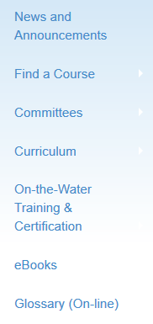
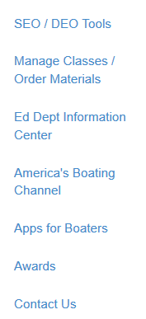
22
Notes:
The Educational Department is responsible for the development of educational products and services that help USPS and its local squadrons to promote recreational boating skills and boating safety through education and hands-on training. The Department’s committees are under the supervision of the National Educational Officer with support from the Assistant National Educational Officers.
Pointing on “Curriculum will bring up a drop down menu which includes a list of current course editions, and a description of America’s Boating Course, each advanced grades and elective course, seminars, and webinars.
The department home page useful DEO/SEO tools helpful to these officers, information on course management and educational material ordering.
The “Ed Dept Information Center” includes policies and procedures; department contacts; forms; ABC3 reports; information for instructors, students, and boaters; and marketing materials.
There are also links to information about On the Water Training and Certification programs.

Slide 23
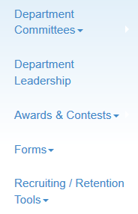
23
Notes:
There are two committees in the Administrative Department
The Membership Committee (MEMCOM): focus is on the individual member; anything regarding recruiting or retaining a member; involving members through boating or civic or social activities; and supporting a member through offering unique member benefits and recognition is found here. Membership retention is key.
The Squadron Development/Leadership Committee: focus is on the squadron and district organizations, whether developing a brand new squadron, offering leadership or operations training, assisting squadrons and districts recruit volunteers, as well as nurturing existing squadrons. Programs are developed, presented, and revamped with squadron growth in mind.
Let’s look at these two committees in a little more detail.

Slide 24
24
Notes:
Clicking on the Membership Committee will open the committee webpage. This is the heading of the committee home page.

Slide 25
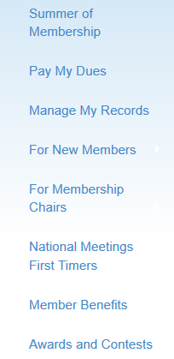
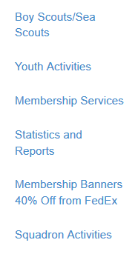
25
Notes:
Along the left side of the home page is a list of topics included under Membership. Click on any of these topics to find information about any of these topics.

Slide 26
26
Notes:
If we click on “Membership Statistics and Reports”, we will get to this page. Clicking on “Monthly Membership Statistics” will open the end of the previous month’s squadron membership data arranged by district. There is also information on finding archived data and graphical statistics.

Slide 27
27
Notes:
On the Membership home page, clicking on “Member Benefits” will open a list of the many benefits available to our members. Each item in the list has a space to click to open a discussion of the particular benefit. Taking advantage of these benefits can easily save more money than is spent on membership dues. Take a look at this list to see the many ways you can save money by being a member of our organization.

Slide 28
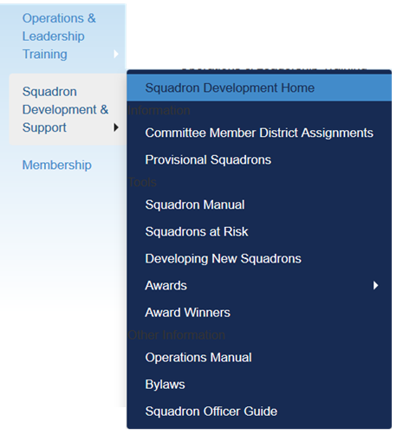
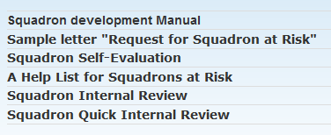
28
Notes:
There are two subcommittees included in this committee; Squadron Development & Support, and Operations & Leadership Training. By pointing to either of these subcommittees on the left side of the page, a drop down menu will appear. Click on any of these drop down menu items to open the appropriate items included under the subject. First, we will start with Squadron Development and Support. Using the drop down menu, click on Squadrons at Risk, then Squadron Internal Review.

Slide 29
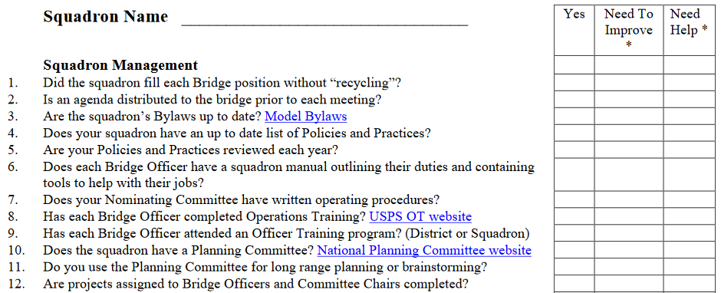
29
PARTIAL LIST OF TOPICS
Notes:
Clicking on “Squadron Internal Review”, there is a form that can be used to perform an analysis of your squadron. This slide shows a portion of this form. Although this form is listed under “Squadrons at Risk”, every Squadron Executive Committee should do this review at least twice a year, not only squadrons at risk. This will show areas in which the squadron is doing well and areas of squadron weaknesses. By honestly evaluating your squadron, you will be able to find areas that need improvement. By identifying these area, you can then begin to set goals for making these improvements and develop a plan to achieve the goals.
You can’t make improvements if you can’t identify the problems, and this type of evaluation will help you identify problem areas.

Slide 30
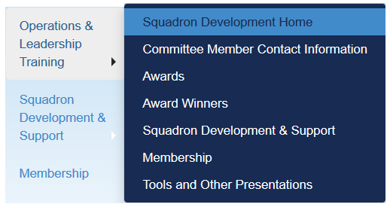
30
Notes:
Pointing to “Operations & Leadership Training” will open a drop down menu of topics under this subcommittee. We will look at some items under “Tools and Other Presentations”.

Slide 31
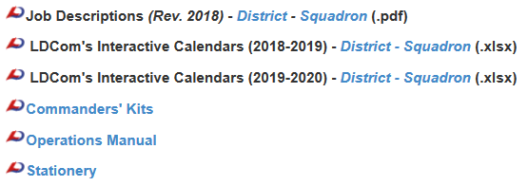
Tools
Other Presentations
Partial List
31
Notes:
Clicking on “Tools and Other Presentations” opens a meu listing “Tools” and “Other Presentations”.
“Job Descriptions” are a bulleted list of duties and responsibilities of district/squadron bridge officers, general and standing committees, and squadron executive committee.
“Interactive Calendars” are spreadsheets for each month with national function dates, due dates for some submittals, and a “to do” list for each month. Districts and squadrons can insert their events and use the calendars for websites and newsletters.
“Commander’s Kits” include links to documents, forms, manuals, and information for district and squadron commanders and should be studied by commanders.
“Other Presentations” include the Operations Training Program, OT in 3, and a number of seminars that can be presented at district and squadron sessions or events.

Slide 32
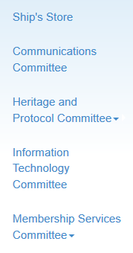
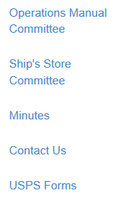
32
Notes:
The Ship’s Store offers a wide variety of USPS merchandise. Many items are available for purchase on this USPS website and at all national meetings.
Squadron and District newsletter editors and webmasters will find essential data on the Communications Committee page.
If you would like to learn the proper way to fly your flags and burgees, visit the Heritage and Protocol Committee and the Flag and Etiquette Subcommittee.
For members involved in the record keeping side of their squadron or district, the Information Technology Committee is a good place to start. Webmasters will also find this page to be most interesting.
The Membership Services Committee maintains the USPS Help Desk and is available to help districts and squadrons with data.
The Operations Manual Committee has previously been discussed.

Slide 33
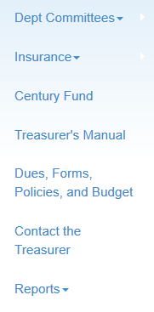
33
Notes:
Under “Dept. Committees”, there are links to the Budget and Finance Committees.
Under “Insurance”, there are links to the USPS Boat Insurance Program and information about coverages for national, district, and squadron programs including on-the –water activities.
The Century Fund has been created to ensure that there is an ongoing source of support for the activities of USPS, now and into the next century.
There is a link to the Treasurer’s Manual. This manual should be studied by district and squadron treasurers as it contains procedures that should be followed and other helpful information.
There are listings of forms and policies that need to be used by district and squadron treasurers under “Dues, Forms, Policies, and Budget”.

Slide 34
WHERE DO WE GO FROM HERE?
We have covered the general navigation of the USPS Website today. We have talked about logging on to the website and many features of the site.
Take some time to explore the website. There is a lot of information available to help all members, and information to help district and squadron officers perform their duties effectively and efficiently.
Many members say that there is a lack of communication in our organization. Our website is one of the most important communication tools available to all of our members.
34

Slide 35
Thank you for attending this seminar. We hope you have enjoyed the presentation and have gained insight into the use of the United States Power Squadrons® website. As we have mentioned earlier, please spend some time exploring the site and studying the information to better understand the functioning of our organization and the materials available to you as a member.
We welcome your comments and critique of this program, and will make an effort to answer any questions you may have. Please address your questions and comments to the current Rear Commander of the Squadron Development/Leadership Committee.
35

