Slide 1
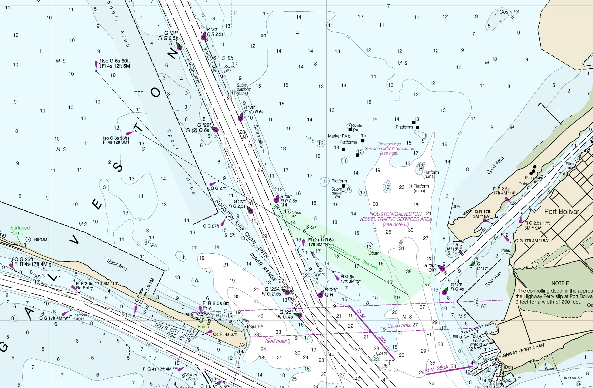
Office of Coast Survey The Nation’s Nautical Chartmaker
Matt Kroll
USPS
February 2017

Slide 2
Matt Kroll
Deputy Chief, Navigation Services Division, Office of Coast Survey (Acting Chief until April 1)
Navigation Services Division
Customer Affairs Branch
Navigation Response Branch
Nautical Publications Branch
NOAA for 18 years
Scanning historical charts
Compile and review RNCs and paper charts
Compile and review ENC

Slide 3
Topics (Status Updates)
MOA
CCWEB
Adopt-A-Chart
How to submit information (IDMS)
Navigation Managers/NRTs
Potential projects
Chart to imagery comparison
Coast Pilot updates
Chart Adequacy concept?

Slide 4
MOA between NOAA and US Power Squadron
MOA expired on 09/30/2016
OCS committed to maintaining the agreement with USPS, MOA will be renewed
Updated based on meeting outcomes
New MOA vetted and signed at fall meeting
Ceremonial signing at the 2018 USPS Annual Meeting in Orlando.

Slide 5
CCWEB
Current status
Determined to be a security issue
NOAA will not be bringing this back
Options for CCWEB
USPS revive under their control
NOAA provided a copy of the software to USPS
NOAA will not be able to provide support for the software

Slide 6
Adopt – A - Chart
NOAA interested in maintaining and growing this program, USPS?
End of CCWEB did NOT stop Adopt – A - Chart
Current participation
Need more discussion
Documentation
Compiling information
Points/awards
District Number | Number of Charts
21 | 9
22 | 9
23 | 1
26 | 7
27 | 2
32 | 6
33 | 2
District Number | Number of Charts
1 | 1
3 | 3
5 | 4
7 | 2
8 | 4
9 | 4
15 | 2
16 | 5

Slide 7
Submitting information to NOAA
Submit through Coast Survey Website
IDMS (Inquiry, Discrepancy Management System)
IDMS
Procedure was presented in Pittsburgh
We will provide the presentation and digital documents
Depthwiz?
Discussions need to be had about depth information
How do we make it easier for both sides?
New system being developed
ASIST (Aimed Stakeholder Interaction Survey Tool)

Slide 8
Navigation Managers, do you know yours?
NOAA’s navigation managers, stationed strategically in port areas along U.S. coasts and Great Lakes, work directly with pilots, mariners, port authorities, and recreational boaters. They help identify navigational challenges facing the marine transportation system, and provide the resources and services that promote safe and efficient navigation.
NOAAs Navigation Managers (NOAA will have a handout at the Expo)

Slide 9
Navigation Response Teams (NRT)
Coast Survey’s six mobile navigation response teams (NRT) conduct hydrographic surveys to update charts for 175 major U.S. ports. They remain on call to respond to emergencies, speeding the resumption of shipping after storms, and protecting life and property from underwater dangers to navigation
NRTs
NRTs Homeported in:
New London, CT
Fernandina Beach, FL
Stennis, MS
Galveston, TX
Seattle, WA

Slide 10
Potential Projects
Image/Chart Comparisons
Coast Pilot Updates
Chart Adequacy
NOAA no longer has the resources to assign point values for information submitted.
NOAA can present awards at annual conference

Slide 11
Potential Projects
Image and Chart Comparisons
RNC (Raster Navigational Charts)
ENC (Electronic Navigational Charts)
Level of functionality/complexity
Low - Spot an issue, screen capture, submit through IDMS
High – Spot an issue, circle and comment on screen, submission automatically goes to a database. (may require username and password)
Still need to develop/define the process.

Slide 12
Potential Projects
Coast Pilot updates
Visual confirmation of prominent features
Local information on dangers to navigation (shoal areas, current characteristics,)
Preferred channels to navigate
Places to anchor in inclement weather
Overhead cable investigations
Submitted through IDMS

Slide 13
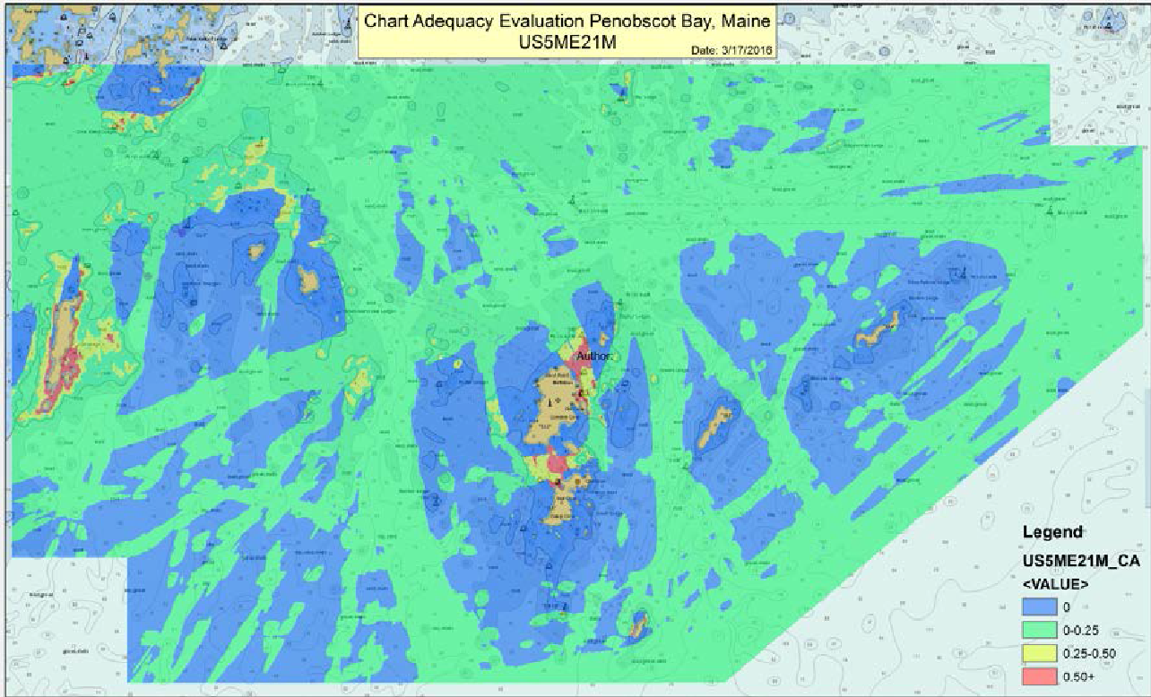
Potential Projects
Chart Adequacy
Not just good or bad, adequate
Based on hydro surveys, vessel traffic, chart discrepancies

Slide 14
Potential Projects
Chart Adequacy
Envisioning 3 phase approach
Phase 1 – Output of program run at NOAA
Phase 2 – Identifying problem areas
Navigation Managers + MCD + USPS
Phase 3 – Combine phases 1&2, pinpoint gaps, identify appropriate means to resolve gaps
NOAA ships, NRTs, contractors, USPS
New concept, not completely developed

Slide 15
THANK YOU!
Questions?

