Slide 1
Document and Support Label 102
R/C Jim Strothers, SN

Slide 2
Confusion
There still seems to be a lot of confusion on how to label the Support Documents and Items.
It will very important to fully understand the concept in the future.

Slide 3
Reasons
NOAA is anticipating the need to have us review the ENC’s (Electronic Navigational Charts) as part of the Co-op Charting program.
This will involve checking each item for the special characteristics assigned to it.

Slide 4
Getting back to basics
We need to go back to some very basic principles that we all learned many, many years ago.
1. The square peg goes in the square hole.
2. The round peg goes in the round hole.
3. The triangle peg goes in the triangle hole.
You get the picture.

Slide 5
Let’s begin with the Support Documents
Most of the time the first support document is the chart section.
This contains the features you are reporting on.
For the purpose of this presentation the chart will be Support Document A.

Slide 6
Capture the chart section you want by whatever method you are comfortable with
Using Paint or some other program that will allow you to insert text and lines, etc on the chart section complete the labeling as follows.

Slide 7
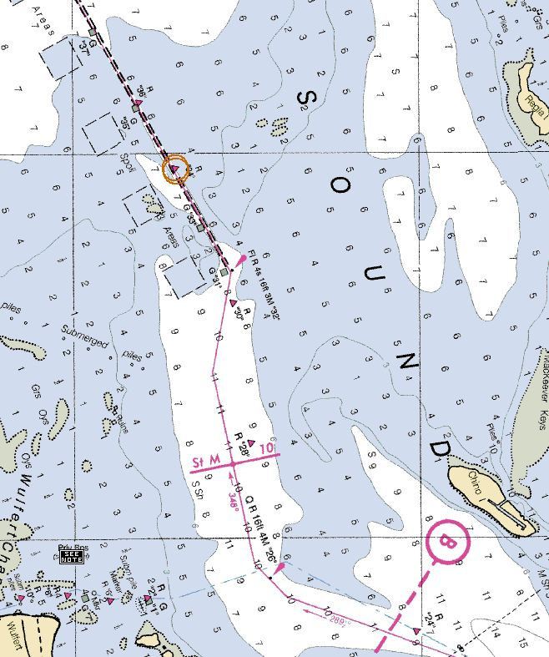
Support Document A
Report ID 1000
Chart 11427, 5/2005, 34th Ed
Item 1
Item 2

Slide 8
Once you have completed the labeling save this Document and all further documents in a file on your computer so you can access them later.

Slide 9
Now let’s move on the other supporting Documents
Support Document B - Shapes
Support Document C - Colors
Support Documents D and E - Reports

Slide 10
Support Document B Report ID 1000
Item 1
Item 2

Slide 11
Support Document C Report ID 1000
Item 1
Item 2

Slide 12
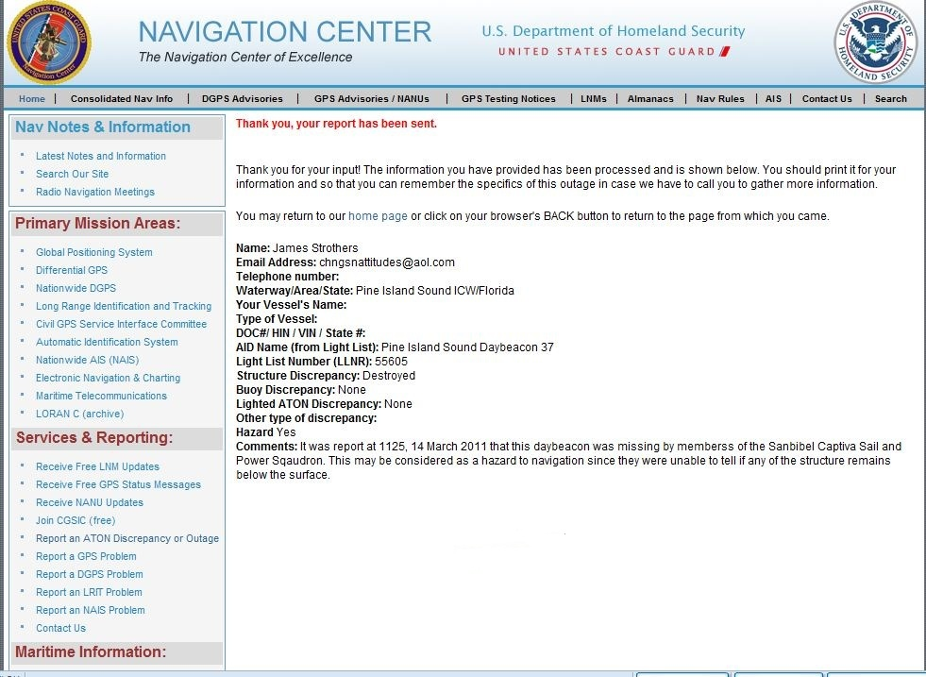
Support Document D1
Report ID 1000

Slide 13
Support Document E2
Report ID 1000

Slide 14
Now let’s put all this information into the Report

Slide 15
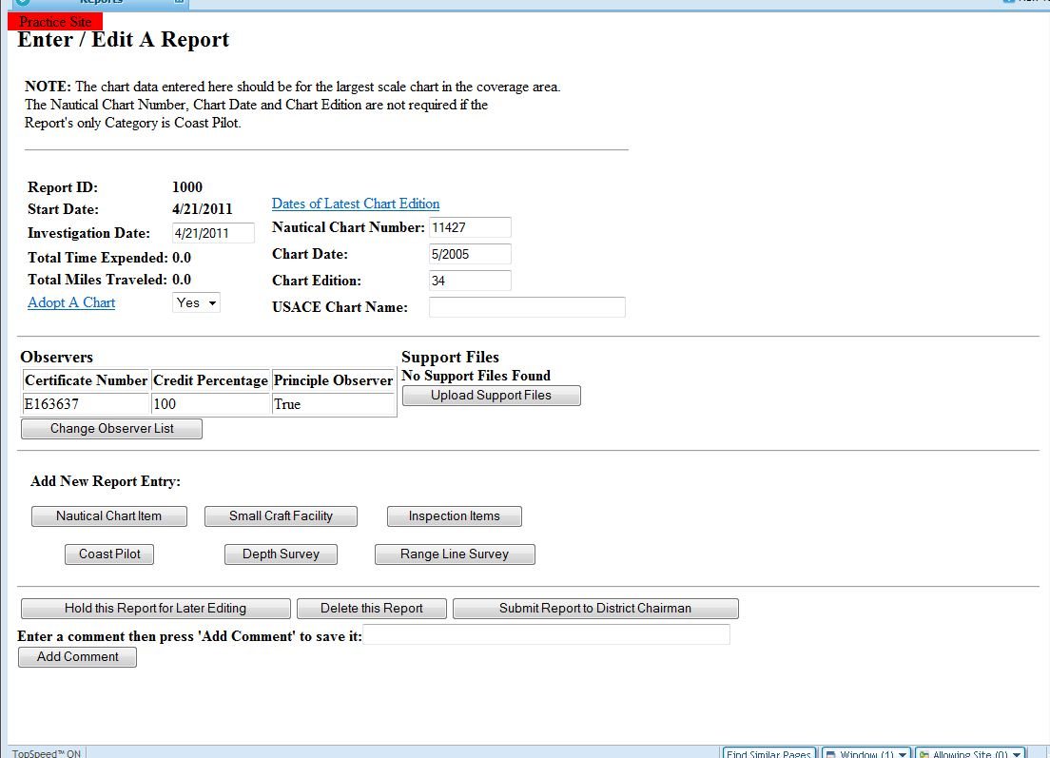
Click here to start data entry

Slide 16
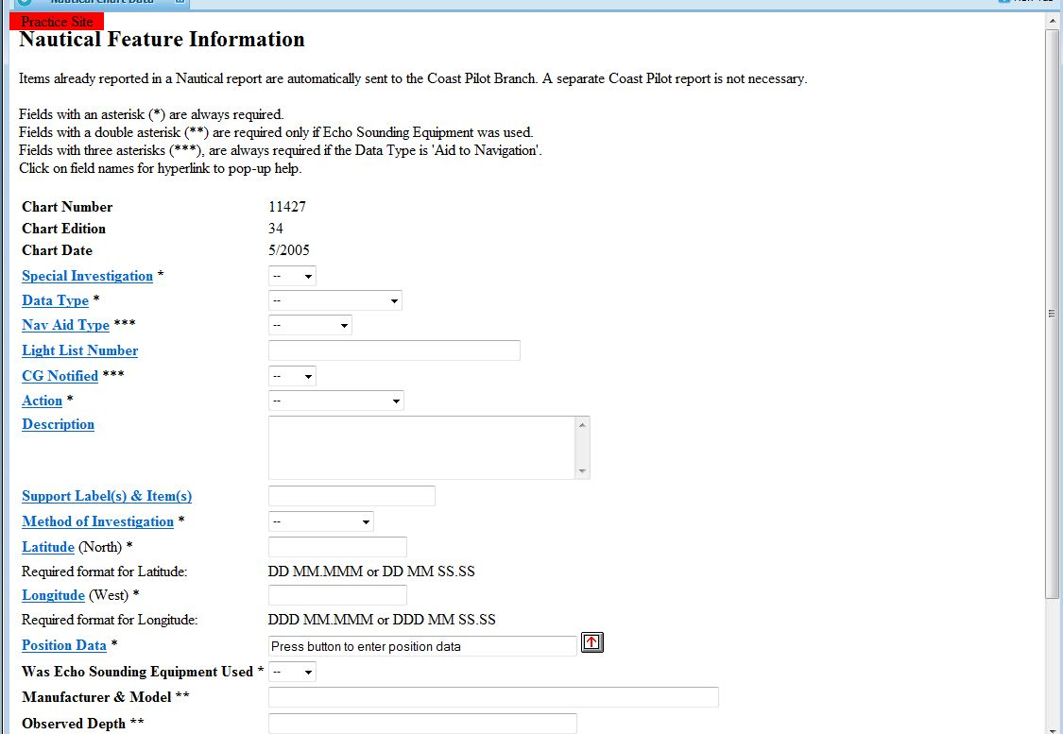

Slide 17
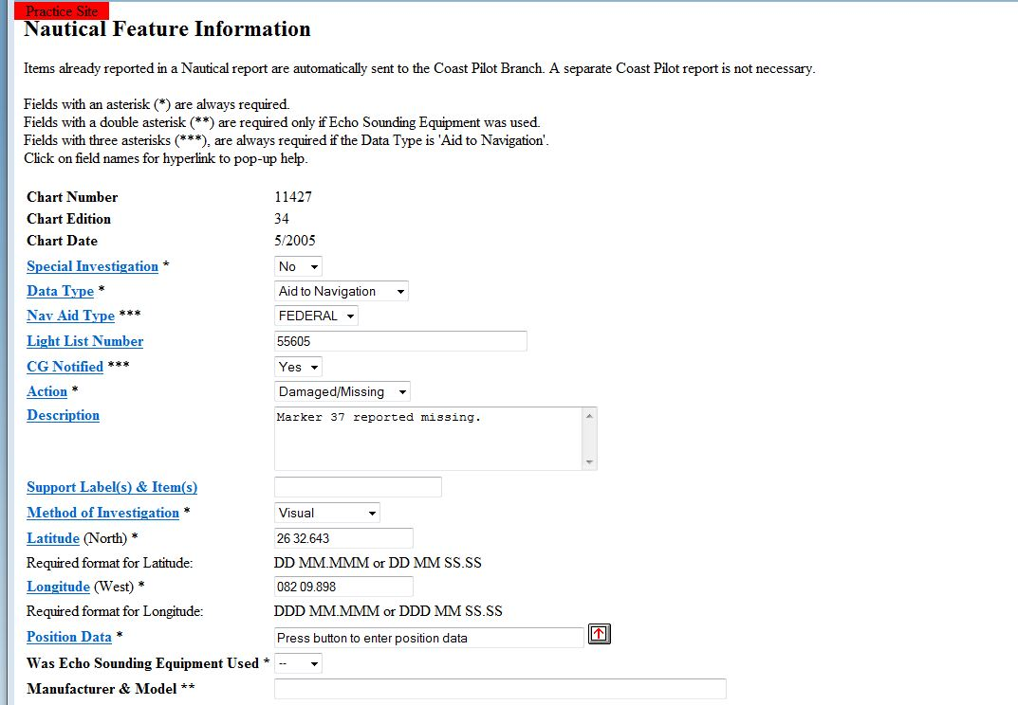
Enter support labels and items for this marker here
A1
B1
C1
D1

Slide 18
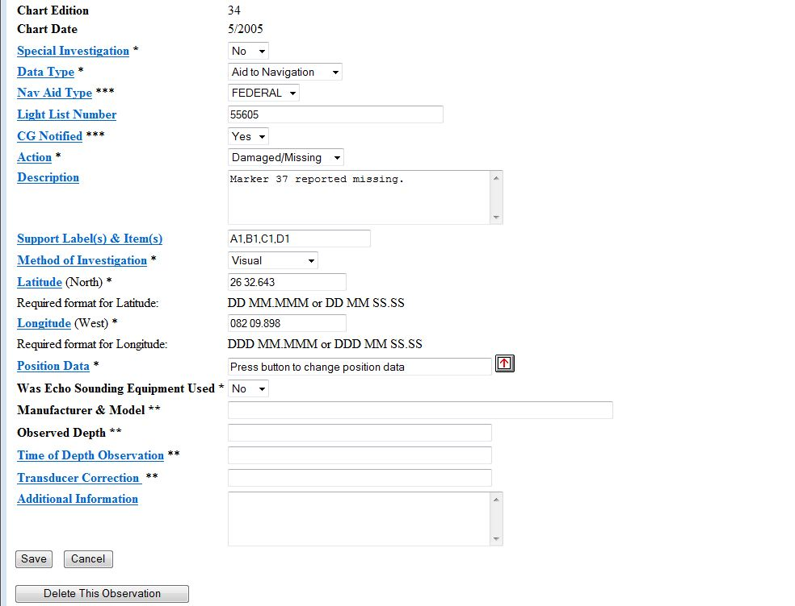
When completed click on save

Slide 19
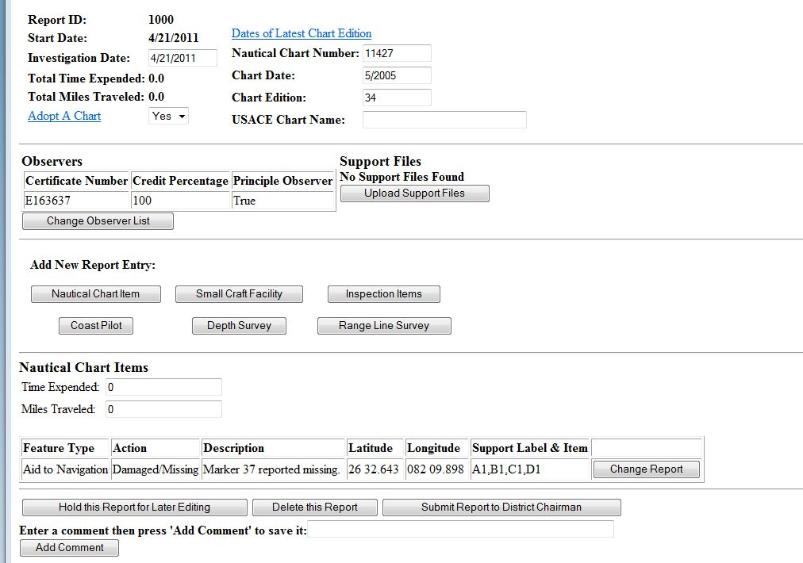
Click here to start second item
All information appears here

Slide 20
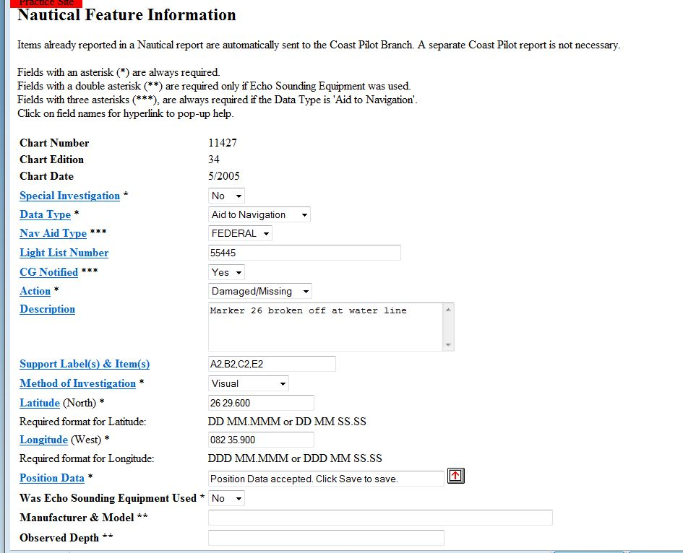
Enter all data as before with the support labels and items referring to this marker

Slide 21
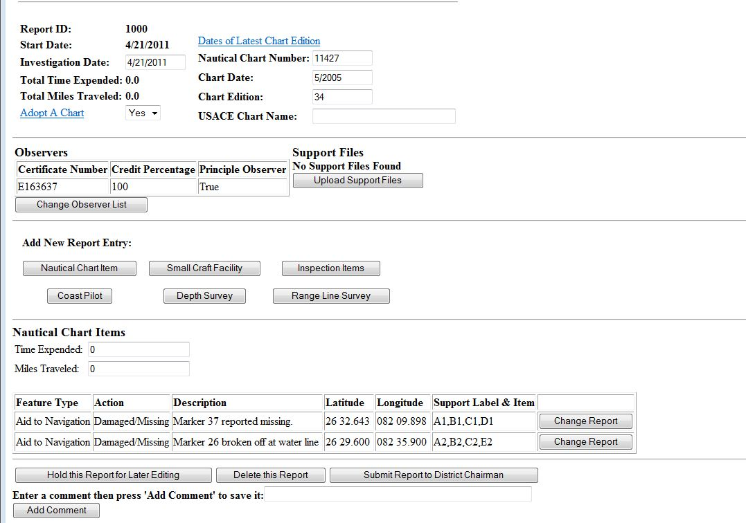
All labels and items are completed

Slide 22
We now need to upload the Documents

Slide 23
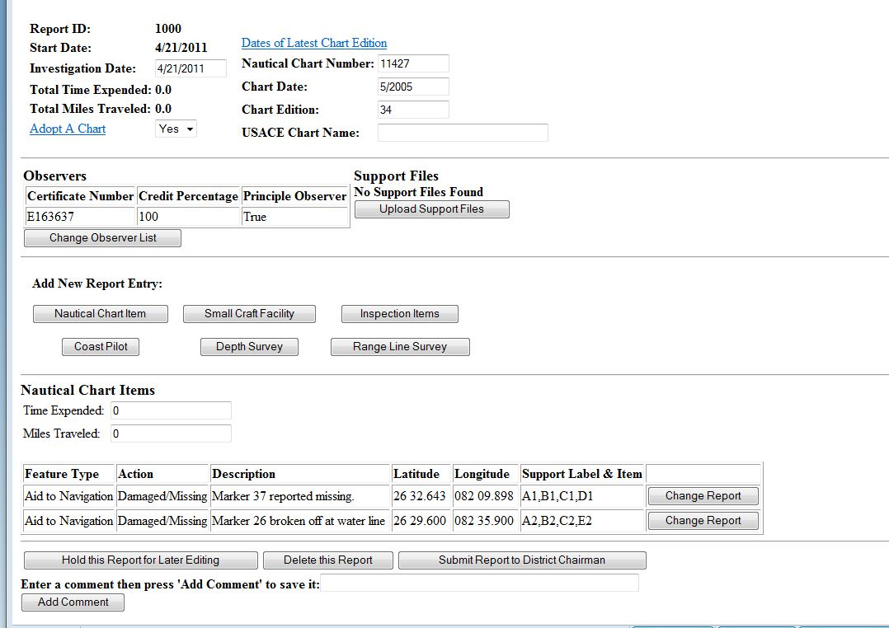
Click here to start upload

Slide 24
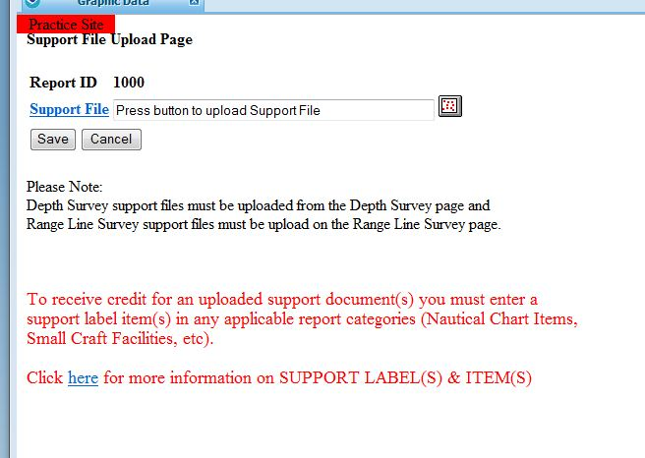
Click here
I believe this is new

Slide 25
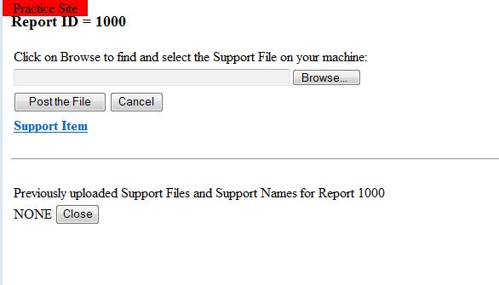
Click here and find document A where you have it saved on your computer

Slide 26
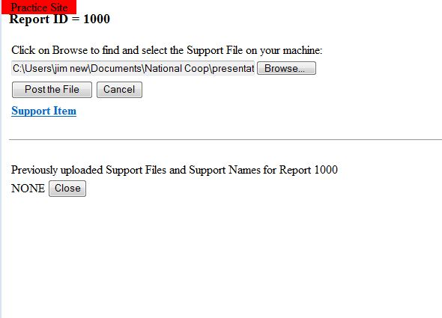
Click to post the file

Slide 27
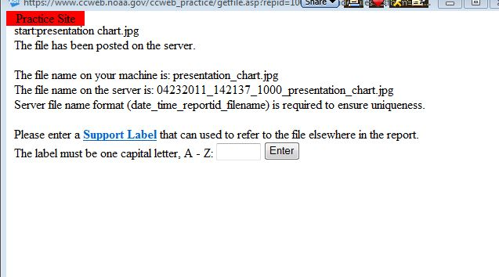
Enter the Document Label here as a capital letter.
NO NUMBER

Slide 28
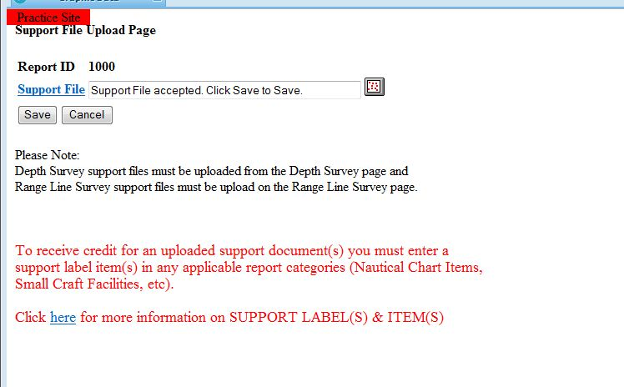
Click here to save

Slide 29
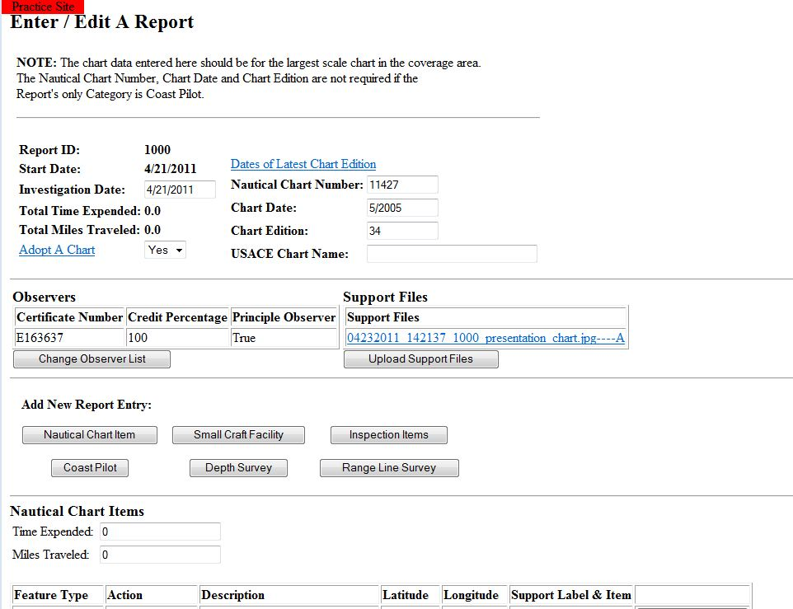
Document has been uploaded
Proceed in the same manner for the remaining documents

Slide 30
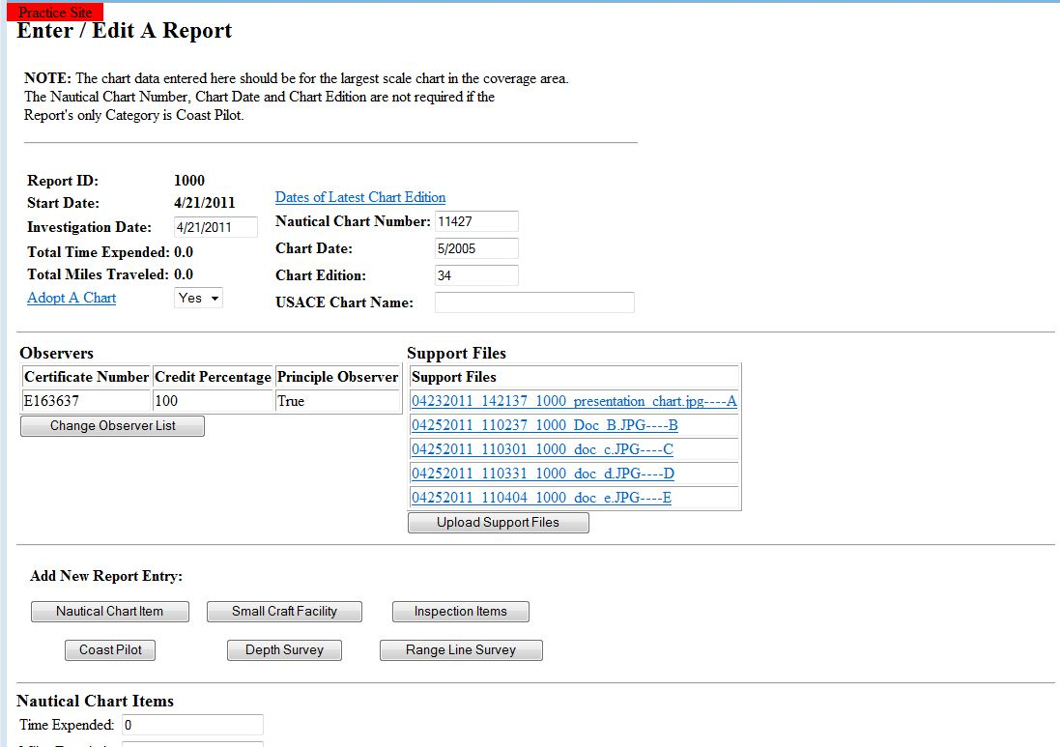
Completed uploads

Slide 31
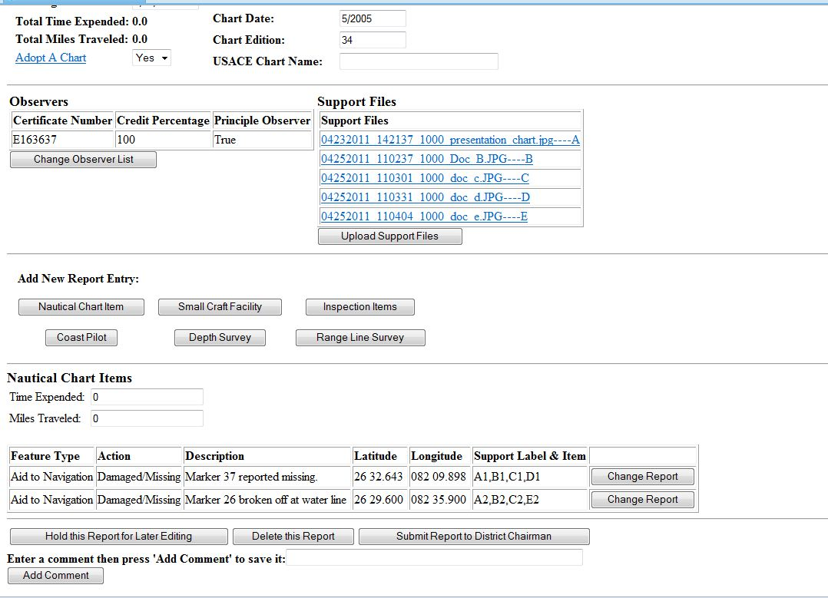
Click on your choice when completed

Slide 32
Summary
This format is the same for all reports requiring supporting information
The document is always the capital letter
The numbers reflect the items on the document.

Slide 33
Questions?

