Slide 1
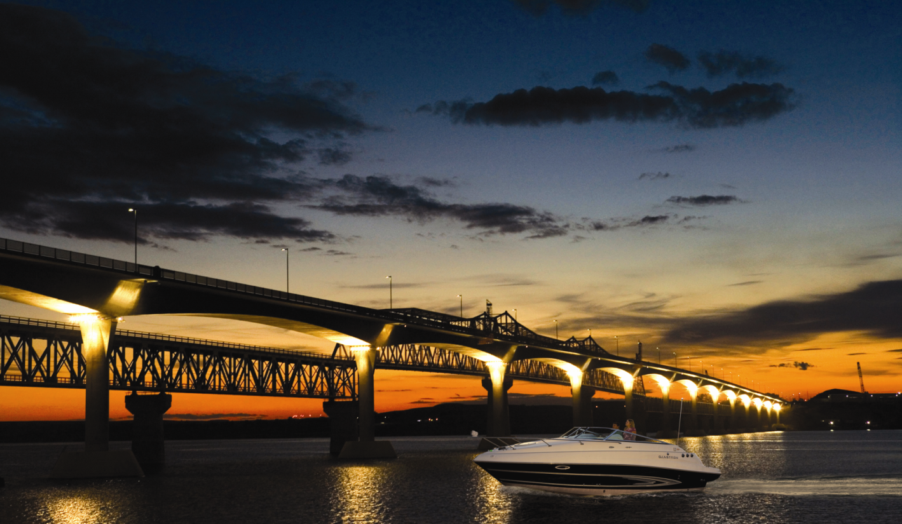
America’s Boating Course 3rd Edition
Oregon
State Regulations
Chapter 2
Section 8
1
>>
Notes:
This Section 8 presentation is prescribed when presenting ABC3 courses in the state of Oregon. It replaces section 8 in the ABC3 Instructor Material.
Oregon specific material to be presented to the students include:
EXPERIENCE OREGON BOATING by Oregon State Marine Board (OSMB).
CLEAN WATER GUIDE by the OSMB
PROTECT OREGON’S WATERWAYS AGAINST AQUATIC INVASIVE SPECIES by OMSB
Consult http://www.oregon.gov/OSMB/Pages/library/library aspx before presenting classes for current information about safe boating in Oregon.

Slide 2
State & Local Regulations
Operator qualifications
Boaters Education Card
Wearing PFDs
Additional equipment
Speed restrictions
Time of day restrictions
mainly for PWCs & skiers
2
>>
Notes:
COMMENT TO INSTRUCTORS:
The slides in this Section 8 have been customized to cover local and state boating regulations, and approved by Oregon State Marine Board. Distribute the recommended State materials at this time, discuss their utility, and ask students to follow along in the EXPERIENCE OREGON BOATING BOOKLET.

Slide 3
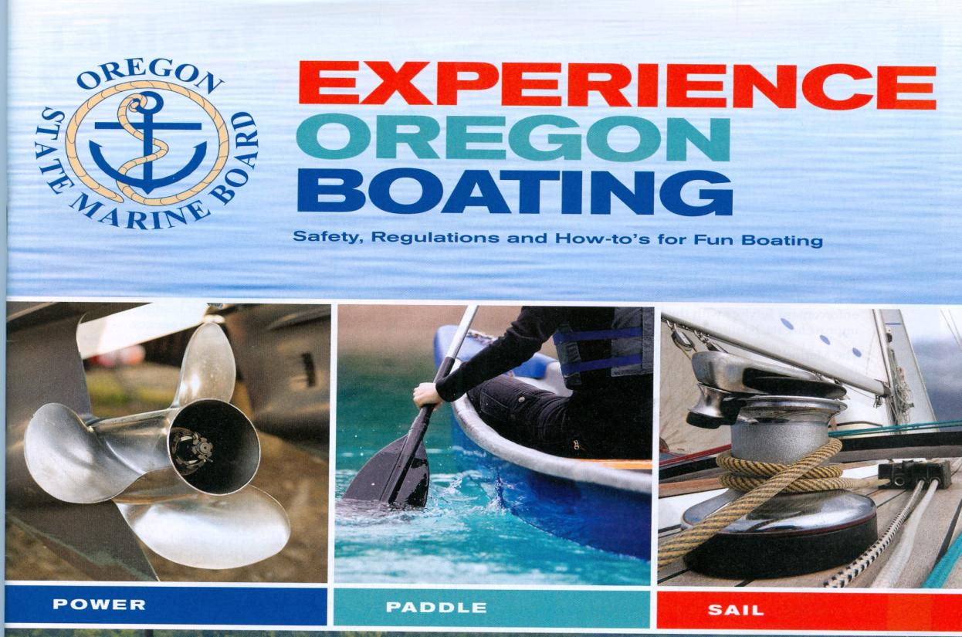
Experience Oregon Boating
Notes:
This is the cover page of the EXPERIENCE OREGON BOATING booklet in use at time of preparing this presentation – 18 August 2015. If new material is developed, place it’s cover on this slide.

Slide 4
Beyond Federal
State & Local Regulations:
Education pg.4
Age requirements pg.4
Registration pg.6-7
Equipment pg.11-16
Special Regulations
Pg.17-18
PWC & waterski pg.18
Speed restrictions
pg.19-34
BUI pg.39-40
Law enforcement
accident reports
pg.43
4
>>
Notes:
Have the students review the overall content, and ask that they follow along in the Oregon Booklet. Be sure to ask questions.
These are some key reference pages in the Oregon booklet, showing the additional material to the Federal requirements discussed in this course. There is some redundancy, but serves as useful reinforcement of the boating safety material.

Slide 5
Oregon Education Requirements
Notes:
Add USPS to the list of options for classroom and on-line classes in Oregon.

Slide 6
Oregon Age Requirement
Notes:
The minimum age for operating a boat in Oregon in 12, and a Boaters Education Card is required.

Slide 7
Exceptions
LEVEL 1. A boater who has:
an expired USCG Boat Operators License, or
attained status of CG Crewman or Coxswain equivalent
-does not need to take a boating safety course or equivalency exam, but must carry a boaters education card when operating a boat recreationally.
LEVEL 2. Education Card not required if person is:
an out-of-state visitor, boating for less than 60 days, or
has current USCG Boat Operators License.
A new boat buyer – temporary certificate of number 60 days
A boat renter – livery complete dockside safety checklist
***See Experience Oregon Boating handbook pg 4***
Notes:
Some exceptions to the requirement for the Boating Education Card.
In order to obtain a Boater Education Card for Level 1, provide a copy of his/her credentials, along with a completed boater education application and the one-time $10 fee to the Marine Board.

Slide 8
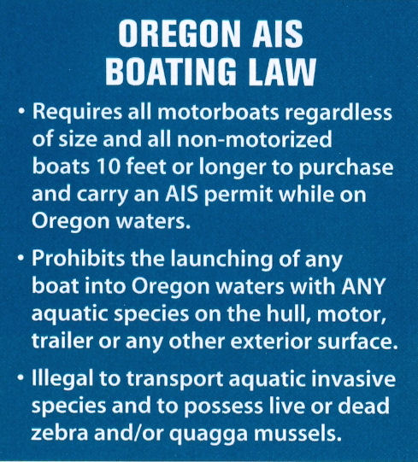
Aquatic Invasive Species (AIS)
Notes:
The State of Oregon is aggressively working to prevent spreading the invasive species, providing methodology to develop funds for the program and implementing laws with check stations to prevent spreading. Two of the handouts from Oregon State Marine Board deals with this subject. It easily encompoasses Laws for no dumping of any trash in United States waters and preventing oil spills.

Slide 9
AIS Protection
Never launch a dirty boat
•
It is illegal to launch a boat with aquatic species
on the hull, motor, or trailer.
•
Even if launching in the same water you came
from, do your best to remove visible aquatic
species and mud from your equipment prior
to launching.
•
Engine flushing and boat rinsing after being in
salt water is highly discouraged because of the
potential for transporting invasive species.
Notes:
The Oregon Clean Launch Law is summarized here. Know it and support the effort – our watersports depend on clean waters.

Slide 10
AIS – Motorized Boats / Sailboats over 12 feet
Registered boaters (including registered sailboats 12 feet and longer) pay an additional $5 surcharge when they renew their boat registration. Current boat decals are proof that you have paid the permit fee.
Registrations are valid for two calendar years.
If you have non-motorized boat in addition to your motorized boat, you will need individual permits when the non-motorized boats are in use.
Out-of-state motorboat permits ($22).
Notes:
All motorized boats pay a $5 surcharge added to their boat registration fee. The registration decal serves as proof of payment into the program. Registration is good for two calendar years. Out of state boater’s permit is $22.
Revenue generated by the fees goes directly into a dedicated fund for mobile boat decontamination equipment, inspection teams, signage, education materials and training.

Slide 11
AIS – Non-Motorized Boats
Manually powered boats (SUP boards, rafts, drift boats, kayaks, canoes, etc.) 10 feet and longer will need to carry one permit per boat when in use.
Permits are transferrable to other manually powered craft.
Permits can be loaned to friends and family members.
Permits are valid for one or two years; only valid for calendar year.
Permit fees are $5 (however, stores charge $5 permit + $2 agent fee)
Notes:
Support for the Oregon AIS program is achieved in part from supplemental fees to boat registrations and water use tags for human powered boats not otherwise paying registration fees.
All permits are sold through the Oregon Department of Fish and Wildlife license agents and offices, and at the Marine Board’s office and through their online store.
If you operate a paddle craft, such as a canoe, kayak or drift boat 10 feet and over, you are required to purchase and carry an aquatic invasive species prevention permit. Human powered boat fee is $5 plus $2 agent fee for 1-year paper or Tyvek permit. Permit is transferable to paddle craft in use.

Slide 12
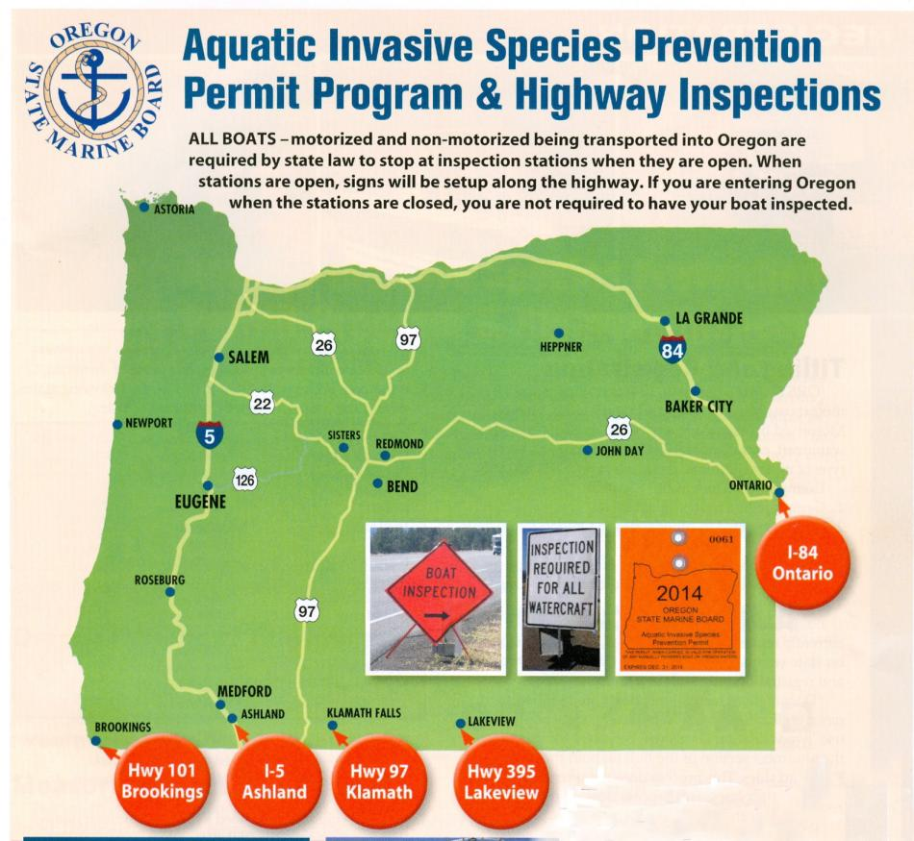
AIS Inspection Stations
Notes:
This map shows boat inspection stations associated with preventing the spread of AIS, supported with fees from boaters.

Slide 13
Boat Registration
Sailboats 12 feet and longer and all motorboats (with any
type of motor) must be titled and registered in Oregon.
Documented recreational boats must register & pay fee if
Oregon is the state of principal use.
Oregon has a two year registration cycle. Fee can be paid
on line at OSMB site.
Title transfer must be submitted within 30 days of purchase
or will be charged a $25 penalty fee.
Boats made after 1 Nov 1972 must have HIN.
Notes:
This overview discusses registration requirements. Documented boats are numbered by the USCG through application, generally boats over 5 tons intending operations in foreign countries. The decals issued at time of registration reflect payment of the AIS support fee.

Slide 14
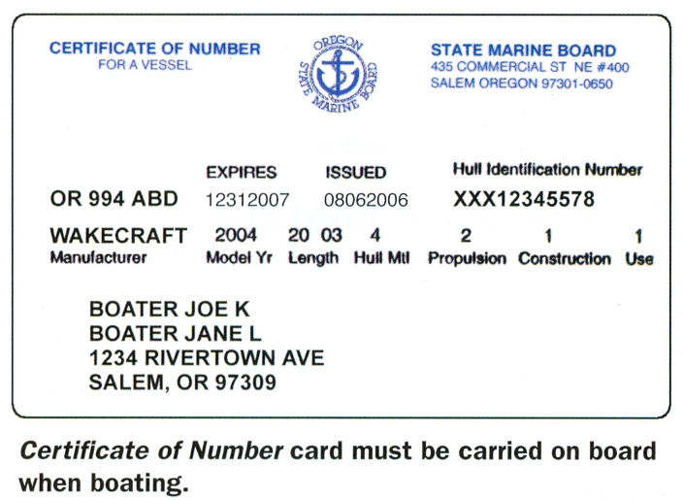
Certificate of Number
Notes:
Like your Boating Education Card, this card must be onboard when operating the boat.

Slide 15
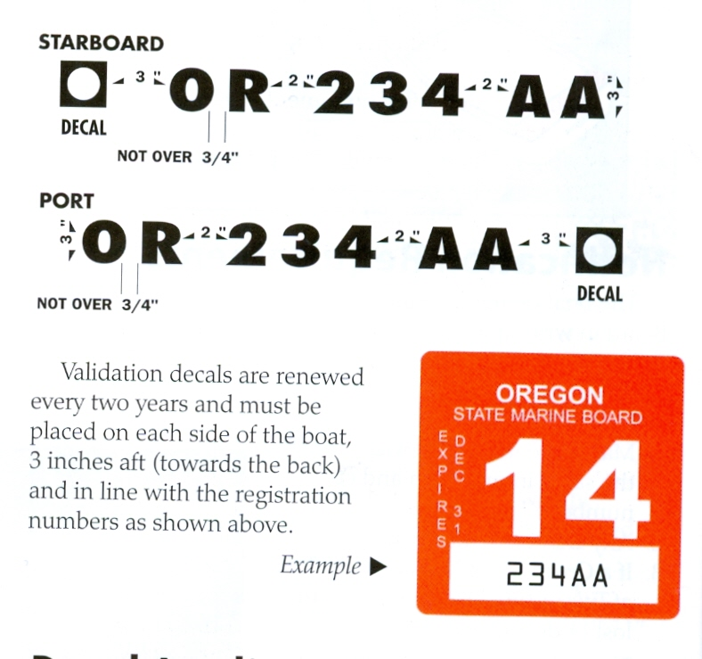
Boat Numbers
Notes:
Note the placement location of the decal, “aft of the registration number, 3 inches.

Slide 16
Equipment
Recommended equipment
Along with the required equipment, the Oregon Marine Board recommends carrying the following:
1. Compass
2. Anchor fenders
3. Flashlight, extra batteries
4. Extra line
5. Bucket
6. Port-a-potty
7. Bilge pump and pads
8. First aid kit
9. Paddle
10. Tool kit
11. Two-way radio
12. Cell phone
13. Visual distress signals
14. Marine VHF radio, if
operating in coastal waters
Notes:
As discussed in the Course, the equipment required by federal regulations is only a portion of that required for safe and fun boating. This list is offered by OSMB, and sound advice for all boaters. Consult A BOATER’S GUIDE TO THE FEDERAL REQUIREMENTS FOR RECREATIONAL BOATS booklet presented with your course material to refresh information about federal requirements.

Slide 17
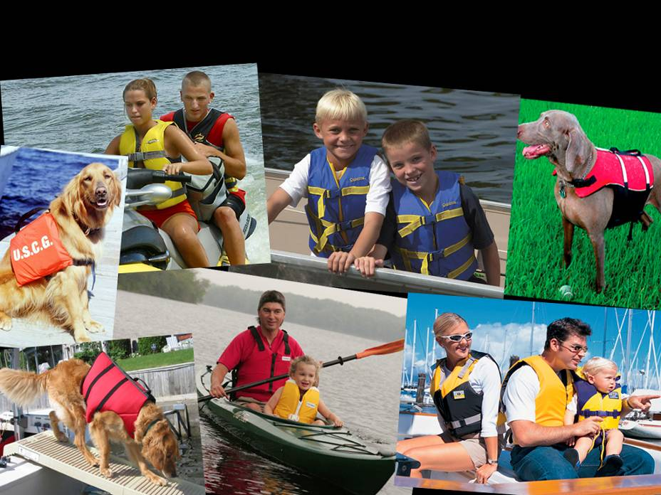
Life Jackets Personal Floatation Devices (PFDs)
One for each person aboard including towed (impact rated).
USCG Approved with legible label, proper size, serviceable and worn (or readily available).
Children 12 and under MUST wear
Notes:
The USCG label includes information about the use intended by the specific jacket. Life jackets are required worn for operations involving high speeds such as watersport towing of skiers and tubers. The life jackets for high speeds are specially designed to stay on the person in the event they fall into the water. Thei label will state the speed to which the life jacket met these needs – impact rated speed.

Slide 18
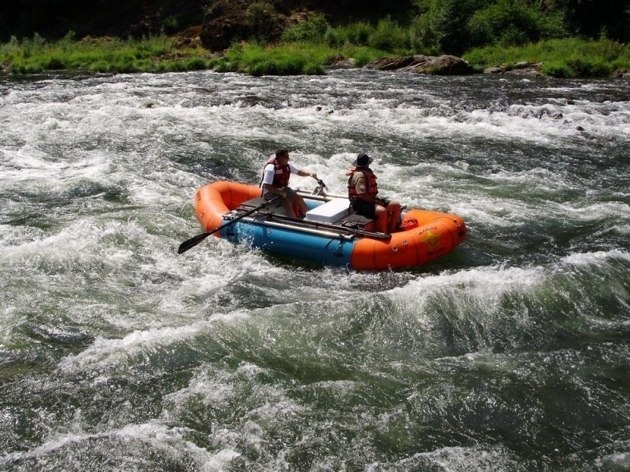
White water Boating
Oregon law requires all boaters to wear a life jacket in
Class III rapids or higher and in areas of known hazards.
Notes:
Helmets are not a requirement in Oregon. However, if you are rafting with a vendor, they may require that you wear a helmet. The Marine Board highly suggests wearing a helmet on any fast moving water or whitewater.

Slide 19
Operation - Speed
Operating at speeds greater than that which allows operator to bring boat to stop within assured clear distance ahead. Take into account visibility, traffic, and weather.
It is illegal to exceed any posted speed limits. Regulatory marks – white with orange borders and geometric symbols.
Notes:
The next 7 slides discuss specific rules regarding boating operations. Know them, they evolved from tragic incidences and are there for your protection and safer boating. REMEMBER THE REGULATORY BUOYS IN SECTION 5?

Slide 20
Operation - Lookout
An operator shall keep a proper lookout at all times while underway. At minimum one person shall watch and listen for dangers that may come from any direction.
In restricted visibility, additional lookouts should be designated while sounding and listening for restricted visibility sound signals.
Notes:
A single large violation of the Navigation Rules as recorded in accident investigations is failure to maintain a lookout at all times under all conditions. If you are alone in a boat you have many duties from captain to lookout!

Slide 21
Operation - Overloading
Capacity Plates are placed on most boats. They specify maximum weights, engine horsepower and number of persons.
Overloading is exceeding the maximums on
the capacity plate.
Use the persons number on the label judiciously. The total of passenger weight must not exceed the posted weight limit.
Load the boat to maintain proper trim.
Notes:
The manufacturer’s manual for the boat provides such information when no plate is attached to the boat. The challenge for all operators is minding the size of the passengers. 6 petite ladies may be OK, but 6 football players may overload your boat. Manage the load so the boat stays in trim for better performance and fuel economy.

Slide 22
Operation – No Wake
SLOW NO WAKE: means operating a boat at the slowest speed necessary to maintain steerage and that reduces or eliminates waves that appear as white water behind the boat. Must observe within 200 feet of:
-Boat Ramp
-Marina or moorage with over 5 boats
-A floating home moorage
THE OPERATOR IS RESPONSIBLE FOR WAKE!
Operators may be liable for damage caused by wake.
Page 19-32 for waterway regulations.
Notes:
NO WAKE IS JUST THAT, and where posted is usually a sensitive area. The specific speeds have been replaced by “slow-no-wake.” If a lake or area has a rule of 5 or 10 mph speed limit that is still enforced. Be careful and alert.

Slide 23
Operation – Unsafe Riding
Sitting, standing or otherwise moving outside of designed seating and operating areas can lead to falling overboard, and severe if not fatal injury from propeller strike.
Riding on bow, transom, or gunwale railings while underway is prohibited at speed greater than 5 mph.
It is illegal to tow a person(s) holding onto a portion of the boat aft of the transom (including a step, ladder, or platform deck) while underway.
Notes:
Best policy is no body parts hanging over the side, ever. Be especially cautious approaching the dock. Can you imagine the inconsideration of having people holding on to the swim platform to be towed, or tubers and knee boarders towed in close, all inhaling the engine exhauste fumes – CO.

Slide 24
Operation Watersports Towing
No towing of persons between sunset and sunrise.
Must have an observer on the tow boat able to communicate with those being towed.
A “skier down” orange square flag must be displayed when launching or recovering to alert other boaters of persons in the water.
Proper distance must be maintained for boat and skier for all objects – at least twice the tow length is good practice
Notes:
The orange skier-down flag is also a good idea for person overboard, letting other boaters know person are in the water and to be cautious. Be sure to brief all on how you the operator intend to manage routine and emergency events.

Slide 25
Operation Especially Hazardous Condition
Peace officers observing Especially Hazardous operations in Oregon waters may order the operator to safe moorage until corrected.
These conditions include:
-Improper or insufficient life jackets, fire extinguishers, backfire arresting devices, or navigation lights between sunset and sunrise
-Overloading / Overpowering / Leaking fuel
Notes:
Clearly, such violations are not tolerable and reasons for loss of life.

Slide 26
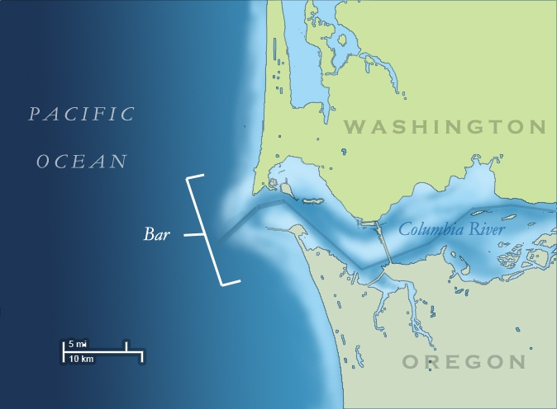
Crossing the Bar
Notes:
Columbia River Bar Hazards
The Coast Guard maintains a recorded bar and weather forecast report at each station. The recording is updated every 3 hours during daylight or when weather conditions change. In addition Coast Guard Station Cape Disappointment can be contacted via VHF-FM Channel 16 for conditions of the bar. New "Restricted Bar" warning signs and lights have been installed at Ilwaco, Chinook, Hammond, and Skipanon boat ramps. If these lights are on... there is some type of safety restriction for the Columbia River bar.
If the lights are not flashing, this is no guarantee that sea conditions ar favorable.
If you arrive are a harbor where a Coast Guard Station is located, and after surveying the bar you notice that it is too rough to attempt crossing into port, contact the USCG via marine VHF channel 16 for advice and assiastance.
NEW - Local Bar Conditions (click to see bar camera images and latest bar observations and Coast Guard restrictions
Columbia River bar report - (360) 642-3565
Grays Harbor bar report - (360) 268-0622
Tillamook Bay bar report - (503) 322-3234
Bar status reports can be monitored on channel 1610 AM. Transmitters are located at many of the local boat ramps near the river entrance.
http://www.wrh.noaa.gov/pqr/marine/bars_mover.php
The editor of this slide has crossed this bar in a US Navy Guided Missile Destroyer, 4800 ton vessel, and found reports of hazards totally valid! Rest assured, attending the Portland Rose Festival celebration is well worth the transit.
Statistics show most accidents and fatalities on the coastal bars result from capsizing. A boat is much more apt to capsize when crossing the bar from the ocean because the seas are on the stern and the operator has less control of the steerage. When looking at the bar from seaward, you do not see the front of the seas or breakers. As a result the bar may appear much calmer than it really is.
As we learned in section 5 on ATONS about advisory marks, the USCG has established a rough bar advisory sign whose location may vary from port to port. The standard sign is 6-feet by 6-feet, white back gound with bright orange borders and bright orange diamond and words “ROUGH BAR” IN BLACK LETTERS. Two alternating flashing amber lights are activated when observed seas on the bar exceed 4 feet in height and are considered dangerous.

Slide 27
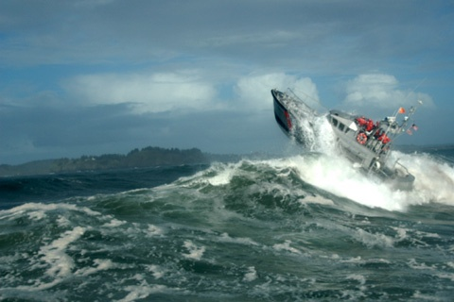
Crossing the Bar
Notes:
Danger Areas
CHINOOK SPUR, UPPER, LOWER AND MIDDLE SAND ISLAND SPURS are built on two rows of staggered pilings. Currents flowing through these pilings attain a velocity of up to 5 knots. A boat which becomes disabled or is maneuvered in such a way as to come in contact with any of these spurs is almost sure to suffer damage or become trapped against them and turn over. Even large boats have been capsized in these areas. Give these spurs a wide berth and never get close to them on the up-current side.
CLATSOP SPIT is the most unpredictable area on the river entrance. During flood currents and slack water it may be calm with only a gentle swell breaking far in on the spit. Yet 5 or 10 minutes later, when the current has started to ebb, it can become extremely hazardous with breakers extending far out toward the channel. You should remain north of the red buoys in this area, particularly just before or during the ebb. The South Jetty has a section broken away on the outer end. The broken section is under water close to the surface. Boats should use extra caution in the area from the visible tip of the Jetty out to Buoy "2SJ" Peacock and Clatsop Spits are called the graveyard of the Pacific for good reason.
JETTY A which is southeast of Cape Disappointment, presents a particular danger when the current is ebbing. Water flowing out of the river, is deflected by the jetty and frequently the currents reach 8 knots, often causing waves up to 8 feet high. Boats proceeding into Baker Bay West Channel make very little speed against the swift current and are exposed to the rough water or surf for long periods of time. The shallow sandy area should be avoided by small craft when heavy seas are present because of the surf which breaks on the beach.
PEACOCK SPIT: Breakers are heavy in all types of current. Sports craft leaving the river should never be on the north side of the green buoys. When rounding Peacock Spit, give the breakers at least a half-mile clearance. Many times unusually large swells coming in from the sea suddenly commence breaking 1/4 to 1/2 miles outside the usual break on the end of the north jetty.
MIDDLE GROUND: This is a shallow area between the North Jetty and main Ship Channel that is subject to breaking seas when swells as small as 4 feet are present. Conditions here can change in minutes with tidal current changes.
Columbia River
Desdemona Sands
Tansy Point
Astoria
In the event of flood conditions in the Columbia River, aids to navigation may be temporarily discontinued, lights may be extinguished or destroyed, and buoys may be extinguished or dragged off station. Under such conditions vessel operators should consult local authorities before attempting to navigate in these waters.

Slide 28
BUI
Boating under the influence of intoxicants (BUI, 0.08% alcohol or drugs) is a class A misdemeanor. Conviction can receive fine up to $6250 and jail for 1 year, suspension of all boat registrations for 3 years, and may require completion of boating safety course.
By operating a boat in Oregon you consent to submit to field sobriety tests.
Notes:
DO NOT BOOZE and BOAT.

Slide 29
Enforcement
Boating laws of Oregon are enforced by county sheriffs and Oregon State Police
USCG also has enforcement authority on all federally-controlled waters.
They are authorized to signal a boat operator to bring the boat to a stop to conduct a safety inspection.
Notes:
Note the telephone contact numbers in the back of your EXPERIENCE OREGON BOATING booklet.

Slide 30
Enforcement
With owner or operator’s consent; or
If a sheriff or other police officer confirms that a safety violation has occurred (probable cause) the sheriff or officer shall conduct a complete safety inspection to determine compliance with all other applicable safety laws.
Notes:
Help them have a great day by not violating the rules and regulations. THE NAVIGATION RULES CAN PREVENT COLLISIONS IF YOU JUST OBEY THEM.

Slide 31
Enforcement
Any boat approaching a stationary law enforcement boat displaying their blue lights, should immediately slow to a speed sufficient to maintain steerage only, alter your course as not to interfere or inhibit with the operation of the law enforcement boat.
You may proceed, unless otherwise directed by the law enforcement officer, beyond the area of operation of the law enforcement boat. When out of vicinity resume transit.

Slide 32
Boating Accidents
Operators involved in a boating accident are required by law to stop their boat immediately at the scene of the accident and:
1. Give assistance to any persons injured in the accident.
2. Give their name, addresses of any occupants to the other boat(s) operator and/or occupants.

Slide 33
Boating Accidents
In Oregon, operators or occupant (when operator is physically incapable) must submit a written report of a boating accident to the Oregon State Marine Board when:
a person dies, disappears, or is injured and receives medical treatment
damage to the property is in excess of $2000
Notes:
The Oregon Accident Report form is attached, and hopefully a copy provided each student. Look it over and be ready to use. Collecting data at an accident scene is much easier and more accurate that after the fact.

Slide 34
BOATING ACCIDENTS
Accident reports must be made:
(1) within 48 hours in the case or death, disappearance or injury
(2) within 10 days of an accident involving property damage
Failure to fulfill operators/witness duty - Class A misdemeanor / fine to $6,250 and/or jail for 1 year.
Failure when death or injury - Class C felony fine to $100,000 / jail for 5 years
Notes:
Lets looks at the form and items to fill in.

Slide 35
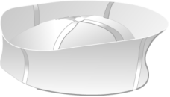
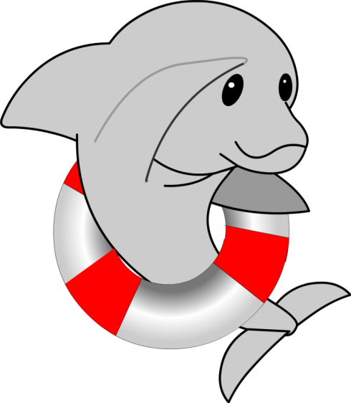
End Chapter 2
END
Notes:
Present the end of chapter 2 review.

