Slide 1
Practice Cruise
Underway
Global Navigation
Chapter 9

Slide 2
Practice Cruise
the Excerpts from the Nautical Almanac, contained in Appendix B of your manual, for all the daily data and altitude corrections to complete the sight reductions;
a copy of any recent edition of the Nautical Almanac for the “Increments & Corrections” tables, the NASR tables, and Table A4 Altitude Corrections Tables – Additional Corrections;
blank copies of the Meridian Transit Form included in Appendix D of your manual and on the USPS Navigation website;
blank copies of the Deck Log included at the end of chapter 9 in the Student Manual; and
Chart N.O. 974, Sight Reduction forms and CLS lotting sheets, included with your course materials.
In addition to the materials used to complete Part I of this Practice Cruise, you will need:
Notes:
Additional details of the solutions to various items of the Practice Cruise are available in the Navigation 15 Instructor’s Manual. Ensure students understand and know how to perform all these tasks before sitting for the Nav 15 Open Book exam.

Slide 3
Cruise – Underway
As the navigator, you plan to review your Navigator’s notebook regularly and update it as needed. You’ll use the GPS as your primary means of positioning, and will use celestial positioning techniques throughout the voyage to maintain your skill in taking sights, in the event your electronics fail and you need to rely solely on traditional methods for positioning.
All celestial EPs and Fixes will be logged, as well as course changes and unusual events. For Leg 1 of the voyage, you have paper charts of adequate scale to maintain your DR plot; once you reach WP2, you will begin your DR plot on a blank offshore plotting sheet.
You’ve brought with you an adequate supply of the 900 series plotting sheets to cover all the latitudes of this voyage.
For celestial observations note the following:
Height of eye: 10.0 ft
Index error: 0° 1.5' (off the arc)
Watch error: f 0-10 seconds
Watch Time: Using ZT
As navigator, you also plan to maintain a written Deck Log and a DR plot using the practices you learned in both the Junior Navigation and Navigation courses, since you understand the importance of a backup log and plot in the event of electronics failure. You plan to manually plot and log waypoints, weather conditions, etc. every four hours or so, unless circumstances dictate
more frequent entries. You will also plot and log your reports to the captain at 0800, 1200 and 2000 daily.
It’s finally time to leave on your planned offshore cruise from the Strait of Juan de Fuca, to Honolulu, HI. During the shakedown cruise, you created a deviation table for the steering compass, which is contained at the end of the Practice Cruise; use this deviation table for the cruise exercises.
Deviation Table
Compass | Magnetic | Deviation
000° | 006° | 6°E
045° | 050° | 5°E
090° | 091° | 1°E
135° | 132° | 3°W
180° | 176° | 4°W
225° | 222° | 3°W
270° | 272° | 2°E
315° | 320° | 5°E
360° | 006° | 6°E

Slide 4
Question 1
Launch OpenCPN, and display your “Straits to Honolulu” route. Pan east of WP1 to Port Angeles, at the east end of the Strait of Juan de Fuca. Locate Port Angeles on your chart; when you are in the vicinity of the port, Switch To a chart that provides a detailed view of the port - Chart #18465_1 is a good choice.
The GPS is connected to OpenCPN and you confirm several of the GPS positions using the navigation aids in the Strait. All electronics seem to be functioning properly.
No question.
Port Angeles is a very busy port, even this early in the morning; you turn on the AIS (which is integrated into OpenCPN) to get a view of the commercial traffic around your boat. You see many AIS targets on the screen, and maintain a course through the harbor and the Straits to stay clear of the commercial vessels.
You and the crew have finished all preparations for the voyage to Hawaii. The date is June 25, 20XX. You download a NOAA weather report; it predicts good weather for the day. The captain indicates all’s ready to leave the dock at Port Angeles and travel through the Strait of Juan de Fuca; you anticipate you’ll arrive at the point of departure from Cape Flattery, WP1, by early morning.

Slide 5
Question 2
0700. You reach WP1 and take departure, logging this event and setting the knotmeter log to zero. The variation in this area is 17° E. The weather is calm with clear skies.
As you review the VPP2 “Weather Conditions Report” for Leg 1, you notice that the current is forecast to have a set of 140° and a drift of 0.4 knots. This will result in a drift angle of about two degrees. You plan to set course using this drift angle and thus the course to steer will be 214°T.
b. What is the Compass Course for Leg l?
1200. GPS position is L 47°45.1'N, Lo125°21.7'W. Knotmeter log reads 0044.5. Northwest winds at four knots with four foot seas continue. Report to the captain.
a. From your OpenCPN route, what is the true course for Leg l?
212°T
Since you’re near-shore and have the paper charts of this area, you start your DR plot on these charts simulated for this Practice Cruise).
0800. GPS indicates L 48°16.2'N, Lo 124°52.3'W. Knotmeter log reads 0008.9. Winds are light, from the northwest, with four foot seas. You report the position to the captain.
Solution : 212°T+2° Drift angle correction = 214°T
214°T – 17°E(Variation) + 4°W (deviation) = 201°C

Slide 6
Question 3
1330. You plan to use celestial techniques frequently during this voyage, to hone your skills in sight-taking. Using your sight planning tools, you find you can get a 2-body fix using the sun and moon this afternoon. You check and confirm the sextant error and height of eye (HE) are as you noted in your Navigator’s notebook. Skies continue clear, and seas are still four feet, so you don’t anticipate any problems getting good sights this afternoon.
No question

Slide 7
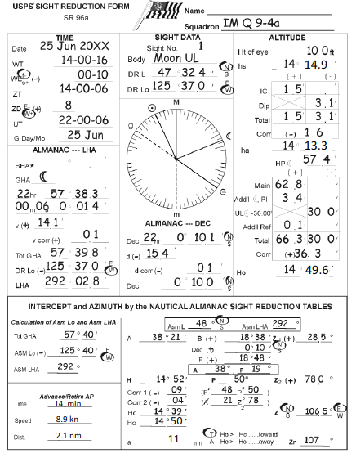
Question 4-a : Moon UL SR
1400. Your DR position is L 47°32.4’N, Lo 125° 37.0’W. Winds are northwest at five knots and the knotmeter log reads 0062.3. At WT 14-00-16, you observe the moon UL at a sextant reading of 14°14.9'. At WT 14-14-12 you observe the sun LL with an hs of 57° 21.2'. Reduce both bodies using the NASR method (70° F temperature and barometric pressure 30.10 inches), and plot the resulting 2-body fix on a CLS plotting sheet. (Don’t forget to advance the AP of the moon sight)

Slide 8
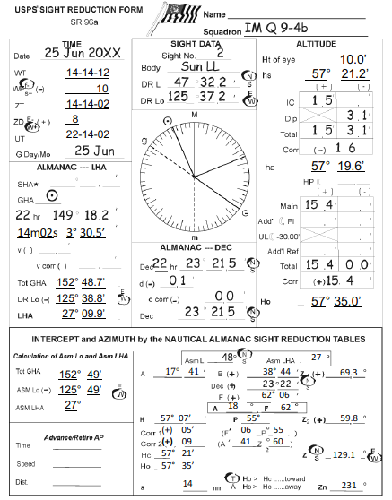
Question 4b – Sun LL SR

Slide 9
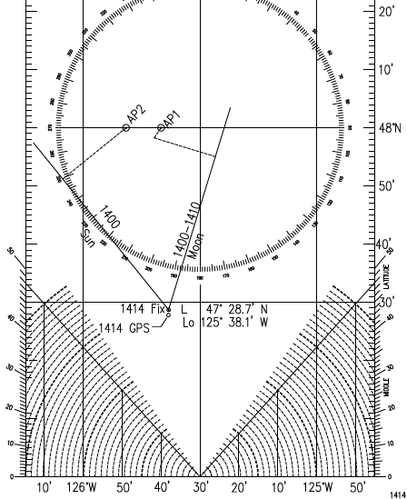
Question 4-c
What is the cut of the azimuths of these two bodies? Is it adequate for a 2-body fix?
Answer :The cut is 56°, which is adequate for a 2-body fix since the smaller angle between the two LOPs must be greater than 45°, which it is.

Slide 10
Question 4d – Fix
Record the coordinates of the resultant 2-body fix:

Slide 11
Question 4-e
At 1414 the GPs indicates a position of L 47° 27.8’N, Lo 125° 38.1’W. How far off is your 1414 Fix from your 1414 GPS position?
Solution: See CLS Form, Q 9-4d. Measure distance from the 1414 GPS position to the 1414 celestial fix with dividers.
You know that this distance is primarily due to error in sight-taking, but are satisfied that your 1414 celestial fix and the 1414 GPS fix positions are fairly close (if your answer was a few nautical miles).
0,8 M

Slide 12
Question 5
You note that the variation in this area is 16° E. Plot the 16° E isogonic line drawing a line from the position L 43°17.0'N, Lo 130°00.0'W, to L 44°31.0'N, Lo 126°00.0'W.
Plot time zone boundaries on the plotting sheet, as appropriate.
You turn the watch over to the relief navigator, sign off on the log for the night and go off duty.
No question
You determine that by tomorrow morning, you will be well offshore and no longer have paper charts to maintain your DR plot. Throughout the day, you’ve checked the GPS positions logged in OpenCPN with your DR plot and they’ve compared well.
Prepare a blank offshore plotting sheet, Chart N.O. 974, to maintain your DR plot starting tomorrow morning. Arrange the plotting sheet for north latitude, and label the meridian on the left 130° W at the top of the sheet.
2000. GPS position is L 46° 42.9'N, Lo 126°19.7'W. Knotmeter log reads 0115.7. Winds from the west at three knots, seas two feet. Report to the captain.
You download a weather report for tomorrow. Prediction is still for good weather, with seas of five feet or less and northwest winds 6-12 knots. No fronts seem to be moving into your area.

Slide 13
Question 6
0800. GPS position is L 45°01.8'N, Lo127°51.4'W. Knotmeter log reads 0231.4. Winds continue from the northwest at 8 kn, with 4 ft seas. Report position to the captain.
No question
All plotting for the remainder of this cruise is to be done on the Chart N.O. 974 which you prepared in Question #5
26 june 20XX
0545 You come back on duty early in the morning. As you check the position and deck log, you note that the vessel is about to move into a different time zone.
0556. Crossed over into the new time zone. GPS position L 45°25.7’N, Lo 127° 30.0’W.
0500 (ZD+9). GPS position is L45°25.1'N, Lo 127°30.6'W. Winds are from the northwest at 8 kn, 4 ft seas. You make the appropriate deck log entry.

Slide 14
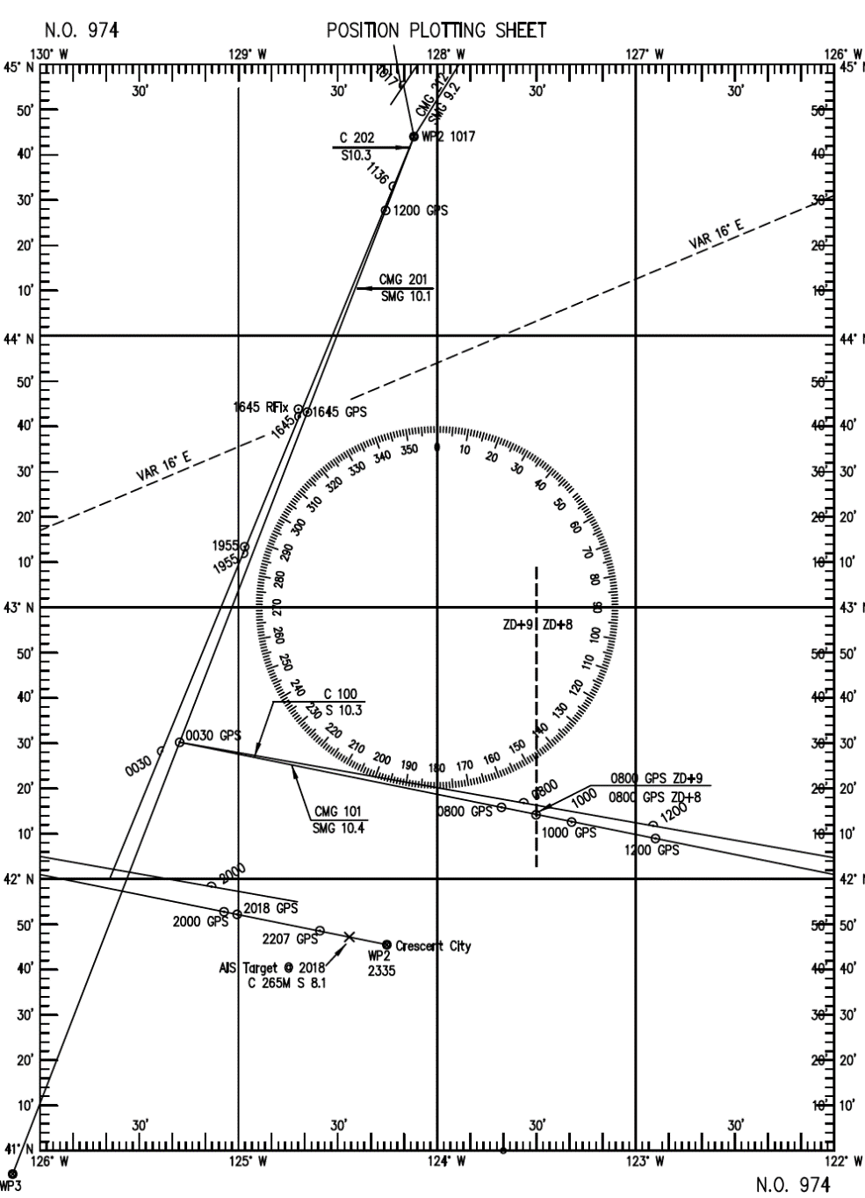
Question 7a
Plot and log this course change.
You determine the set and drift of Leg 1 of this voyage and find it is very close to the information provided in the VPP2 reports. Since the current information in VPP2 was quite accurate for Leg 1, you plan to use the VPP2 forecast for Leg 2. The predicted set and drift of 074° at 0.3kn will result in a drift angle of approximately one degree, making the course to steer 202°T. Restart your DR plot at this time from WP2.
1017. You arrive at WP2 and change course to your Leg 2 heading. Knotmeter log reads 0251.7. Your DR position is L 44°55.3'N, Lo 128°10.1'W. Winds are still out of the northwest but have increased to about 10 kn, seas remain at 4 ft.
From your OpenCPN route, what is the true course for Leg 2?
16⁰ E
201°V

Slide 15
Question 7b
While you were computing set and drift, a crew member determined that meridian transit will occur at 1136 at which time your DR position will be L44°31.4'N, Lo 128°14.1'W
11-36-05. You observe the sun’s upper limb at an hs of 69° 04.2'. Knotmeter log reads 0265.3. Using a Meridian Transit Form, reduce this sight.
What is the resultant Compass Course for Leg 2?
You want to confirm the vessel’s position later in the day by developing a running fix using a meridian transit of the sun and a late afternoon sun sight. You confirm the sextant error and height of eye, in preparation of the meridian transit sun sight.
202°T – 16°Var + 4° deviation = 190°C

Slide 16
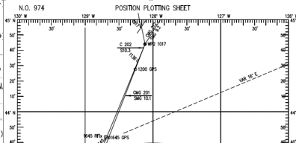
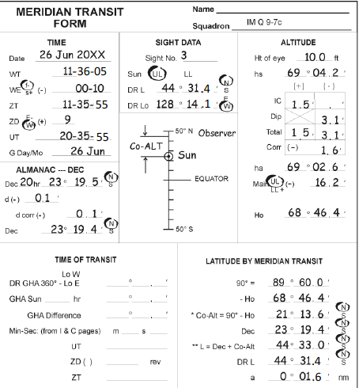
Question 7c – Sun MT
What is the calculated latitude?

Slide 17
Question 8
1200. GPS position is L 44°27.8'N, Lo 128°15.9'W. Knotmeter log reads 0269.4 Winds are NW at 6 knots, seas are four feet. Report to the captain.
No question

Slide 18
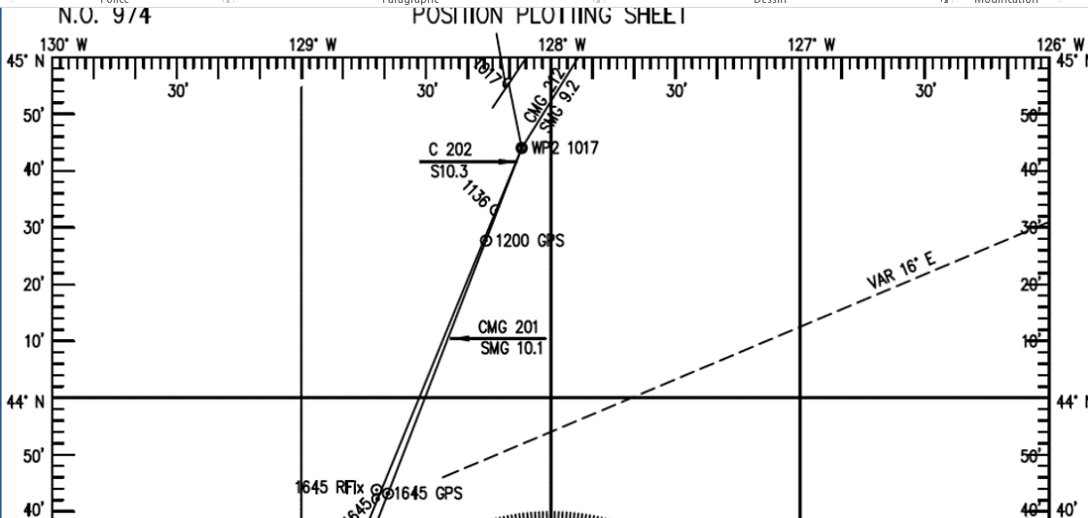
Question 9 a
1645. GPS position is L 43°43.2'N, Lo 128°40.1'W. You prepare to take another sun sight to establish a running fix with the noon sight. At 16-45-22, the hs of the sun’s upper limb is 25°27.0'. The knotmeter log reads 0318.3. Reduce this sight using the Law of Cosines method.
What is your 1645 DR position?
Solution: This position is determined from the knotmeter log distance at 1645, measured from WP2 on the DR course line.
L 43°42.2’N, Lo 128°41.8’W

Slide 19
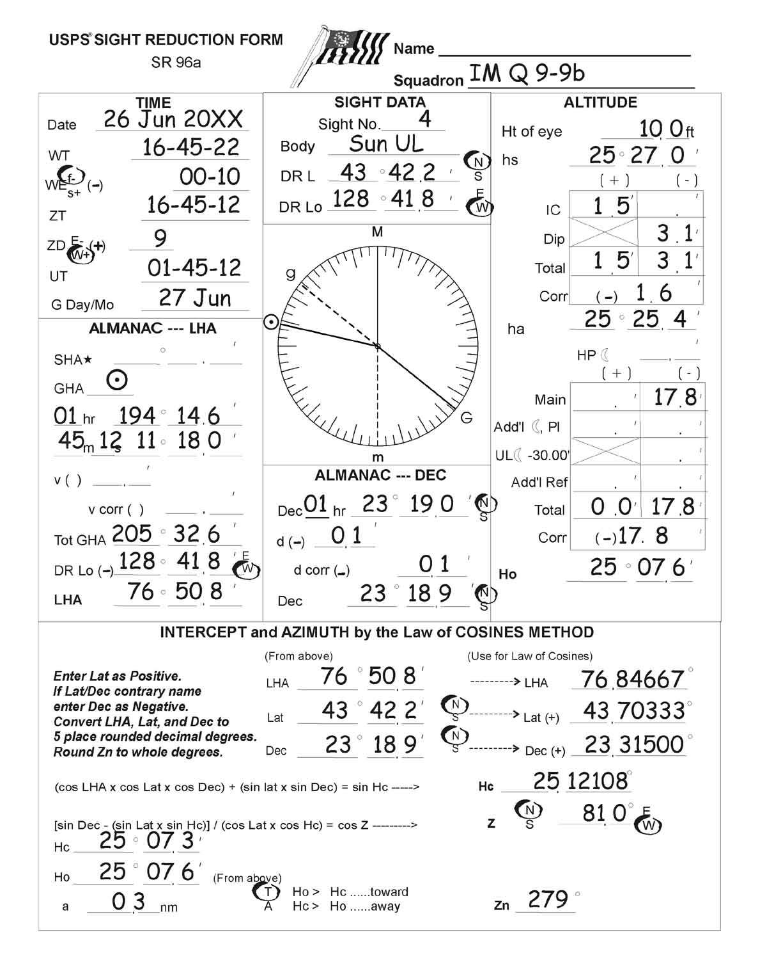
Question 9b
Record the results of this sun sight reduction :
Observed altitude (Ho) :
Computed altitude (Hc) :
The intercept (a) :
The azimuth :
25°07,6’
25°07,3’
0,3 nm T
279°

Slide 20
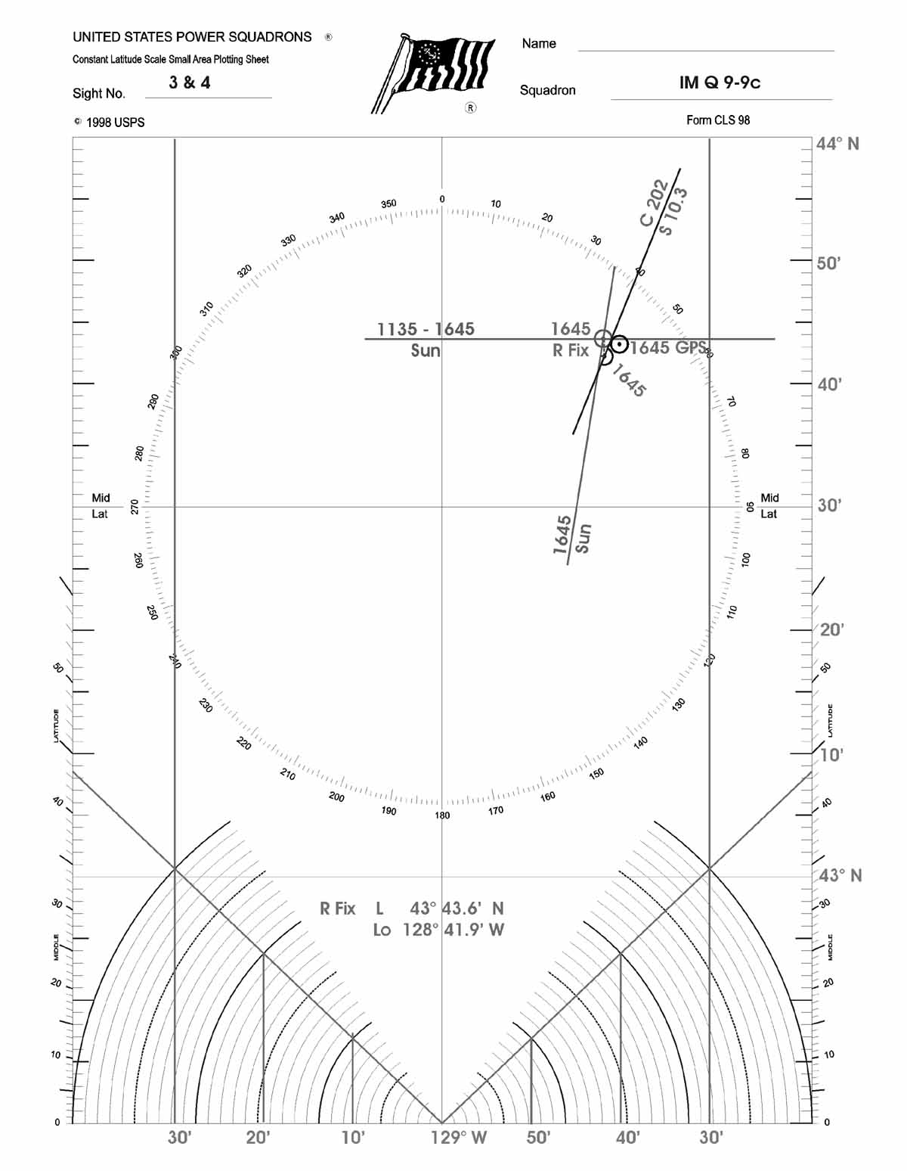
Question 9c
Determine the running fix with the 1135 MT sight you reduced earlier.
What are the coordinates of the running fix?
L43°43,6’N, Lo128°41,9’W

Slide 21
Question 10 a
1800. GPS position is L 43°31.3'N, Lo 128°46.6'W; the skies are clear with a northwest wind at six knots. Knotmeter log reads 0331.2. Since the GPS seems to be working quite satisfactorily, you decide that a 3-body fix during the evening hours will give you an opportunity to not only hone your celestial skills but also to determine your “shooting” accuracy.
Using the procedure you learned in this course, develop a first estimate of the ZT of Civil Twilight. Use the SMG of 10.1kn and a CMG of 201°, as forecast by VPP2.
What is the first estimate position?
Use the procedure detailed in Chapter 2. The step numbers (below) refer to the steps described in Chapter 2, para 59.
1. From the NA excerpts, extract the LMT of CT for the tabulated latitude closest to the current GPS position of L 43°31.3'N, for the given date. The closest tabulated latitude is 45°N, and for the date of 26 June, the time of CT at 45°N is 2028.
2. Using this as ZT, extend the intended track, and measure the coordinates. The time of 2028 is 2 hrs 28 minutes (= 148 min) from the current time (1800); traveling at a SMG of 10.1kn, the distance traveled in that time is:
D = 10.1 kn x 148 min / 60 = 24.9 nm
3. Measure a distance on the N.O. 974 plotting sheet that is 24.9 nm from the 1800 GPS position, in the direction of 201°T, and record the coordinates.
L43°08,1’N, Lo128°59,0’W

Slide 22
Question 10 b
When will the end of Civil Twilight occur at your projected position?
Solution: From 10.a, the 1st estimate position at CT is :
L43°08,1’N, Lo128°59,0’W
Use the procedure detailed in Chapter 2. The step numbers (below) refer to the steps described in Chapter 2, Example 2, para 37-41.
5. Now, find ZT by correcting for DLo
ZM = 135°
DLo = Lo –ZM
= 128°59,0’W -135°W
= 6°1,0’E
= 6,017°E, rounded to 6,0°E
6,0⁰ X 4 min./degree = 24 minutes
Since DLo is east, the correction is subtracted :
LMT CT 2020 (from step 4, above)
DLo (E) -24 minutes
ZT CT 1956
1. For the date in question (26 June, 20XX), find the time of evening CT listed that brackets the latitude of interest.
Tab L LMT CT
45°N 2028
  40°N 2006
5° interval 22 minutes int.
2. L43°08,1’N – 40° = 3°08,1’ = 3,135°
3. (3,135°/5° interval) X 22 minutes interval = 13,79 minutes, rounded to 14 m
4. LMT CT for L40° 2006
Correction to L43°08,1’N +14 minutes
LMT CT for L43°08,1’N 2020
ZT1956

Slide 23
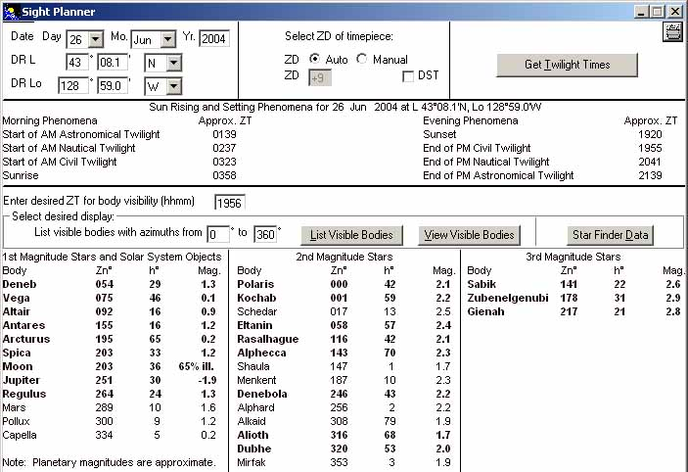
Question 10c
Using Celestial Tools, plan a 3-body fix for this date and time (Note: use 2004 for the year). Print a copy of the Celestial Tools ‘List Visible Bodies’ in the ‘Sight Planner’screen, and file it in your Navigator’s notebook
Which bodies have the best magnitude, azimuth cut, and reasonable altitude for a 3-body fix? (List a few).
Alioth (Vega or Jupiter)-Arcturus;
Altair – Anteres – (Spica or Moon);
(Alioth or Dubbe)-Vega-(Spica or Moon). Any of these groups would be a reasonable choice.

Slide 24
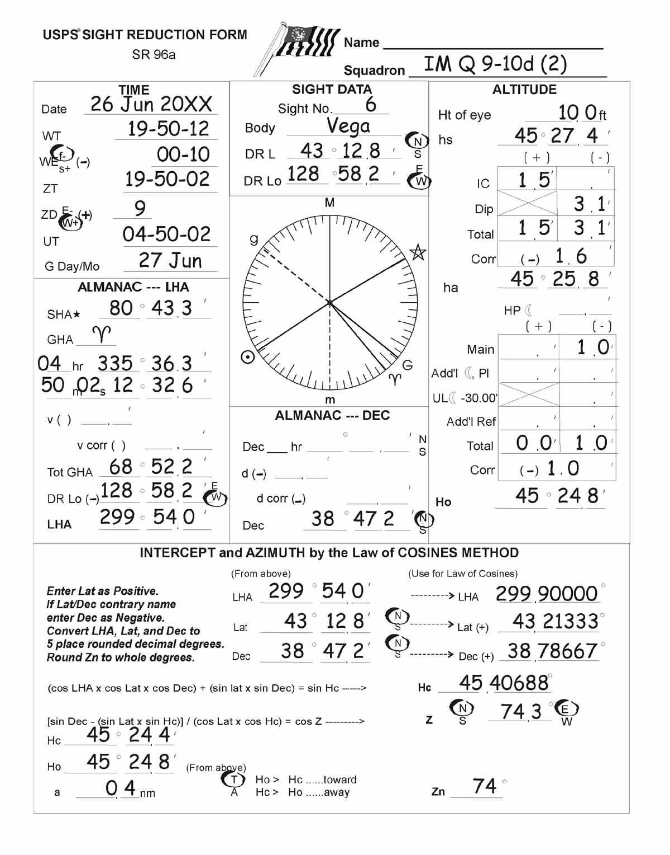
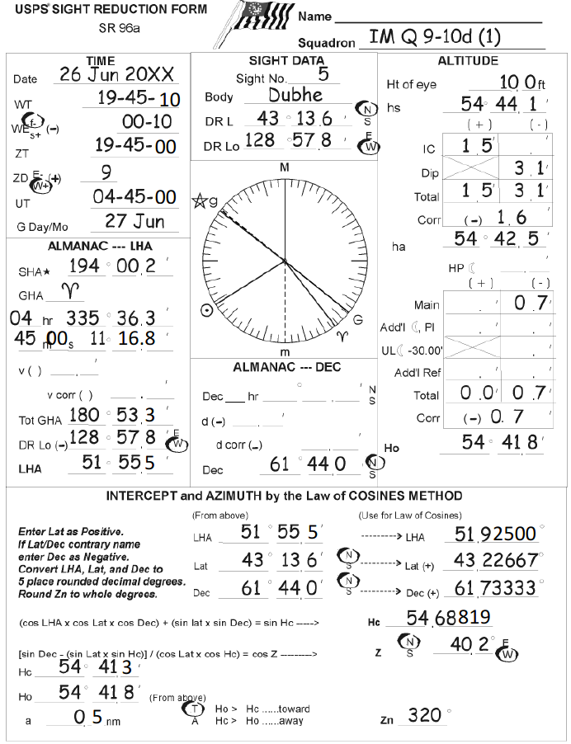
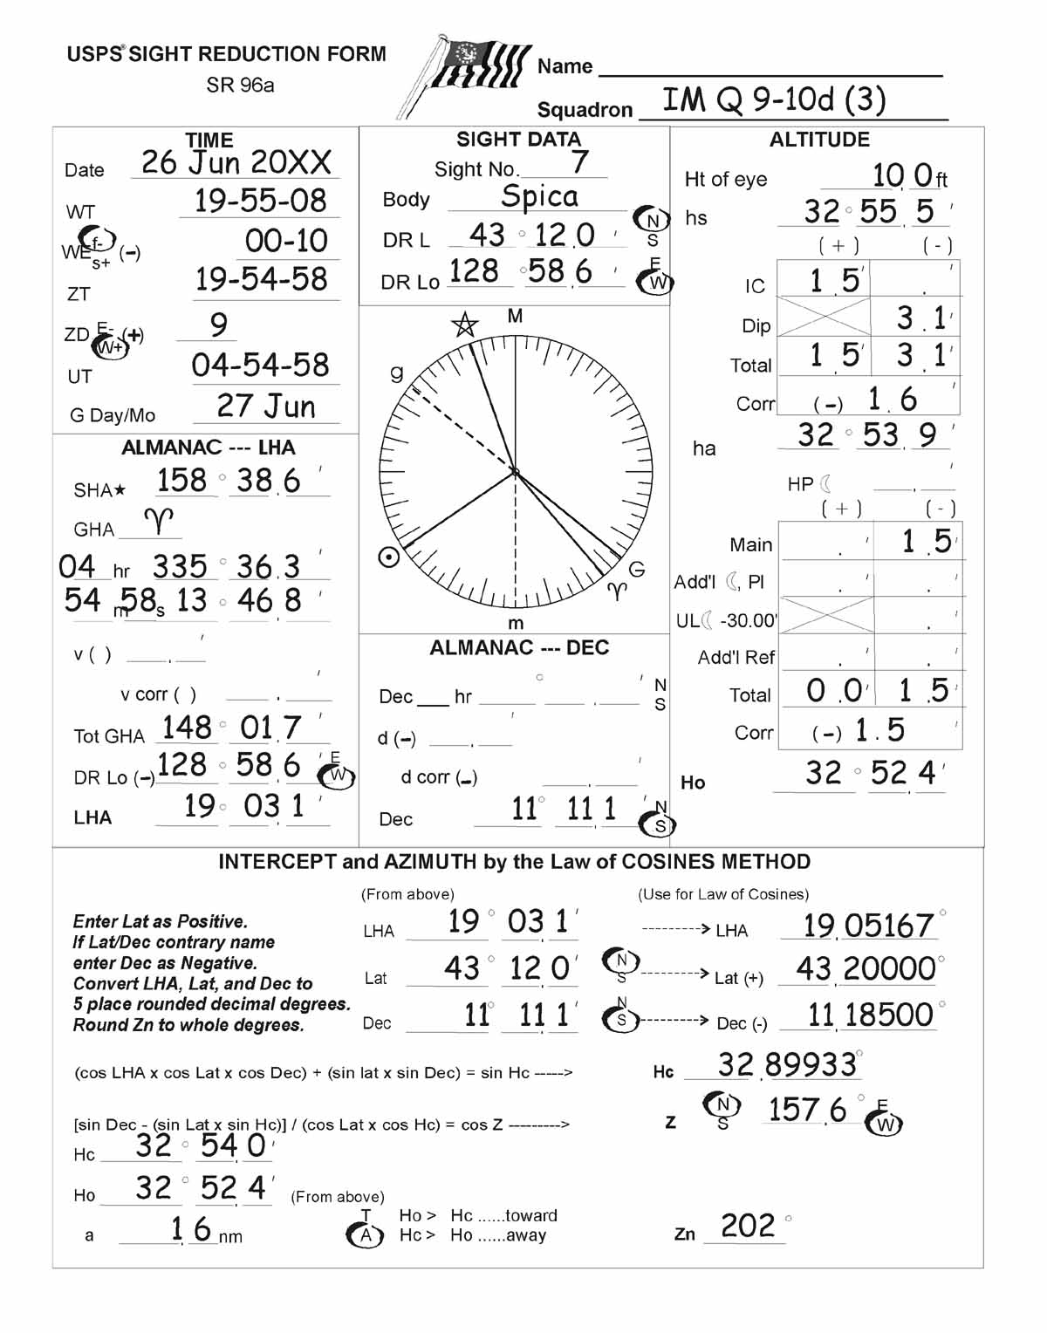
Question 10 d
Beginning at approximately 1945, you take the following sights:
Reduce these sights by the Law of Cosines method, and plot them on a CLS sheet to determine the 1955 fix position.
Solution: See SR Forms, Sights # 5, 6, & 7, IM Q 9-10d (1, 2, & 3). Since these sights are being reduced to determine a 3-body fix, each sight is reduced from its respective DR position, determined from the knotmeter log distance from WP2, on the DR course line.
WT | Body | Hs | Knotmeter Log
19-45-10 | Dubbe | 54°44,1’ | 0349,2
19-50-12 | Vega | 45°27,4’ | 0350,1
19-55-08 | Spica | 32°55,5’ | 0350,9

Slide 25
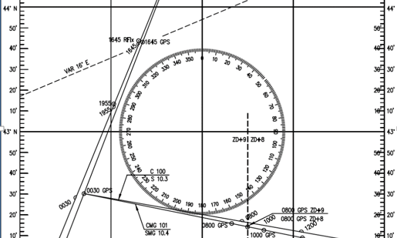
Question 10 e
What is your 1955 DR position?
Solution: This position is determined from the knotmeter log distance at 1955, which is 0350.9, measured from WP2 on the DR course line.
L43°12,0’N, Lo128°58,6’W

Slide 26
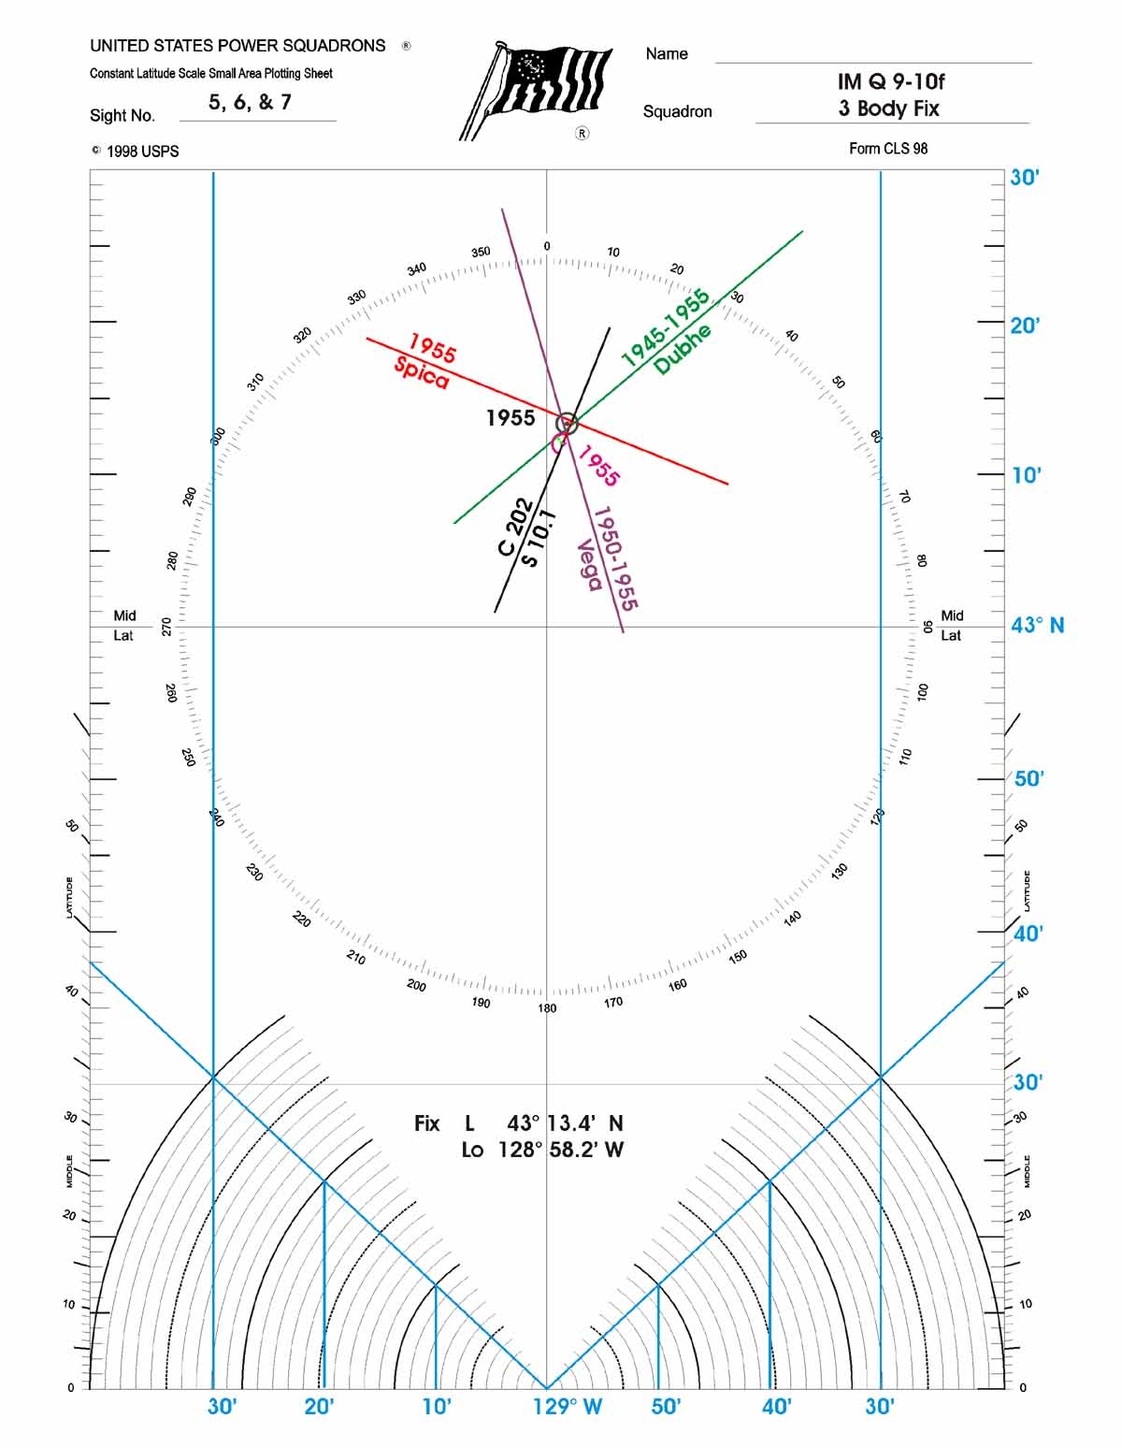
Question 10 f
You note that difference between your celestial fix and the1955 GPS position, and feel confident that your shooting accuracy is about one nautical mile.
2000. Report the 1955 fix position to the captain. Knotmeter log reads 0351.8
You download a weather report for tomorrow. Prediction is still for good weather, with calm seas. No fronts seem to be moving into your area.
You turn the watch over to the relief navigator for the night and sign off on the log for the end of your day on duty.
What is the 1955 fix position?
See CLS Form, IM Q 9-10f.
L43°13,4’N, Lo128°58,2’W

Slide 27
Question 11
You get to the bridge and check the GPS position, which is L 42°32.5'N, Lo 129°18.0'W; knotmeter log reads 0395.6. To get a quick picture of expected weather and sea conditions when you divert to Crescent City, you decide to download a weather GRIB with wind, waves, and pressure information.
27 june 20XX
0015. The crew member on watch wakes you up. The captain received a call on the satellite phone for Bill, the other member of the crew, notifying him of an emergency at home. Bill and the captain discussed the situation, and agreed it’s important that Bill gets to where he can fly home as quickly as possible. They reviewed charts to find the closest port to divert to that has airline service, and determined Crescent City, CA would be the best choice. The captain would like you to re-set the course to Crescent City.
Select an appropriate latitude and longitude area for the area of your expected route back to Crescent City and a grid of 0.5° x 0.5°with current and forecasted conditions for 24 and 48 hours later. (Use the date of working this Practice Cruise)

Slide 28
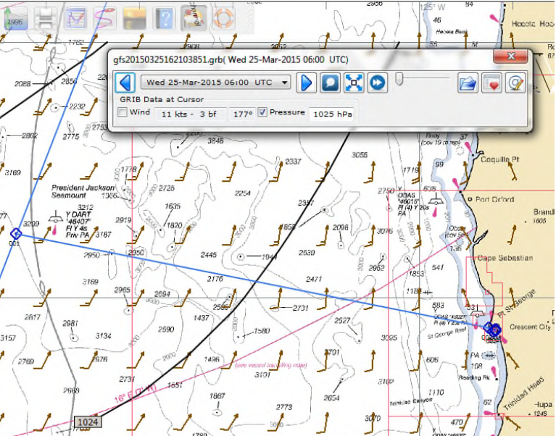
Question 11 a
Insert the downloaded GRIB into OpenCPN and print a copy of the area of your route showing the weather information for your Navigator’s notebook.
Solution: The actual copy of the area will vary depending upon the date that the student downloads the GRIB, but it should look similar to the one included at the end of this section.

Slide 29
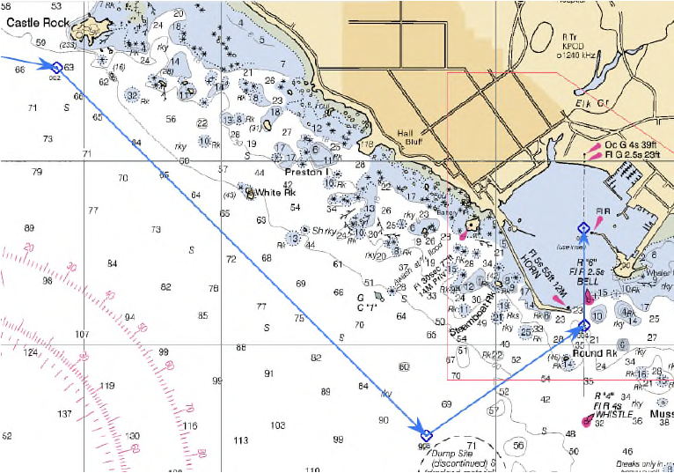
Question 11 b
Turning southeast, you insert WP3 just north of the dumpsite NW of R”2” at L 41°43.5’N, Lo 124°12.5’W.
Turning northeast, insert WP4 just south of the entrance to Crescent City near R”6” FL R2.5s at L 41° 44.1’N, Lo 124° 11.35’W.
Now turn north and follow the range markers (Oc G 4s and FL G 2.5s) safely into the center of the harbor where you insert WP5. (Note: Look for the range markers on the north side of the harbor.)
0030. You have the preliminary information you wanted and are now ready to start on your way to Crescent City. GPS currently indicates L 42° 30.2'N, Lo 129° 19.2'W; knotmeter log reads 0398.2.
As Navigator, you plan a route to Crescent City in OpenCPN, with your current 0030 position as WP1. You select a position northwest of Crescent City and just south of Castle Rock at L 41° 45.5’N, Lo 124° 15.2’W to insert WP2 for this route.
What is the expected wind direction for this route? (from your GRIB)
Save this route as “Divert CC”. (If the only charts currently in OpenCPN of this area are small scale charts without the detail you need; copy charts #18603_1 and #18603_2 from NOAA onto your computer.
Answer:Your wind direction depends upon the date of working this Practice Cruise.

Slide 30
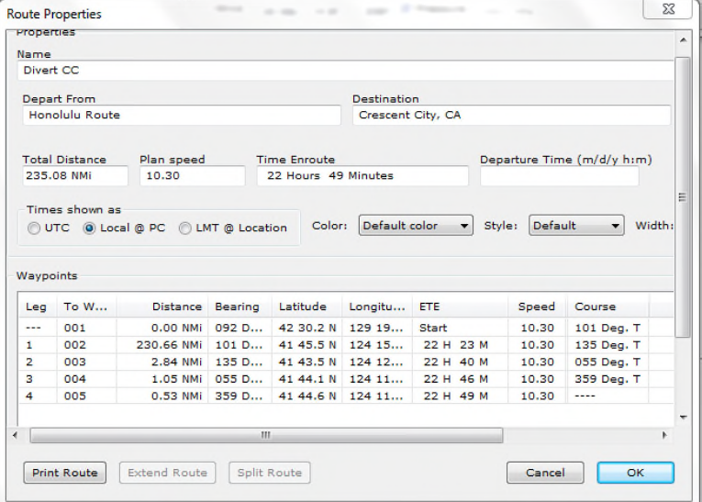
Question 11 c
Print a copy of the waypoint information for this new route and place it in your Navigator’s notebook.
Solution: Open Route Manager and double click on the route. You should have a screen that is similar to the one that is included with the materials.
Let the students know that the distance that is shown next to WP1 depends upon where their boat is located. By right clicking near the waypoint, and selecting ‘Move Boat Here’, you can minimize that distance.

Slide 31
Question 11d
Checking the variation in this area, you note that you will be entering an area of 15° variation before you arrive at WP2. From your OpenCPN route, what is the true heading to Crescent City between WP1 and WP2 using 15° variation?
Answer : 101⁰ T

Slide 32
Question 11 e
You provide the heading information to the captain for the revised route, and he executes the change in course to Crescent City. Plot and log this course change. The DR position at 0030 is L 42°28.2'N, Lo 129°22.8'W. You re-start your DR course from the 0030 GPS position using a 1° port drift angle correction, anticipating a northerly current. Due to this current, you calculate S = 10.3 kn.
What is the resulting compass course for this leg?
Answer : 101⁰ T - 15⁰ Var - 3⁰ deviation = 083⁰C
Instructor Notice: In the Student Manual, this bullet is shown after 11e. Advise the students of this error so that they utilize the 1° port correction.

Slide 33
Question 11 f
You update your Navigator notebook and check a few details in OpenCPN on this revised route. Your main concern is encountering unexpected hazards along the route; you see no problems indicated on the charts for the offshore part of this revised route and decide to examine the details of the approach to Crescent City in the morning. You turn the watch back over to the relief and return to your bunk.
At an average boat speed of 10.3 knots, what is the total distance and expected time to complete this voyage as shown in “Route Manager”?
Answer: Distance 235 nm;
time 22 hours 49 minutes

Slide 34
Question 12
Zoom in on the Crescent City area; switch to chart # 18603_1 and study the approach into the port.
0800. You come back on watch. GPS position is L 42°15.0'N, Lo 127° 35.6'W. Knotmerer log reads 0475.4. Weather conditions are clear with winds about 10 kn with 5 ft seas. Report position to the captain.

Slide 35
Question 12 a
What dangers do you see on your route as you approach Crescent City?
There are lots of rocks to avoid in the area as you approach the channel into Crescent City.
Range Markers

Slide 36
Question 12 b
You are now satisfied that the route you created to Crescent City will assist you in getting into the harbor safely. You return to your task of monitoring Leg 1 of this route.
At 0824, you cross the ZD+9 / ZD+8 time zone boundary. GPS position is L 42° 14.2’N, Lo 127° 30.1’W
1000 (ZD +8).
GPS position is L 42°13.0'N, Lo 127°21.8'W
Zoom the area of Crescent City harbor to show WP3, WP4, and WP5. Print a copy and place it in your Navigator’s notebook.

Slide 37
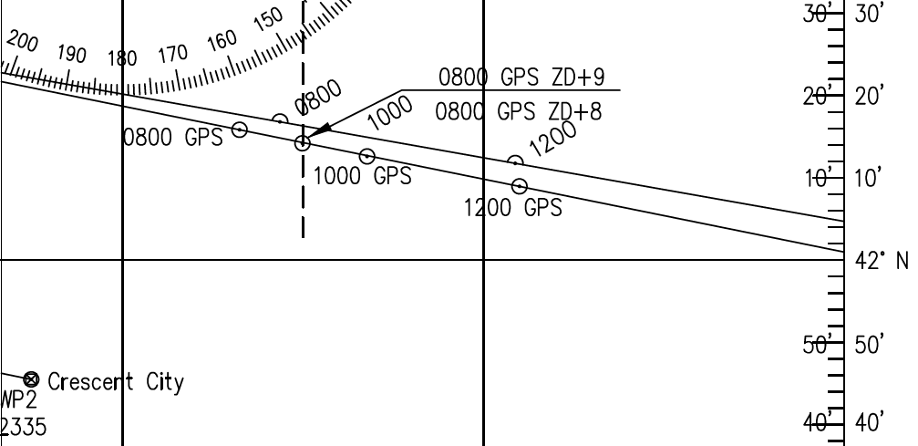
Question 13
1200. GPS position is L 42°09.0'N,Lo126°54.3'W. Knotmeter log reads 0506.3. Report to the captain.
As you maintain your DR plot on the 974 plotting sheet, you notice your course will run off the right side of the sheet very soon. When this occurs, renumber the left meridian 126° at the bottom of the plotting sheet and restart your course from the left side of the sheet. Transfer your isogonic line to the left side of the plotting sheet, as well.
2000. GPS position indicates L 41°52.8'N, Lo 125°04.4'W. Knotmeter log reads 0588.7
and winds are west at seven knots. Report the position to the captain

Slide 38
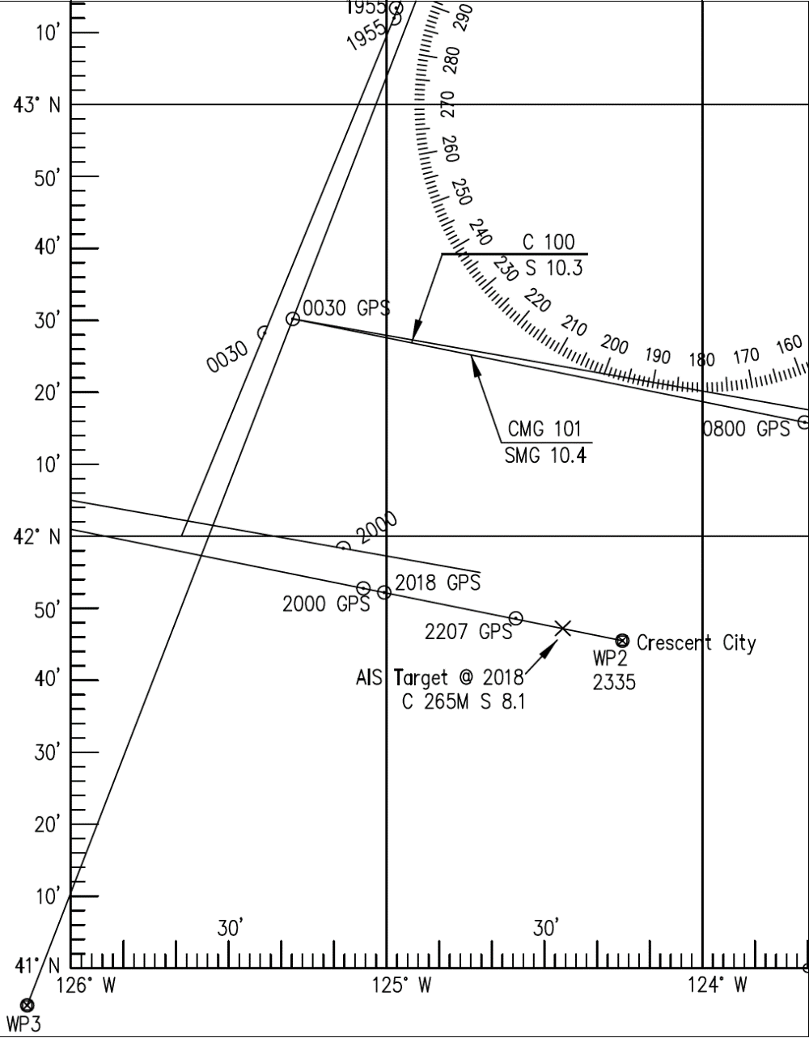
Question 14 a
------------------------Click Mouse to Close --------------------------
.. Status = Underway
.. COG = 265M Hdg = 265M Spd = 8.1 Kn
ROT = None
Position – 41 47.2000N 124 26.5000W
Last Update = 06:27:XX -
MMSI 338123450 Call Sign W0AA0
Name = Little Toot
Type = Towing
Draft: 13’0” Length: 124’0” Beam: 37’0”
Dest. = Portland
ETA = 07/01 14:24 UTC
IMO No. 1234567
Place a mark on your OpenCPN route to indicate this ship’s current position. Right click on the position and select ‘Drop Mark’.
Does this ship pose a potential danger to you?
2018. GPS indicates L 41° 52.2'N, Lo125°00.4'W. You notice an AIS target on the OpenCPN screen, indicating the ship is directly ahead of you. You watch the ship’s movement; it appears to be moving in your direction. You click on the AIS target icon, and the following screen is displayed
Yes, it’s on a reciprocal course to yours, heading directly toward your vessel, and it will be less than an hour to the CPA (closest point of approach).

Slide 39
Question 14 b
What action do you take?
You hail the ship on your VHF radio, providing him with your position and heading. You’ll continue to monitor “Little Toot’s” position until you safely pass the tow.
Since the AIS information provides you with the vessel’s name, you hail “Little Toot” on your VHF radio, ensure he sees you and negotiate a safe port-to-port passage.

Slide 40
Question 15
2207. GPS indicates L 41°48.6'N, Lo124°35.4'W; knotmeter log reads 0610.5. You’ve monitored “Little Toot” since first seeing him on your AIS and now safely pass the tow. Log this event.
No question

Slide 41
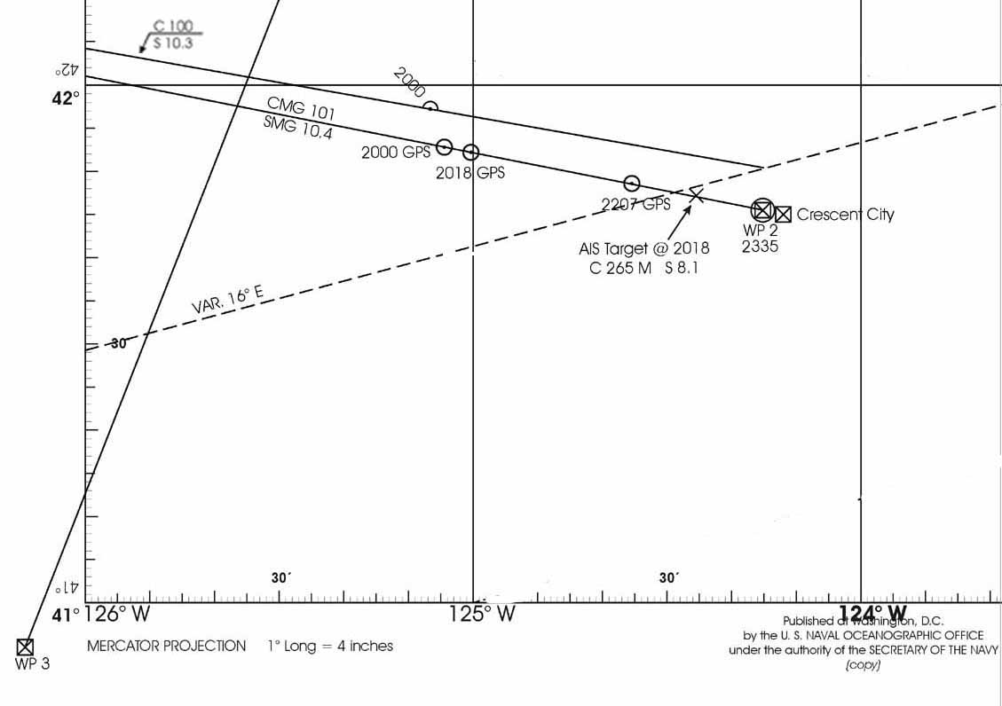
Question 16 a
2335. You arrive at WP2 southwest of Castle Rock; knotmeter log reads 0625.6. Since you are now in coastal waters, you will end your offshore DR plot, and begin observing land features and navigation aids to guide the captain safely through the remaining near-shore legs. You provide the compass courses for the remaining two legs of the route to the captain. Assuming no drift for these short legs, what are the compass courses for the legs?
Leg 2
121°C (134°T-15°E (Var.)+2°W (deviation)= 121°C)

Slide 42
Question 16 b
Leg 3:
You have already set the alarm zone for the area to your port, to alarm if you stray 300 yards off course and get too close to the rocks. You monitor your course and the alarm zone closely on this leg of the route, to ensure you stay in safe waters.
End the offshore plot. You continue to observe land features and navigation aids during remaining near-shore legs, until tied up at dock.
You hail the harbor master in Crescent City on the VHF radio, notifying him that your vessel is coming in after hours, and asking where you can tie up for the night. He responds that transient vessels are on Dock H, and instructs you to tie up at that dock.
031°C (055°T-15°E-5°E= 035°)

Slide 43
Question 17
2352. You arrive at WP3 and change course to Leg 3 of the route, slowing your speed to about 3 kn. You carefully navigate your way through the channel, continuing to monitor your alarm zones and keeping watch for other potential hazards. When you reach WP4 of the route, ETA 0014, you will make your way into the channel and pilot to Dock H where you tie up for the night. Bill will be on the first airplane out tomorrow morning, on his way home.
Close your offshore deck log

Slide 44
Deck Log

Slide 45
Deck Log

Slide 46
Deck Log

Slide 47
Deck Log

Slide 48
Practice Cruise
Underway
End of
Global Navigation
Chapter 9

